Slide 1


Owens Corning – Composites Solutions Business
Innovation for Value Creation
Visuals for publication
Je crois que c’est plutôt
« how to drive » etc
Anne Berthereau, Owens Corning Composites Solutions Business
Director of Technology Innovation
Nov 6th, 2014 – Interview with “InnovationLeader ”
Copyright © 2014 Owens Corning. All Rights Reserved.

Slide 2
Building technology portfolio
Market & techno. watch
Internal needs
Manufacturing capabilities mapping
Technology portfolio

Slide 3
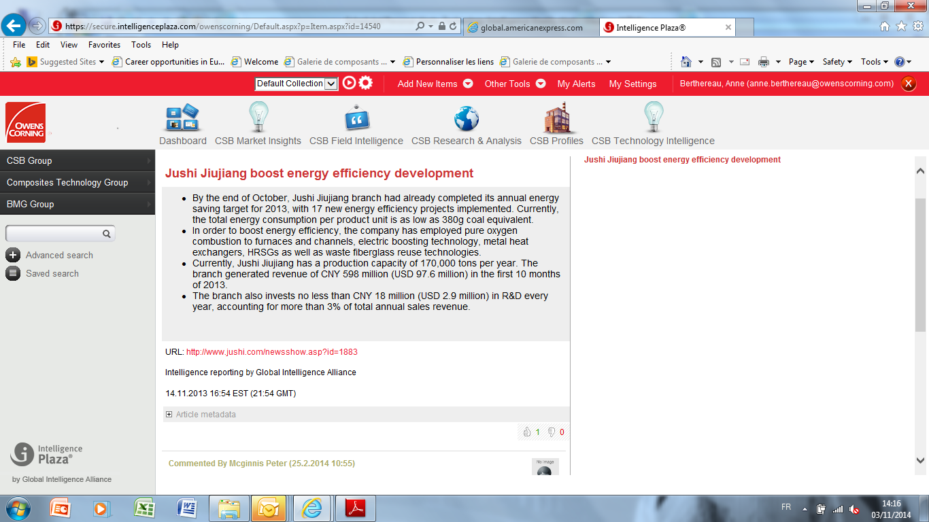
Technology intelligence approach: leaRN from outside to nurture new concepts
A weekly forum to push for sharing and brainstorming
An engine to ensure the connectedness of global technical community
Customized for CSB needs
Key experts accountable for leading discussions through on line discussion
95% of satisfied users!

Slide 4
Bi-annual Manufacturing Capabilities Mapping
Capabilities Position What do we see ? How could we address gaps & sustain advantage ?
Capability 1
Capability 2
Capability 3
Capability 4
Capability 5
Capabilities such as:
Glass & Raw Materials , Glass recycling, Melting & Energy intensity, Process control, etc.
For each capability:
Owens Corning position (competitive advantages, room for improvement…)
Information about competitors (IP activity, competitive advantages, assets…)
Identification of technical opportunities and threats
…
For each capability:
Identification of potential improvement actions
Further evaluations / analysis to be made
On-going actions
Capex investments required
Actions to be taken
…
Owens Corning Capability Position Versus Industry
World Class
At Parity
Disadvantaged
4

Slide 5
Measuring the Return of our Innovation EFFORTs/Choices
At division level, three types of quarterly indicators:
Value creation
Financial impacts
Products: revenues from new products, NPV
Technology: EBIT, cash savings, capital avoidance
R/D monetization
Operational efficiency
% Projects/products launch on time
Balanced pipeline (stage 1 to 5)
# new projects
Budget/Capex under control
Innovation Enablers
Competencies (training, hiring…)
IP portfolio value
New tools box
KET (key enabling technologies)
Value
creation
($ impact)
Effectiveness
of the R&D process
Innovation enablers
& their impacts

Slide 6
Rewarding innovation
Quarterly Pinnacle Award > Annual Innovation Award
  An innovative approach to solving a customer’s problem while achieving positive results for the customer and Owens Corning
Annual Slayter Award
  Productivity / waste elimination; new product innovation;
  high-impact breakthroughs
Annual Marzocchi Awards
  # of patents
Annual Early Career Award
  Outstanding contributions to the field of materials science and engineering
Annual Board of Director’s Cup
  Using the resources of our company to deliver extraordinary results for our customers, employees and shareholders
Notes:
The Owens Corning Early Career Award is bestowed annually upon a leading researcher in recognition of outstanding contributions to the field of materials science and engineering.
(Russell) Games Slayter: “Father of Fiberglas” and noted inventor. Awarded more than 160 United States patents, chiefly in glass technology
Alfred Marzocchi. Dr. Marzocchi was awarded many patents spanning over four decades – solidly placing him in
the highest echelon of contributors to Owens Corning’s patent portfolio.

Slide 7





Copyright © 2014 Owens Corning. All Rights Reserved.

