Slide 1

Who We Are

Slide 2
Who We Are
Changed our name from CVS Caremark to CVS Health, reflecting continuing evolution as a health care company
Pharmacy innovation company working to lead customers on a path to better health
Higher purpose separates us from other companies: create experiences that empower customers to live healthier lives
Digital extends and enhances what we provide in our physical retail stores, feeds into all our business goals

Slide 3
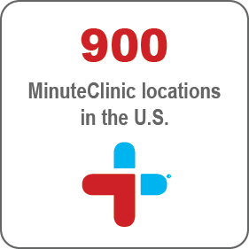

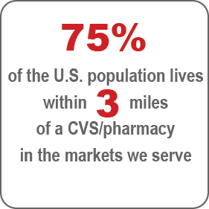
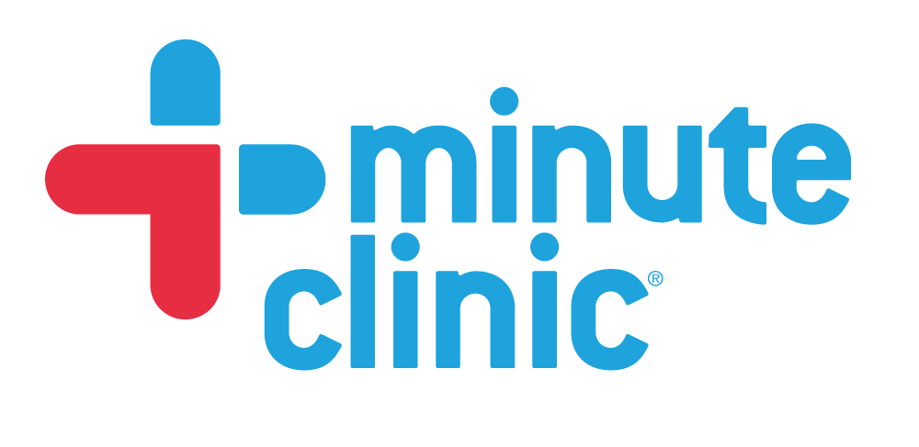
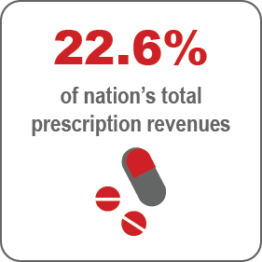
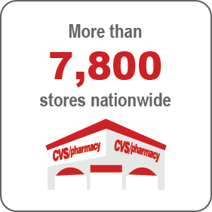
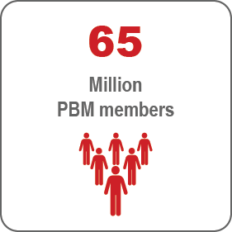
More Than a Retail Pharmacy

Slide 4
More Than a Retail Pharmacy
  More than 7,800 retail stores nationwide, serve more than 5 million customers per day.
  75% of the population in the markets we serve lives within 3 miles of a CVS/pharmacy.
  MinuteClinic has seen more than 22 million patients. Today we have 900 clinics and we’ll grow to over 1,500 sites over the next few years.
  Cover nearly 65 million through our pharmacy benefit management (PBM) business and dispense and manage more than $21 billion specialty drugs annually.

Slide 5
by connecting customers to CVS Health’s unique assets when, where and how they want.
“
A Connected Health Experience makes it radically easier for people to…
save time and money,
and stay healthy
”

Slide 6
Connected Health Experience
  Create a Personalized Path to Better Health through “Connected” Health Experience
  Use digital to garner new customers, engage with top customers, focus communications, improve customer service
  Committed to an ambitious Digital Pharmacy Strategy
    Arm our customers with useful tools and information that previously only available to medical professionals

Slide 7
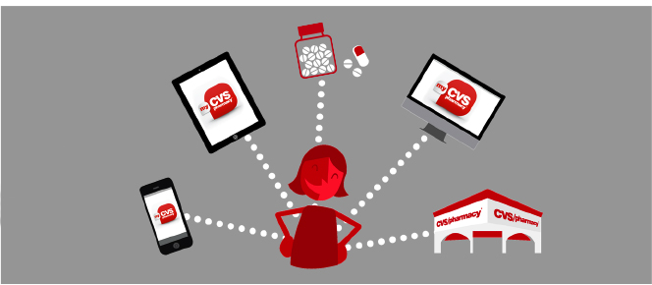


Empowering Connected Health
INTEGRATED DIGITAL VISION AND STRATEGY
Save
Money
Live Healthier
Lives
Save
Time

Slide 8
Empowering Connected Health
  Integrated pharmacy and health care delivery model:
    Integrated Pharmacy Experience
      Seamless retail, mail and specialty experience
    Integrated Front Store Experience
      Personalized shopping options and rewards with a complete selection of health products
    Integrated Health Tools and Services
      Stay on meds, manage chronic condition & access the MinuteClinic

Slide 9
How Will We Do It?
ADAPTIVE
OPEN
ENERGETIC
INFLUENTIAL
CARING
CLEAR
EXCITING
EVOLVING
DRIVEN
RELENTLESS
FAST
INNOVATIVE
DIVERSE
TECHNOLOGY
DEDICATED
NEW
PASSIONATE
TEAMWORK
TALENTED
FORMATIVE
ENERGIZED
DATA-DRIVEN
COLLABORATIVE

Slide 10
How Will We Do It?
  Smart Digital strategy more than just innovation for innovation’s sake
    Using technology to help people and make our customers’ lives easier
    Give customers what they haven’t even thought of yet
  Bring together the right people, services, and expertise to deliver integrated personal health experience
  Committed to leveraging technology to bring mission to life and to make an enormous impact on how our customers engage with the brand

