Slide 1
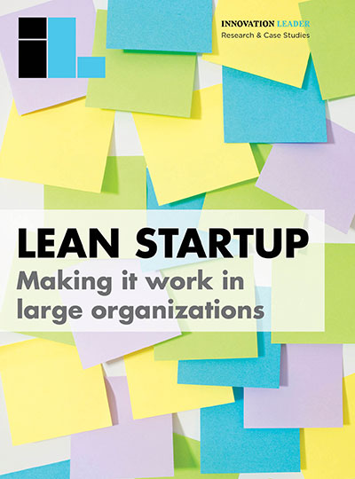
In May 2016, Innovation Leader fielded a survey on how large organizations are using lean startup methodology. We received 170 qualified responses. The majority of respondents (82.4 percent) had already used lean startup in some way within their organization, with an additional 9.4 percent considering or exploring it. While we invited input from our community, including service providers, in designing the survey, no one had influence on the way the data was analyzed or interpreted.
The following pages present charts summarizing the survey results and key comments.
Feel free to distribute to your teams internally, or use in your own reports with credit to Innovation Leader.

Slide 2
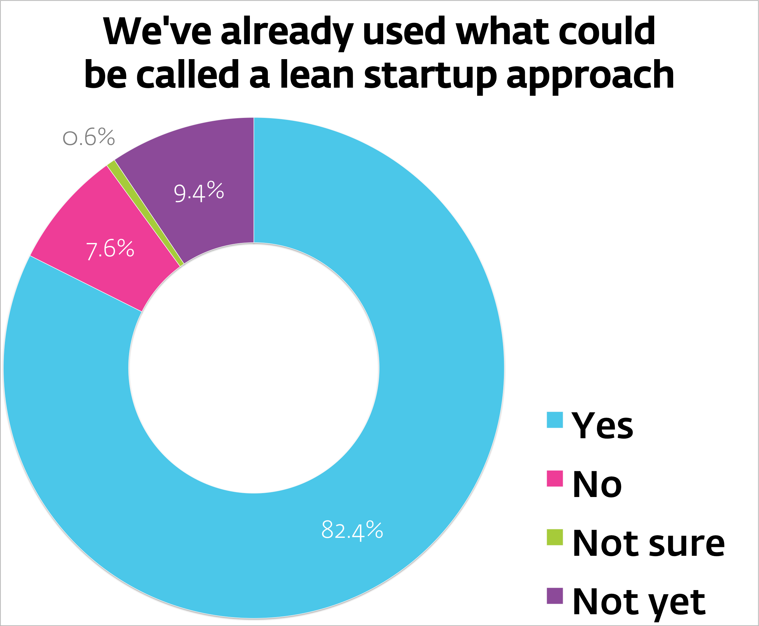

www.innovationleader.com

Slide 3
Key comments:
  • “Start slow, build small successes. Ask for forgiveness, not permission.”
  • “Consider the program a MVP. If you wait until the program is fully baked, then it will never get off the ground.”
  • “Get your best team on the first few projects you do.”
  • “Be scrappy. Be a ‘rounding error’ in the G&A budget.”
www.innovationleader.com

Slide 4
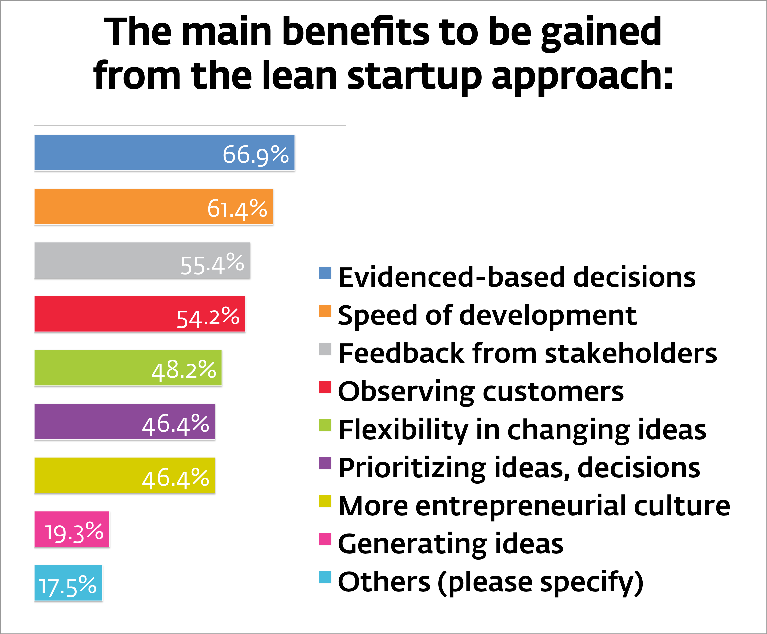
www.innovationleader.com

Slide 5
Other benefits mentioned:
  • A quicker way to learn, or discover what doesn’t work: “Fail fast & cheap.” “Learn fast.”
  • Reduce development costs; be more efficient with budget. “Making small bets across a larger portfolio.”
  • Lean startup can assist in recruiting, and elevate employee morale.
  • “Focusing on problems rather than being married to solutions.”
www.innovationleader.com

Slide 6
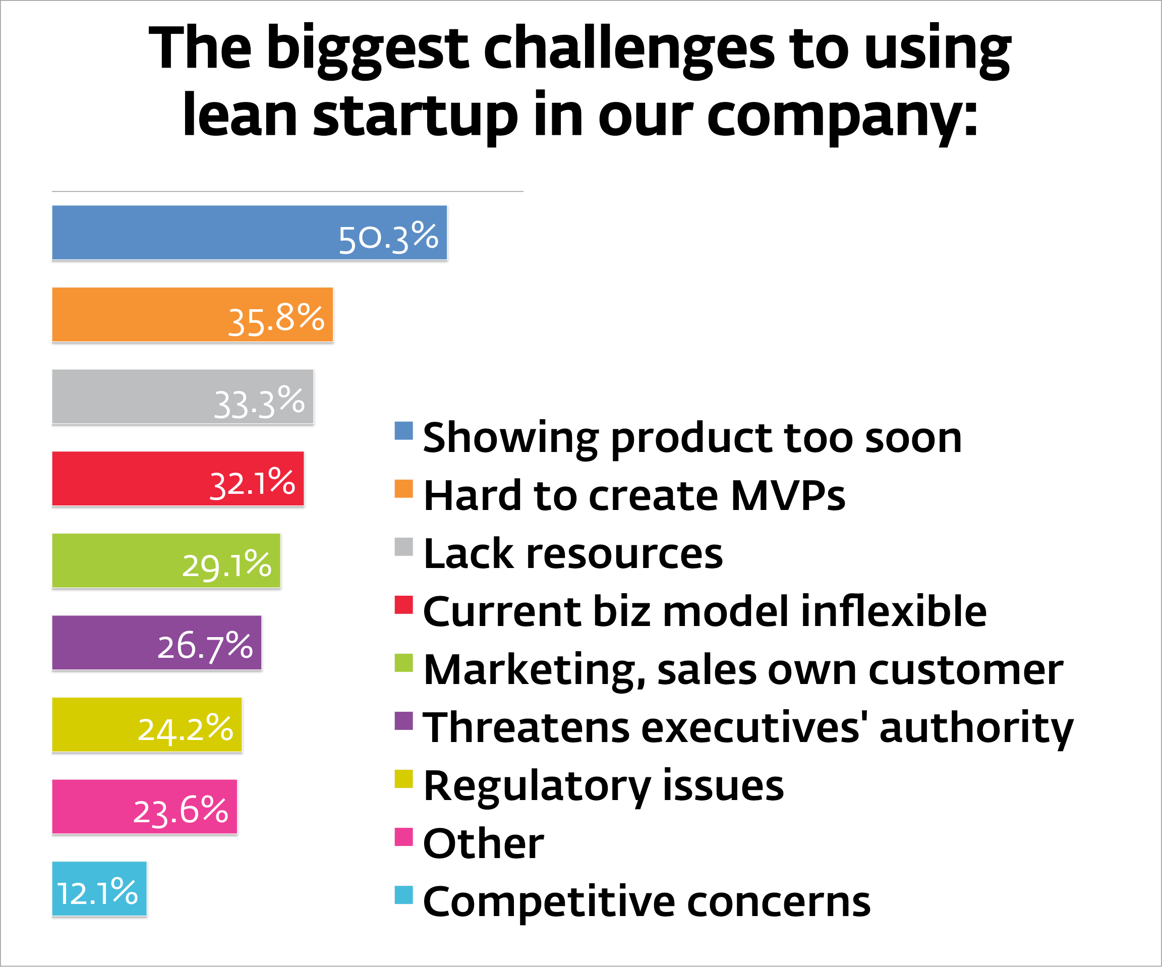
www.innovationleader.com

Slide 7
Challenges (explanations):
  • Showing customers products that are rough or not fully-baked (50.3 percent)
  • Hard to create “minimum viable products” in our industry, for regulatory, compliance, or manufacturing/operational complexity reasons (35.8 percent)
  • We don’t have the necessary resources, whether people or funding (33.3 percent)
  • The current business model is inflexible (32.1 percent)
  • Marketing or sales feel they own customer relationships (29.1 percent)
www.innovationleader.com

Slide 8
Other challenges respondents mentioned:
  • “Folks do not want their methods/ turf threatened with new ideas.”
  • “...Many leaders think the lean startup methods involve taking more risks.”
  • “Internal culture lacks the urgency to embrace this approach.”
  • “Securing sponsorship and resources is inconsistent and time-consuming.”
  • “Going from MVP to a scalable, true production-level product.”
  • “Lean startup at our company was not supported from the top.”
www.innovationleader.com

Slide 9
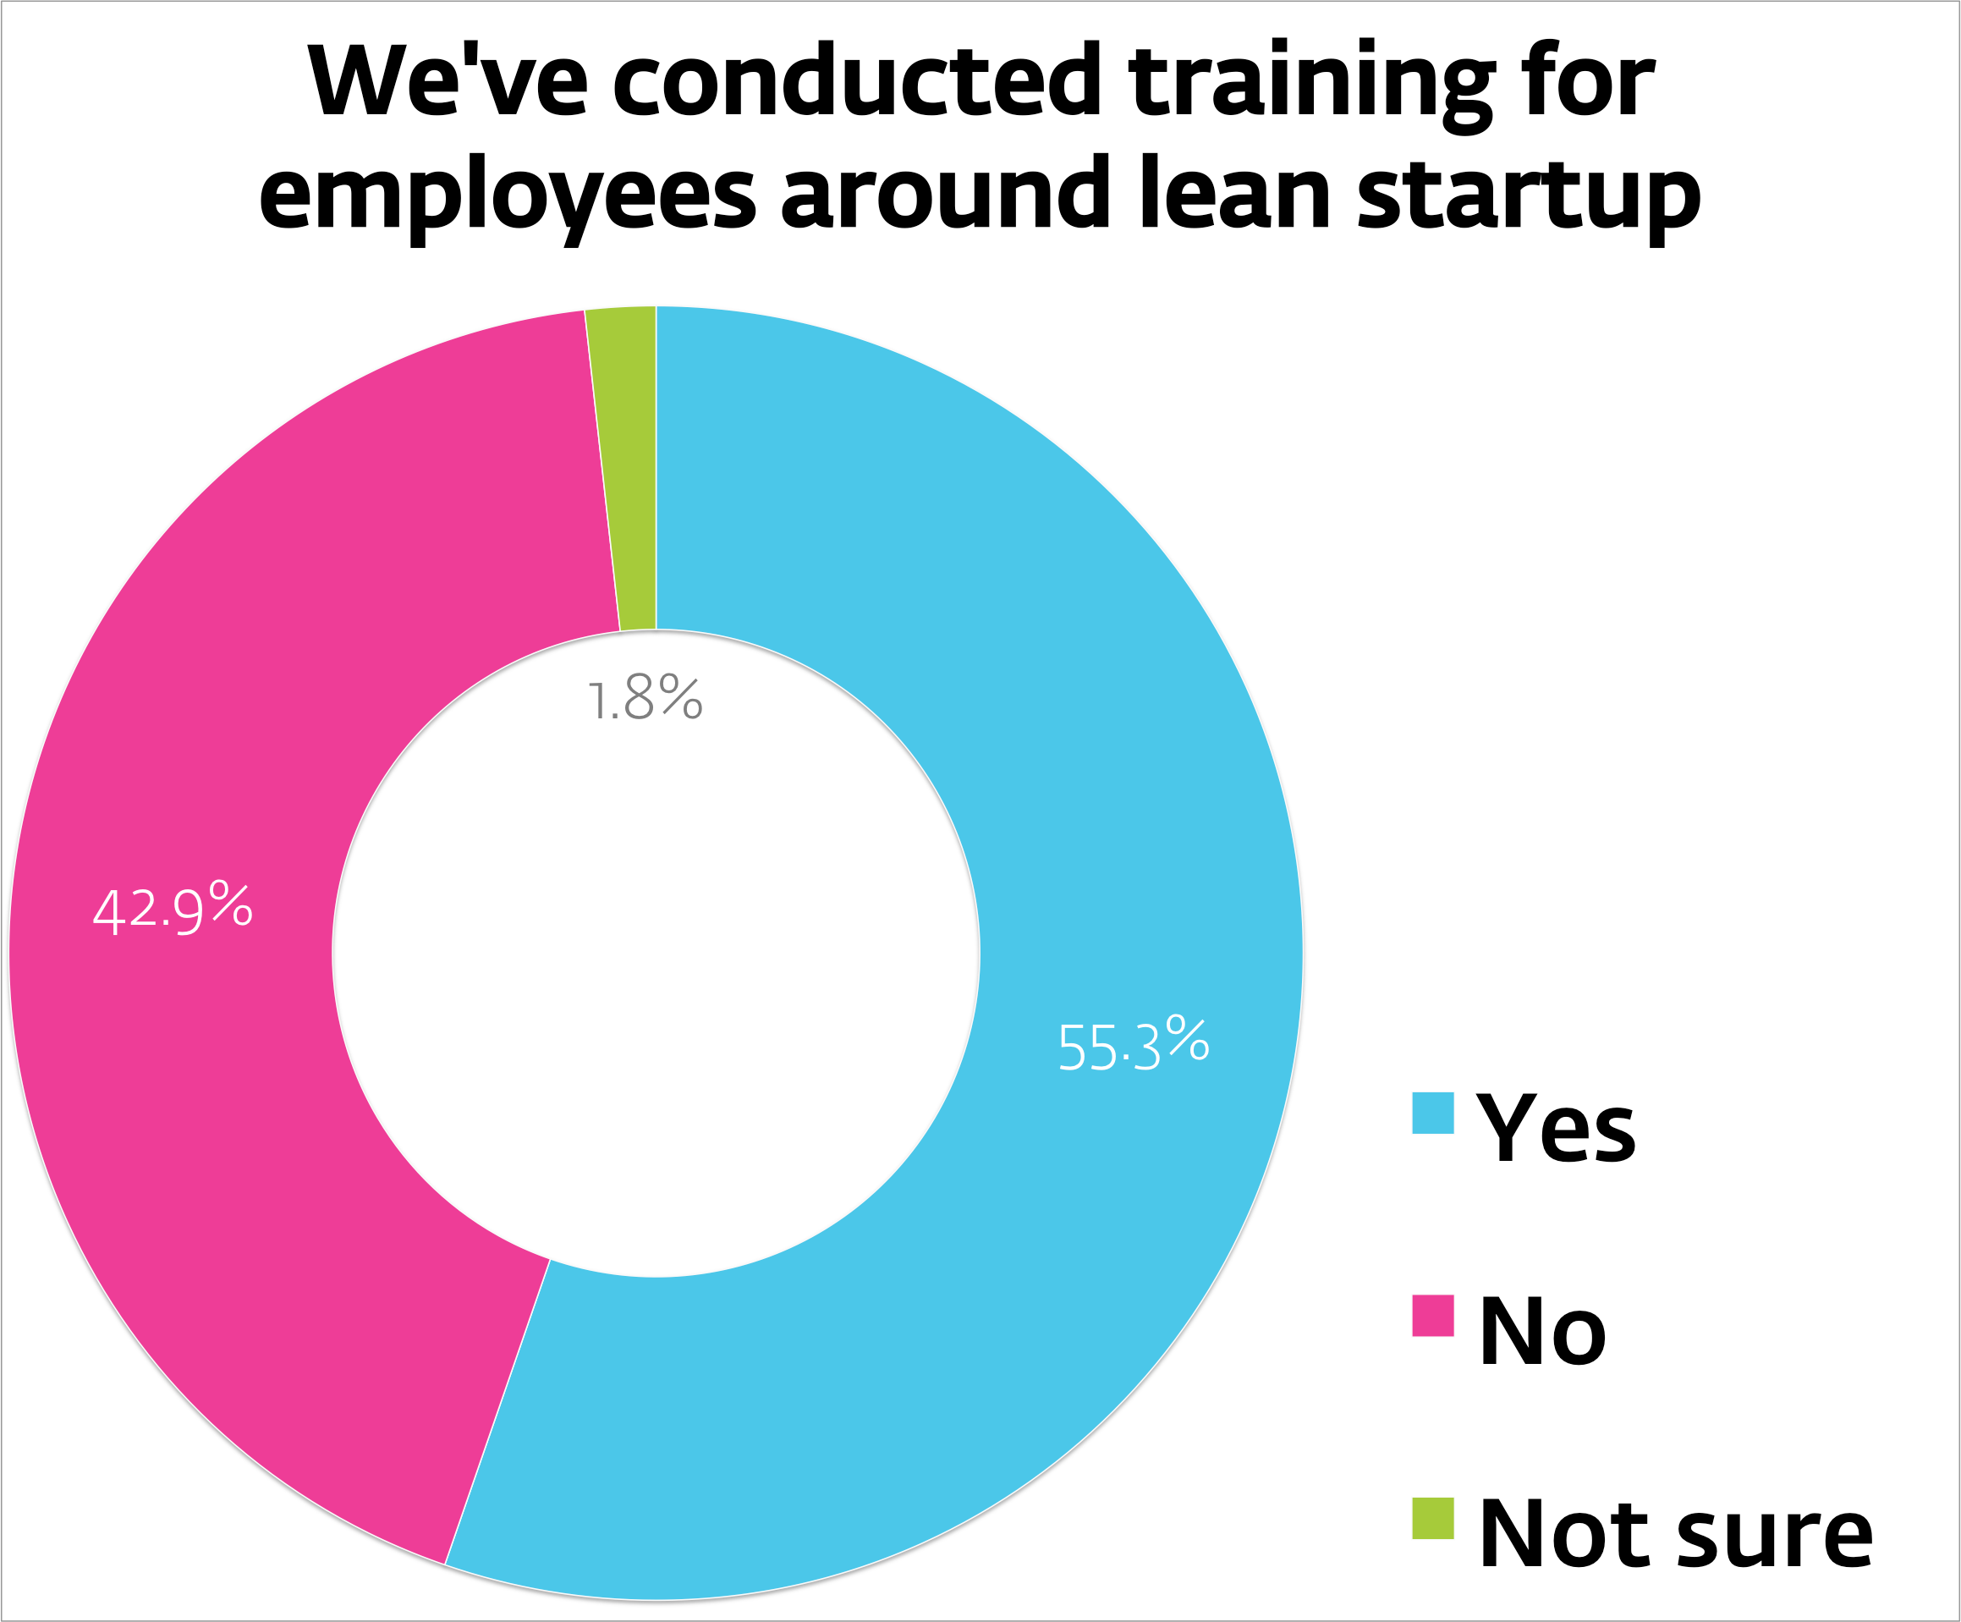
www.innovationleader.com

Slide 10
Key comments on training:
  • “Training must include leadership at the highest levels. If they don’t understand the changes you are trying to make, they are likely to make decisions based on the gut feeling they get when they hear the word ‘lean.’ Training must also include all functions that could potentially create roadblocks.
  • This is an extremely different approach for our organization, so lots of training is required to convince our people to adopt the lean mindset and ‘leave the building’ [to gather customer input.]”
  • “External trainers initially will ensure [lean is] applied with rigor, and not just applied as a cliché to ‘say you’re doing it.’”
www.innovationleader.com

Slide 11
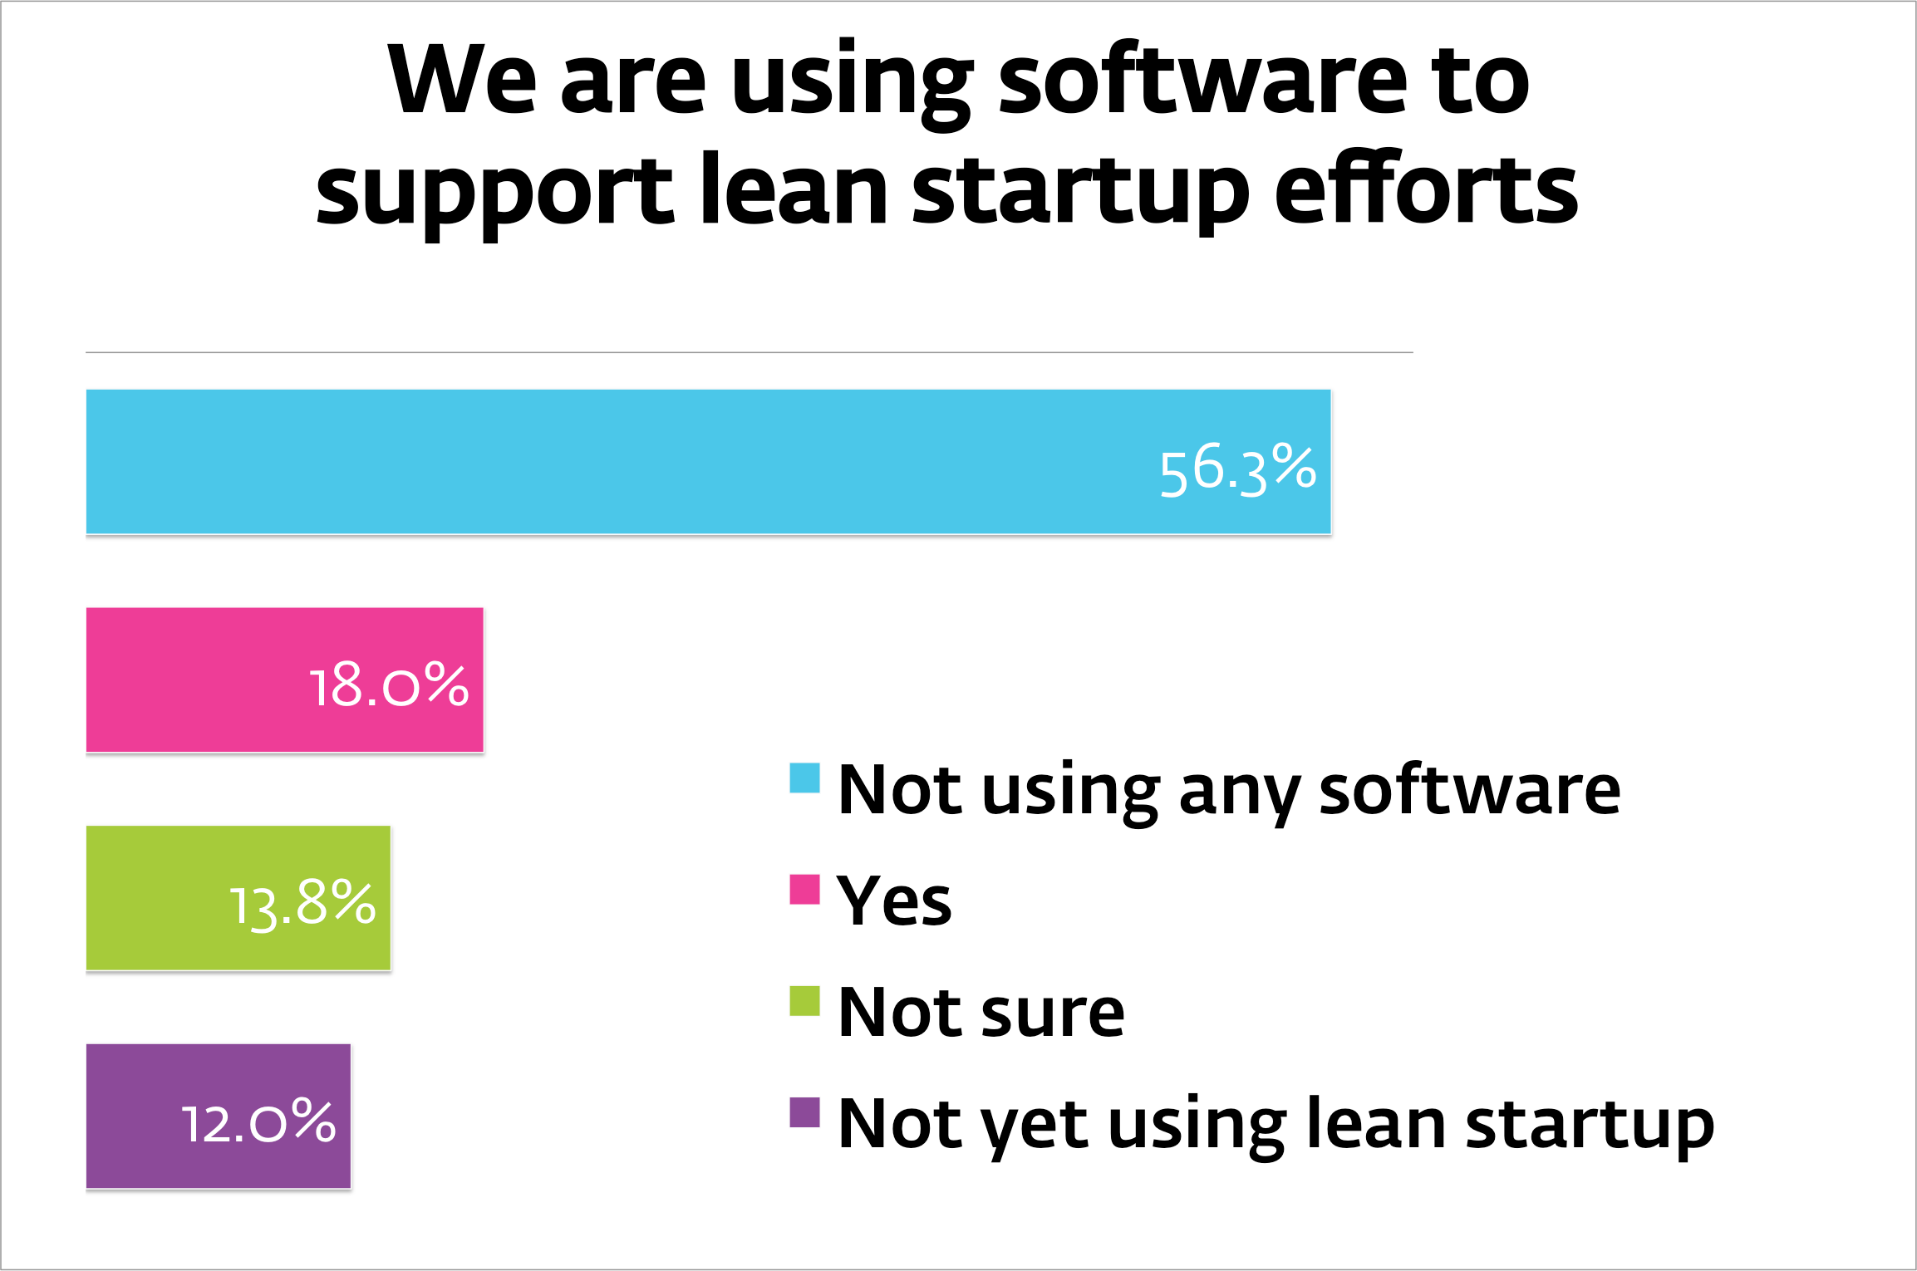
www.innovationleader.com

Slide 12
Software mentioned most often:
  • Strategyzer
  • LaunchPad Central
  • Slack
  • Jira
  • Confluence
  • Brightidea
www.innovationleader.com

Slide 13
Biggest allies for the lean startup approach
  • The CEO, “executive leadership,” the COO, or “the C Suite.”
  • The innovation organization, the Chief Innovation Officer, or the open innovation team
  • The CFO or finance leader. One respondent explained, “Among the C-suite, whom we’ve engaged as an internal ‘venture capital’ board on this work, the CFO has been particularly supportive. He likes how the process provides visibility and informed spending.”
  • The marketplace” or “customers,” suggesting that once a company is practicing lean startup, it delivers results or a closer tie to the company that customers appreciate. One respondent wrote that “customers [are] excited to be a part of the development process.”
www.innovationleader.com

Slide 14
Advice from the front lines
  • “Define a vision which has the support of a senior executive, but don’t wait for a consensual agreement from everyone in the company.
  • “The best way to get buy-in is to show results.”
  • “Remind the organization of past projects that went too far before getting customer feedback.”
  • “Make sure your external partners and collaborators for external pilots know that pilot implementations can be temporary or change direction.”
  • “You need the commitment to adjust resources for winners discovered during lean startup activities, so you can scale them successfully.”
  • “Get out of the building and break the rules.”
www.innovationleader.com

Slide 15
In addition to survey data, our complete 85-page report on Lean Startup, available at InnovationLeader.com, includes interviews with Steve Blank and Alex Osterwalder, as well as commentary and case studies from companies such as GE, W.L. Gore, General Mills, Ericsson, Intuit, Telefónica, Adobe, and Alaska Airlines.

