Slide 1
  the innovation imperative

Slide 2
  Many companies say the word “innovation” a lot, and hope that good things will happen as a result.

Slide 3
  They may even put the word “innovation” in a few peoples’ job titles, and expect them to make thousands of other employees more innovative.

Slide 4
  Very few companies understand that making a real commitment to corporate innovation requires 5 things:
  1. Senior-level vision and support
  2. Appropriate resources
  3. Openness to the outside world
  4. A way to measure progress
  5. Patience

Slide 5
  So why should innovation be a priority in 2017?

Slide 6
  67 years: Average lifespan of an S&P 500 company in the 1920s.
  15 years: Average lifespan of an S&P 500 company today.
  75% of today’s S&P 500 will be replaced with new firms by 2027.
  (Source: Richard Foster, Yale School of Management)

Slide 7
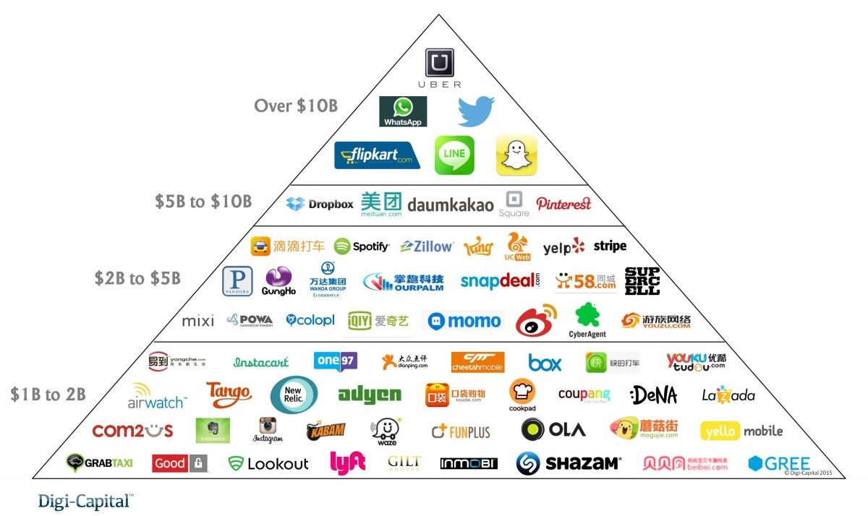
  Startups around the world are increasingly able to raise $1B+ to challenge incumbents.

Slide 8

  No need to worry about innovation if you’re already on this list:
  1. Apple
  2. Alphabet
  3. 3M
  4. Tesla Motors
  5. Amazon
            Source: “Most Innovative Companies 2016,” strategy&

Slide 9

  Or this one:
  1. Tesla Motors
  2. Salesforce.com
  3. Regeneron Pharmaceuticals
  4. Incyte Corp.
  5. Alexion Pharmaceuticals
            Source: “World’s Innovative Companies 2016,” Forbes

Slide 10
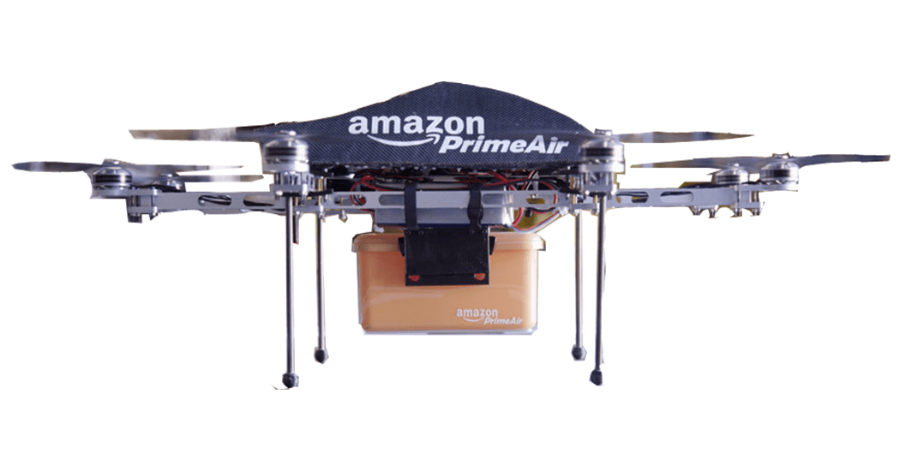
  Or this one:
  1. Amazon
  2. Baidu
  3. Illumina
  4. Tesla Motors
  5. Aquion Energy
            Source: “50 Smartest Companies,” Technology Review

Slide 11
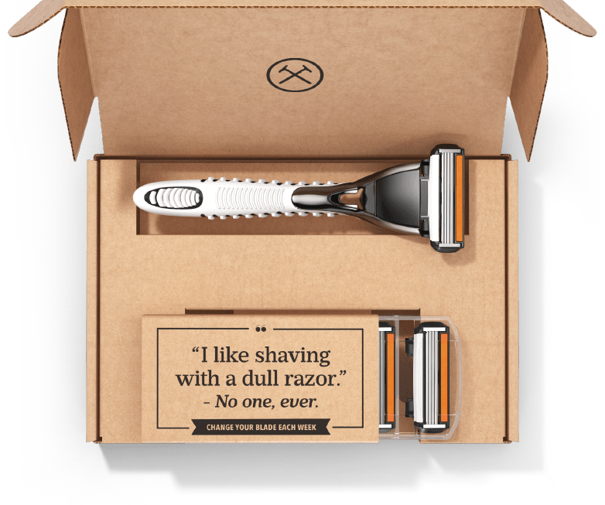
  For many companies, the easiest way to innovate is to buy an innovative, fast-growing startup.
  (Unilever paid $1B for Dollar Shave Club in 2016.)

Slide 12
  But that short-changes the development of your own innovation capabilities, like:
  Gathering customer insights and spotting market trends faster
  Co-creating new products/services with suppliers, customers, startups
  Building relationships with the top academic researchers in your field
  Training employees in methodologies like lean startup, design thinking, Agile development
  Creating a lab, studio, or ‘skunkworks’ to explore new possibilities outside of the business units.

Slide 13

  At most companies, the M&A “muscle” is far better developed than the innovation muscle.

Slide 14
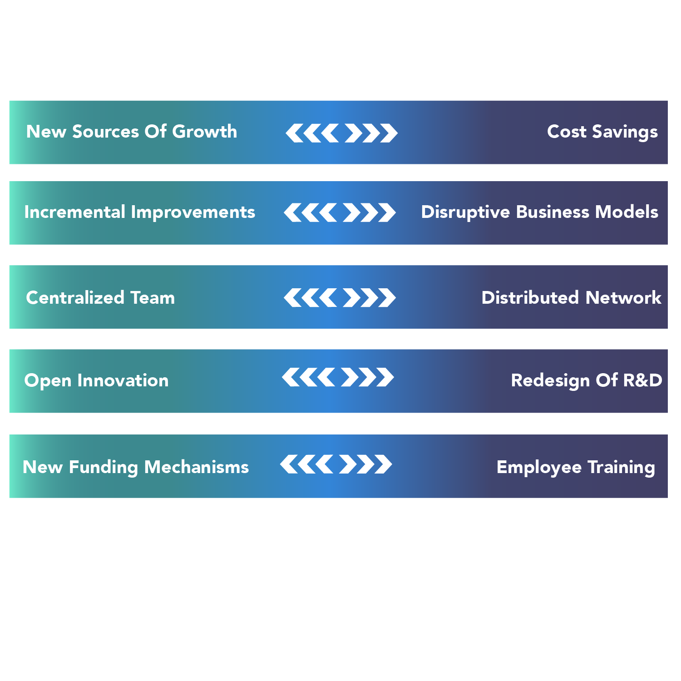
  Senior leadership needs to decide what they want when they say “innovation.”
  There are no bad choices…except trying to do too much at once.

Slide 15
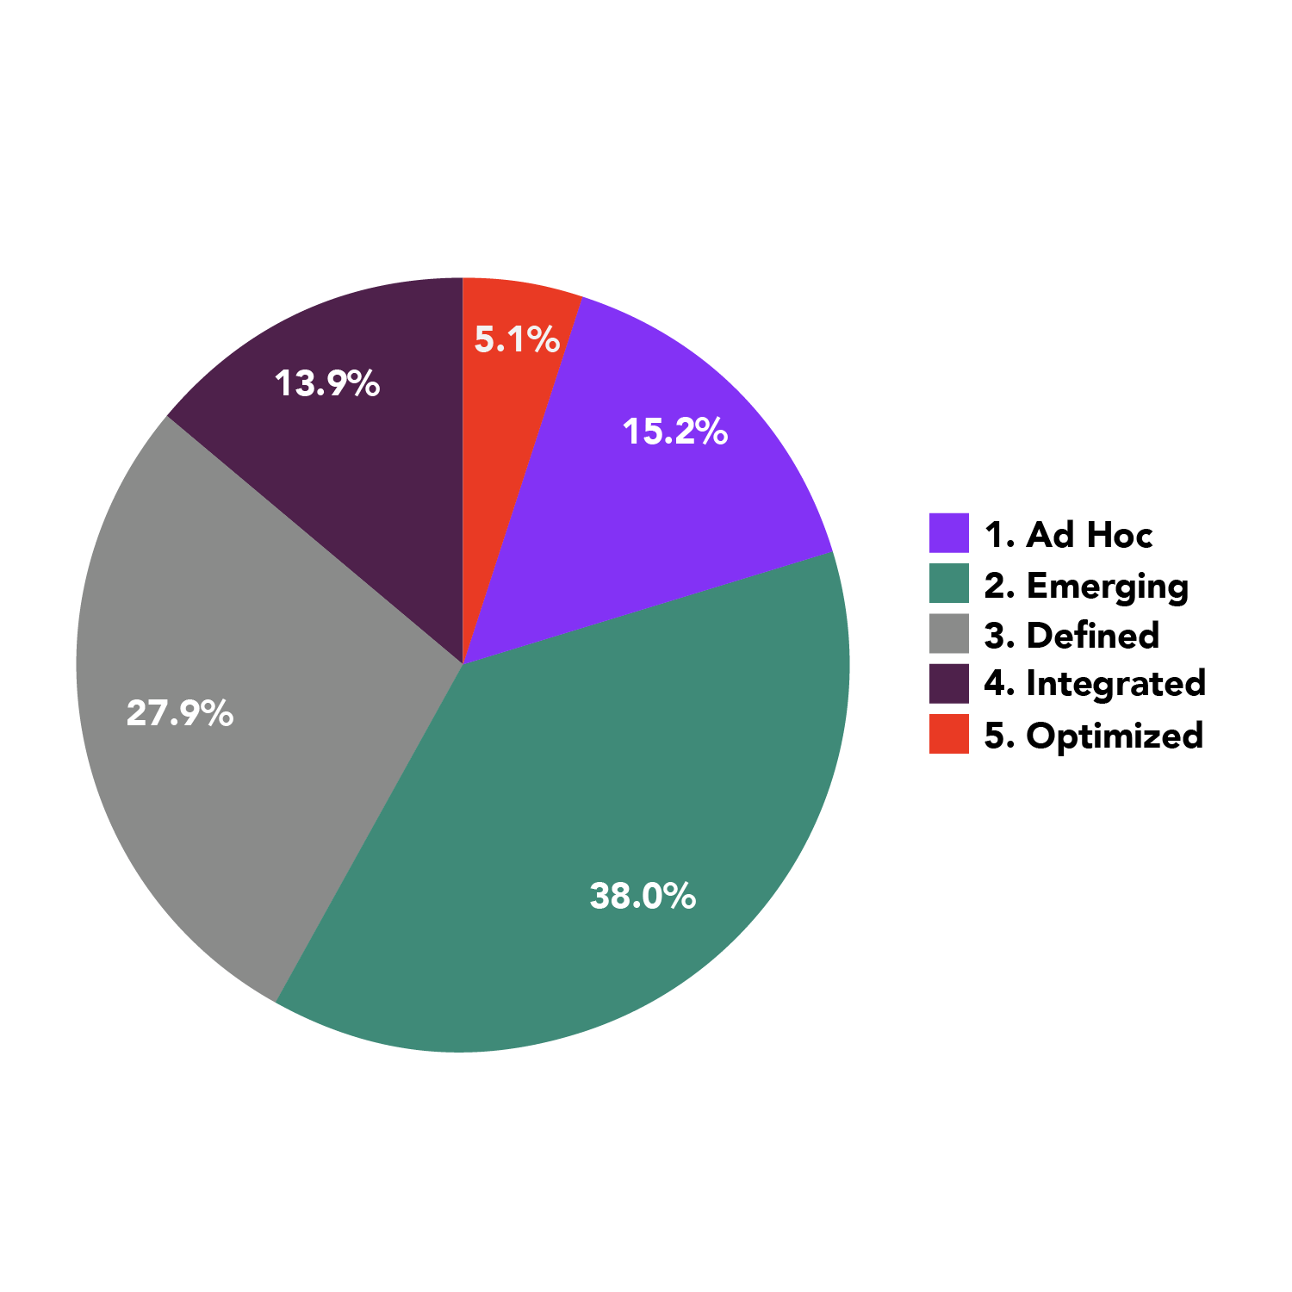
  At most companies (53.2%), an innovation effort is still in its earliest stages
Our 2015 Benchmarking Survey of 197 executives at large companies outlined five phases of “innovation maturity,” from ad hoc to optimized. More than half said their program was in the easiest two stages (ad hoc or emerging.) Just 5.1 percent of companies said their program was optimized, the furthest-along stage. On the more mature end of the spectrum were consumer products and industrial manufacturing firms. Less mature: financial services, healthcare, media.
  How mature is your innovation program?

Slide 16
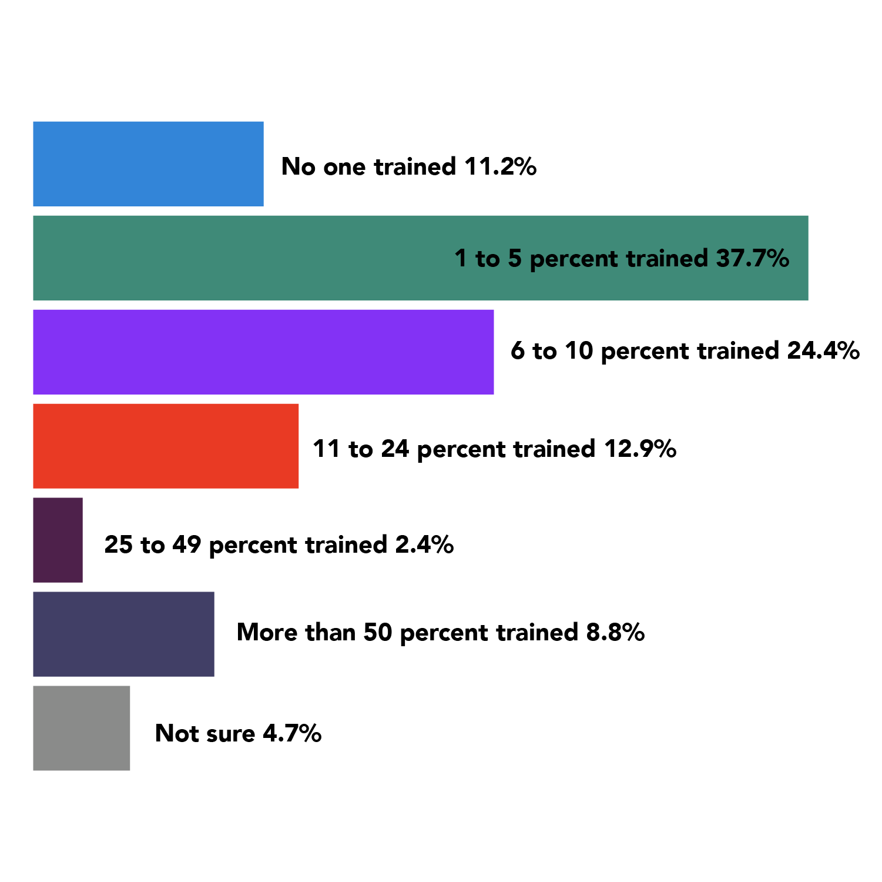
  Few companies are investing in large-scale training on innovation techniques
  Percent of staff trained on innovation techniques

Slide 17
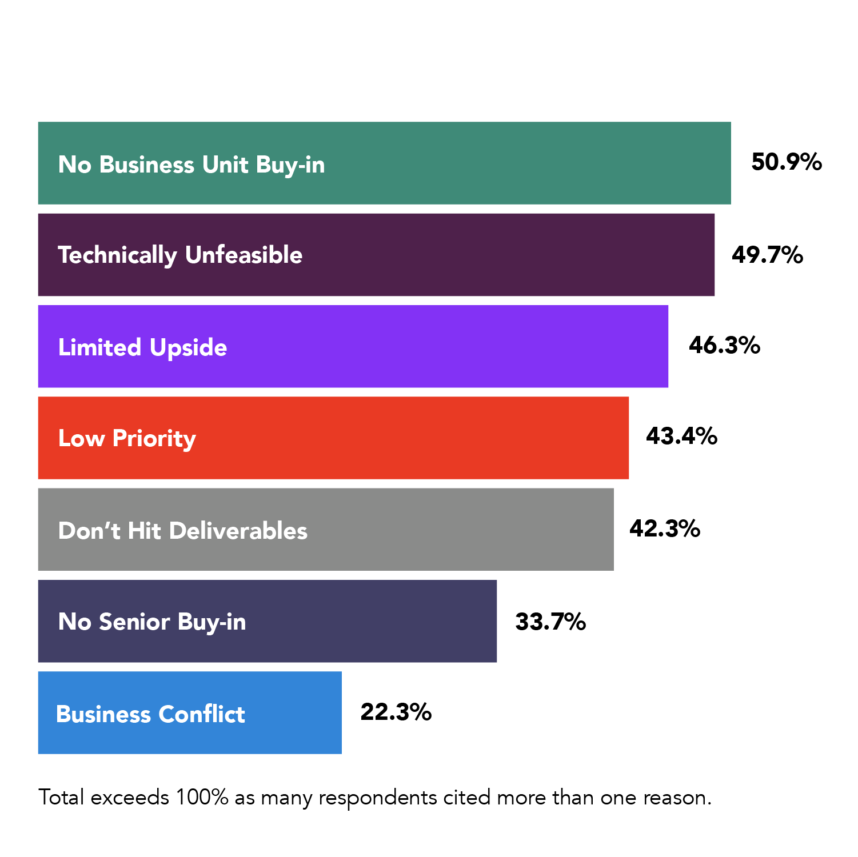
  (Reasons #1, #6, and #7 are about poor communication/ relationships with business units and senior leadership.)
  Why do new projects get killed?

Slide 18
  How should you be measuring progress?
  Many companies get obsessed with tracking what we call ‘activity metrics’ (i.e., how busy are you?)
  …# of ideas generated
  …# of employees involved in challenges/competitions
  …# of prototypes at various stages of development
  …# of patents issued
  …# of startups screened

Slide 19
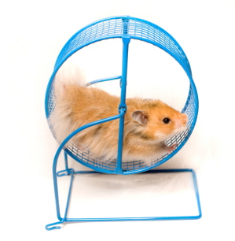
  But tracking too many metrics can be like:

Slide 20
  The best measurement systems:
  Are designed around ‘impact metrics’ — concrete data on dimensions that truly matter to senior management.
  Revenue from new products/services
  Cost reduction/operational efficiencies
  Growth in market share
  Customer satisfaction/retention
  Successfully launching new business models

Slide 21
  The benefits that accrue to companies that are the innovation leader in their market go beyond revenue, margin, and stock price…
  Brand value and media attention
  Recruiting the best talent
  Becoming ‘partner of choice’ for startups, distributors, resellers, independent agents
  Company morale and employee retention
  Leverage and ‘permission’ to innovate more boldly, invest more, enter new markets

Slide 22

  Who’s doing it right?
  Adobe has created the Kickbox program to teach and empower employees to rapidly prototype their ideas, and test them with customers in the real world.
  http://kickbox.adobe.com

Slide 23

  Who’s doing it right?
  Nike has a sophisticated process for funding new ideas, determining which should launch in the market, and supporting them with marketing when they do. Recent example: the HyperAdapt self-lacing shoe.
  http://news.nike.com/news/innovation-2016

Slide 24
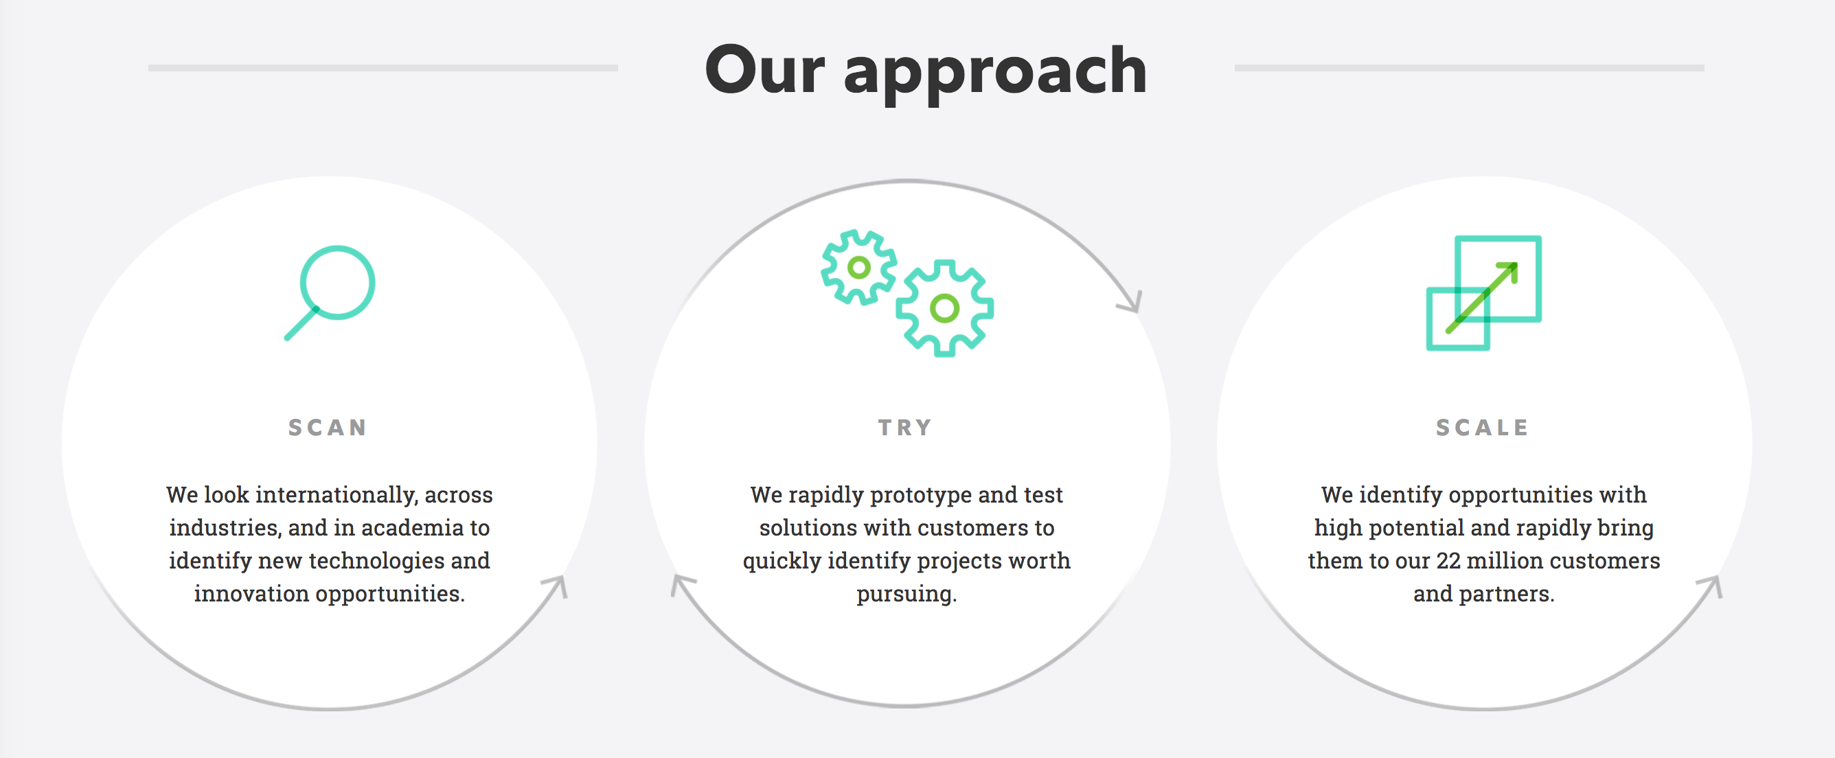
  Who’s doing it right?
  Fidelity Labs explores new technologies, like bitcoin, online games, and smart watches, that could affect the way people save and invest. Founded in 1999.
  http://fidelitylabs.com

Slide 25

  Who’s doing it right?
  Founded in 2007, the General Mills Worldwide Innovation Network looks for advanced technologies outside the company that can help General Mills with future products.
            http://gwin.force.com

Slide 26



  Who’s doing it right?
  Lululemon Athletica’s lab stores, in New York and Vancouver, bring teams of designers close to customers.
            http://lululemonlab.com

Slide 27
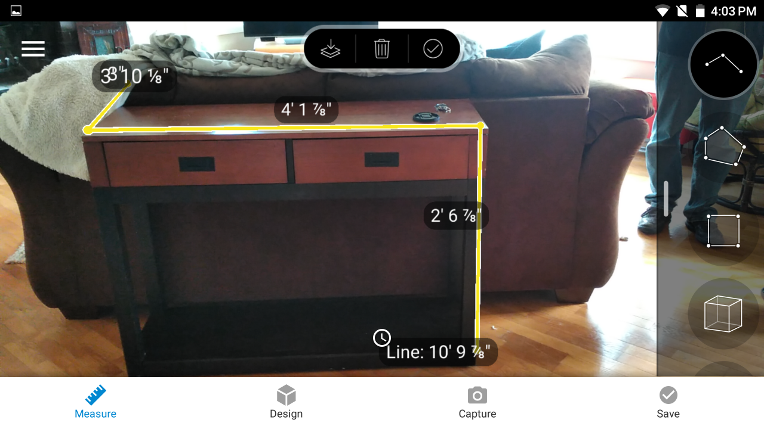

  Who’s doing it right?
  Lowe’s has created a network of labs in Seattle, India, and San Francisco to explore “how technology will change the future lives of customers and employees.”
  http://lowesinnovationlabs.com

Slide 28
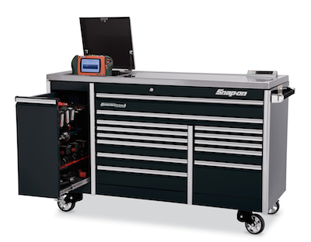
  Who’s doing it right?
  Snap-on Tools connects with customers multiple times throughout the innovation process, from studying problems to creating prototypes to finalizing design and the eventual launch.

Slide 29

  Who’s doing it right?
  Disney has a CEO, Bob Iger, who seeks to understand the technologies with potential to affect the entertainment business; the company’s R&D arm, Walt Disney Imagineering, has been keeping company ahead of trends since 1952.

Slide 30
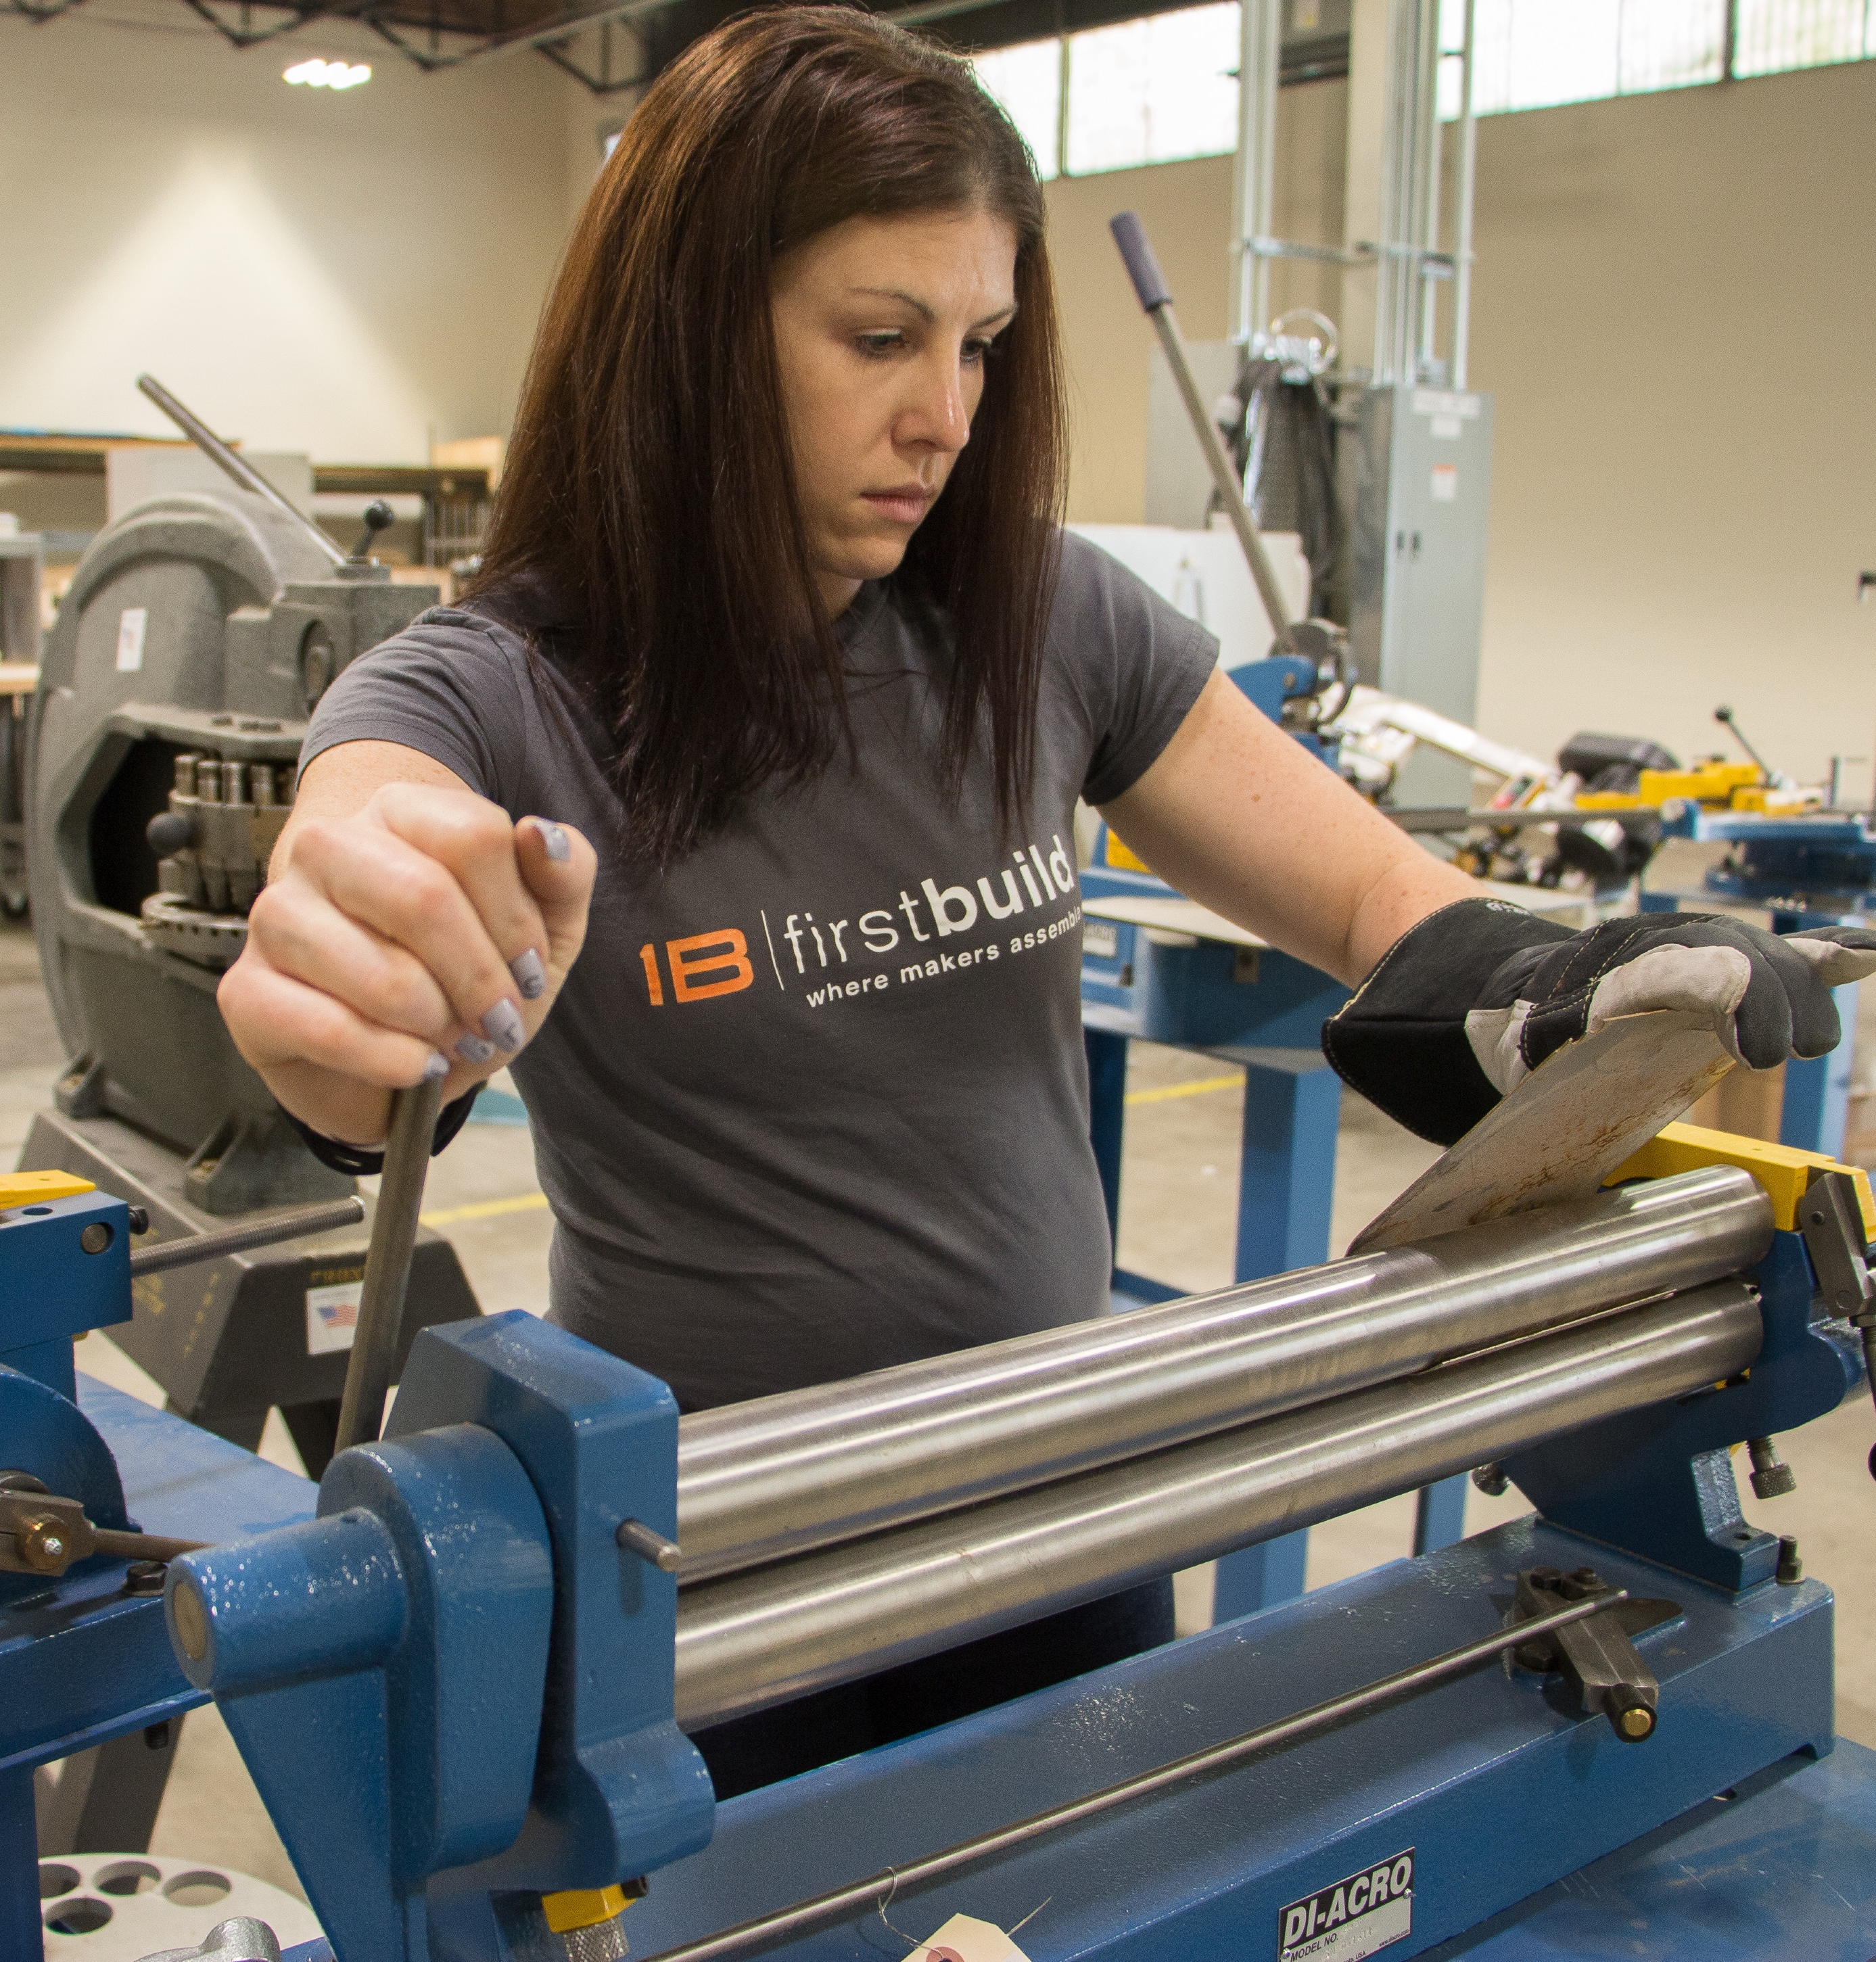

  Who’s doing it right?
  FirstBuild, created by GE Appliances in Louisville, Kentucky, is a ‘makerspace’ that invites entrepreneurs and inventors to participate in product design challenges. FirstBuild products have been launched on crowdfunding sites like Indiegogo.
  http://firstbuild.com

Slide 31

  But patience is a challenge for large organizations investing in innovation…
  Coca-Cola’s Founders program, to create and fund new ventures in partnership with entrepreneurs: 2013-2016
  Alaska Airlines’
  Customer Innovation Team: 2012-2015
  Nordstrom Innovation Lab, to develop
  new retail technologies: 2011-2015
  MassMutual’s “Society of Grownups,”
  financial education space: 2014-2016

Slide 32

  And lack of alignment can prove fatal…
  …whether between innovation and senior leadership,
  or innovation and the lines of business.

Slide 33

  Other things that can kill innovation initiatives…
  Executive champion leaves the organization; strategy changes.
  Team tries to do too much at once.
  Market pressures: Falling stock price, organizational cost-cutting, increased competition, etc.
  Poor staffing choices.
  Lack of funding to scale past proof-of-concept/pilot stage.
  Our full list: innovationleader.com/things-that-kill-innovation-initiatives

Slide 34
  To conclude, 5great CEO quotes on innovation…

Slide 35
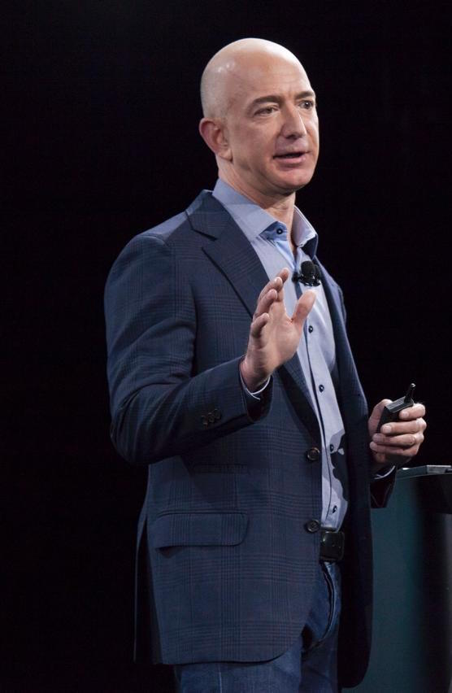
  “We’ve had three big ideas at Amazon that we’ve stuck with for 18 years, and they’re the reason we’re successful: Put the customer first. Invent. And be patient.”
  — Jeff Bezos

Slide 36

  “Innovation distinguishes between a leader and a follower.”
  — Steve Jobs

Slide 37

  “Disruption happens. You have to be aware of it. But I don’t think it should paralyze you.”
  — Beth Comstock

Slide 38

  “Failure is an option here.
  If things are not failing, you are not innovating enough.”
  — Elon Musk

Slide 39

  “Times and conditions change so rapidly that we must keep our aim constantly focused on the future.”
  — Walt Disney

Slide 40
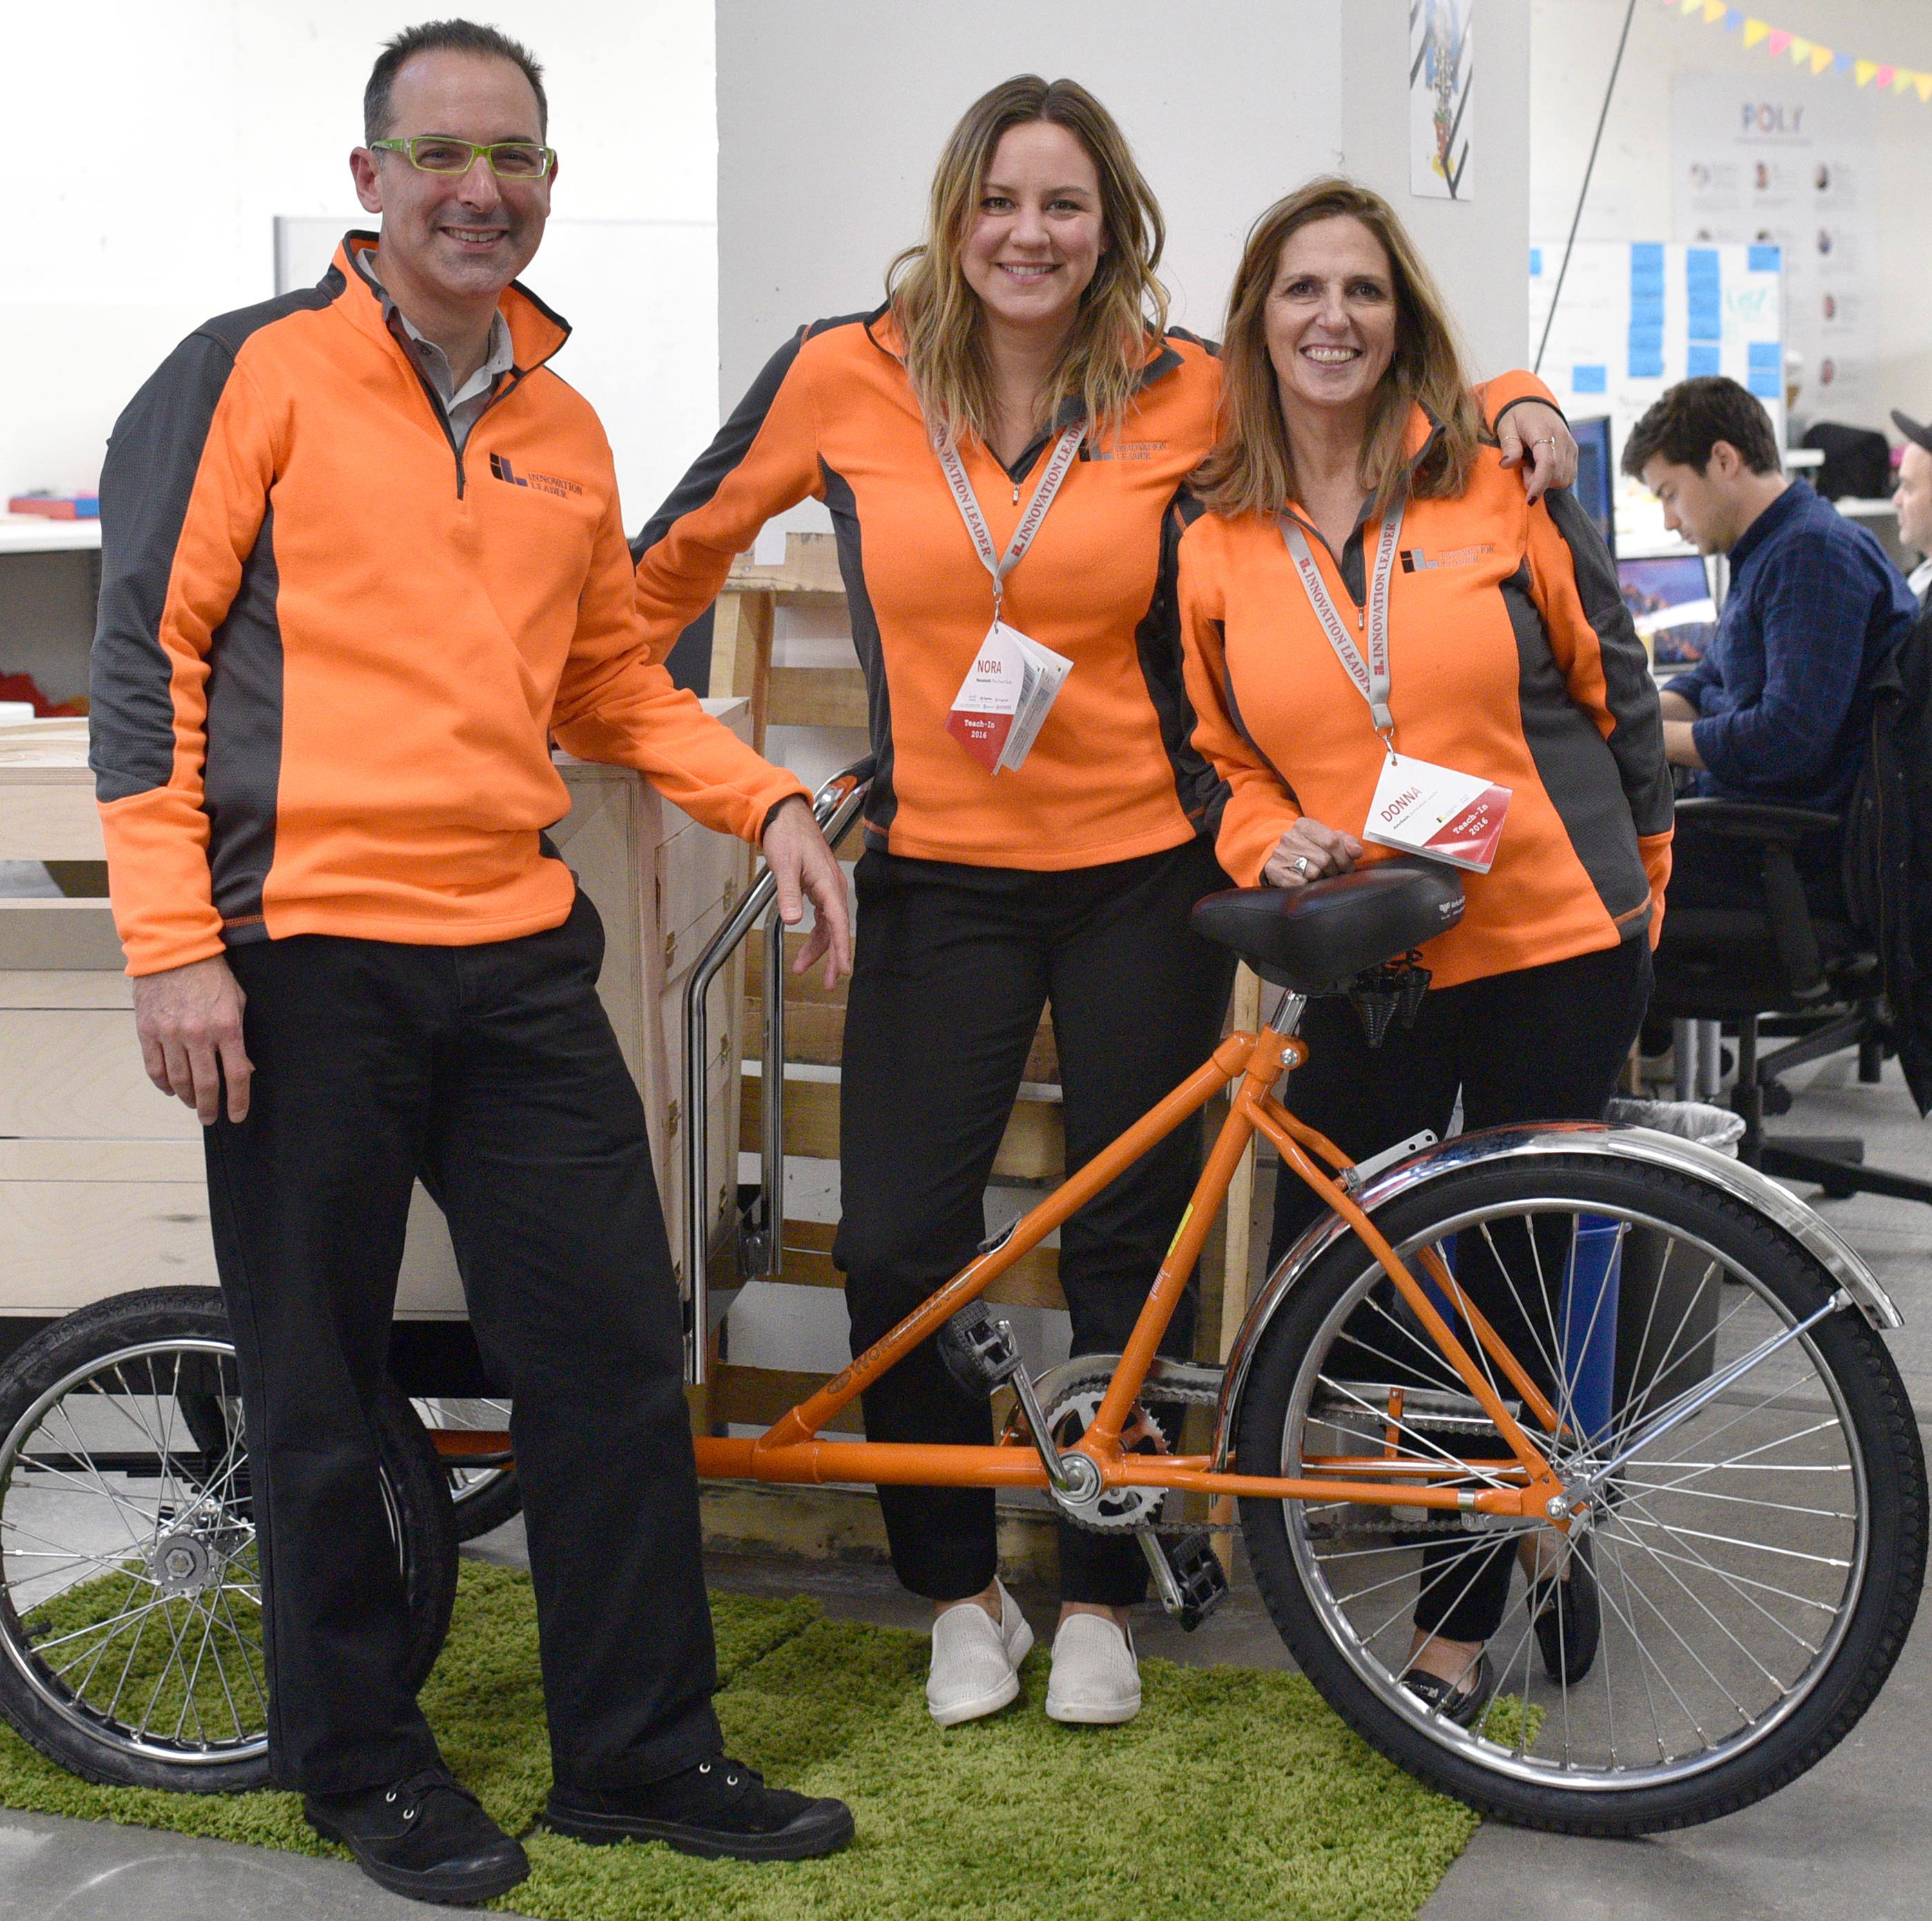



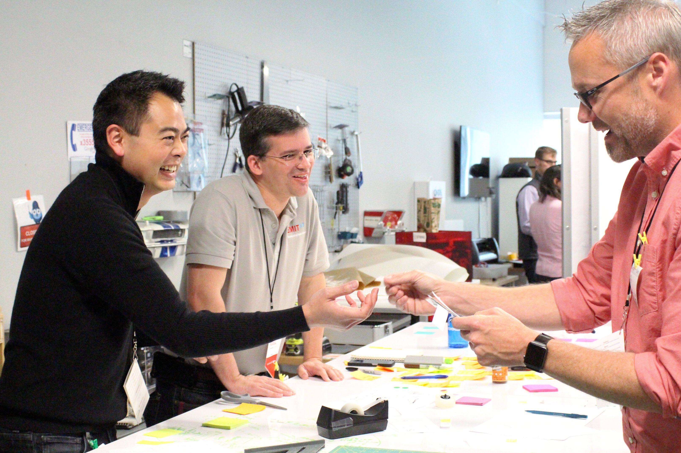
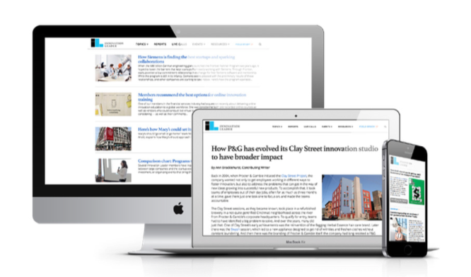
  Innovation Leader is the world’s leading authority on corporate innovation.
  Learn more about us at innovationleader.com

Slide 41
  If you use slides or data from this presentation, please credit Innovation Leader/@innolead.
  Thanks!

