Slide 1
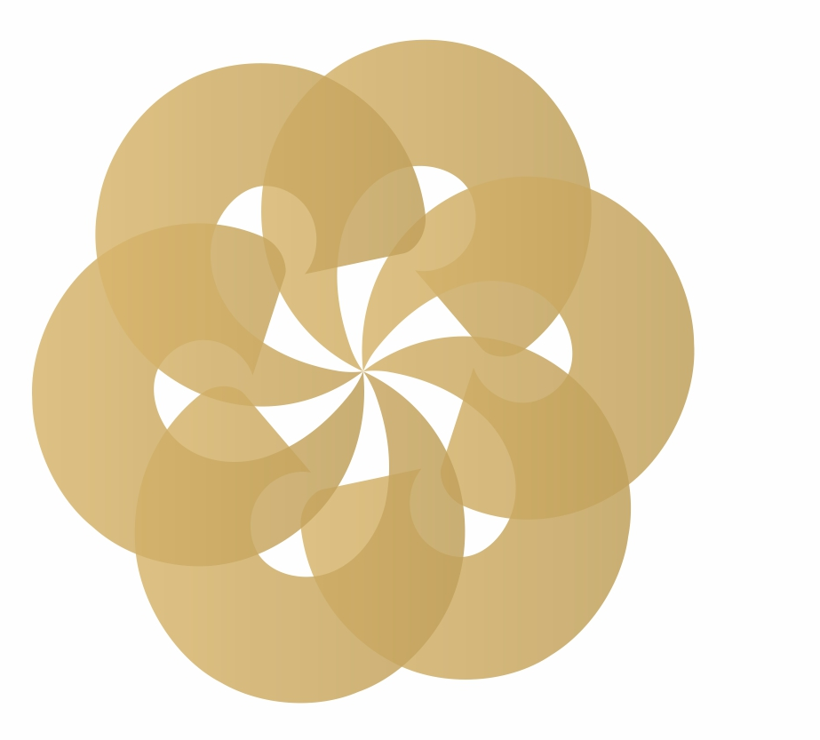
Innovation at Reliance

Slide 2


Reliance is one of the top 50 most innovative companies in the world!

Slide 3

World’s largest single location refining hub

Slide 4
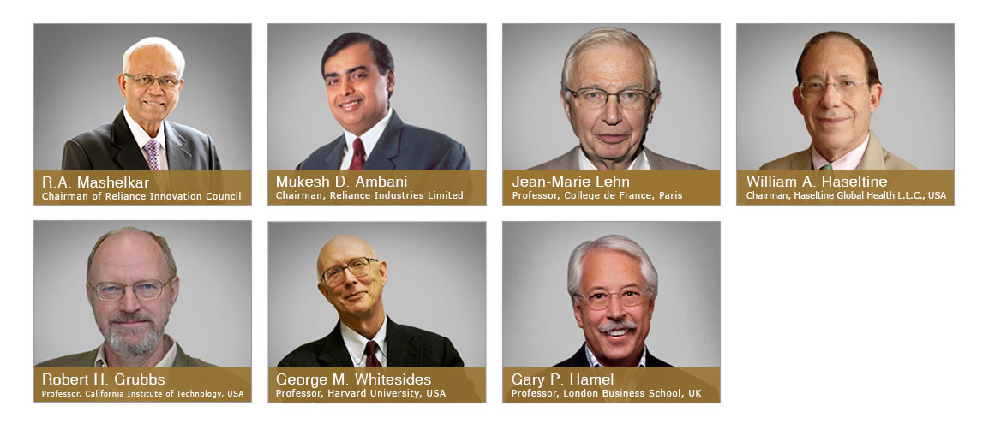
Reliance Innovation Council

Slide 5






Institutionalizing Innovation
Environment
Process
Talent

Slide 6

Creating 100 Innovation Leaders

Slide 7

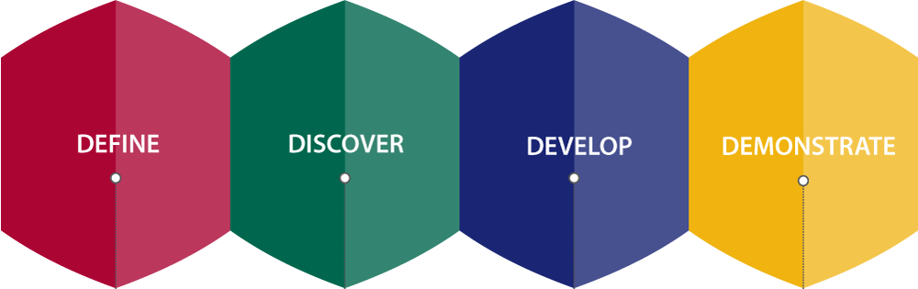
Beyonders - D4 Process

Slide 8
Develop deep empathy for customers
Look beyond your industry for ideas
Think beyond product innovation
Transform the way the job gets done
Imagine the impossible
Become a contrarian
Beware of idea killers

Slide 10

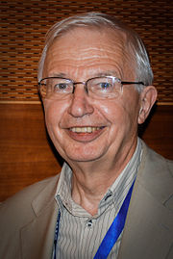
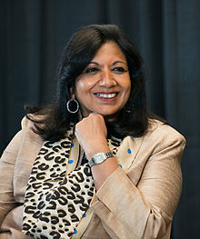

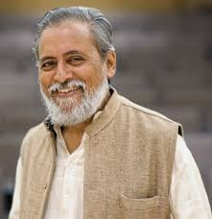
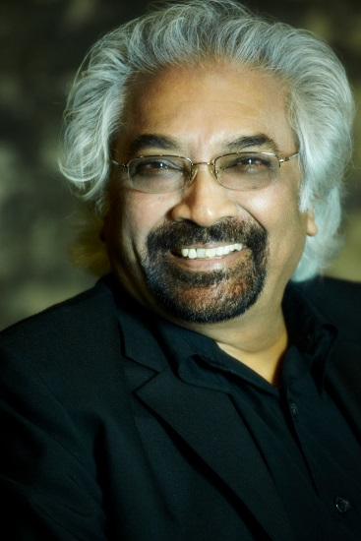

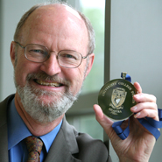




Slide 11
Decoding Reliance’s Innovation DNA
Challenge conventional wisdom
Challenges are possibilities
Make resources a ‘non issue’
Make trust an instinct
Chase reverse cash flow

Slide 12
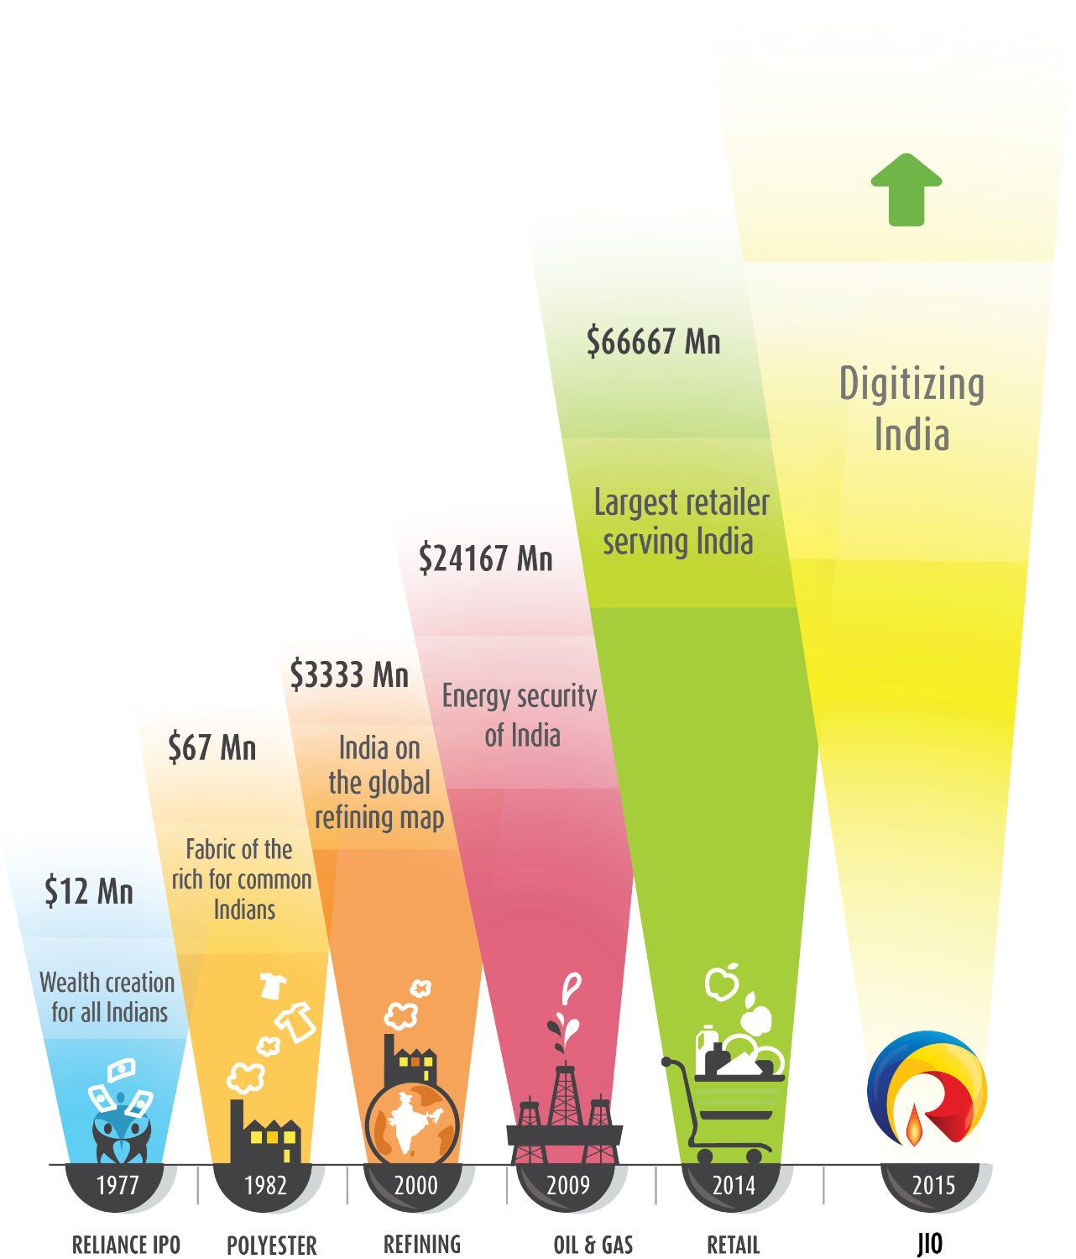

Innovation Led Growth

