Slide 1

  Actual Intelligence built on A.I.
Notes:
AI is misunderstood.

Slide 2
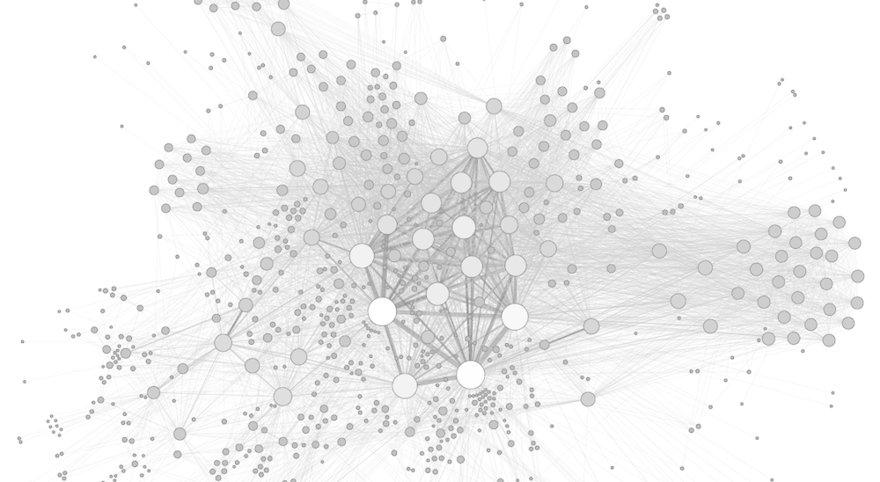
Consumers today expect smarter experiences.
Notes:
Across all of their experiences. Banking, Travel, food. Same goes for retail
Examples: Uber, Sephora, Spotify, Dominos

Slide 3
Different problems draw upon
different types of intelligence
for answers:

Slide 4
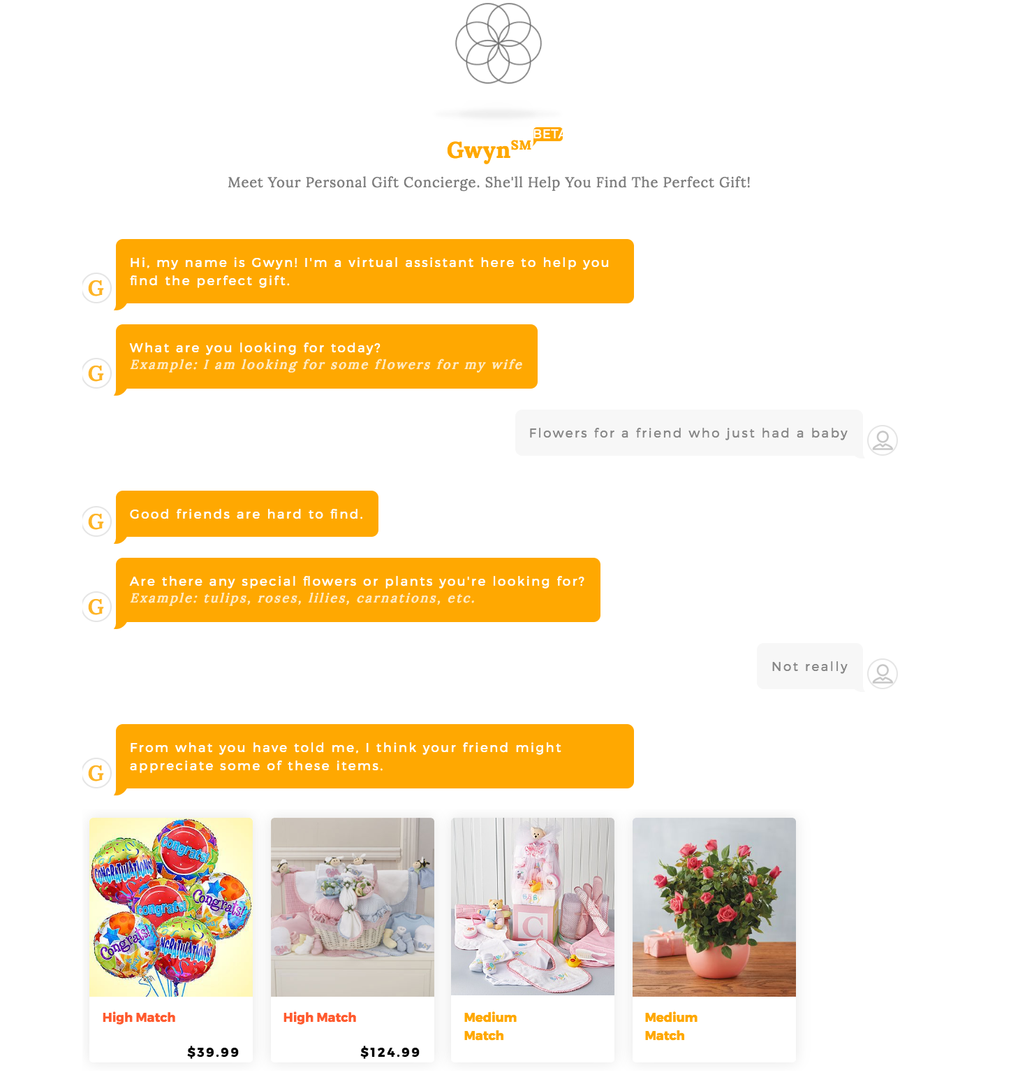
Getting the right flowers for an occasion
Notes:
How much would a dozen roses would cost vs. What are the right flower for 25th anniversary or a baby?

Slide 5
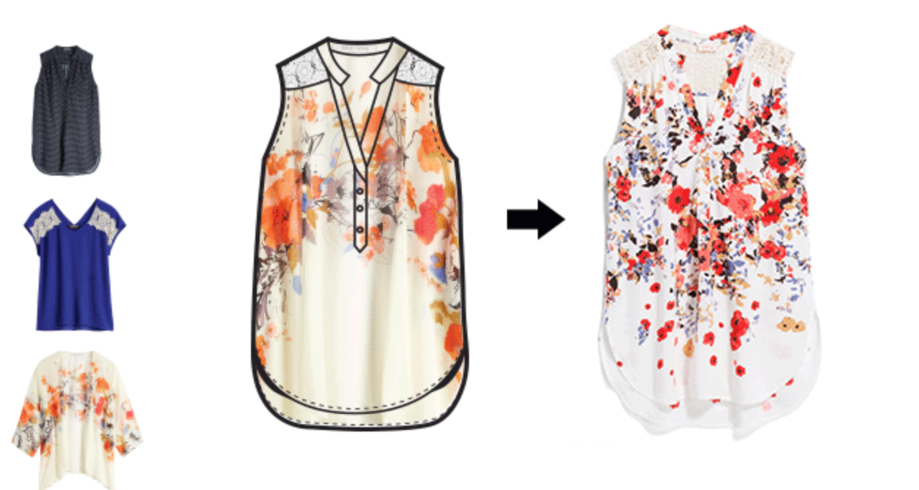

Creating products based on customers feedback
Notes:
Stick Fix: Stick Fix customers a box of clothing personalized based on a a profile the customer fills out.
They use feedback on each box to identify what customers like and dislike and create new items based on the feedback

Slide 6

Getting and installing the right vanity and faucet for a bathroom remodel
Notes:
Getting and installing the right vanity and faucet for a bathroom remodel is more complex.
Home Improvement is a complex customer experience with multiple products, expertise, content. Decisions are high involvement and made over time

Slide 7



unfamiliar
products
Home Improvement is Inherently Complex
easier
decisions
harder
decisions
familiar
products
Notes:
Home Improvement is inherently complex.
Office supplies e.g. paper is a simple product and reordering is a simple decision
Buying clothes/Vacation planning are familiar products but picking specific clothes for an occasion of planning a two week long family vacation in another country is more complex.
Home improvement is inherently more complex because of the scale, multitude of unfamiliar products, and the need for expertise

Slide 8
Applying AI to this Complexity:
1. Structure the Unstructured
2. Build Intelligence in Layers
Notes:
Across all of their experiences. Banking, Travel, food. Same goes for retail

Slide 9
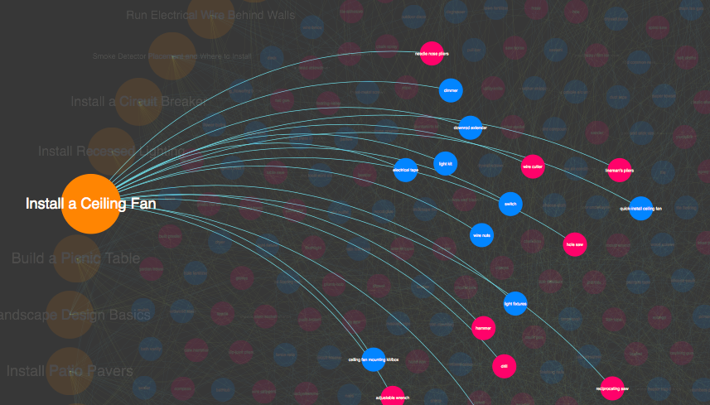
1.
Structure
the Unstructured
Notes:
Structured content is the foundation for implementing AI. At Home Depot we have used disparate data sources and data such as prodcut data, project guides, how to content etc. and create a non linear mapping so we can use it as a foundational element for several experiences across the journey such as….

Slide 10


Understand what a customer needs when they search
Using structured content to…
Notes:
e.g. Serving up relevant, meaningful content when we anticipate that they need it over visits and time.

Slide 11
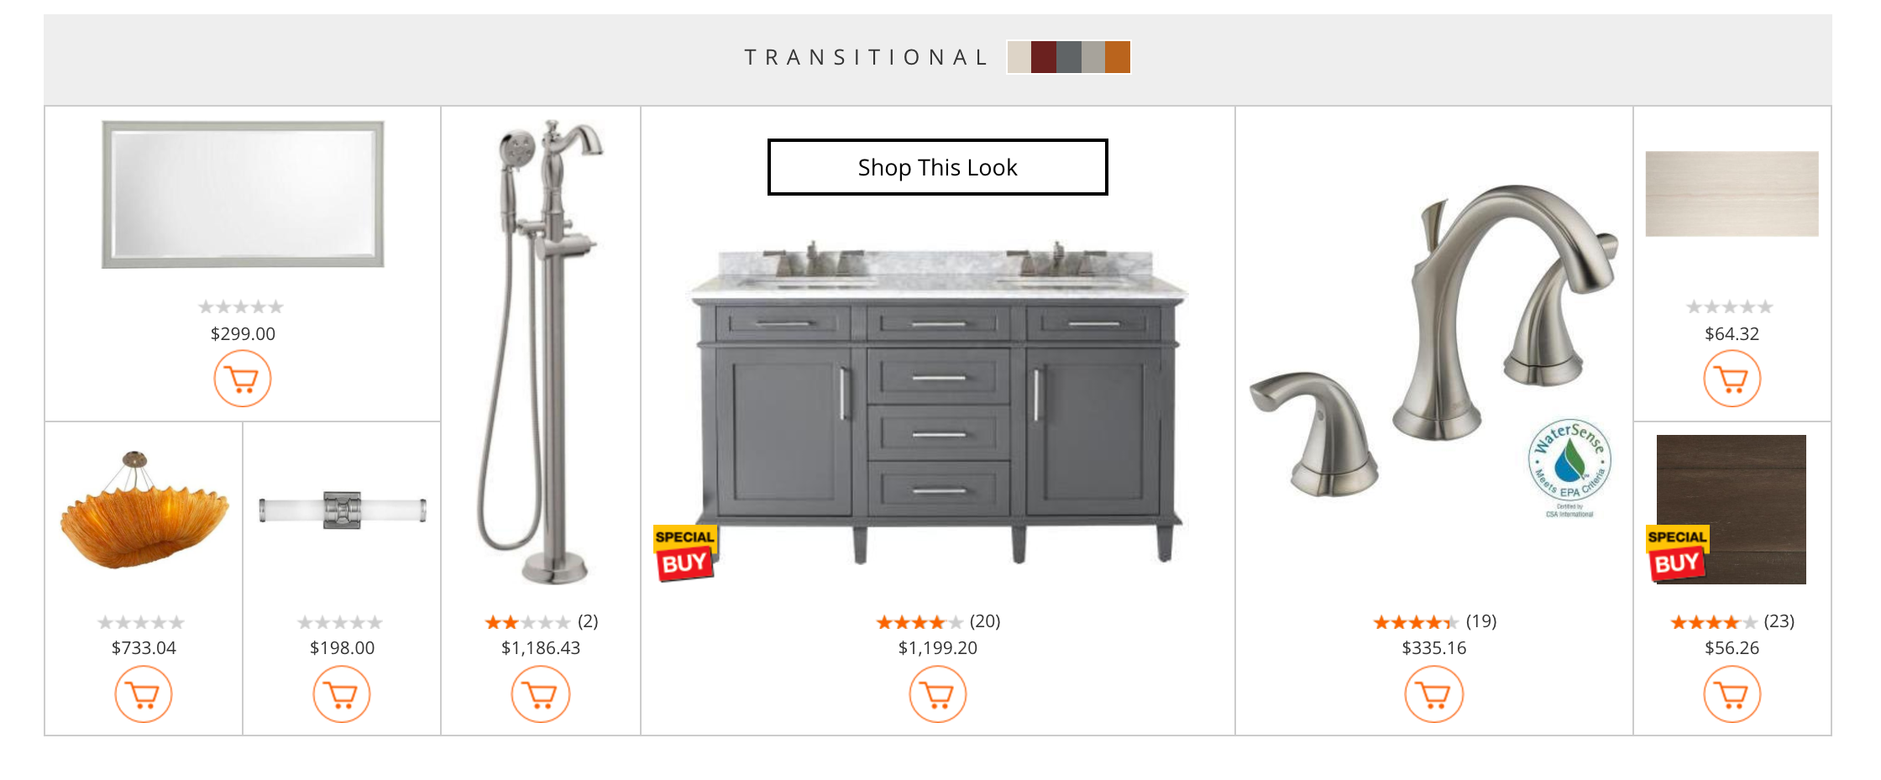
Using structured content to…
Make
the right recommendations

Slide 12
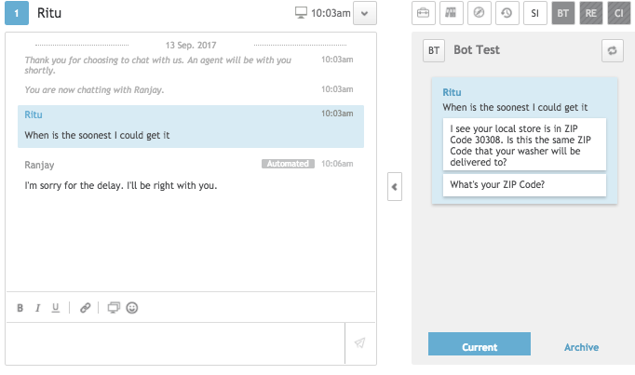
Using structured content to…
Empower associates with knowledge
Notes:
and helping answer customers frequently asked questions quickly via a chat bot, saving them time and effort.

Slide 13
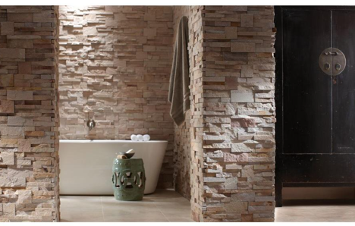
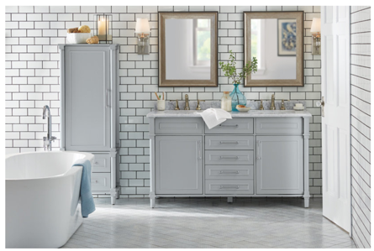


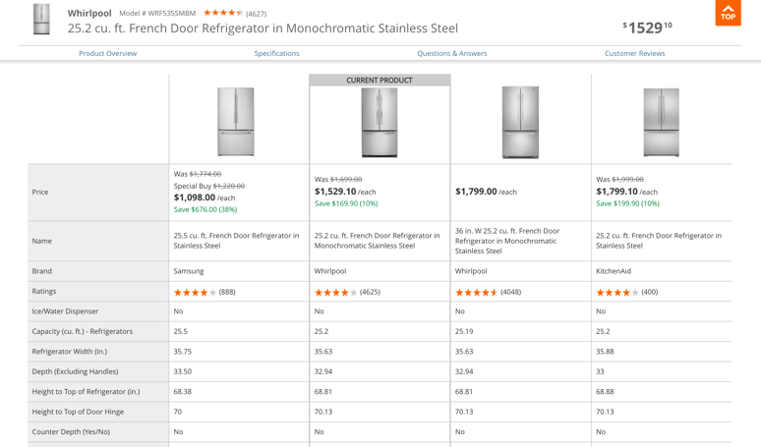
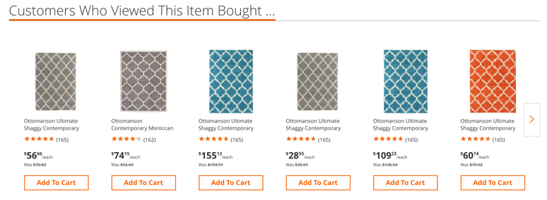
2.
Build Intelligence in Layers

Slide 14
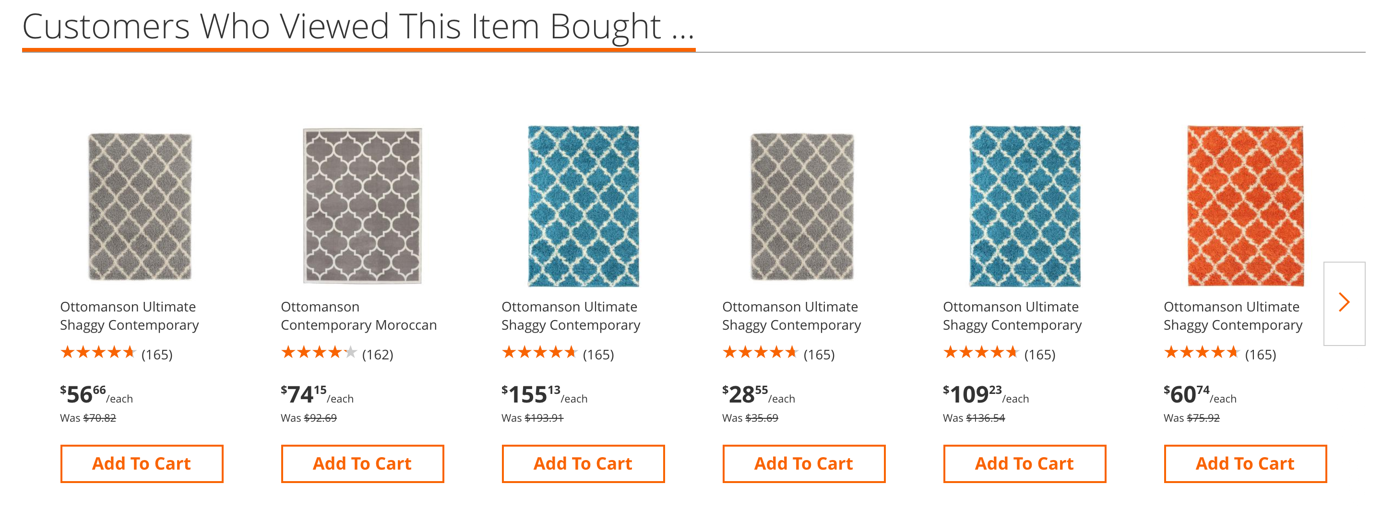
Building Intelligence in Layers
Crowd behavior based recommendations
Notes:
All retailers use Basic ML for crowd behavior based recommendations

Slide 15
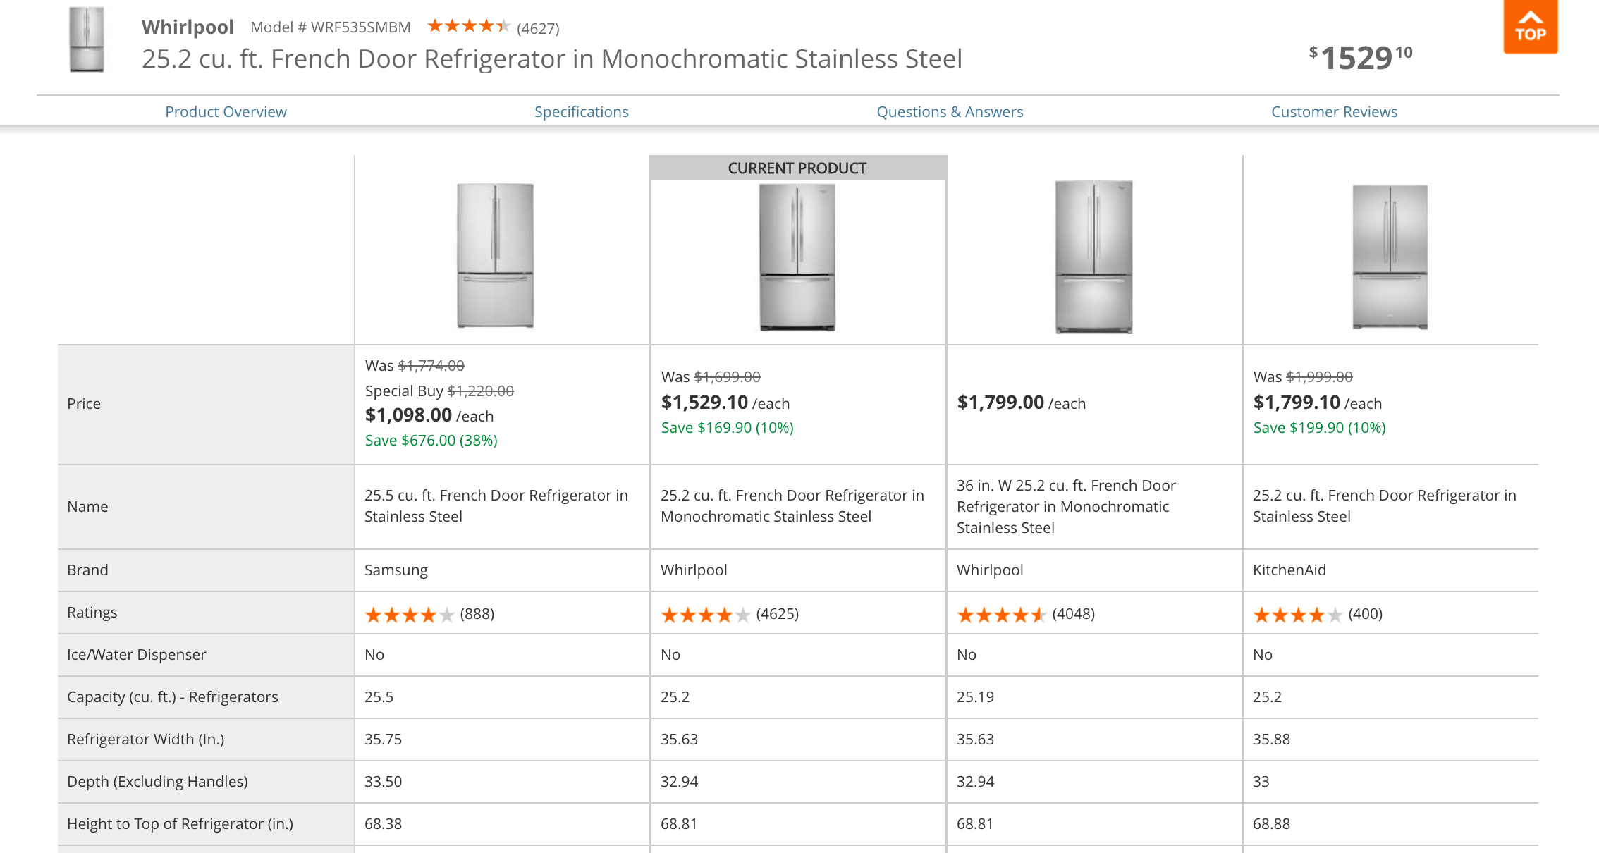
Crowd behavior based recommendations
+ Product Intelligence
= Feature Based Recommendations
Notes:
Feature Based Recommendations uses features Machine Leaning

Slide 16


Feature Based Recommendations
+ Visual
Intelligence
= Style-based
Recommendations
Notes:
Layer in imagery and you are now no longer restricted to the features one person has used to describe the product.

Slide 17
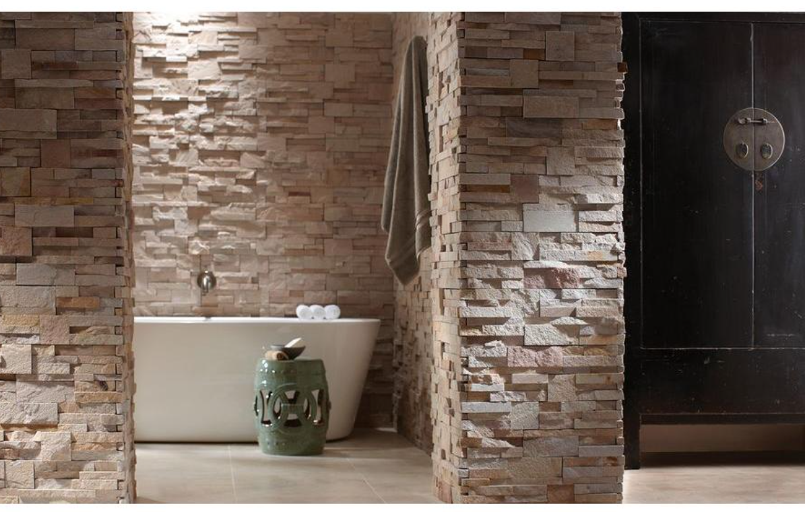

Visually Similar Recommendations
+ Individulized Intelligence
= Contextual
Recommendations
Notes:
When you add an additional layer of personalization (also based on structured customer data), you start to get a very intelligent system that visually recommends products based on a persons preferences. e.g. in the images, the same tub is used in two different styles

Slide 18
How to build AI that works.
3 Lessons Leaned:
Notes:
- Home Depot has by no means fully exploited what AI can do
- But we have adopted 3 practices that we believe will help us get there

Slide 19
1.
Have a purpose for AI
Online Experience
In-Store Experience
Assortment
Fulfillment
Pricing
Basic
Returns
Intermediate
Advanced
A.I. starting point
Improvement path
Measurable end-point
Notes:
- I have seen many retailers work on AI for AI's sake
- At Home Depot, we are very clear on specific business outcomes in various segments of our business to achieve our company's outcomes
- We asked ourselves "which problems can AI help us solve" and we started there
- We quickly realized that this approach not only kept us focused but also helped us pivot the capability into complementary parts of the organization

Slide 20
2.
Create an environment for data science to thrive
Core
Business
Team
Data
Scientist
Data Practitioner
Notes:
- Too many times, we've seen our data scientists speak and our business stakeholders glaze over in confusion
- We created the capability within Home Depot to help connect the dots between what is possible in the SCIENCE of data with ART of what's needed to win in our core businesses

Slide 21
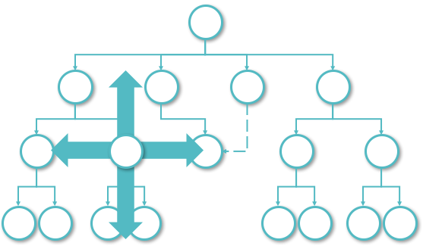
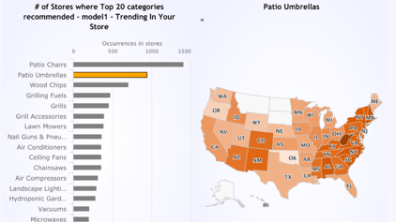
3.
Make AI User Friendly
Democratize
Demystify
Notes:
- Making the concept easy to understand was key. We took two approaches
- One: we made it a point to spread AI far and wide within the organization
- Two: we created visuals and tools that made the benefits easy to understand for a 5th grader (so our merchants could understand it!)

Slide 22

Re-think the Paradigm

Slide 23
Questions
?

