Slide 1
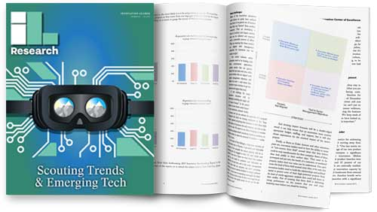
  Best Practices in Scouting
  Trends & Emerging Tech

Slide 2

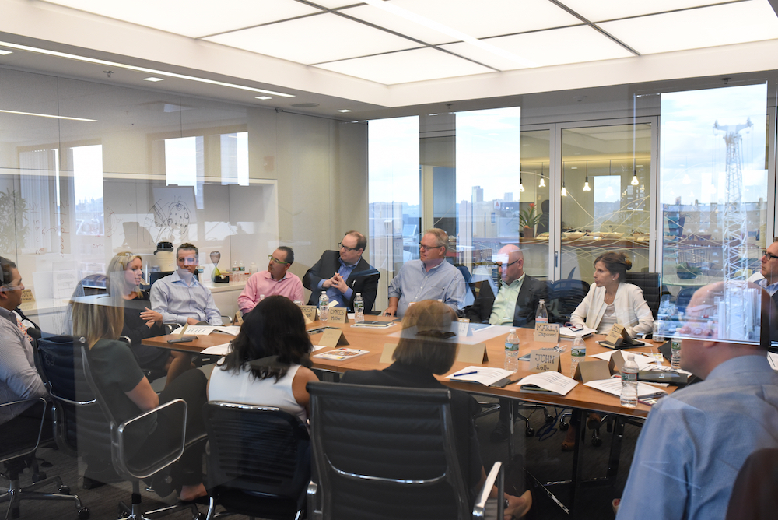

> About us
We’ve built the largest community of corporate innovators, strategy execs, and R&D leaders — and we work hard to help them achieve real impact in their organizations. We’re an unbiased source of research and case studies. A convener of the best events on corporate innovation. And we work hard to help all the members of our community win.

Slide 3
> Companies know scouting is important
1. Spotting emerging technologies and disruptive trends | 54.7%
2. How to spur cultural change / risk-taking | 52.3%
3. Metrics, reporting, dashboards | 40.4%
4. Operationalizing/rolling out successful projects into the business | 39.1%
5. Building communities / networks of innovators | 38.2%

Slide 4
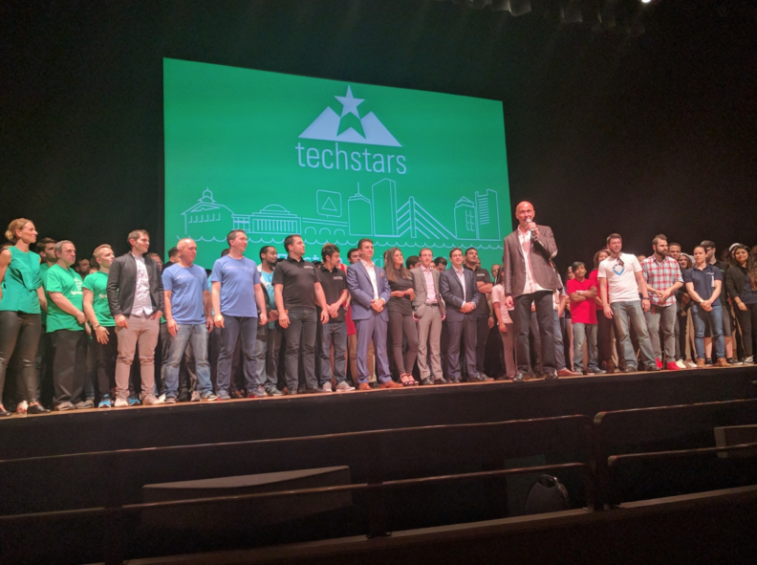
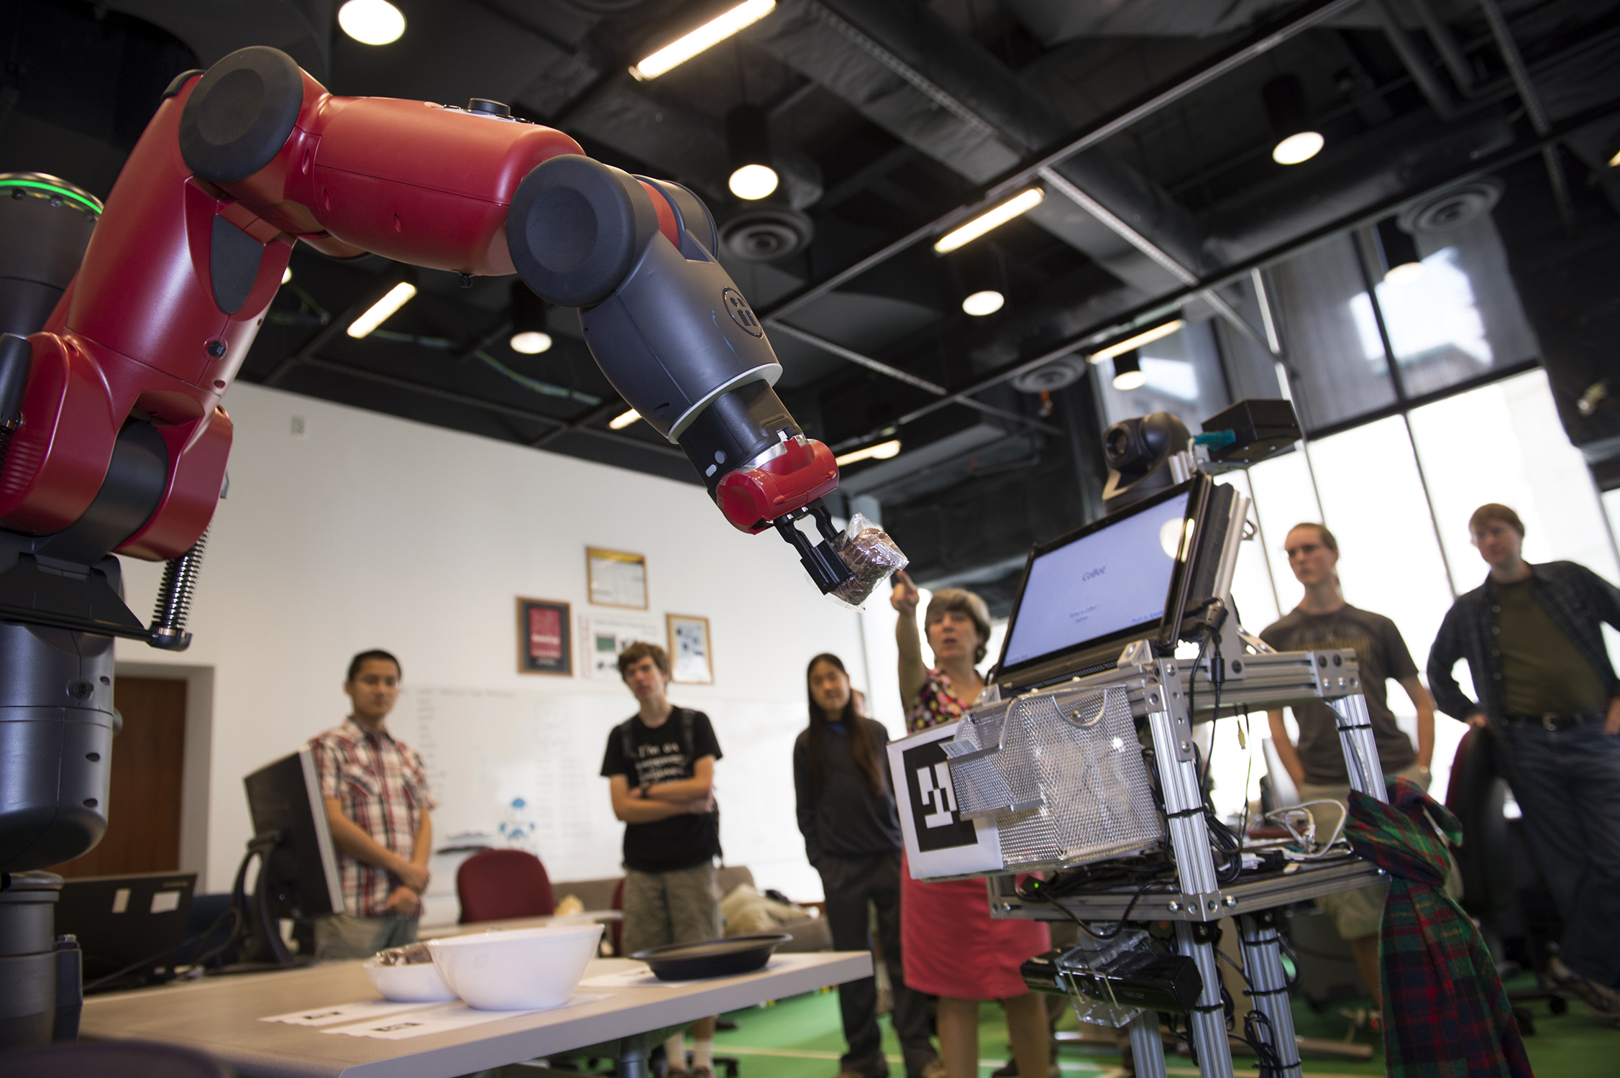

> Scouting is fun!

Slide 5
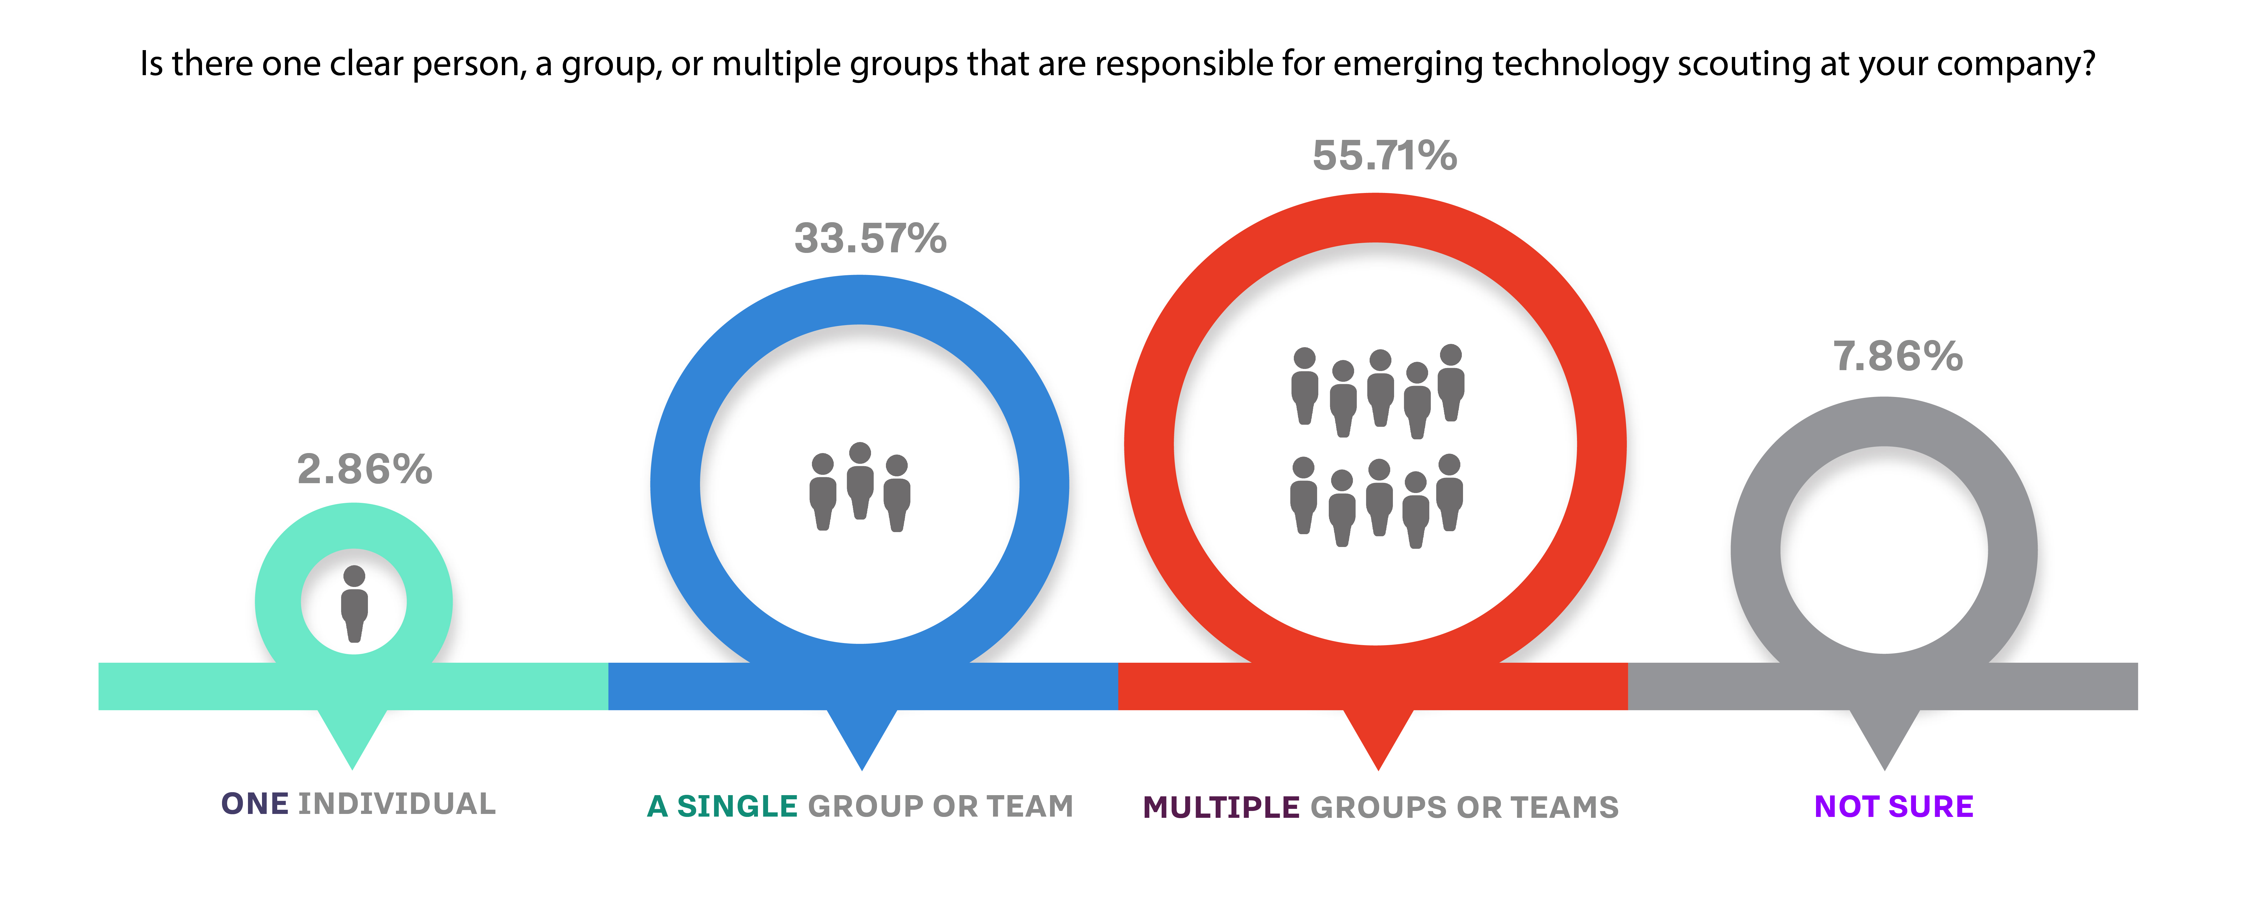
> They have multiple teams scouting emerging tech

Slide 6
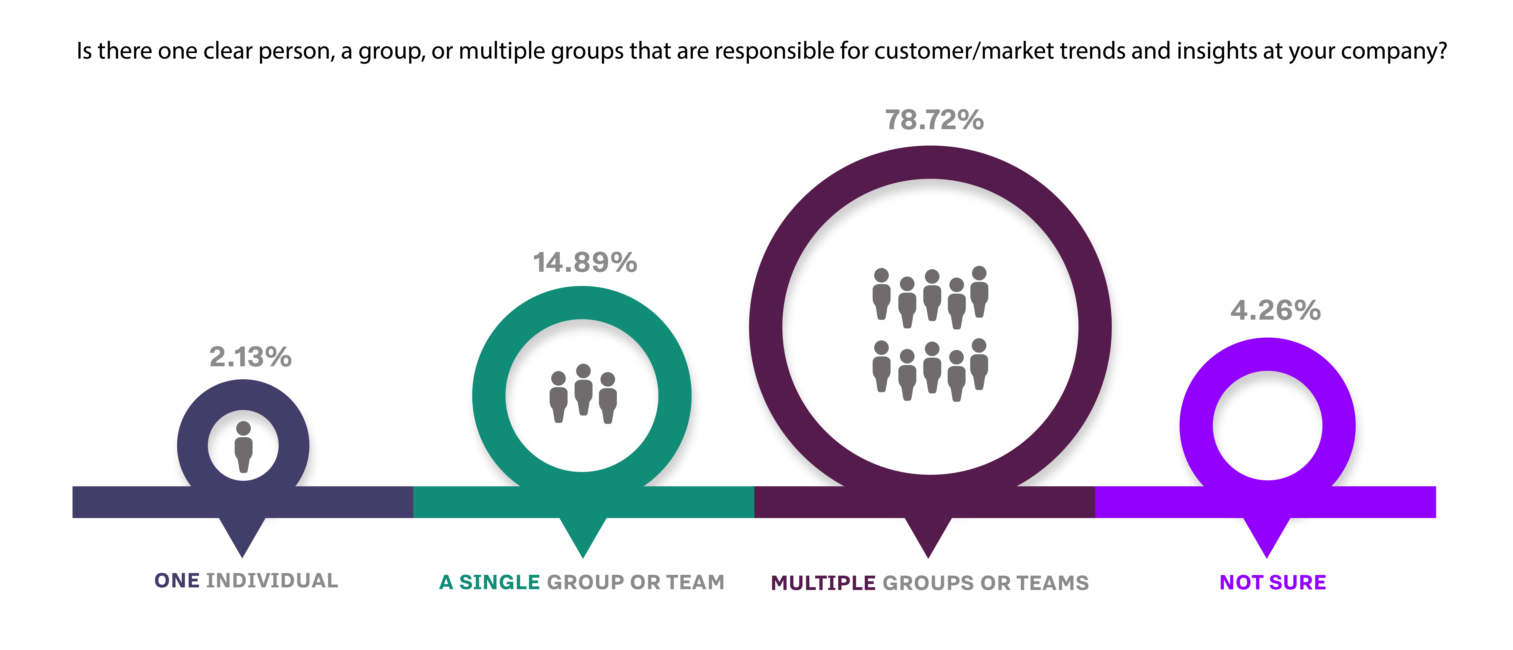
> They have multiple teams scouting trends

Slide 7
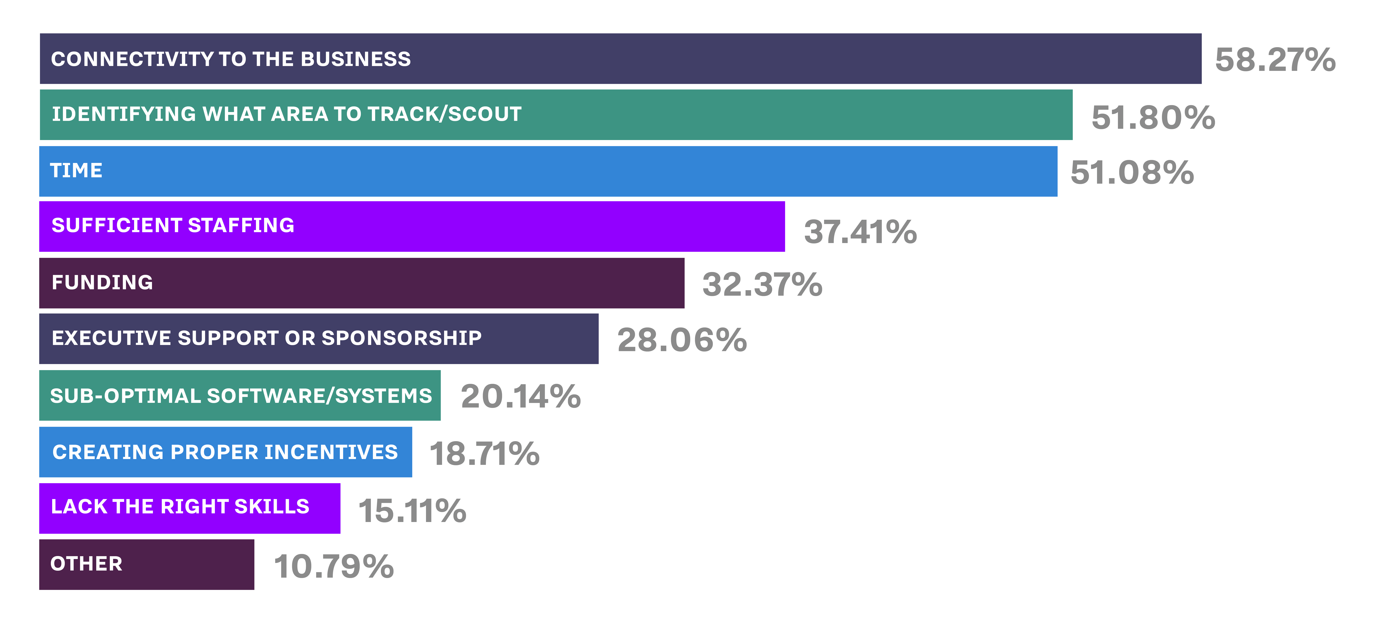
> …But there are big challenges to doing it well

Slide 8
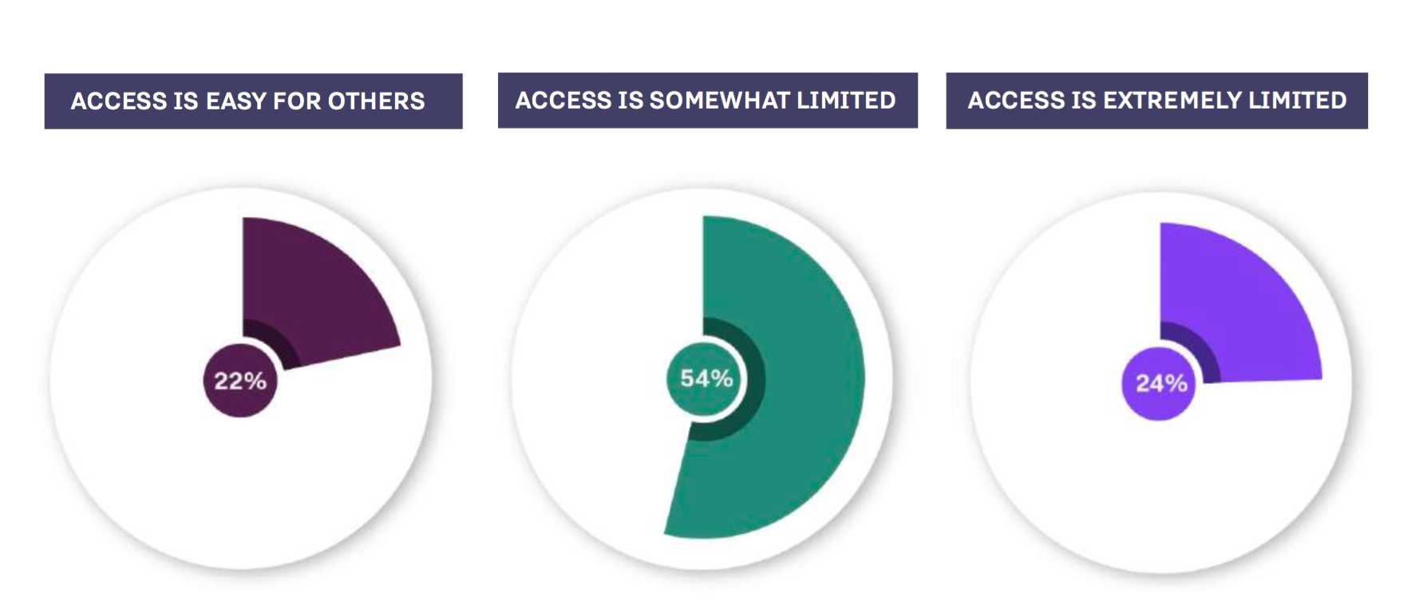
> Access to scouting “findings” is limited

Slide 9
> Access to scouting “findings” is limited
“There’s not a centralized location where all [this research is] available. Access is granted upon request, and on a ‘need to know’ basis.”
“I’m not sure where to find all the resources we have in my organization.”
“No standard process; no central location; tribal knowledge.”
“We are open to having anyone review the information, but are a little behind in making it easily available.”

Slide 10
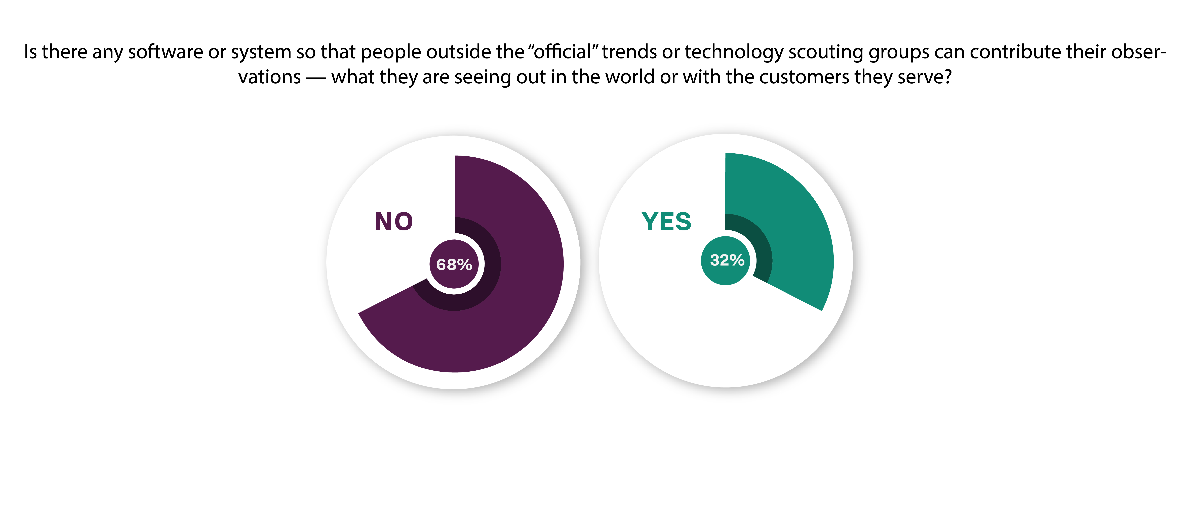
> Can others contribute what they see?

Slide 11
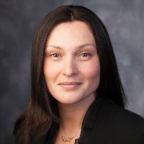
> Advice
“You need a lens. That allows you to be more precise. We’ve found that broad exploration doesn’t lead to a lot of meaningful outcomes.
— Tatyana Zakrevskaya, AVP, Innovation, Manulife

Slide 12

> Advice
1. Be solution-focused, not ideas-focused.
2. It takes time to set up a scouting program, so you need a level of patience, persistence, and consistency
3. You must develop the ability, once opportunities come in, to be able to rapidly test them—to turn them into prototypes.
— Nigel Hughes, Global Head of R&D, Kellogg Co.

Slide 13
> Advice
“Dedicate the time, make this more than an annual exercise, designate areas to track and make someone accountable. If it isn’t someone’s day job, it doesn’t happen.”
— Anonymous survey respondent

Slide 14
> What else is in the report?
Aligning with Corporate Strategy
Operating the Radar
Communicating to the Rest of the Organization
Running Tests and Experiments
Helping the Business Take Action
Trend Scouting Consultancies & Databases
Tech Scouting Consultancies & Databases
Scouting Worksheet
Case Studies & Interviews:
Kellogg Company, Nokia, Goodyear, General Motors, Siemens, Autodesk, Lululemon, Sherwin-Williams
For more, visit innovationleader.com/research

Slide 15
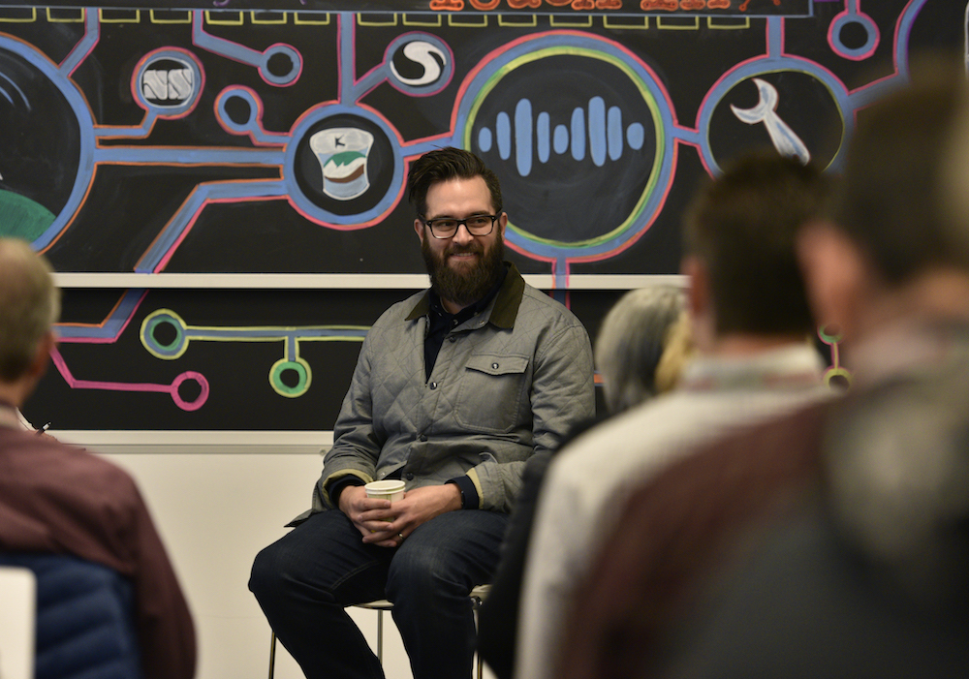
> Today’s Guest Star
Kyle Nel, Founder & Former Executive Director, Lowe’s Innovation Labs; former Manager of Customer Insights, Walmart

Slide 16
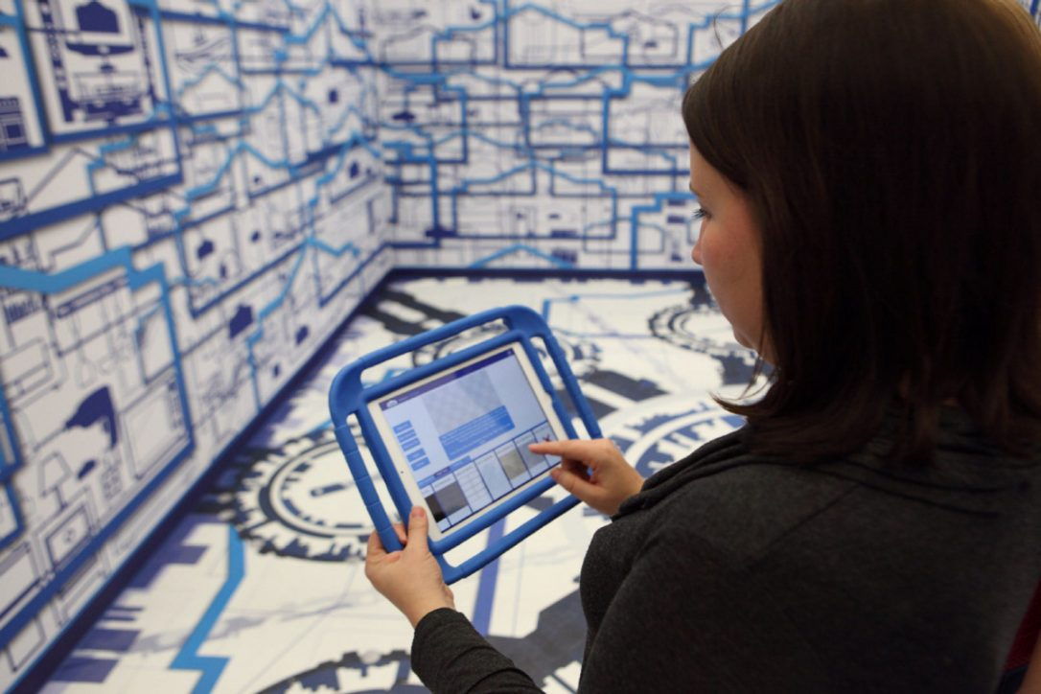
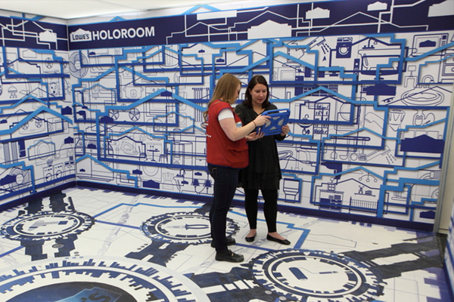
> Lowe’s Innovation Labs

Slide 17
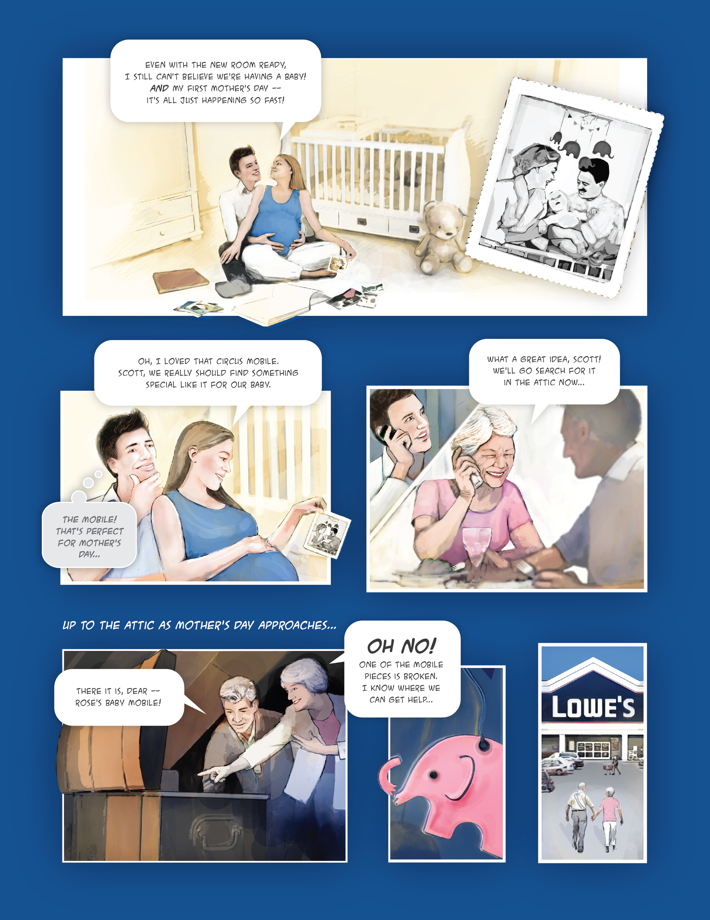
> Lowe’s Innovation Labs

Slide 18
> Your questions? (…and what’s next for us)
February: One-day event on Tech and Trend Scouting in San Francisco, Feb 28th, 2018 (fewer than five spots remain)
Corporate Innovation Night in Boston, Feb 15th (see vencaf.org/corpinno)
March: Spring issue of our print magazine
Webcast on “Innovation by the Numbers” on March 15th
April: New York City Field Study, April 19th-20th
May: One-day event on healthcare in Boston,
May 17th

