Slide 1
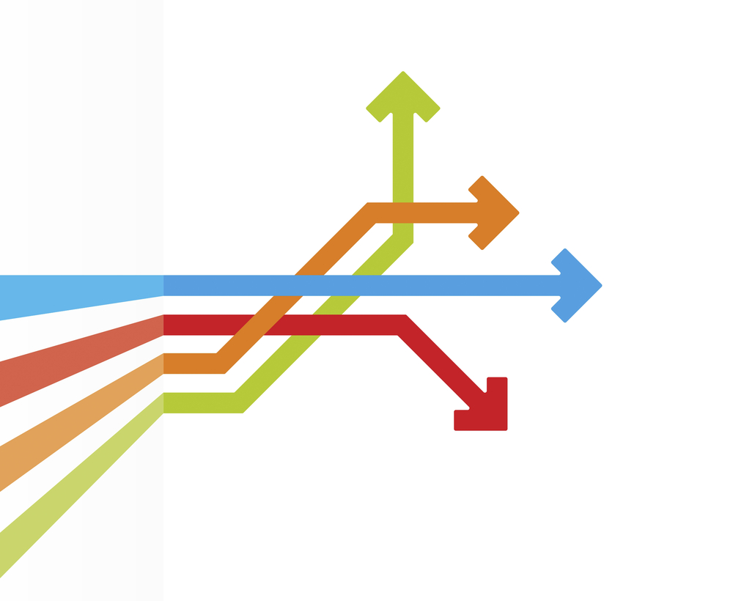
25 Recent Data Points & Rankings for Innovators in Large Organizations
Compiled by Innovation Leader (@innolead)
November 2019

Slide 2
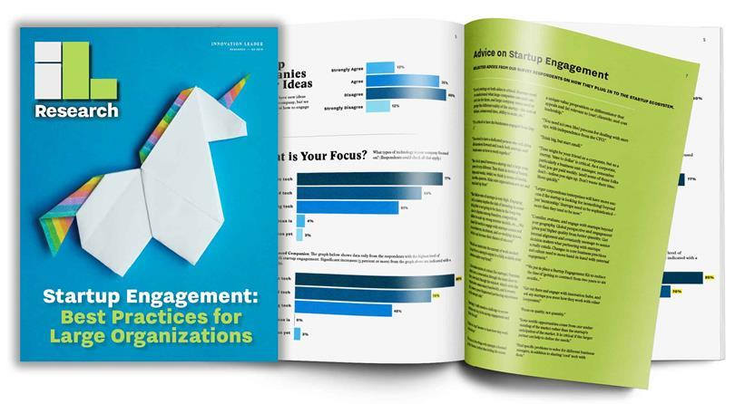

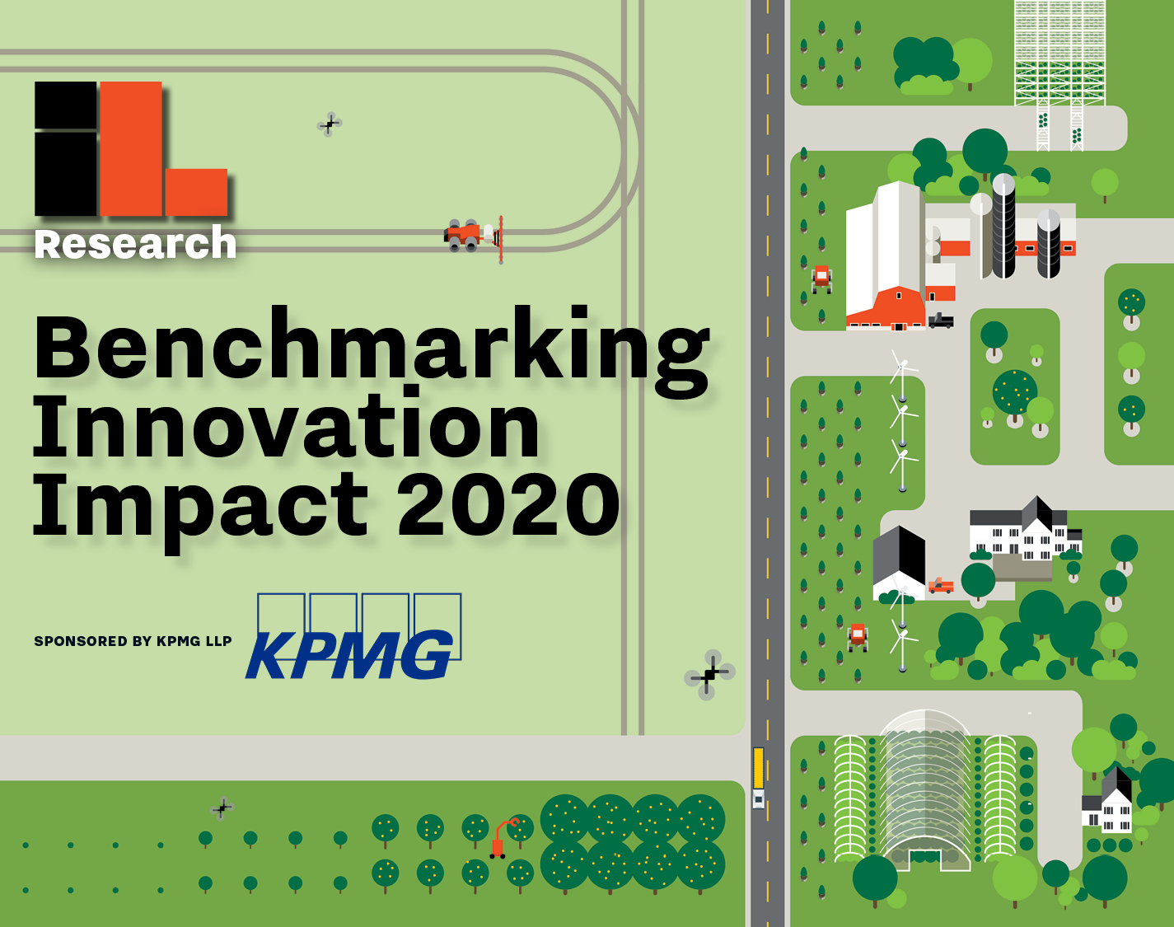
> About Innovation Leader
We’ve built the largest network of corporate innovators, strategy execs, and emerging tech leaders — and we work hard to help them achieve real impact in their organizations. One of our key offerings is quarterly research reports that collect data, interviews, and advice on best practices. This report includes Innovation Leader data, as well as data from other sources.
innovationleader.com
@innolead on Twitter & Instagram

Slide 3
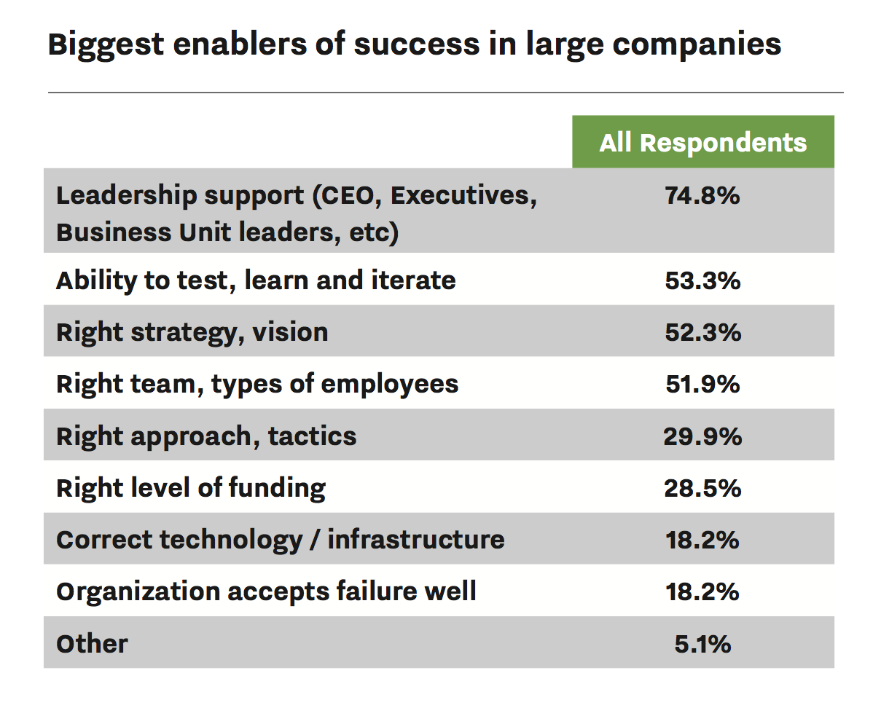
> What are the biggest enablers of innovation success?
*Source: Innovation Leader survey of 215 professionals in large organizations, 2019.
https://innovationleader.com/benchmarking2020

Slide 4
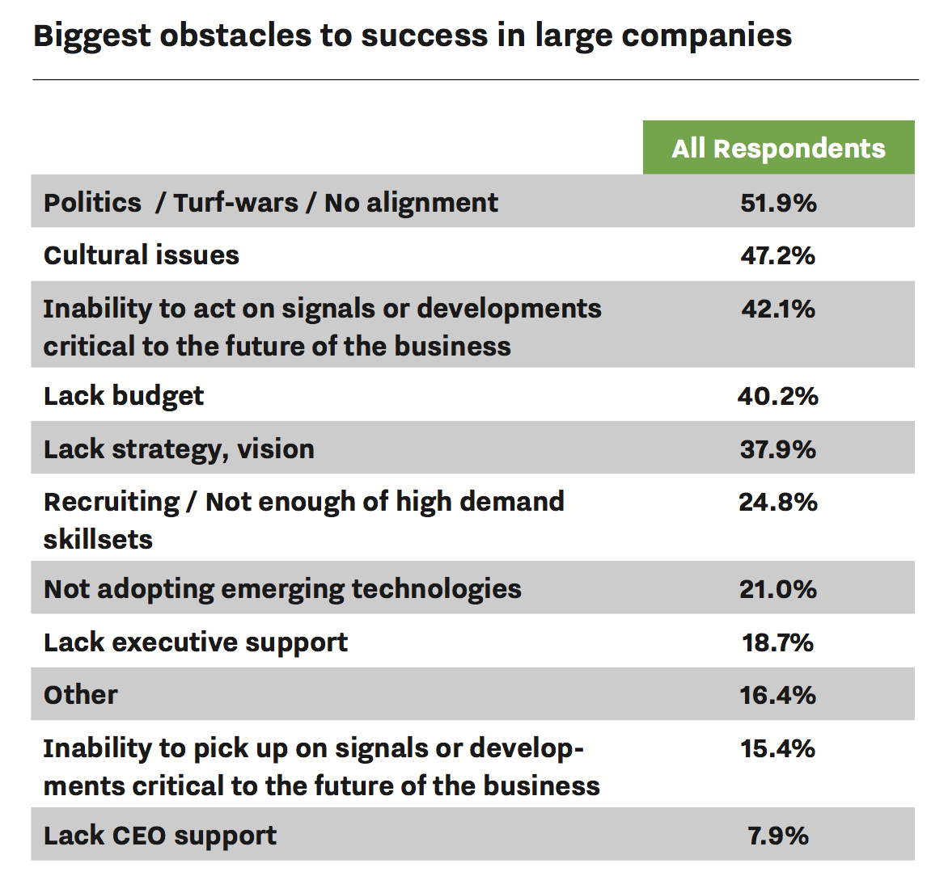
> What are biggest obstacles to innovation success?
*Source: Innovation Leader survey of 215 professionals in large organizations, 2019.
https://innovationleader.com/benchmarking2020

Slide 5
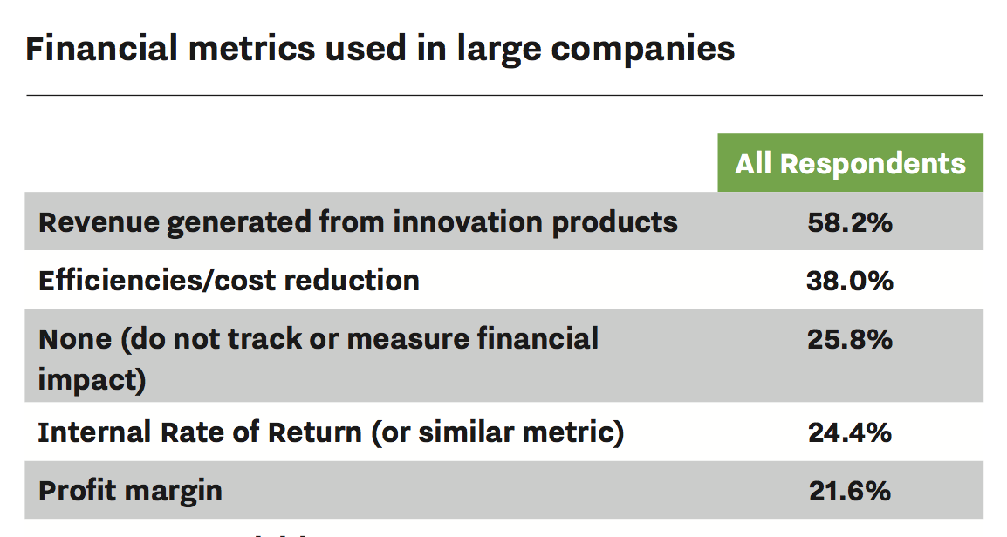
> Top 5 financial metrics used to gauge innovation impact
*Source: Innovation Leader survey of 215 professionals in large organizations, 2019.
https://innovationleader.com/benchmarking2020

Slide 6
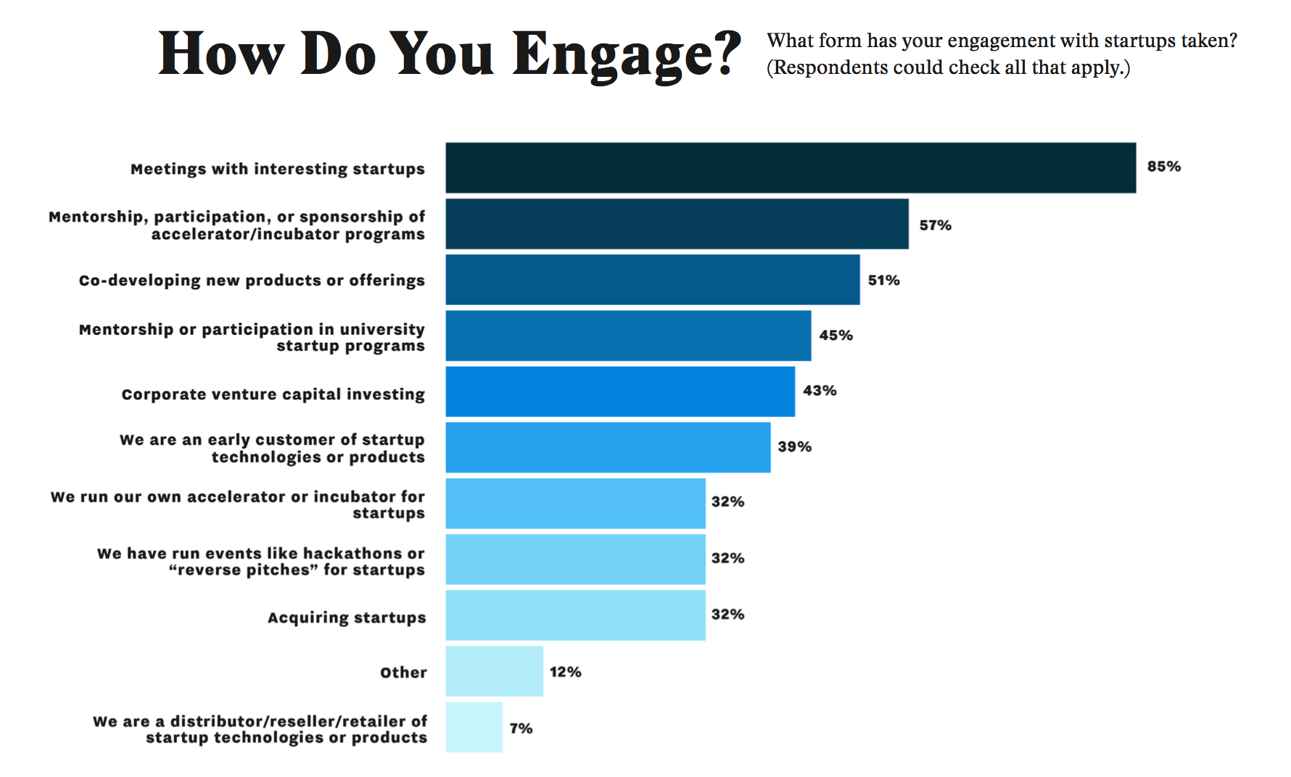
> Large companies and startup engagement
*Source: Innovation Leader survey of 115 professionals in large organizations, 2019.
http://innovationleader.com/startup-engagement

Slide 7
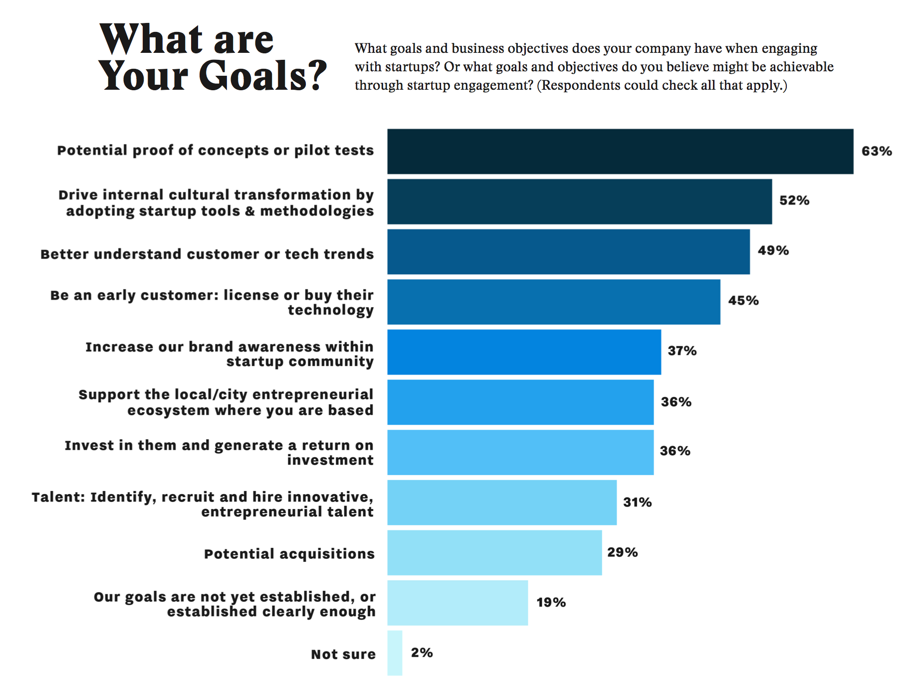
> Large companies: Goals of startup engagement
*Source: Innovation Leader survey of 115 professionals in large organizations, 2019.
http://innovationleader.com/startup-engagement

Slide 8
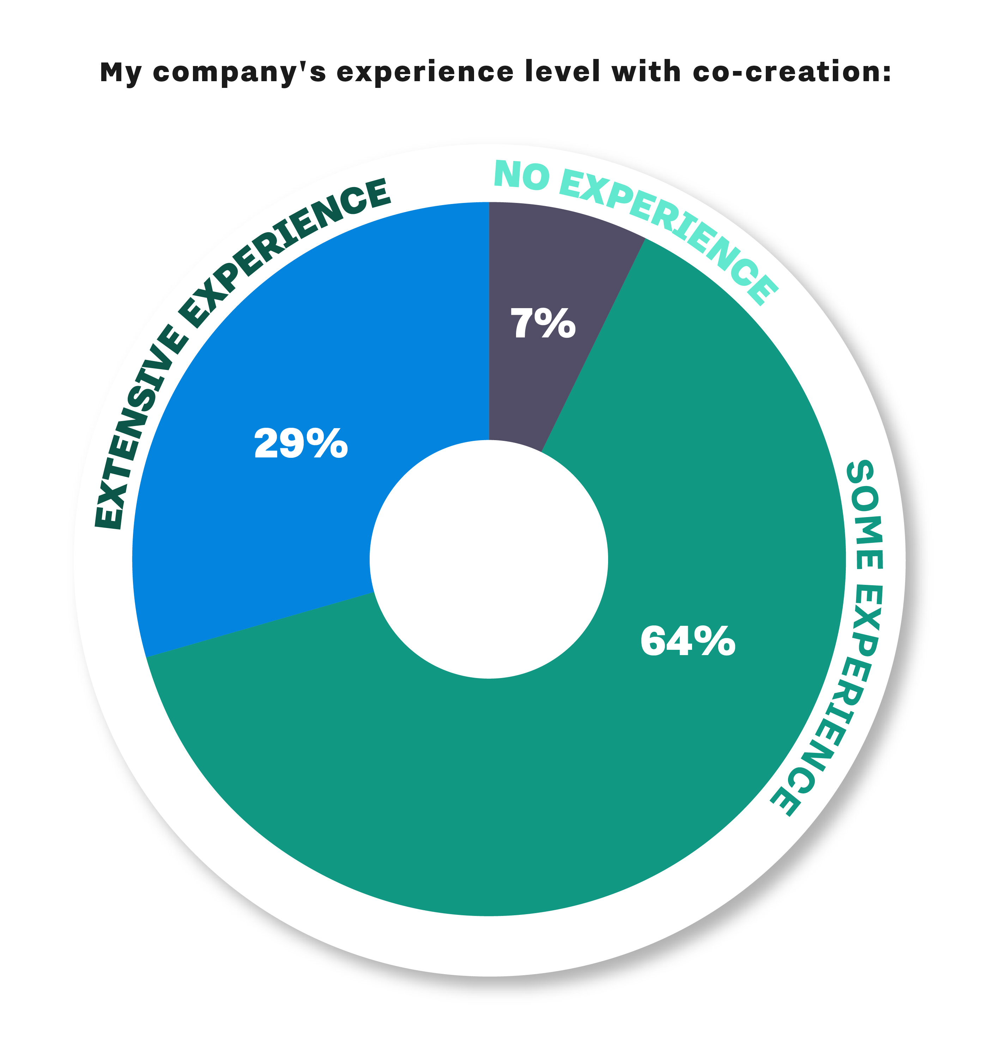
> Experience with co-creation activity
*Source: Innovation Leader survey of 257 professionals in large organizations, 2019.
http://innovationleader.com/co-creation-ecosystem-report

Slide 9
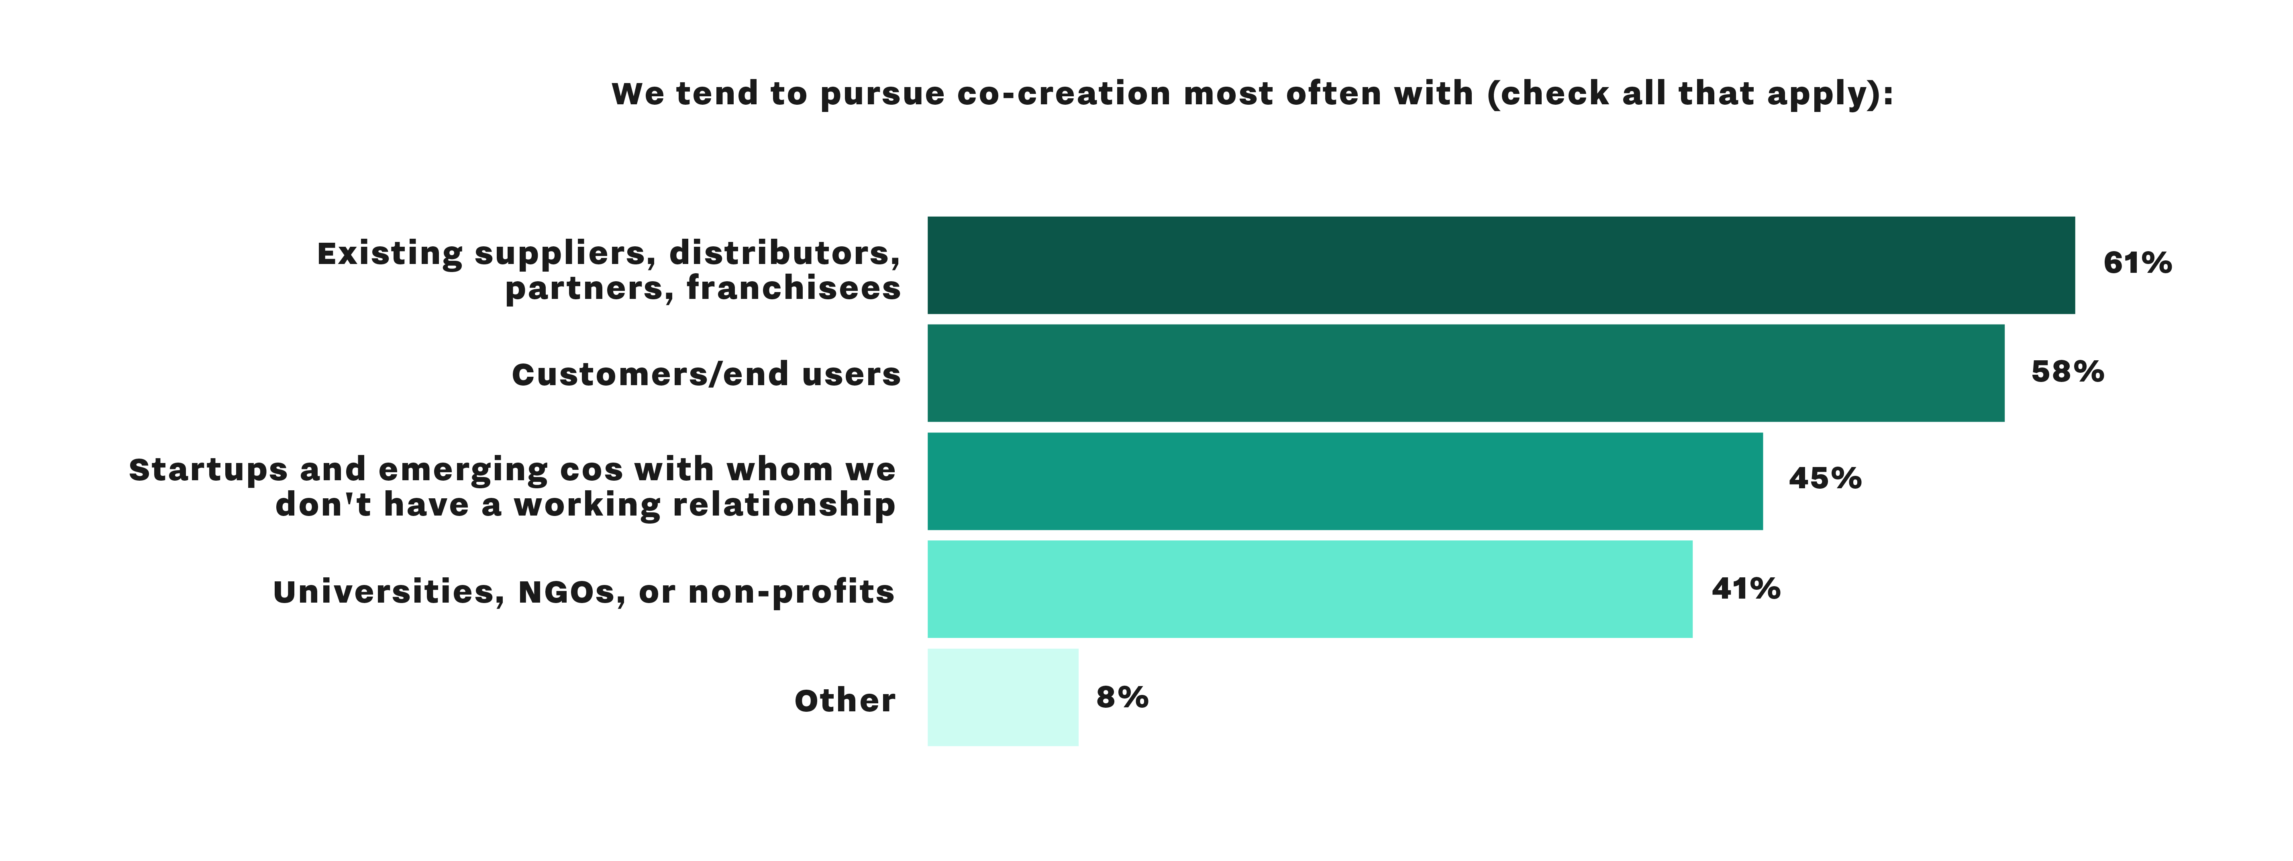
> Common partners for co-creation activity
*Source: Innovation Leader survey of 257 professionals in large organizations, 2019.
http://innovationleader.com/co-creation-ecosystem-report

Slide 10
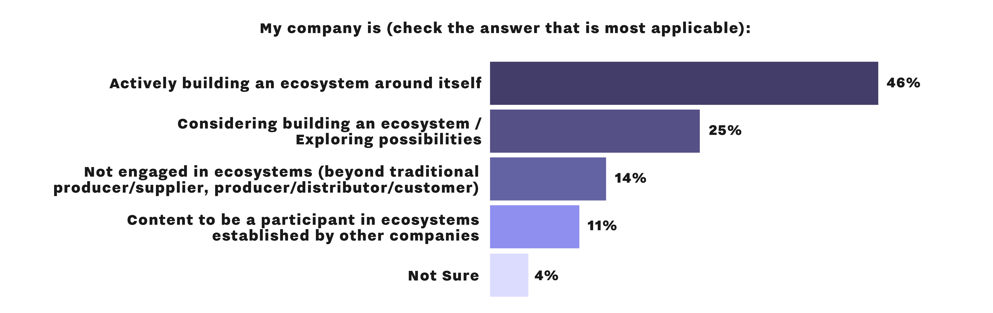
> Ecosystem building — status
*Source: Innovation Leader survey of 257 professionals in large organizations, 2019.
http://innovationleader.com/co-creation-ecosystem-report

Slide 11
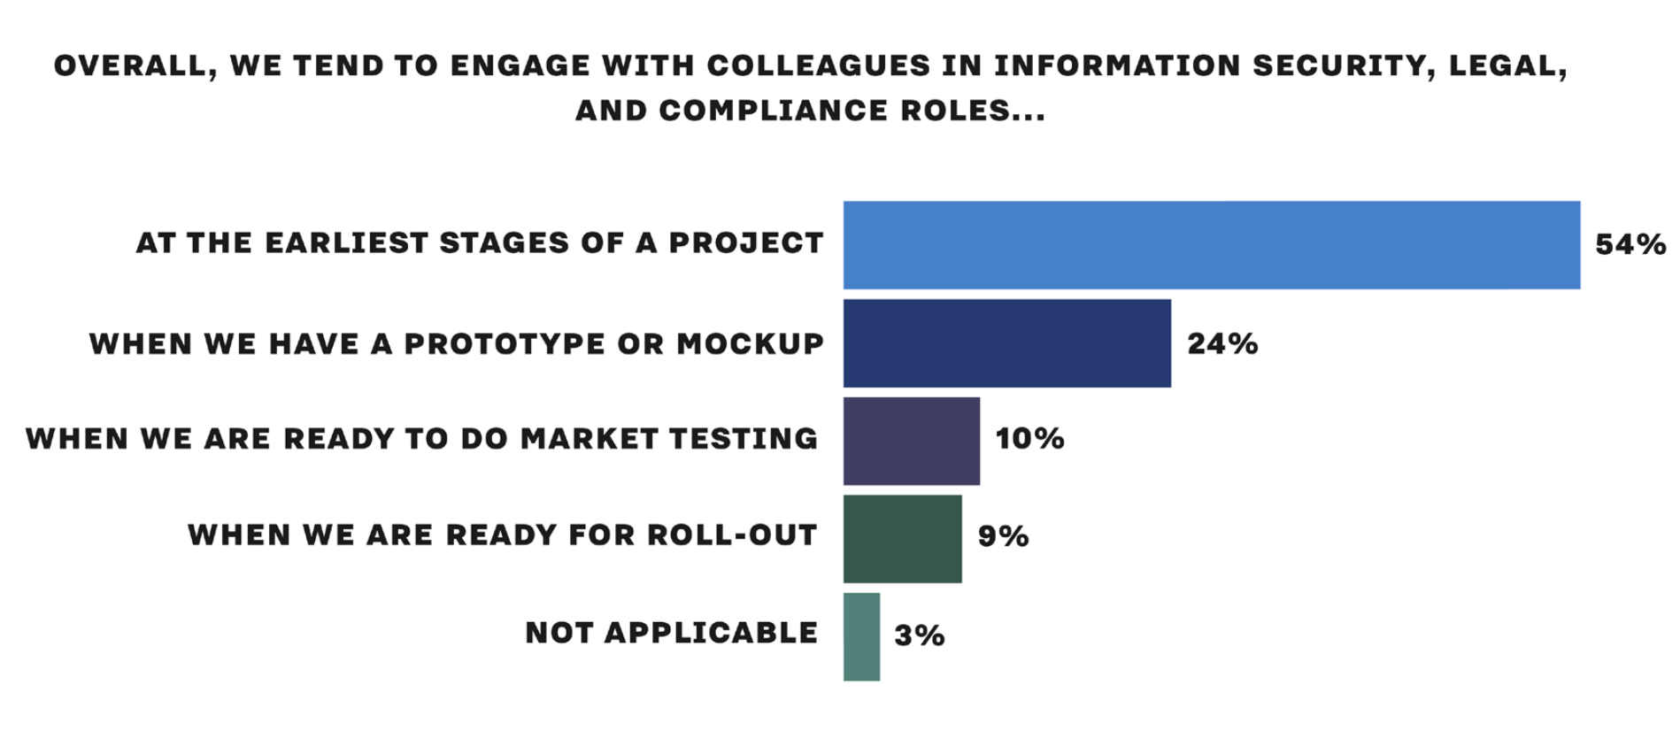
> Engagement between innovation groups and colleagues in security, legal, and compliance roles
*Source: Innovation Leader survey of 150 professionals in large organizations, 2019.
http://innovationleader.com/risk

Slide 12
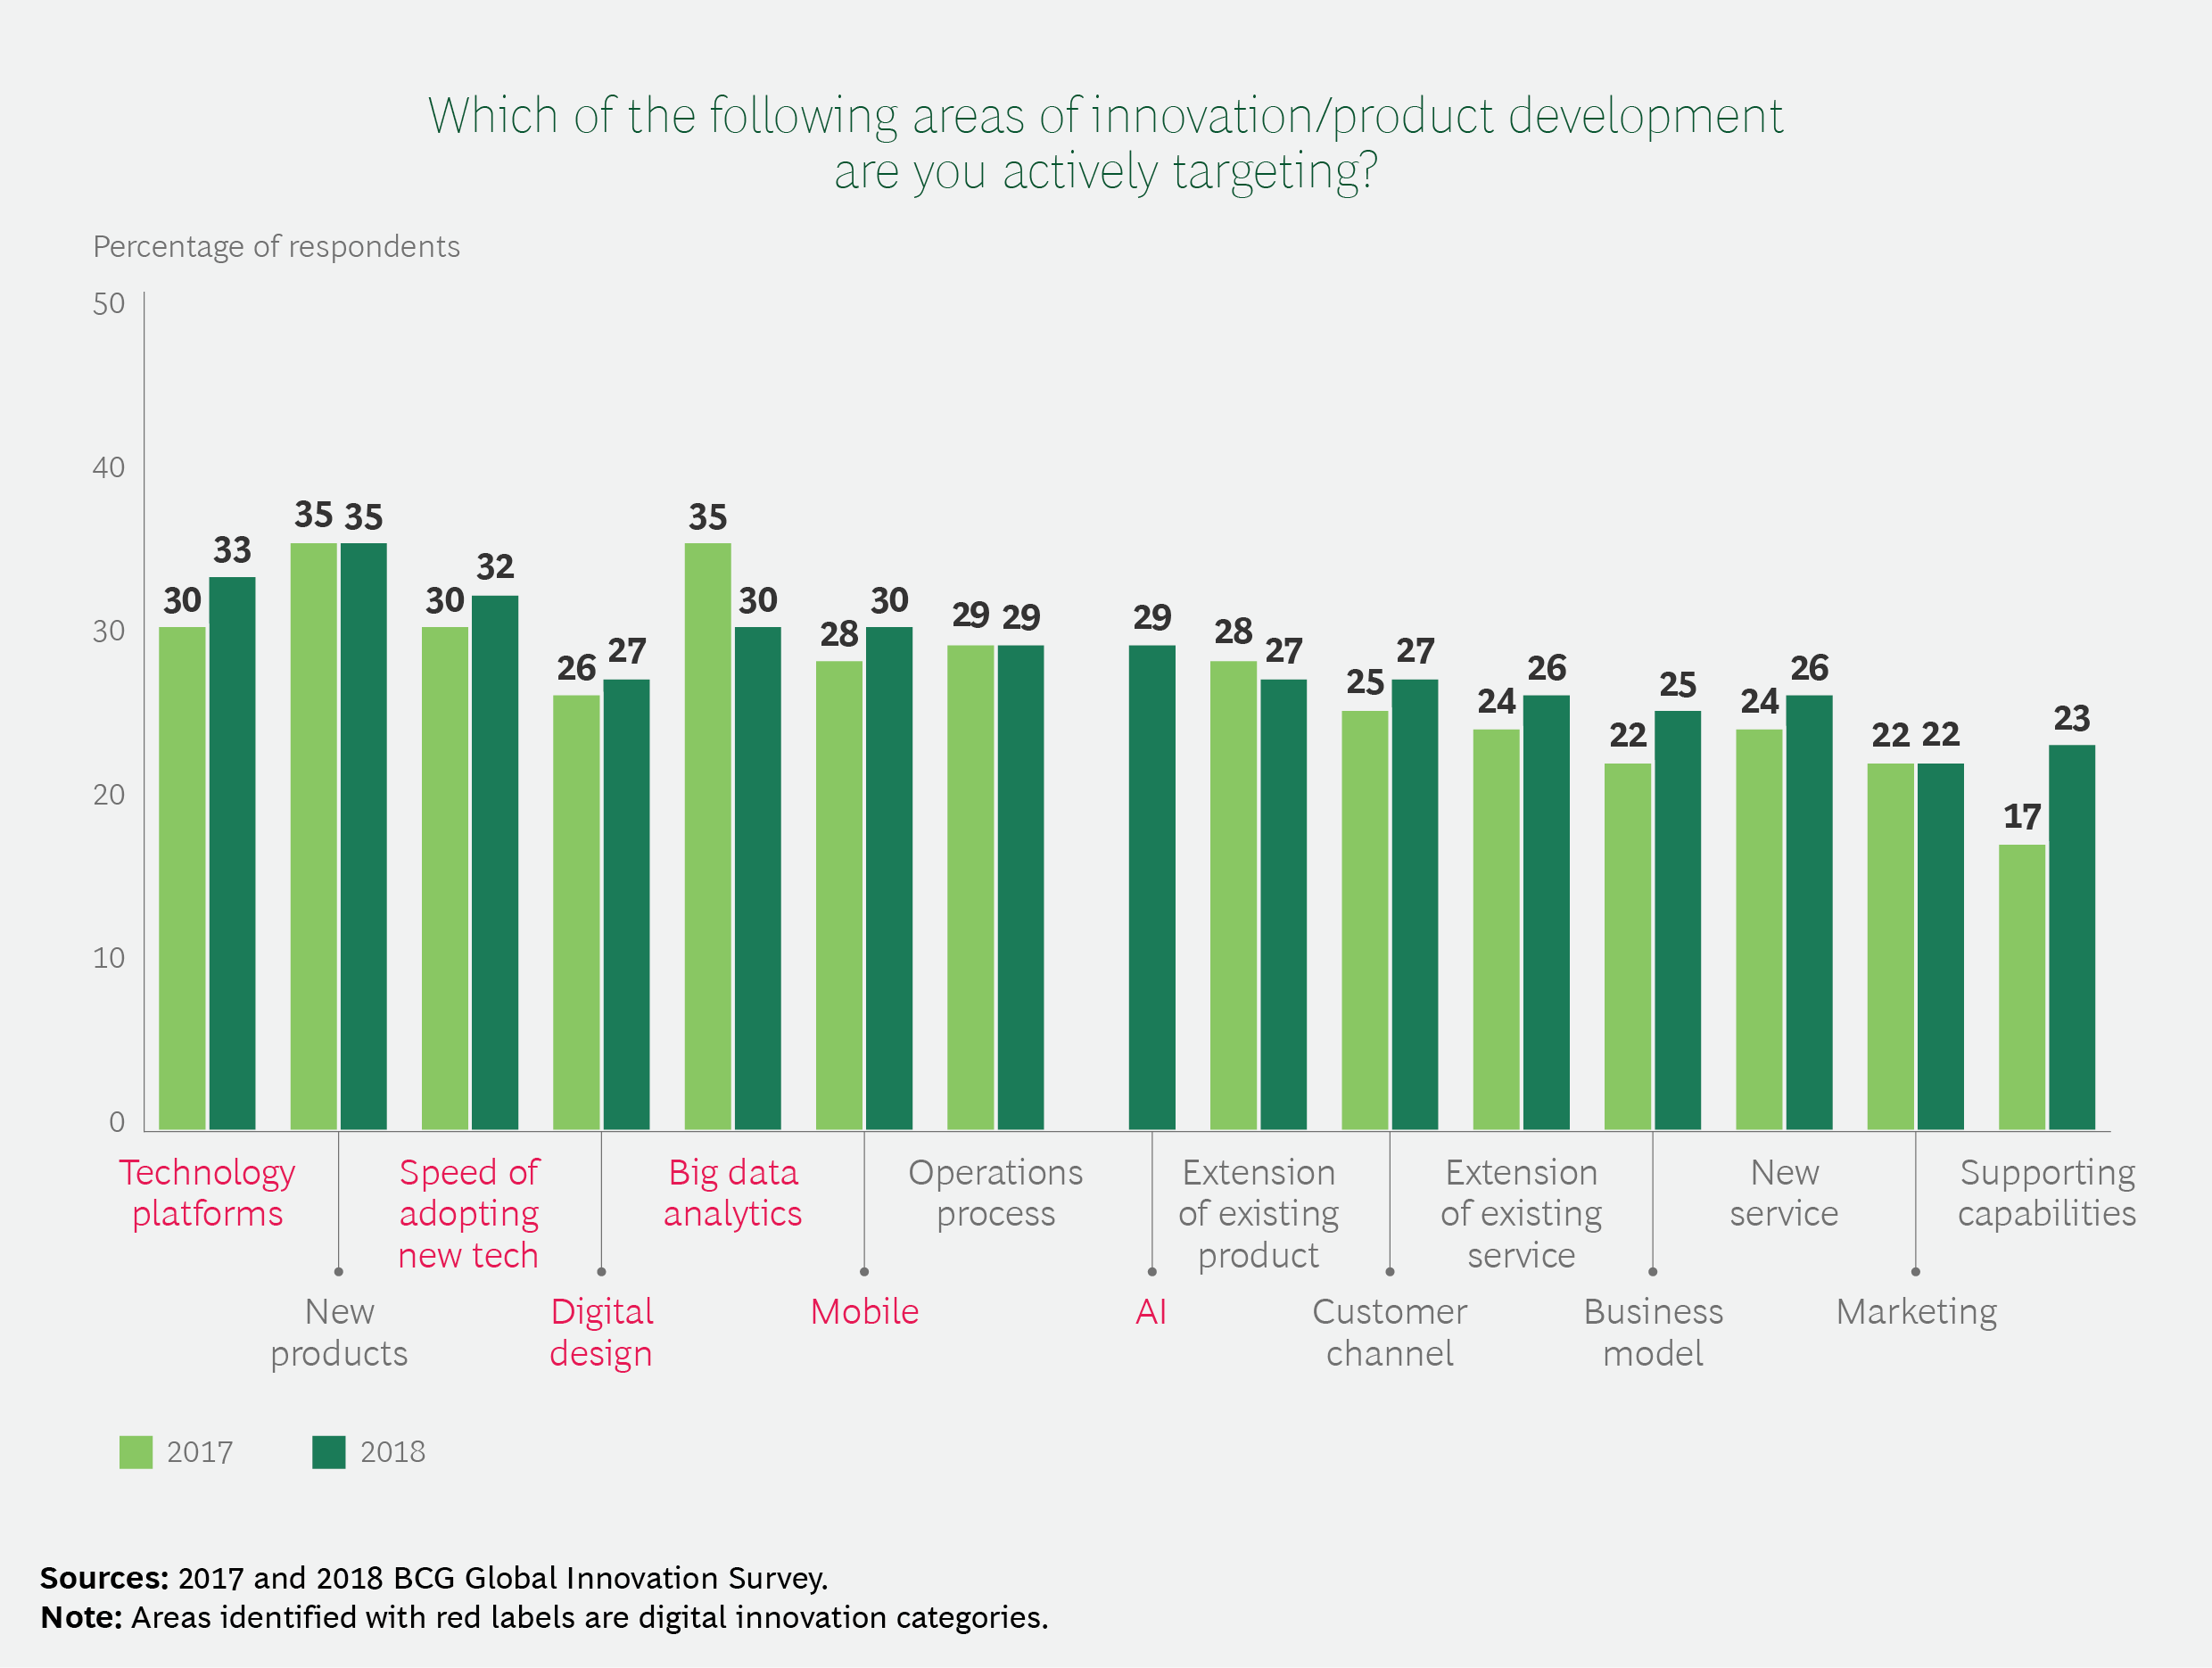
> BCG: What areas of innovation are you targeting?
*Source: Boston Consulting Group
https://www.bcg.com/en-us/publications/2019/most-innovative-companies-innovation.aspx

Slide 13
> BCG’s Most Innovative Companies 2019
1. Alphabet/Google
2. Amazon
3. Apple
4. Microsoft
5. Samsung
6. Netflix
7. IBM
8. Facebook
9. Tesla
10. Adidas
*Source: Boston Consulting Group
https://www.bcg.com/en-us/publications/2019/most-innovative-companies-innovation.aspx

Slide 14
> Fast Company’s Most Innovative Companies 2019
1. Meituan Dianping
2. Grab
2. NBA
4. Disney
5. Stitch Fix
6. Sweetgreen
7. Apeel Sciences
8. Square
9. Oatly
10. Twitch
*Source: Fast Company
https://www.fastcompany.com/most-innovative-companies/2019

Slide 15
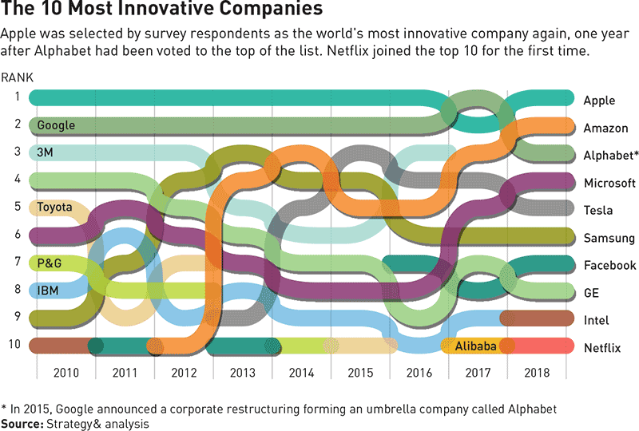
> Strategy&: Most Innovative Companies 2010-2018
*Source: Strategy&, part of the PwC Network
https://www.strategy-business.com/feature/What-the-Top-Innovators-Get-Right?gko=e7cf9

Slide 16
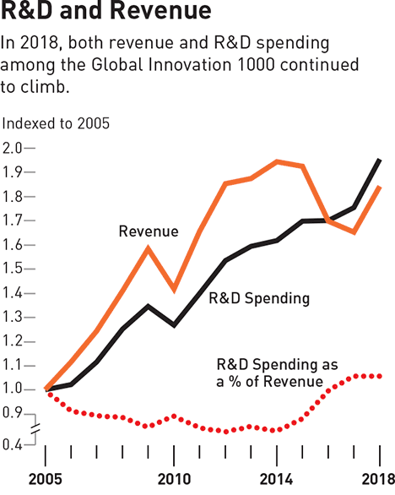
> Strategy&: R&D spending and revenue
*Source: Capital IQ data, Thomson Reuters Eikon data, Strategy& analysis
https://www.strategy-business.com/feature/What-the-Top-Innovators-Get-Right?gko=e7cf9

Slide 17
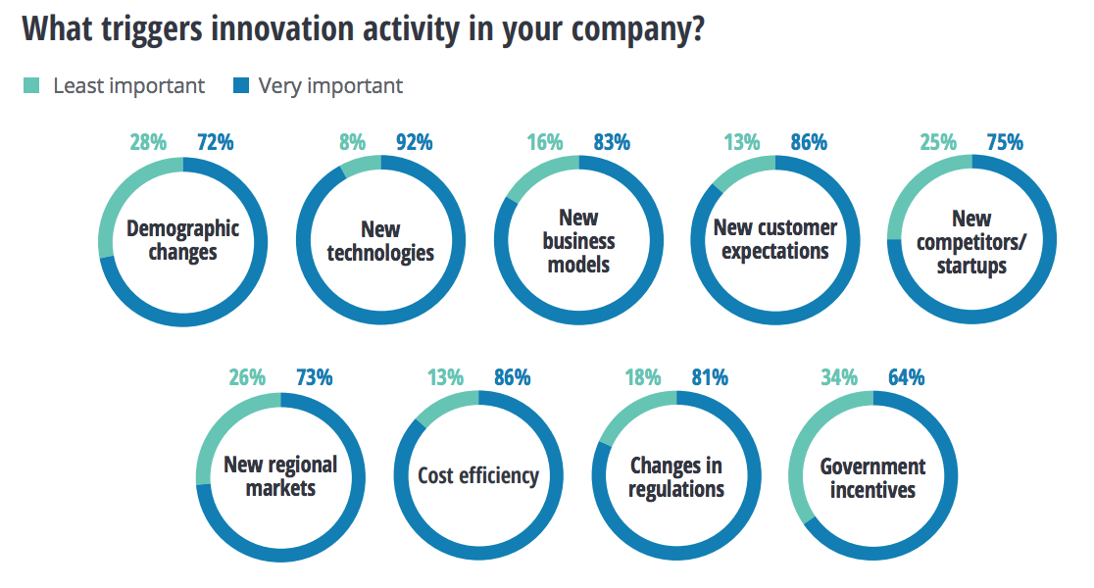
> Deloitte: Triggers for innovation activity
*Source: Deloitte “Innovation in Europe” report (survey of 760 companies)
https://www2.deloitte.com/us/en/insights/topics/innovation/innovation-in-europe-digital-technology-strategies.html

Slide 18
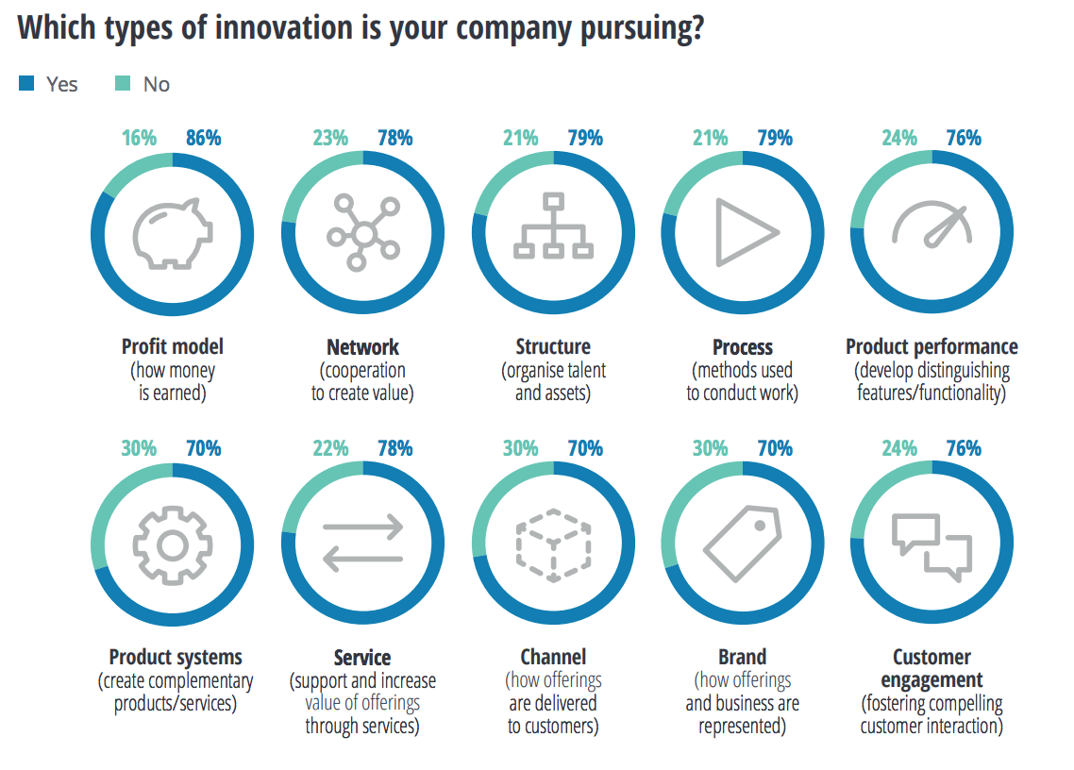
> Deloitte: Types of innovation
*Source: Deloitte “Innovation in Europe” report (survey of 760 companies)
https://www2.deloitte.com/us/en/insights/topics/innovation/innovation-in-europe-digital-technology-strategies.html

Slide 19
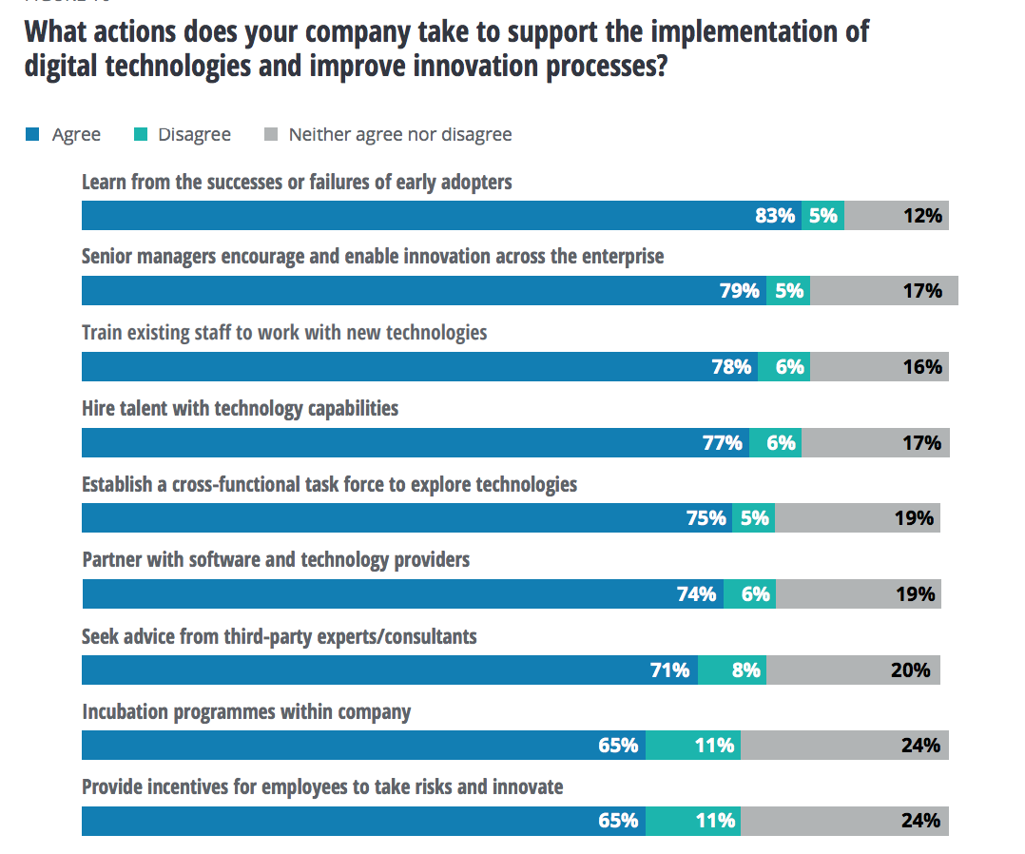
> Deloitte: How do you improve innovation processes?
*Source: Deloitte “Innovation in Europe” report (survey of 760 companies)
https://www2.deloitte.com/us/en/insights/topics/innovation/innovation-in-europe-digital-technology-strategies.html

Slide 20
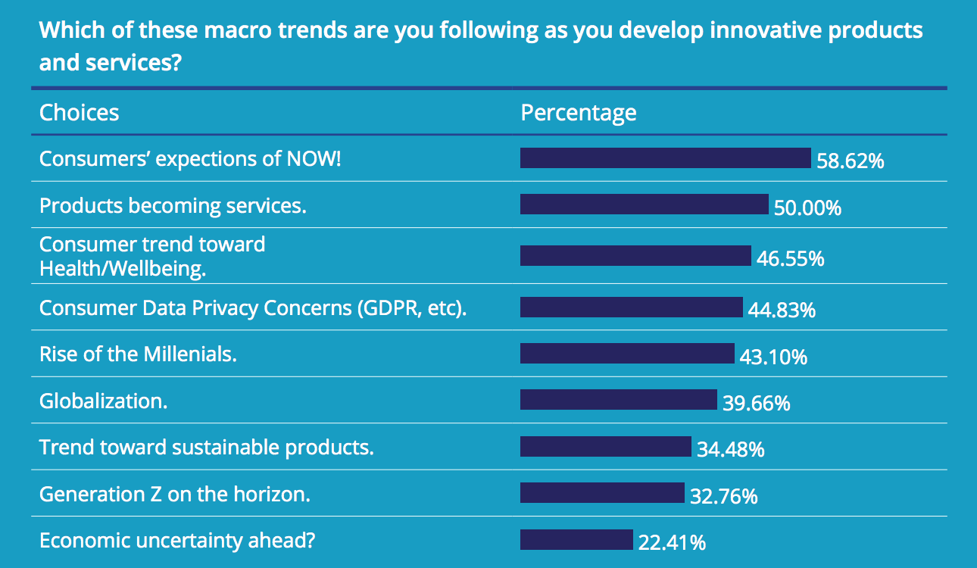
> Innovation Trends Report: Macro trends
*Source: Innovation Trends Report 2019 by Bret Waters (interviews with 100 corp. innovation executives) https://bretwaters.com/2019paper/

Slide 21
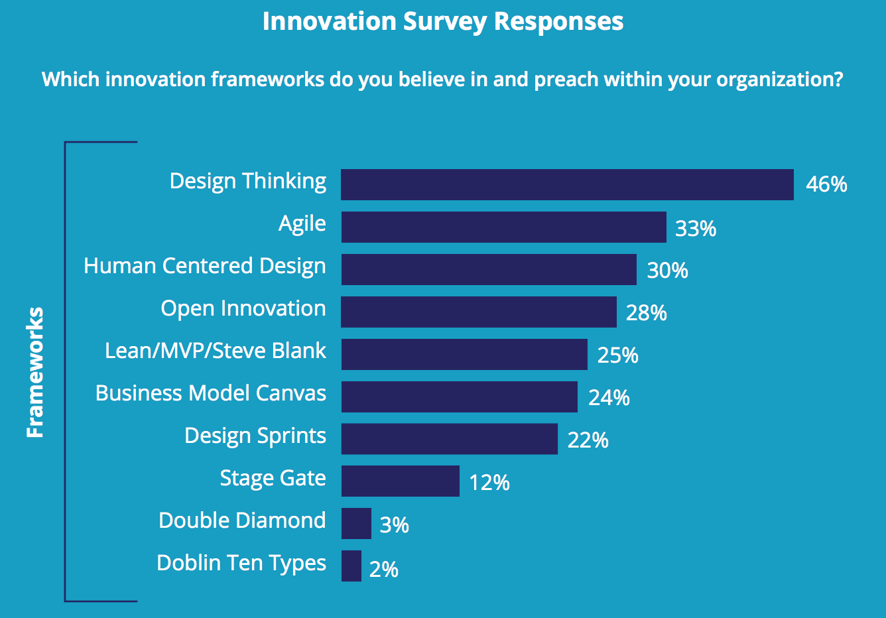
> Innovation Trends Report: Innovation frameworks
*Source: Innovation Trends Report 2019 by Bret Waters (interviews with 100 corp. innovation executives) https://bretwaters.com/2019paper/

Slide 22
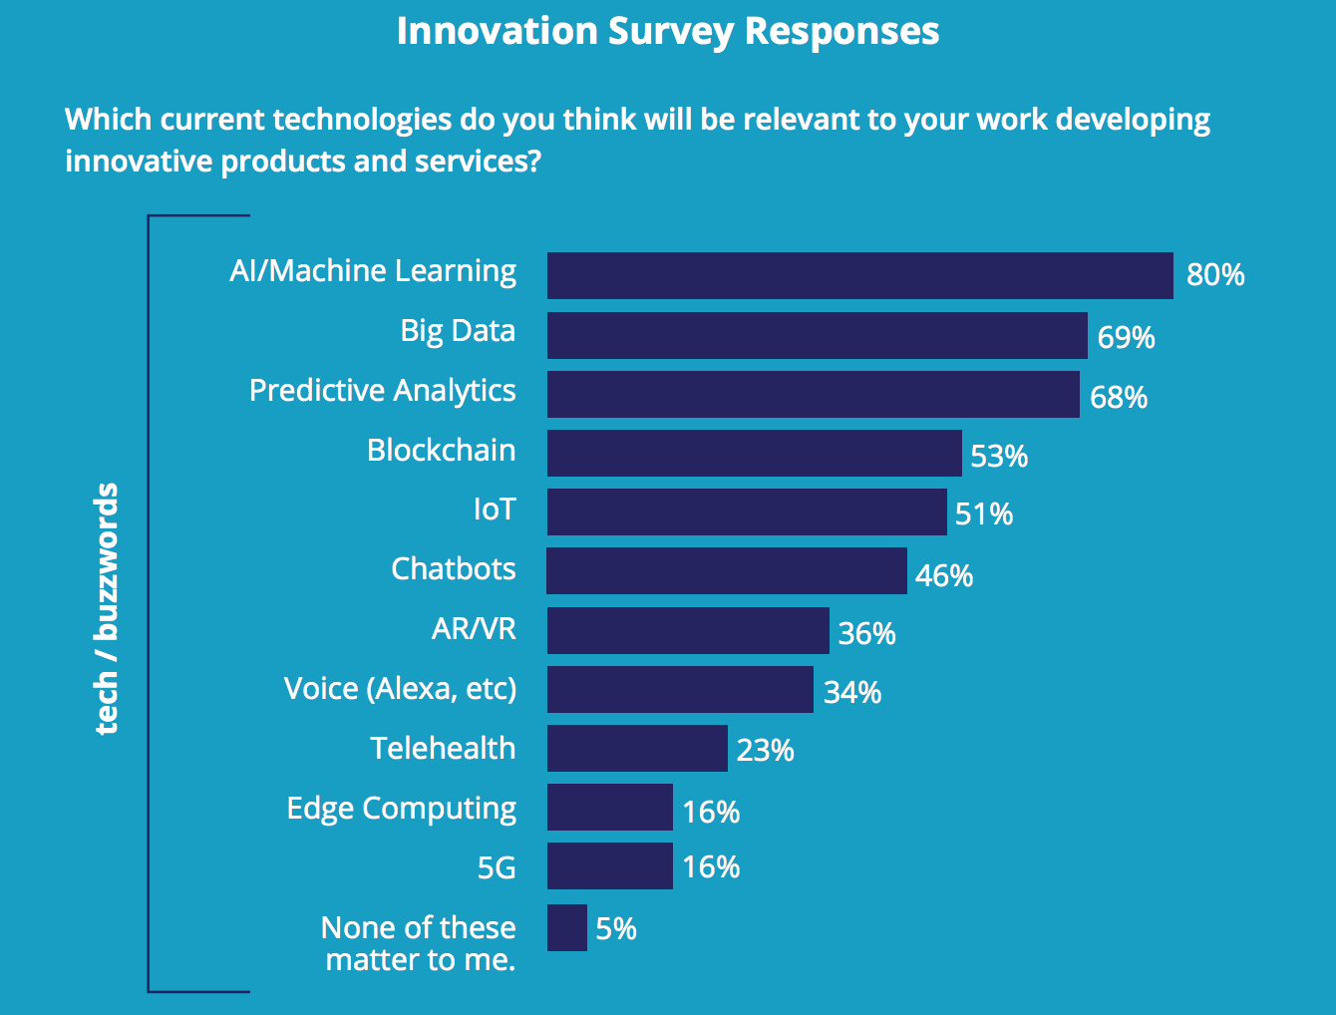
> Innovation Trends Report: Relevant technologies
*Source: Innovation Trends Report 2019 by Bret Waters (interviews with 100 corp. innovation executives) https://bretwaters.com/2019paper/

Slide 23
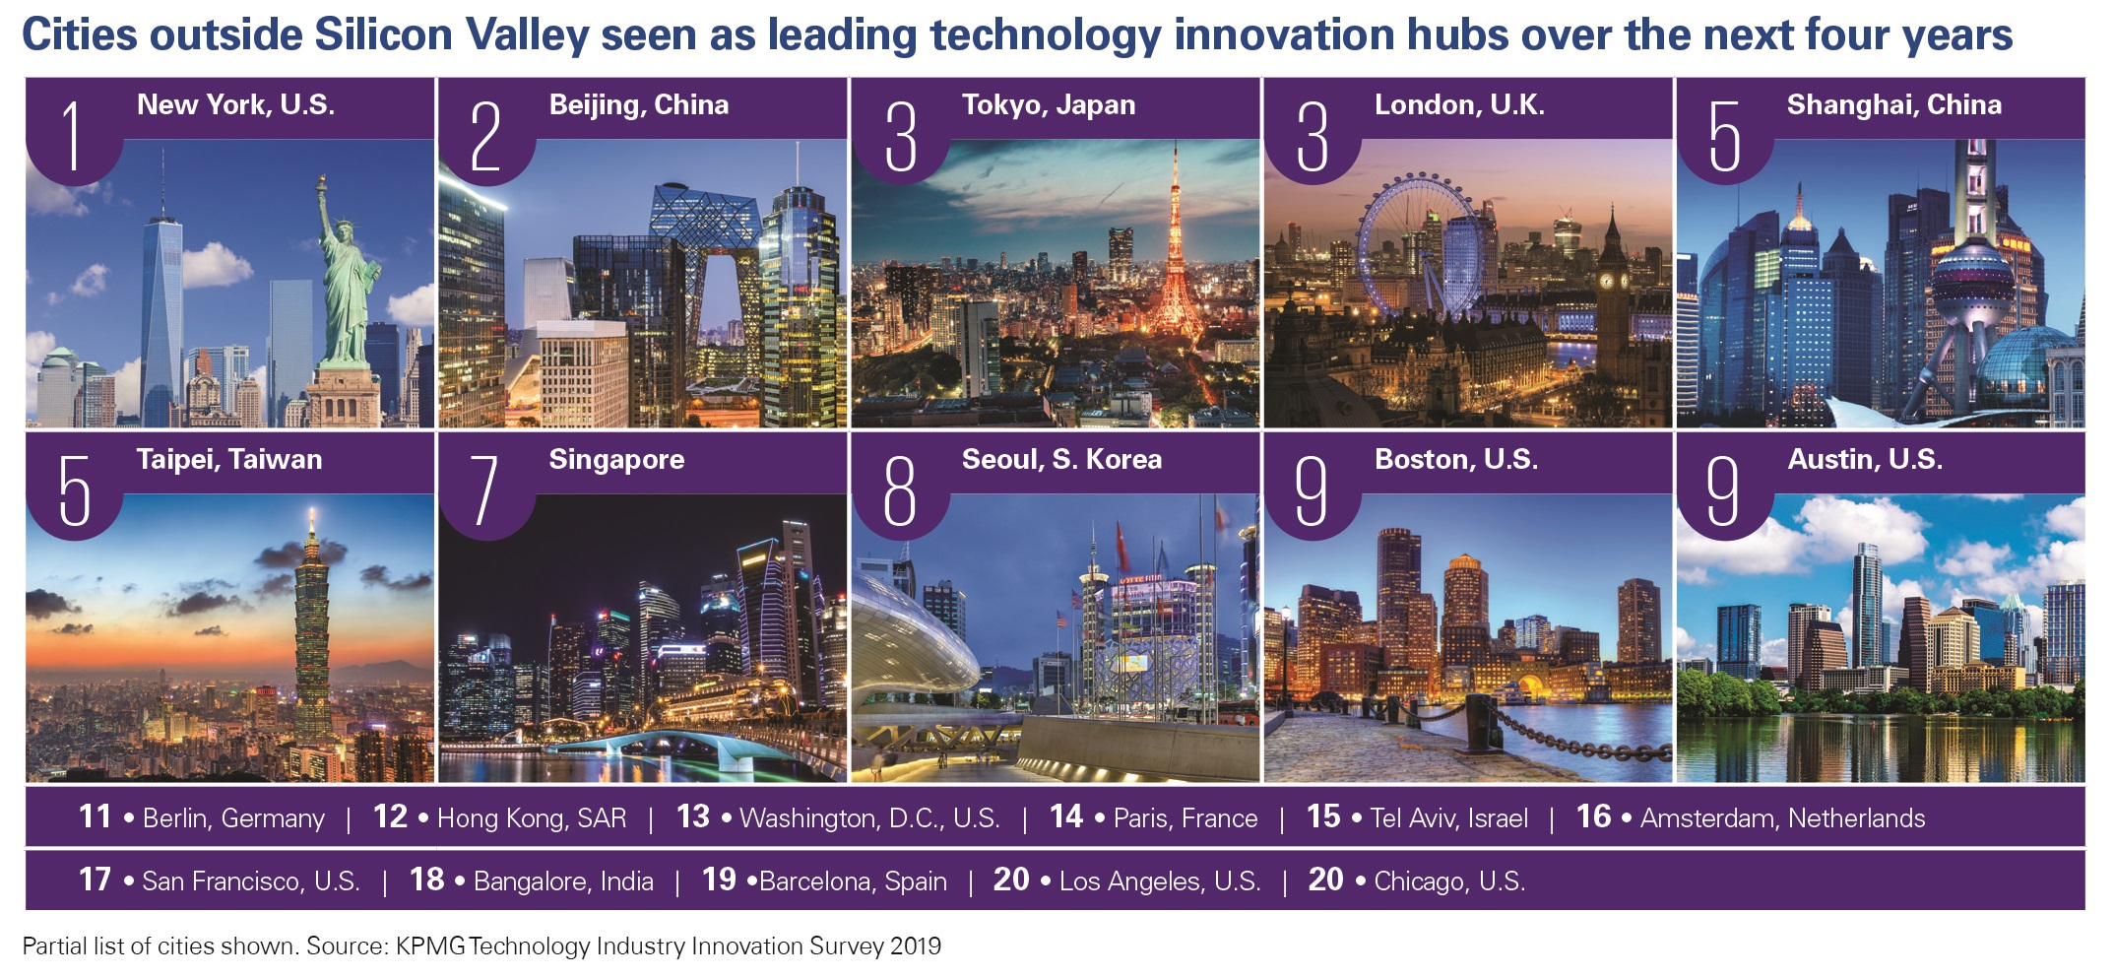
> KPMG: Tech hubs outside of Silicon Valley
*Source: KPMG survey of 740 global tech industry leaders
https://info.kpmg.us/techinnovation/tech-hubs.html

Slide 24
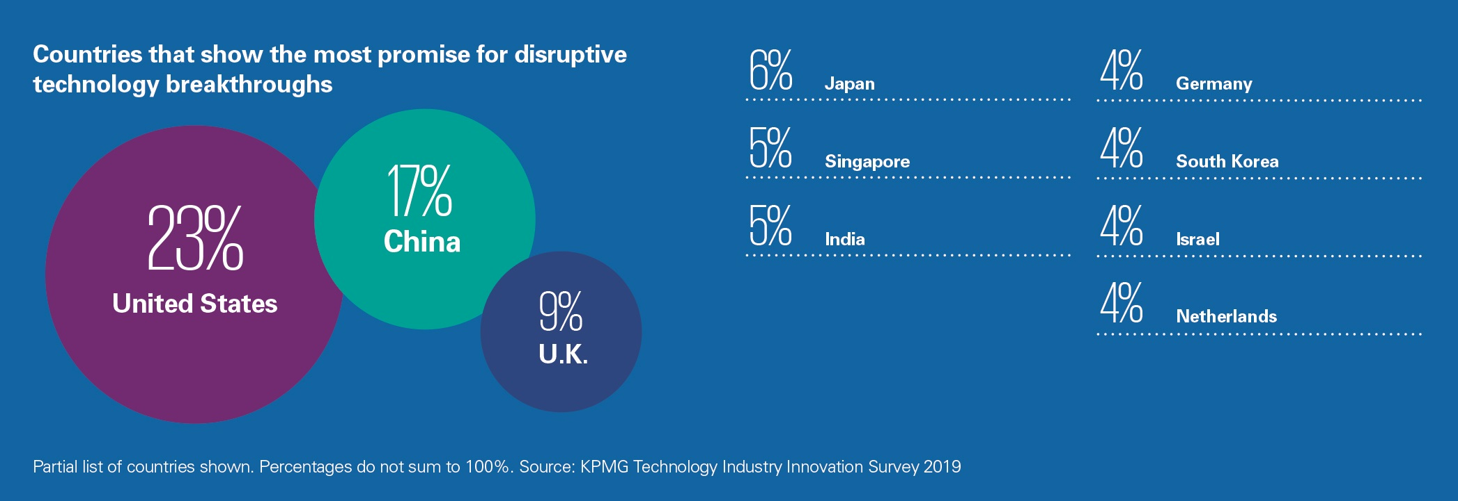
> KPMG: Countries that show the most promise
*Source: KPMG survey of 740 global tech industry leaders
https://info.kpmg.us/techinnovation/tech-hubs.html

Slide 25
> CB Insights: Corporate Innovation Products That Changed the World
1. Waymo (Google X)
2. Amazon Alexa (Amazon Lab126)
3. Watson (IBM Research)
4. The Kindle (Amazon Lab126)
5. The Ethernet (Xerox PARC)
6. Unix (AT&T Bell Labs)
7. C programming language (AT&T Bell Labs)
8. The Charge-Coupled Device (AT&T Bell Labs)
9. The Smartphone (IBM Research)
10. The Graphical User Interface (Xerox PARC)
11. The Computer Mouse (Xerox PARC)
12. The Laser Printer (Xerox PARC)
13. The Photovoltaic Cell (AT&T Bell Labs)
14. The Transistor (AT&T Bell Labs)
*Source: CB Insights
https://www.cbinsights.com/research/corporate-innovation-labs-best-products/

Slide 26
> Global Finance: Best Financial Innovation Labs 2019
Lab | City
Accelerator Frankfurt | Frankfurt
Alior Bank RBL | Warsaw
Barclays Accelerator | London, Tel Aviv, New York
Beta-i | Lisbon
BNY Mellon Global Innovation Centers | London, Chennai, Pune, Singapore, Silicon Valley, Pittsburgh, Pennington, Jersey City, Oriskaney
boostLAB Powered by BTG Pactual | Sao Paulo
Capital One Labs | Washington, DC, New York
Citi Innovation Labs | Dublin, Tel Aviv, Singapore, Mexico City, London, San Francisco
Cyberport | Hong Kong
DBS Asia X (DAX) | Singapore
Deutsche Bank Innovation Labs | Silicon Valley, Berlin, New York, London, Singapore
DIFC Fintech Hive | Dubai
Fidelity Labs/FCAT | New York
FinLab AG | Frankfurt
Fintech Innovation Lab | New York, London, Hong Kong
FIS Global – FIS Financial Inclusion Lab | Bengaluru
LUISS Enlabs | Rome, Milan
OTP Bank Innovation Lab | Budapest
PayPal Innovation Lab | Singapore, San Jose, Scottsdale, Chennai
Santander InnoVentures | London
Startupbootcamp — FinTech | Amsterdam, Cairo, Cape Town, Chengdu, Dubai, Hartford, London, Melbourne, Mexico City, NYC
Synechron — FinLabs | Amsterdam, New York, Charlotte, Fort Lauderdale, London, Dubai, Hyderabad, Bengaluru, Pune, Serbia, Singapore, Paris
TechQuartier | Frankfurt
Wells Fargo Startup Accelerator | New York
YES Fintech | Mumbai
*Source: Global Finance
https://www.gfmag.com/magazine/june-2019/innovators-2019-innovation-centers

Slide 27
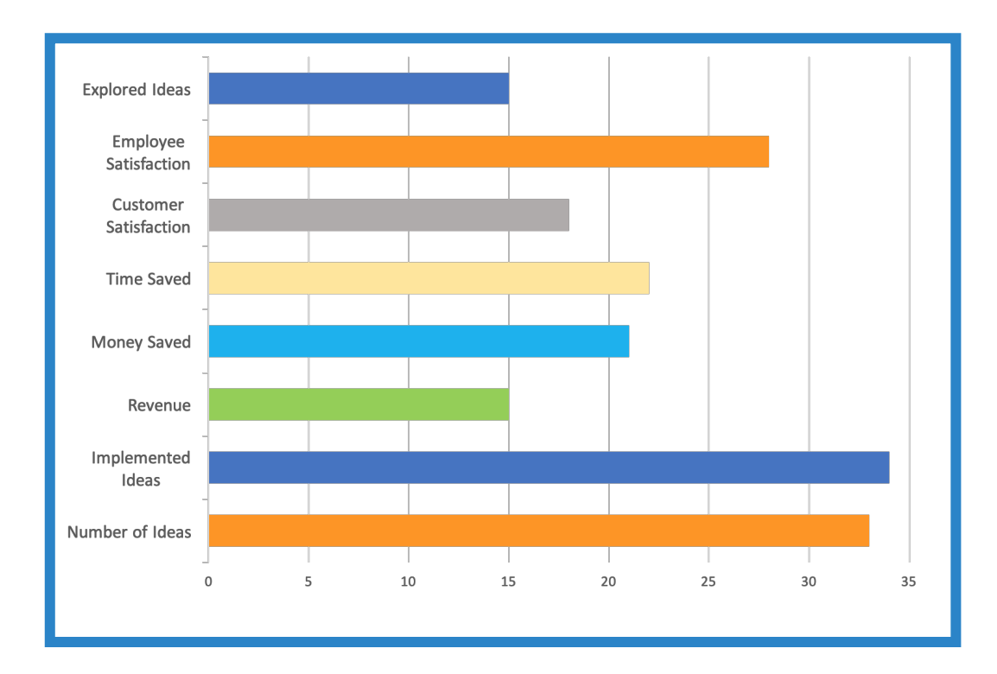
> IdeaScale: How companies measure the success of crowdsourcing initiatives
*Source: IdeaScale “2019 State of Crowdsourced Innovation” report
https://ideascale.com/resource/2019-state-of-crowdsourced-innovation-report/

Slide 28
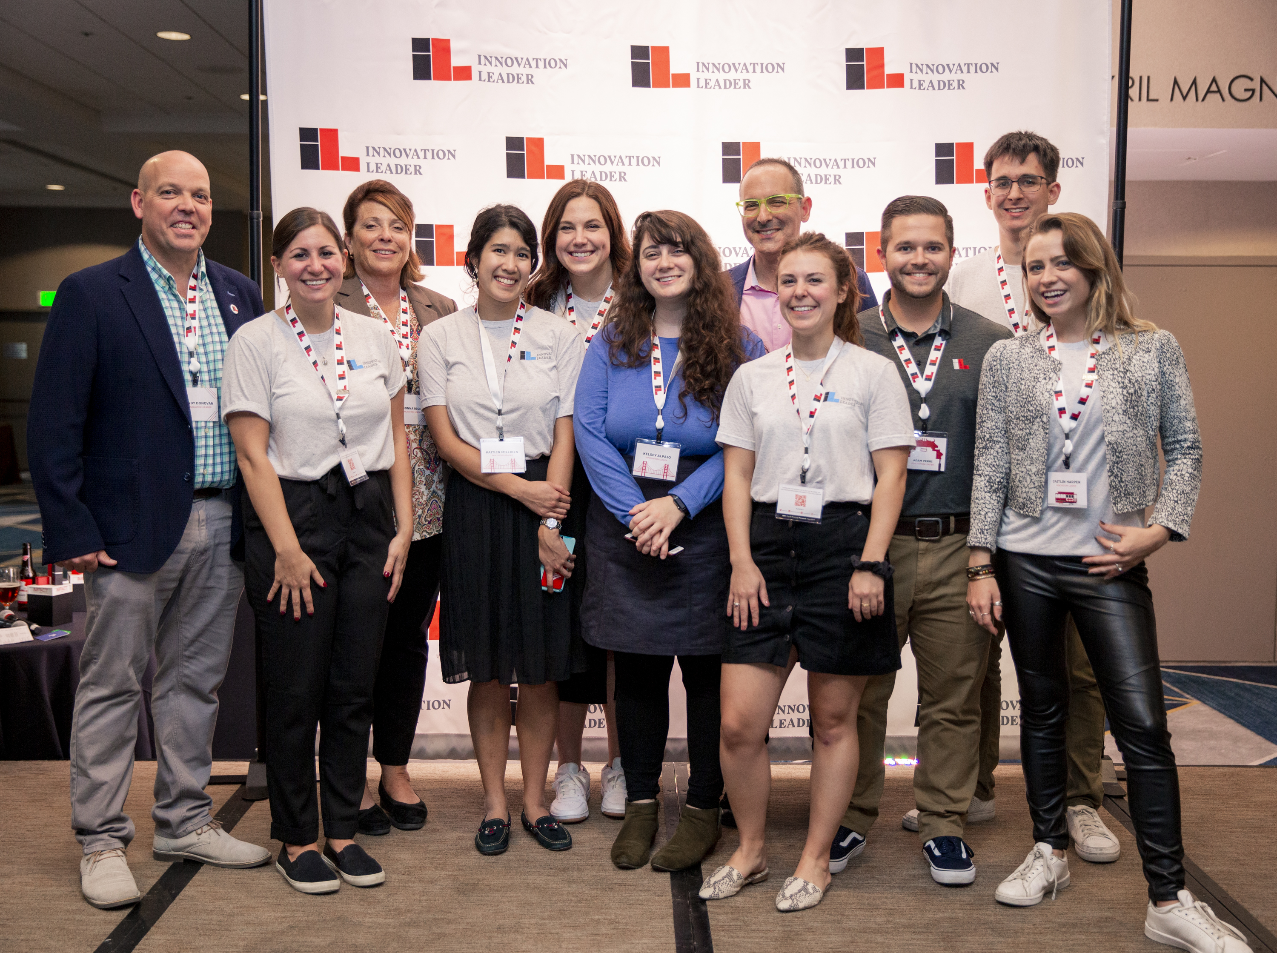
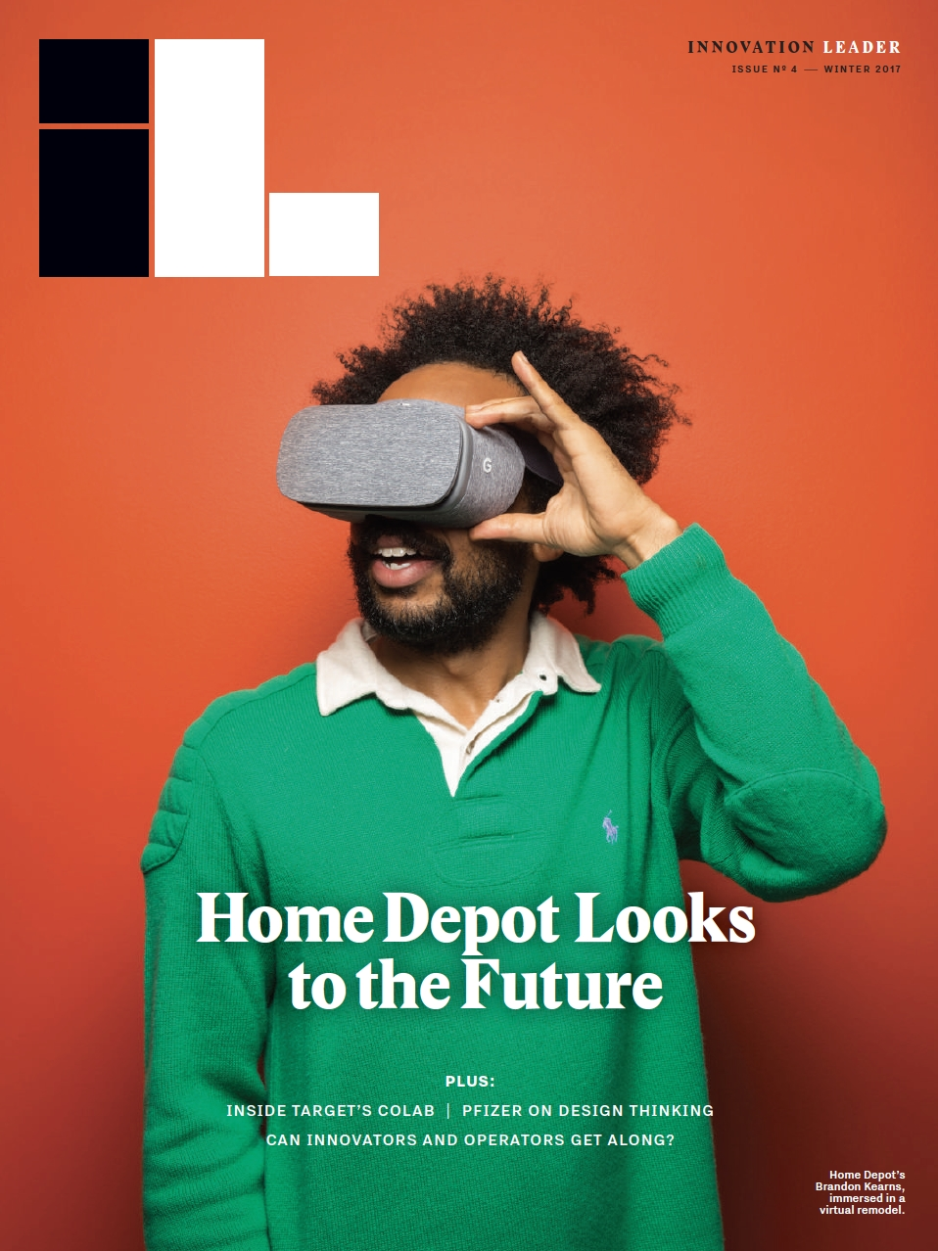
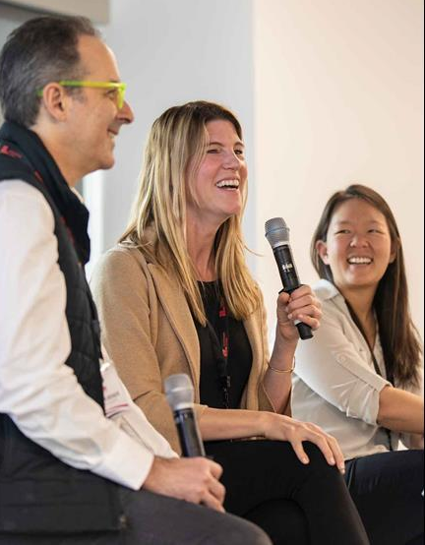

> We’d love to stay connected!
innovationleader.com/email (newsletter)
linkedin.com/company/innovation-leader
@innolead (on Twitter or Instagram)
info@innovationleader.com
*Note: If you cite any of the data from this presentation,
please reference the original source. Thanks!

