Slide 1


Black & Veatch’s Growth Accelerator

Slide 2
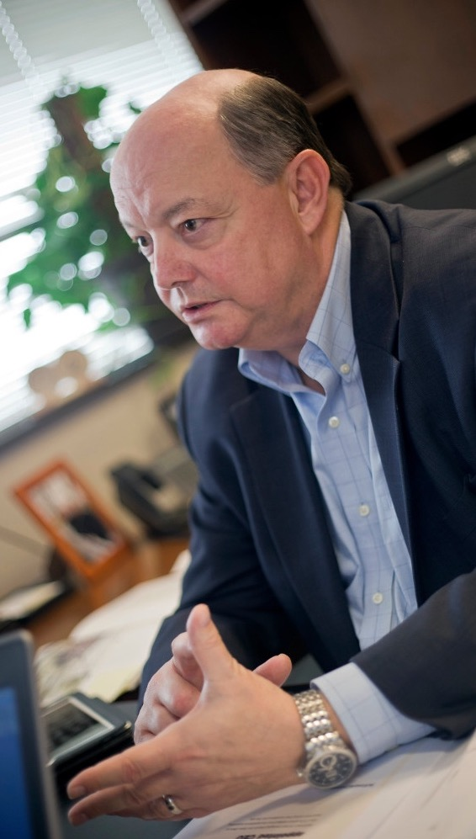

Innovation Imperative – From the Top Down
A crucial component of Black & Veatch’s future imperatives is to discover new ways to bring value and innovation to our clients and our industries.
Black & Veatch focuses our global innovation program around encouraging all professionals to never lose sight of the value of creative destruction to drive creative disruption.
Chairman and CEO Steve Edwards has challenged all professionals to play a role in helping shape our next 100 years.
“
I’d rather we were the ones being the disruptors, than wait and realize we were disrupted and our markets have gone away.
- Steve Edwards, Chairman & CEO
Black & Veatch invests in professional development programs, such as ASPiRE, to provide the foundational behaviors to be an innovation leader.

Slide 3





Timeline: From Vision to Results
Growth Council established
First crowd-sourced innovation challenge on Spark: “How Do We Grow”​
Process, governance, structure for Growth Accelerator established
Launch of Innovation programs (Ignite, Sparkbox, NextOpps, etc.). ​
Multiple initiatives advance to pilot stage and begin earning revenue
Steve Edwards becomes new Chairman and CEO of Black & Veatch
Nov 2013
2014
2015
2016
2017
2018
Initial concept for Growth Accelerator pitched ​
ASPiRE cultural change initiative launched
Growth Accelerator launched​
8 founders develop initial programming ​
First seed stage investments (drones, residential solar)

Slide 4



Growth Accelerator
Mission Statement
Background
We are driving rapid, transformational, and sustainable growth, discovering opportunities, and challenging convention.
The Growth Accelerator works both outside our core business and with our core businesses. In either case, we seek to discover new opportunities for clients and the global communities in which we work.
CEO
Growth Council
Business Units
Growth Accelerator

Slide 5
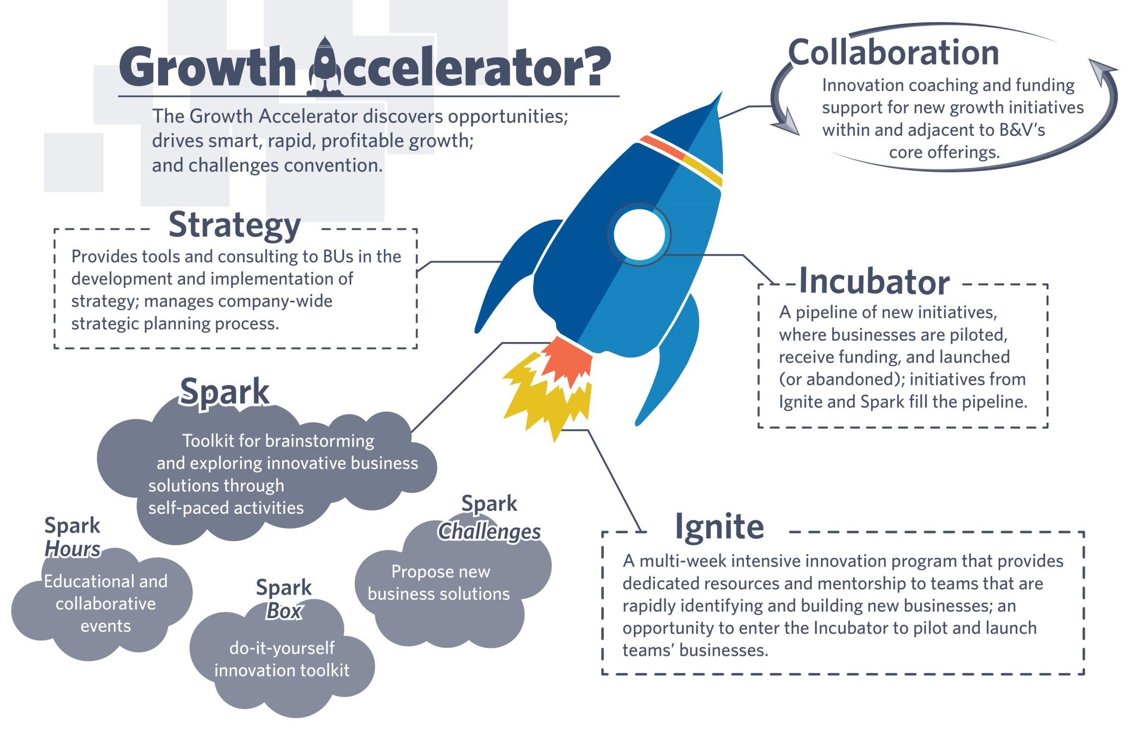
Section 5 Divider
Solid Color

Slide 6

Ignite Program Overview
The objective of Ignite is to bring new development initiatives to market faster, at lower cost, and with more validation than previous efforts
Three, 3-day innovation challenges: India, U.S. regional office, Global Headquarters
One 8-week innovation bootcamp: teams operating in collaborative, fast-paced environment
Outcomes are pitches for Pilot funding

Slide 7


Ignite Program Overview
3-Day Innovation Challenges (Multiple Locations – numbers are per location)
3-Day Innovation Challenge
30-60 Participants
20-40 Initial ideas
5-8 Teams,
5-7 people per team
5-8 Pitches
Top ideas
8-Week Innovation Bootcamp
4-6 Teams Total, 2-3 people per team
Training, mentorship, validation
4-6 Pitches

Slide 8



Current Incubator Projects
Seed
Pilot
Launch / Transition
Construction Robotics
Portable Water Treatment
Waste – Resource Recovery
Space Infrastructure
Renewable H2O
EV Infrastructure (India)
Solar for Schools
DataFuze – Remote Sensing Analytics
Solarhood – Residential Solar
NextGen Agriculture
Advanced Transportation
Suncrate – Modular Solar
NextOpps – Gig Economy App
Food/Bev Data Analytics
Mining Industry
Diode Ventures – Project Development
Data Center Industry
GA Accountable
Core / Vertical Accountable

Slide 9

Featured Projects

Slide 10
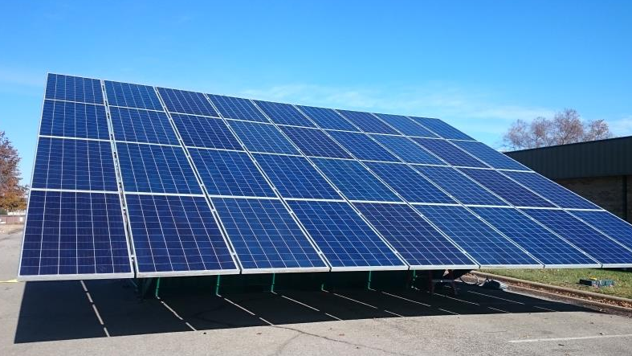
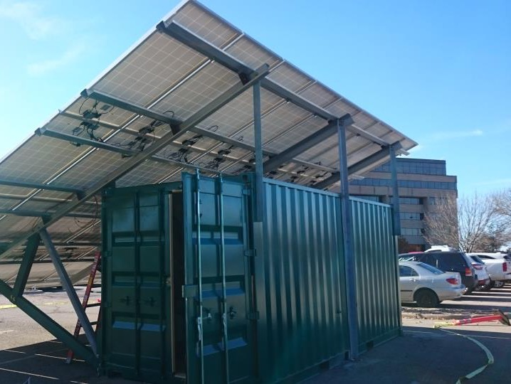

Suncrate
Modular Solar Power Systems (Innovation Partnership)
Partnership with start-up company Hog Power Energy
Features
  Easy transport, assembly
  Battery storage capability
  Affordability for rural markets, developing countries
  Disaster recovery (Puerto Rico)
Our goal for our Suncrate partnership is to be an affordable provider of a distributed solar solution and to have a short installation period of two hours or less. This support disaster recovery and remote energy needs globally.

Slide 11


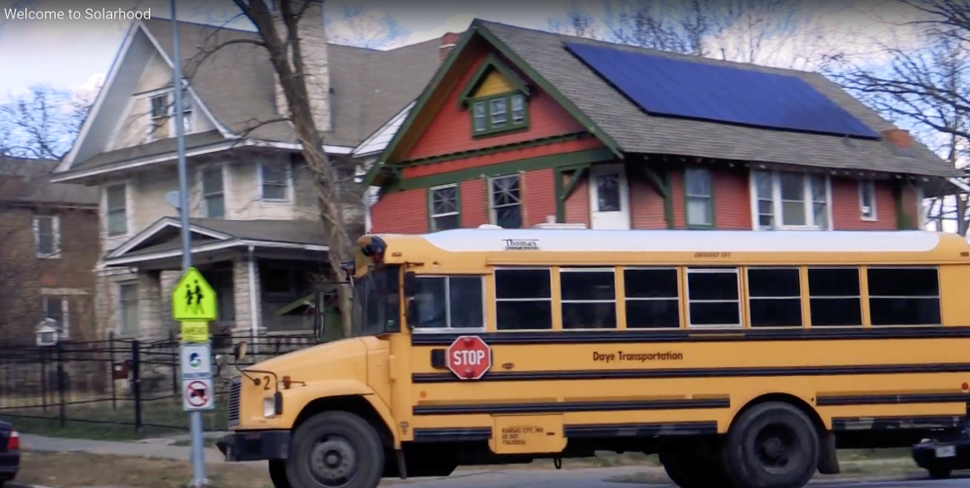
Web (Solarhood.com) and Mobile App for Solar Potential for Homes
  Our first consumer product, app
  Our first residential solar project
  Our first referral business model
Adjacent markets for core technology
  Commercial and institutional customers
  Utility white-label solution
  Services platform
Save money by going solar.
In 2016, there was one new solar panel installation every 84 seconds.
Source: Solar Power Authority 5/2017

Slide 12
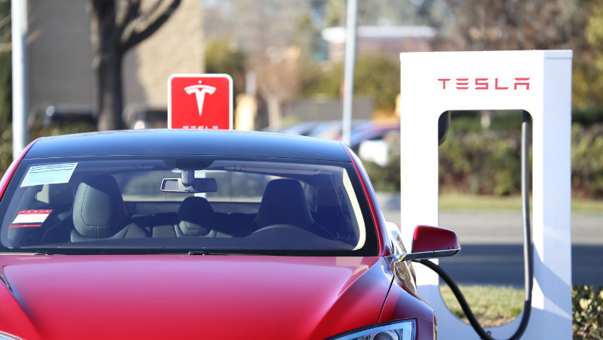
Electric, Autonomous and Shared Fleet Services
Innovation to Support Advanced Transportation
  Advance electrification infrastructure
  Fleet infrastructure for high demand use and maintenance
  Depots for autonomous vehicle fleets
Preparing for Autonomous Vehicle Conversion
  By 2030, there could be 90 million AVs operating in the U.S. (KPMG, 2017)
  A depot for an autonomous vehicle fleet of 2000 vehicles could consume 20-40 MW of power
  Machine Learning and AI
We are already using AVs on solar construction sites and designing our first AV depot for a transportation company.

Slide 13
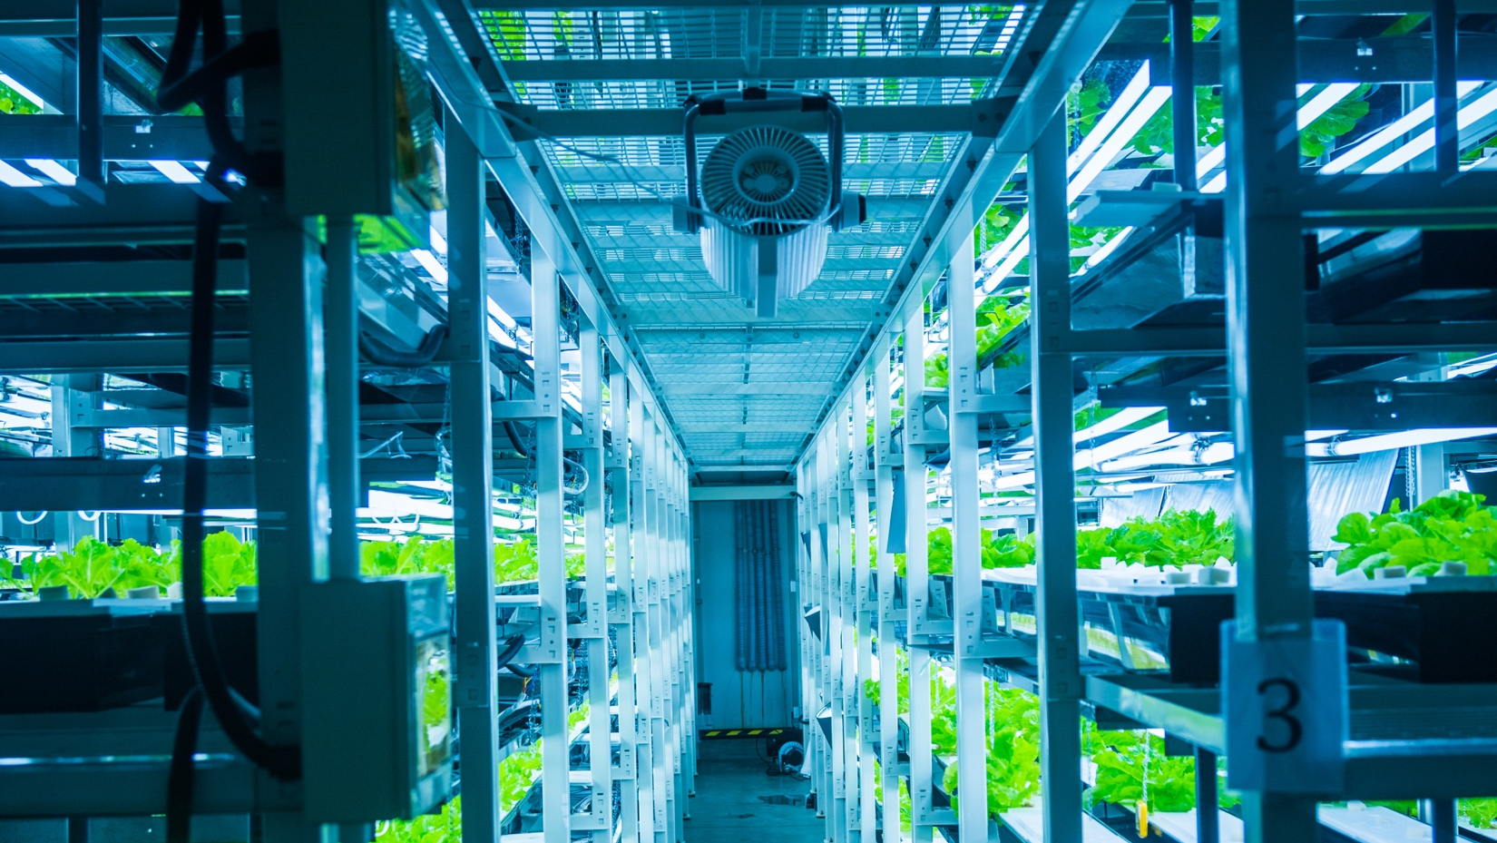
NextGen Ag
Indoor farms (greenhouses, vertical farms, etc.) allow high quality produce to be sustainably grown throughout the whole year, close to the consumer
Energy intensive industry with high power demands, specialized HVAC, LED lighting, and environmental controls
  10 MW for 100,000 SF facility
Initial studies through turnkey construction and finance
The retail grocery industry is now looking at innovations like NextGen Ag to provide access to fresh produce on site.

Slide 14
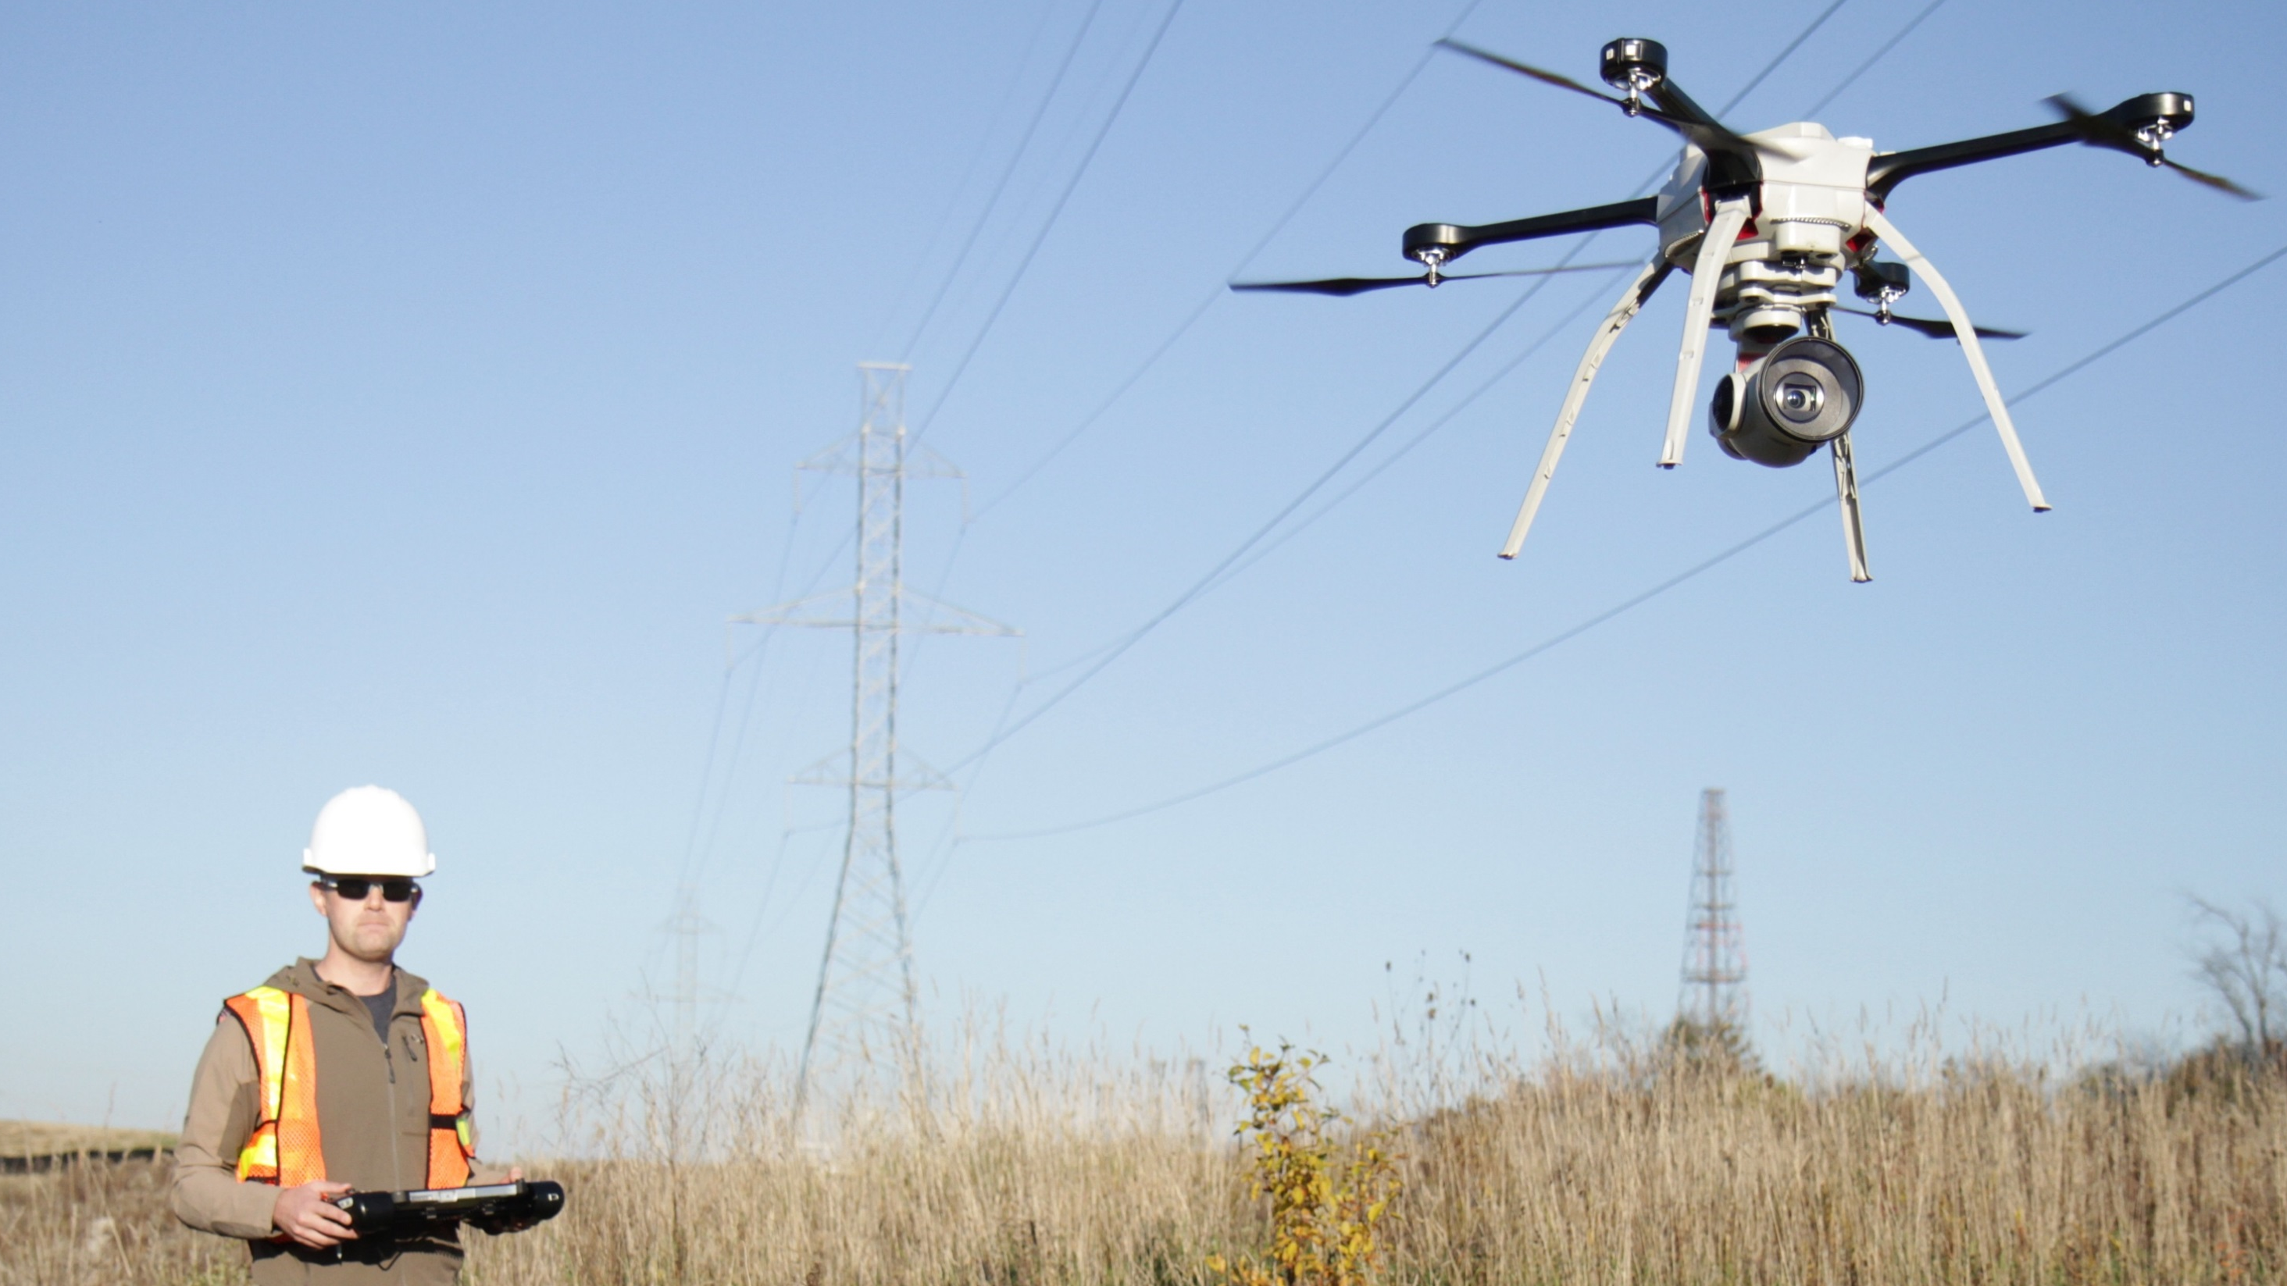
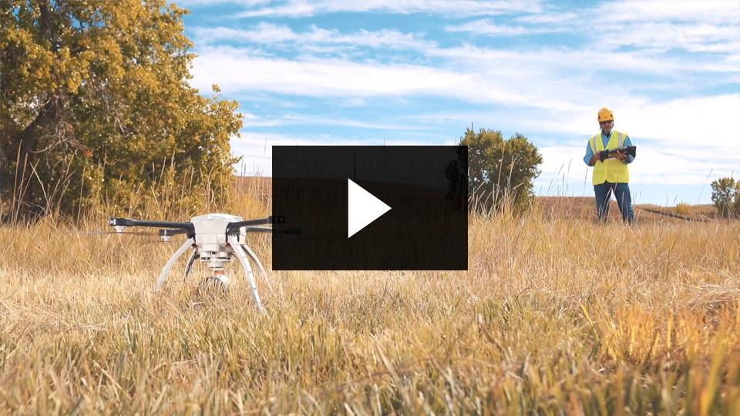
Asset Data Collection & Analytics
Innovating How, Where We Collect Data
  Unmanned Aerial Systems (UAV)
    Improved Safety
    Increase Amount, Detail of Data Collected
    Speed, Frequency
  Enable Partnerships
  Using Data to Establish Benchmarks
  Artificial intelligence, Machine Learning
Creating Agility, Enabling Pivots
Reduce Risk, Empower Better Decision Making
UAS have the ability to collect asset data from transmission and gas assets in remote areas that manned aircraft can not safely access.

