Slide 1


Collected Data from Recent Reports

Slide 2
About This Presentation
This presentation collects data from Innovation Leader's recent research reports. Feel free to use these charts and graphs internally in your own presentations, or in public presentations, with credit to Innovation Leader / innovationleader.com. We ask that you do not post this presentation on the web in its entirety, as it was created exclusively for Innovation Leader's members.
We’re grateful to the sponsors who underwrote these reports: The Nason Group, Mastercard, Sopheon, Techstars, KPMG, and Planbox.

Slide 3

Healthcare Innovation
Q1 2018 — Data from 84 respondents

Slide 4
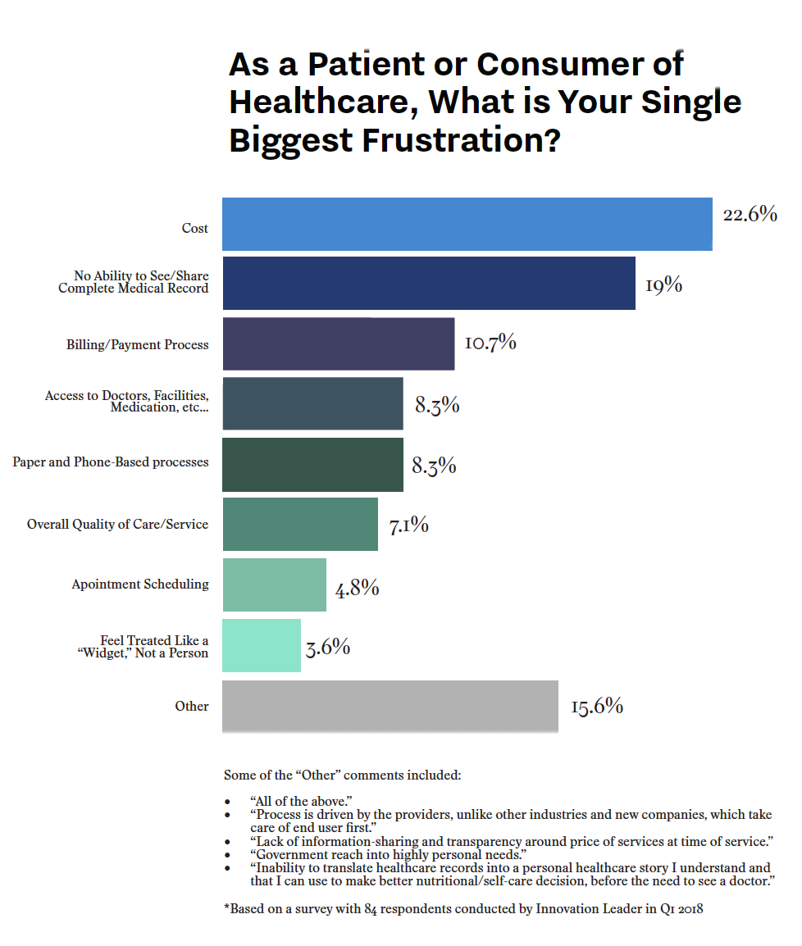
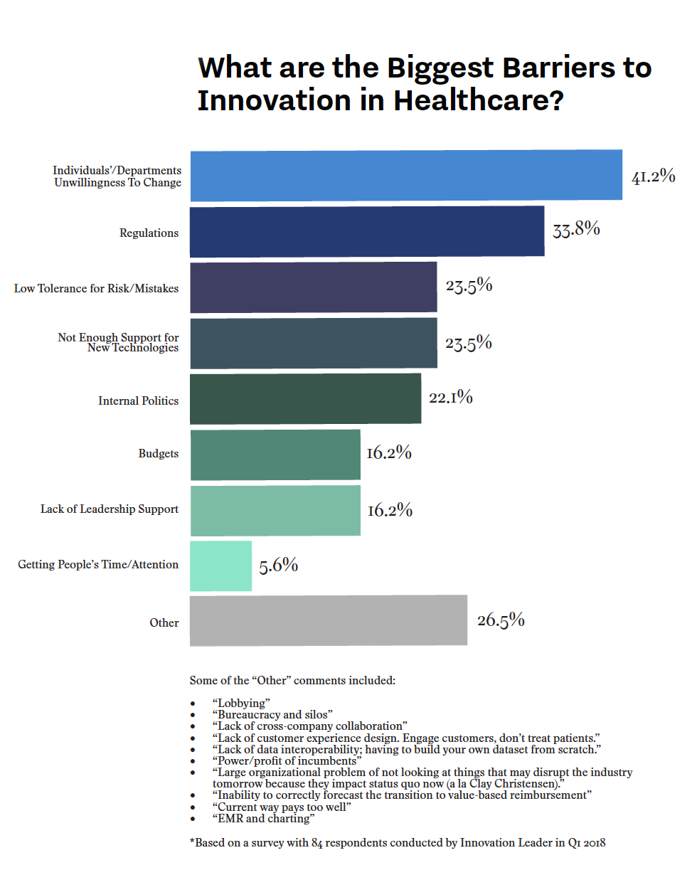

Slide 5


Slide 6

Innovation & Risk Q4 2018 — Data from 150 respondents

Slide 7
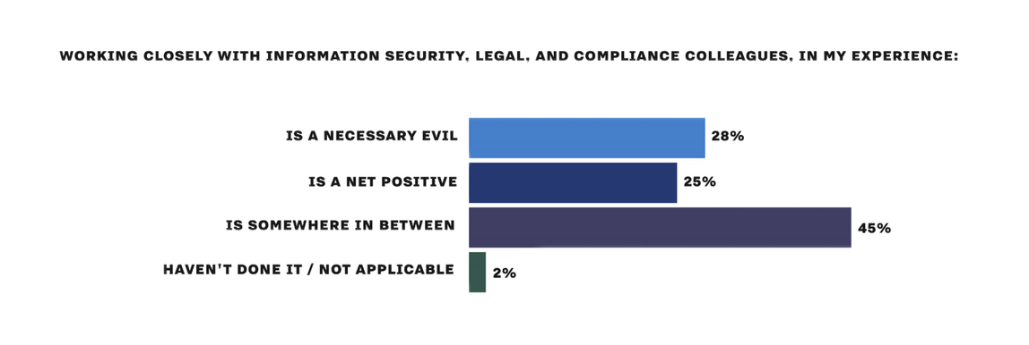
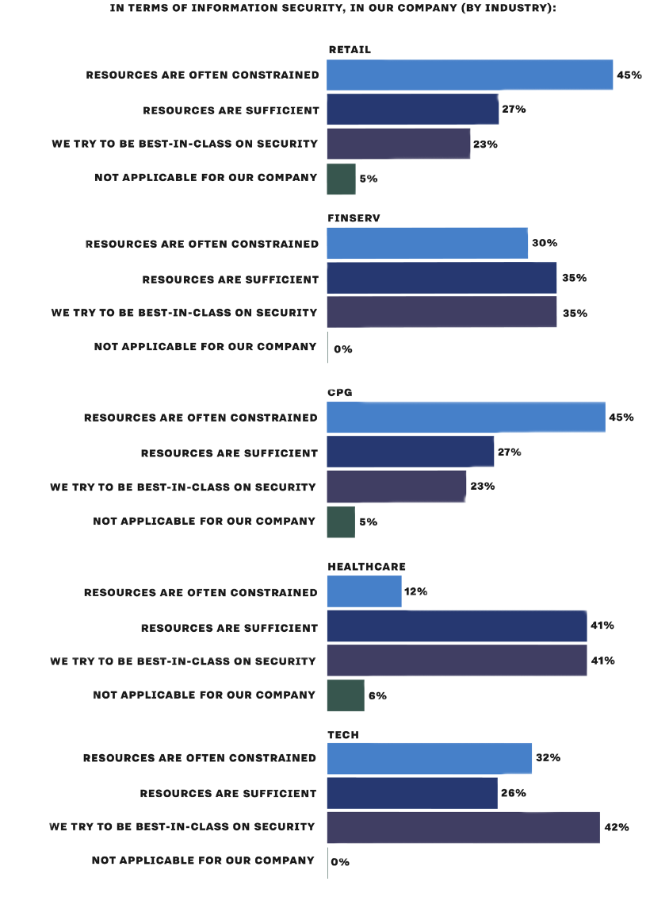
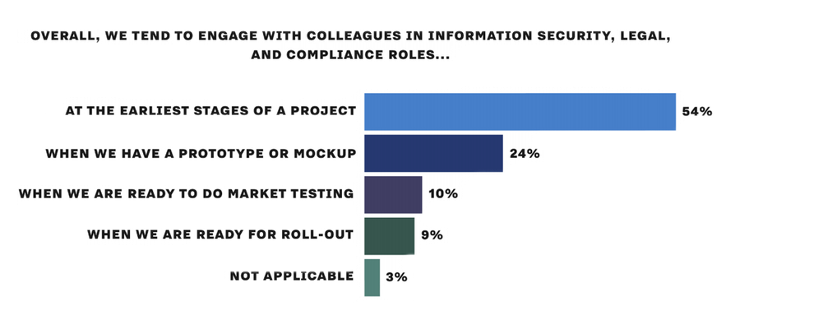
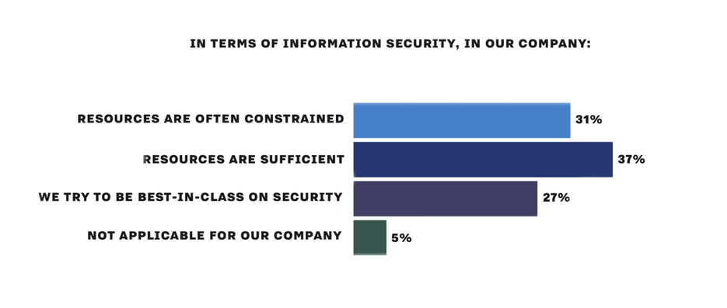

Slide 8
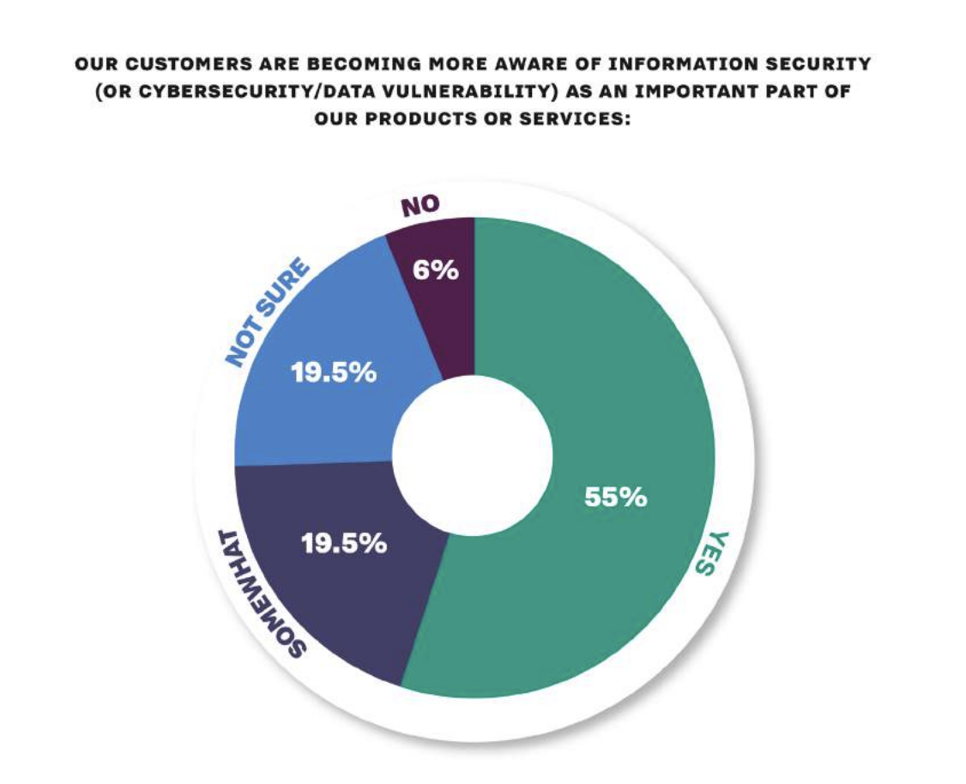
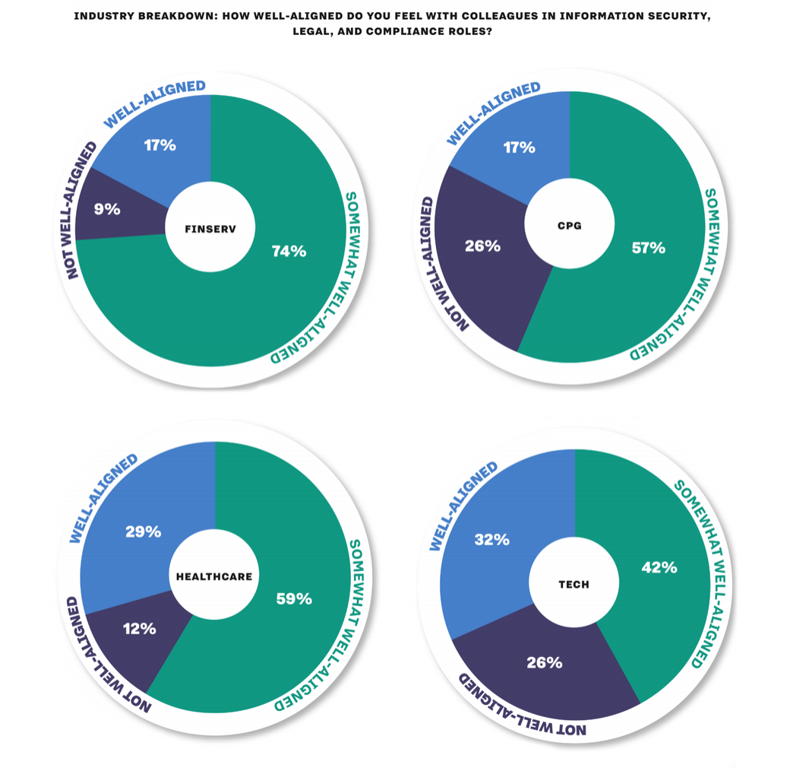
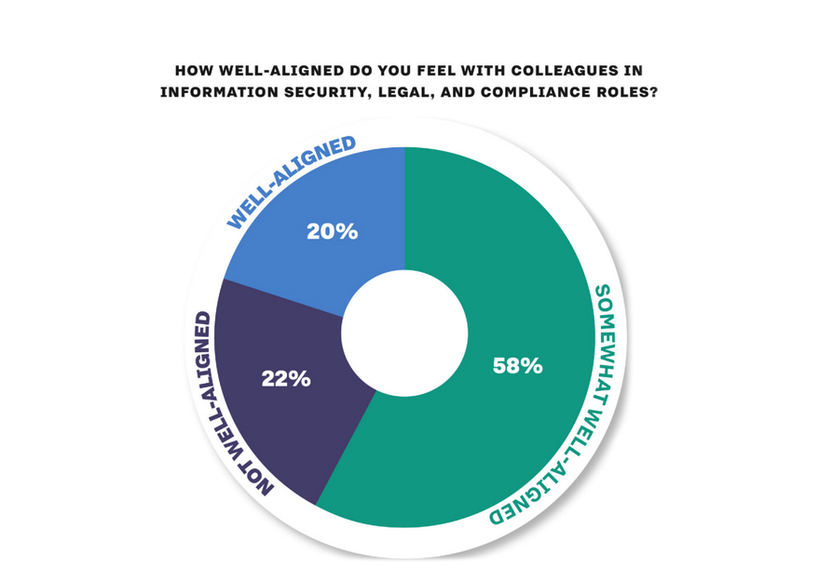

Slide 9
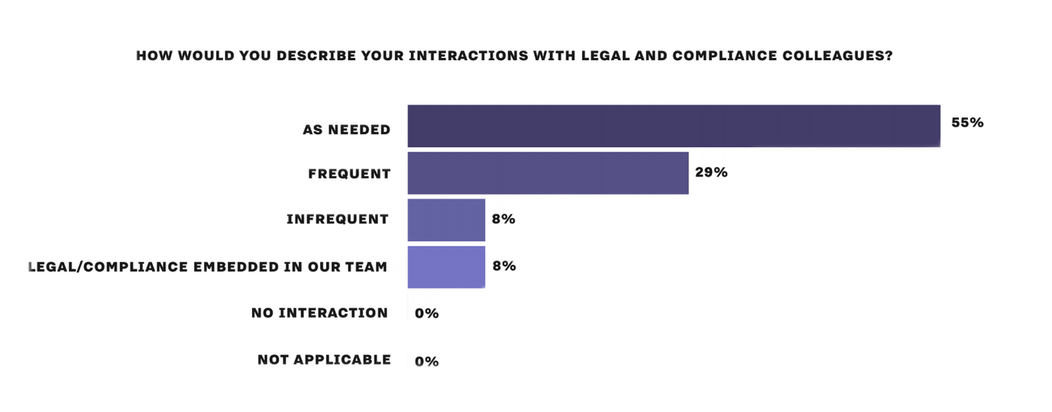
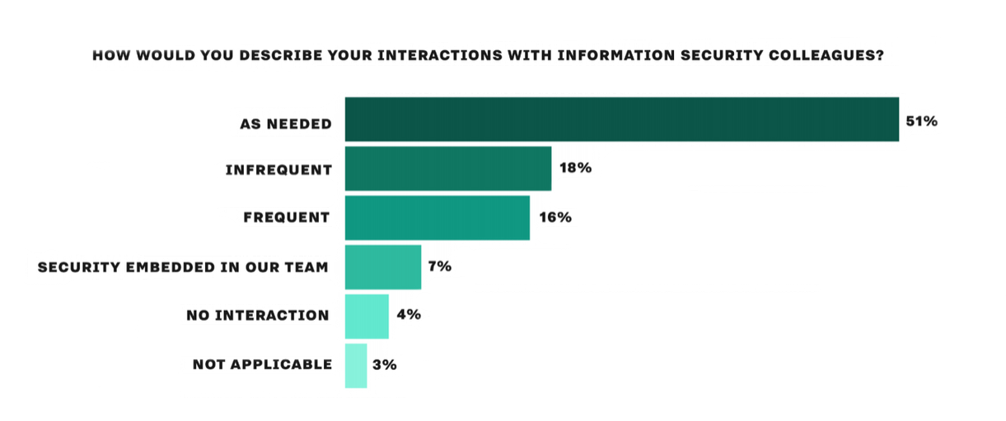

Slide 10

Best Practices: Co-Creation & Ecosystem Development
Q1 2019— Data from 260 respondents

Slide 11
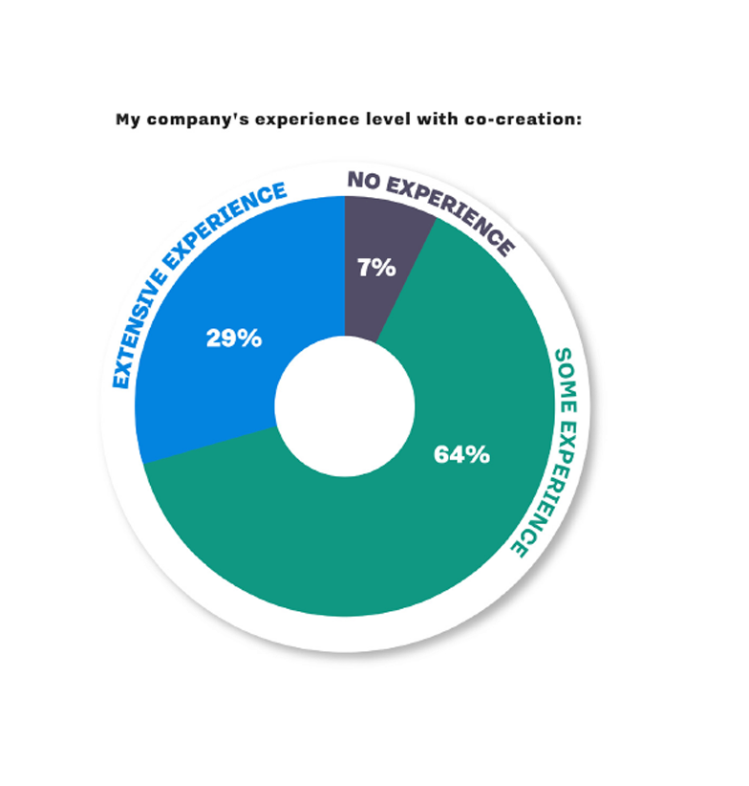
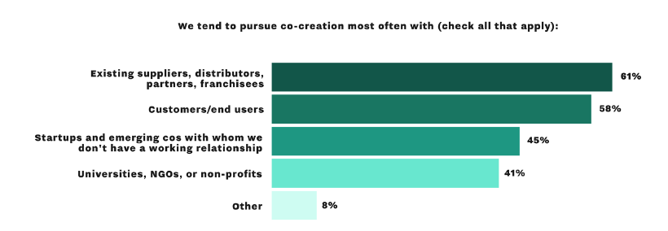
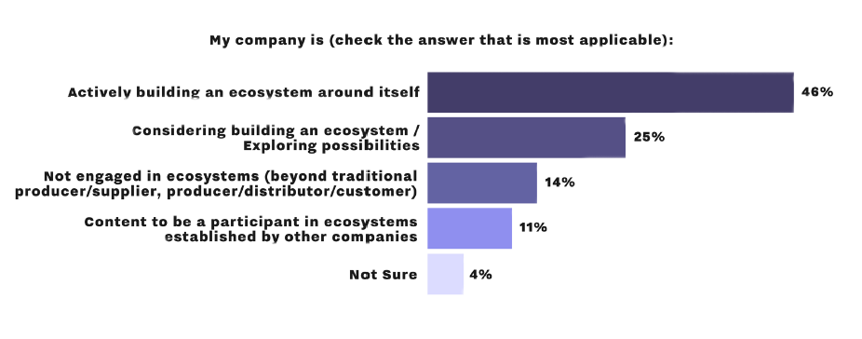


Slide 12
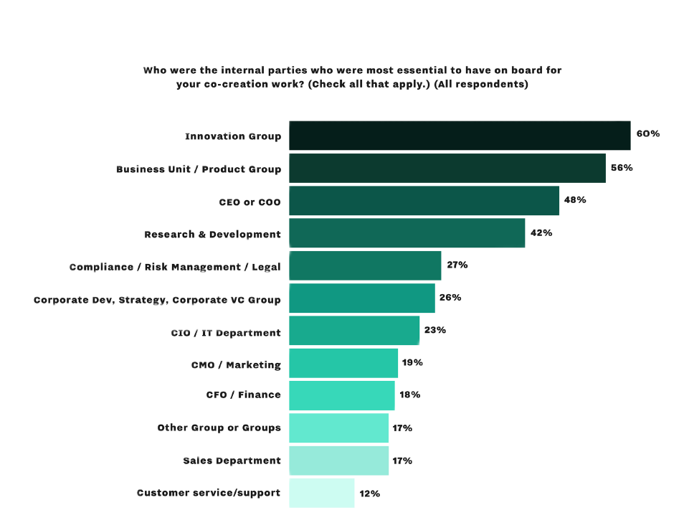
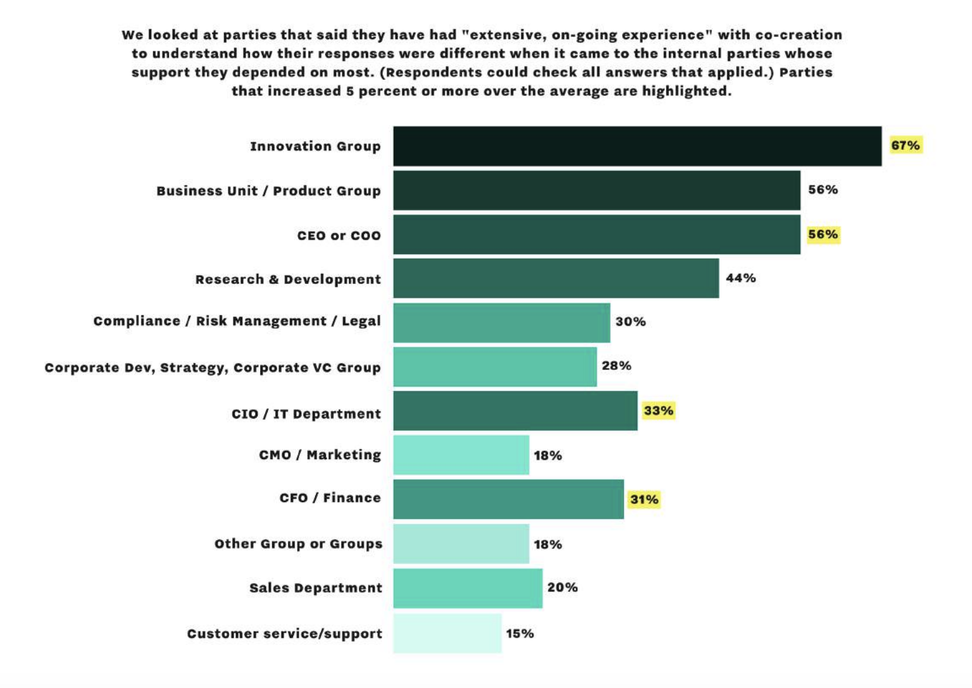

Slide 13

Startup Engagement: Best Practices for Large Organizations
Q2 2019 — Data from 115 respondents

Slide 14
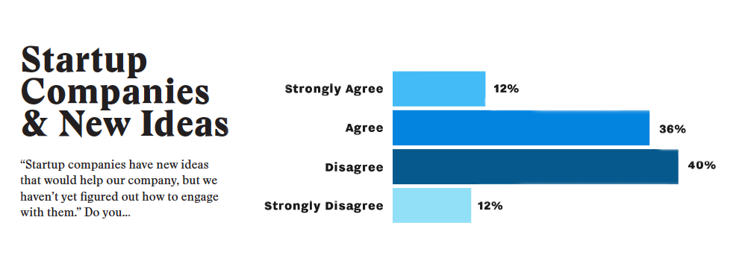

Slide 15
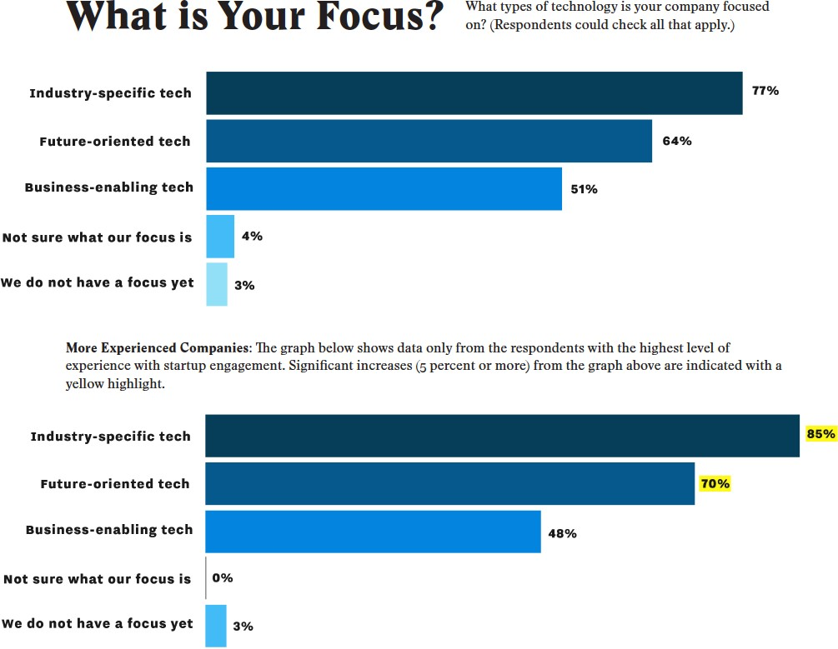

Slide 16
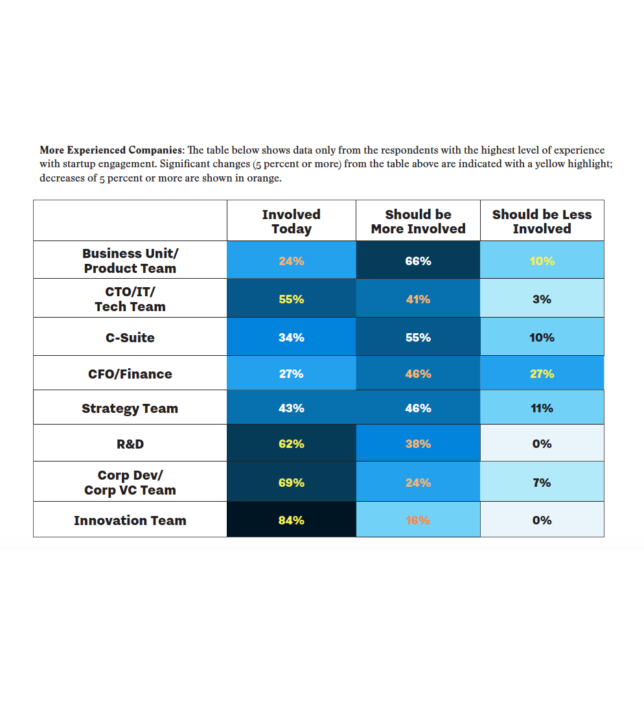
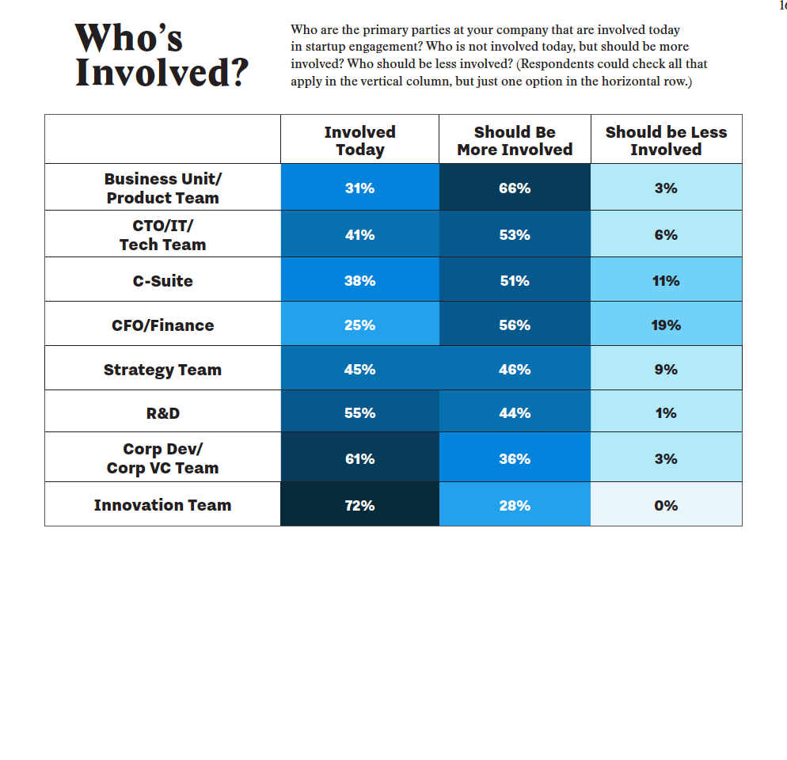

Slide 17
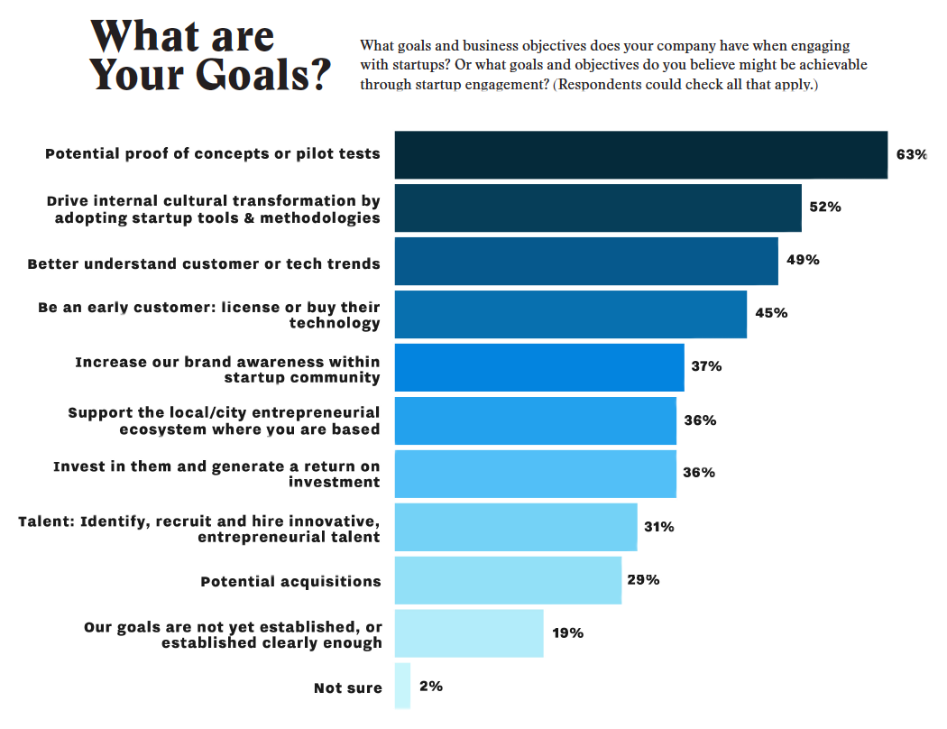

Slide 18
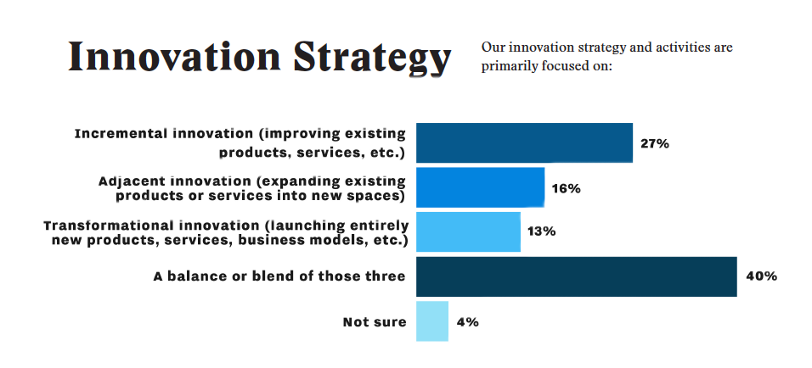
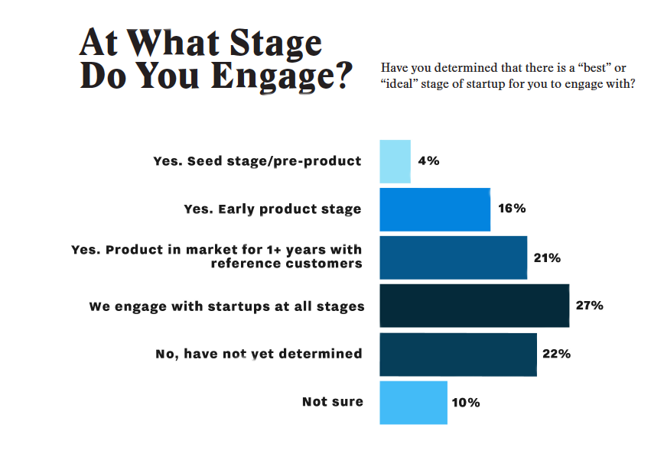

Slide 19
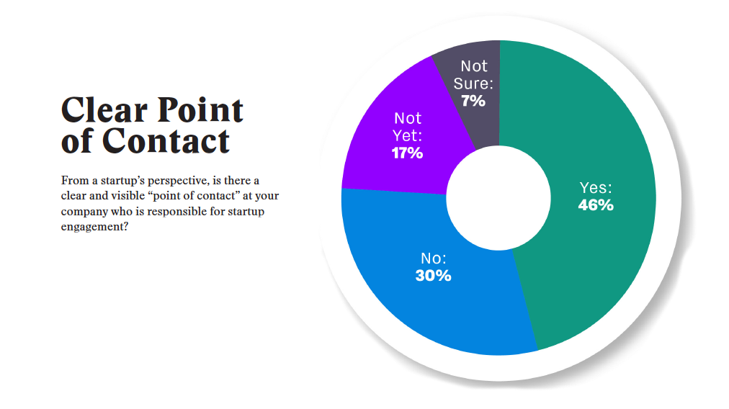

Slide 20
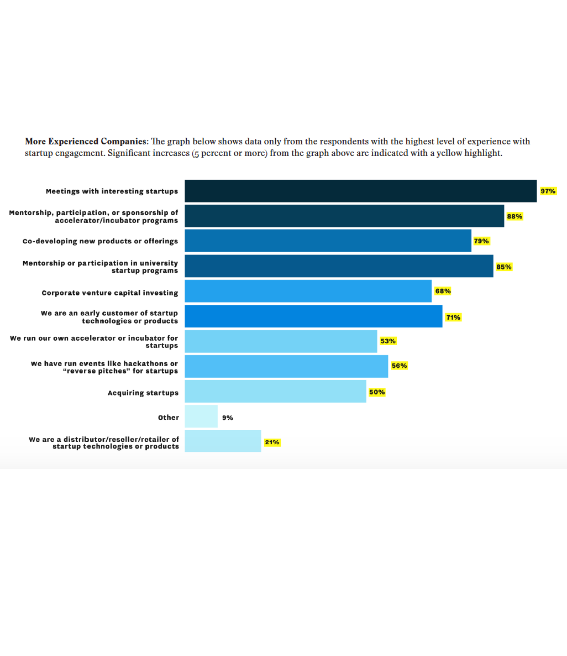
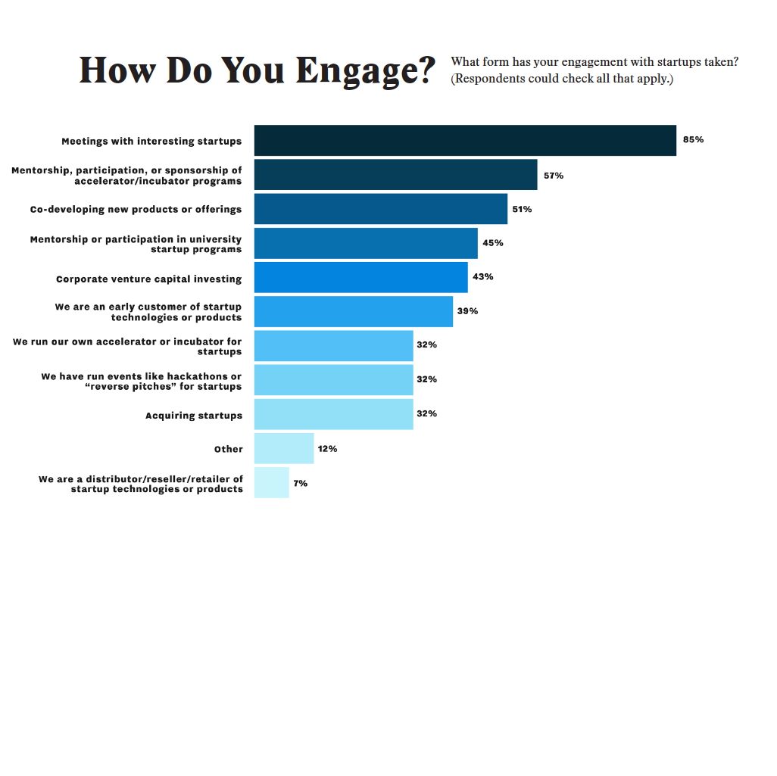

Slide 21
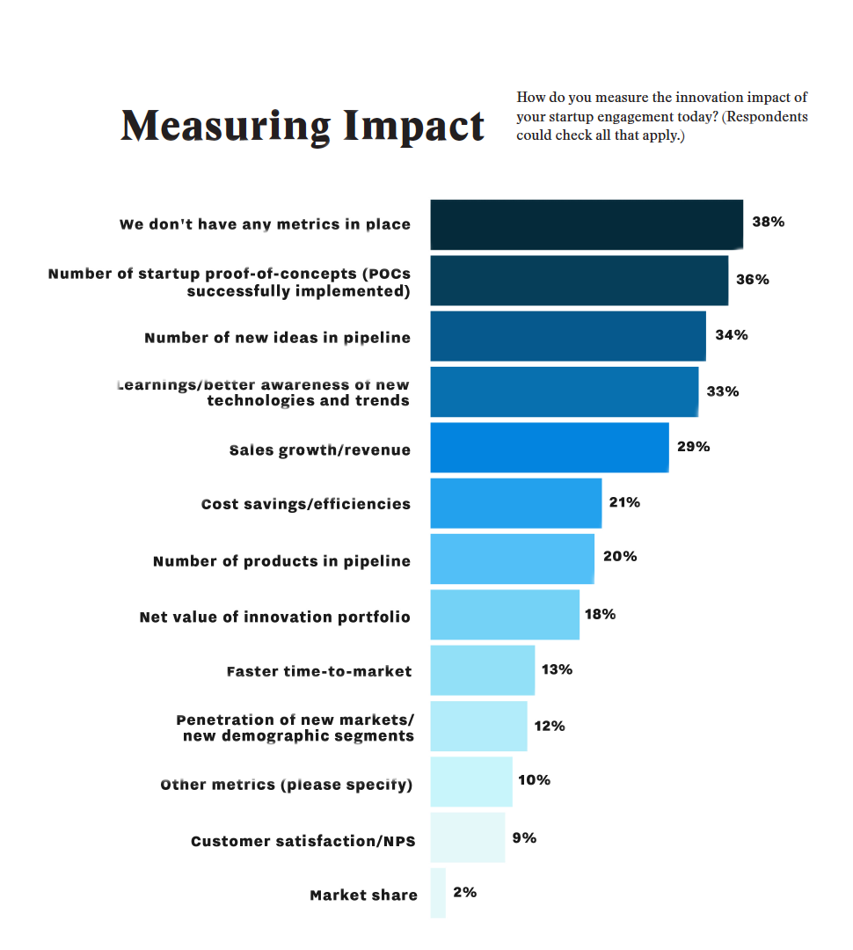
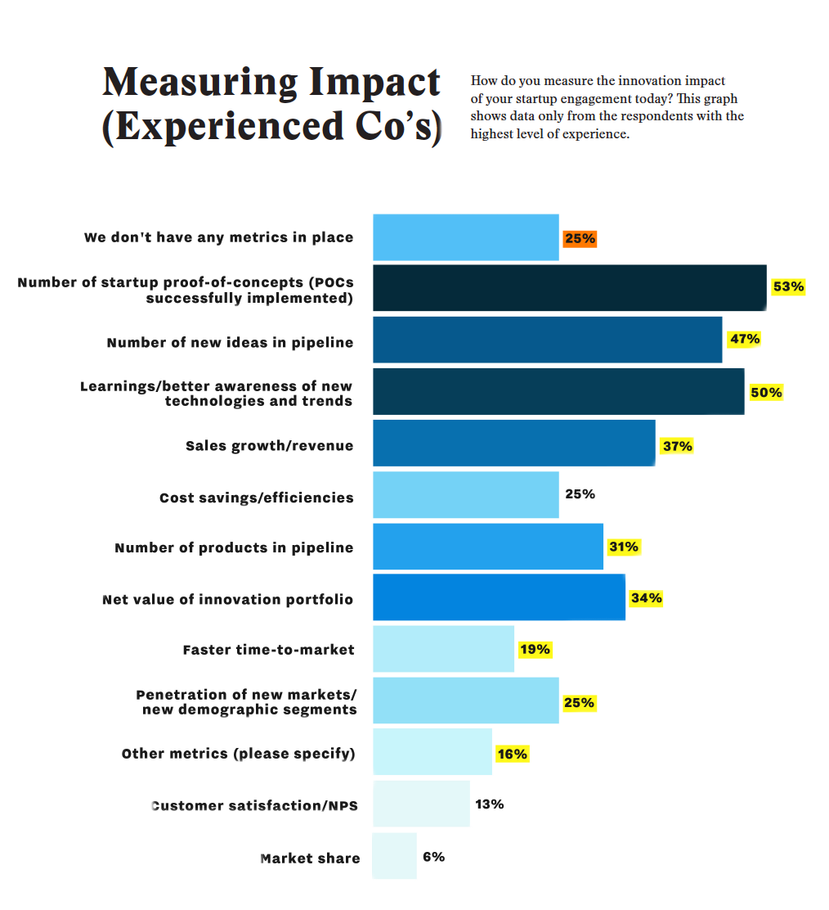

Slide 22
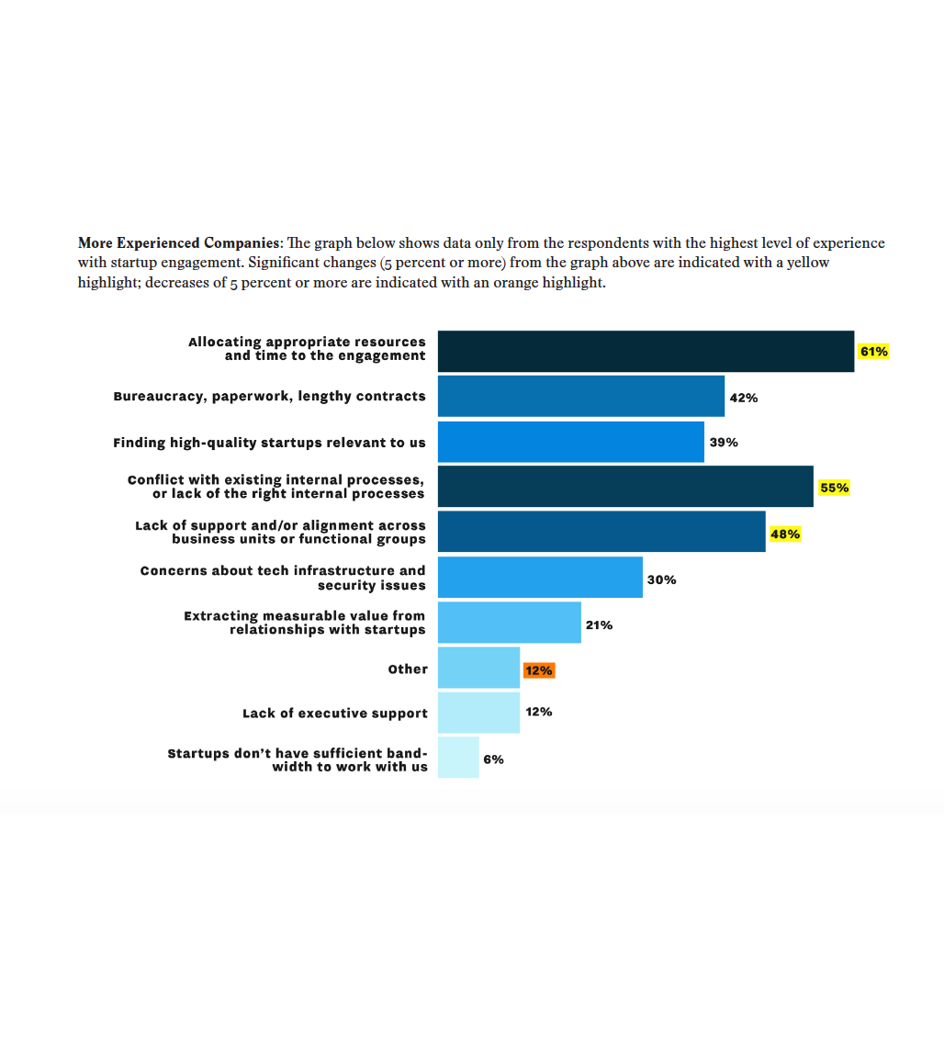
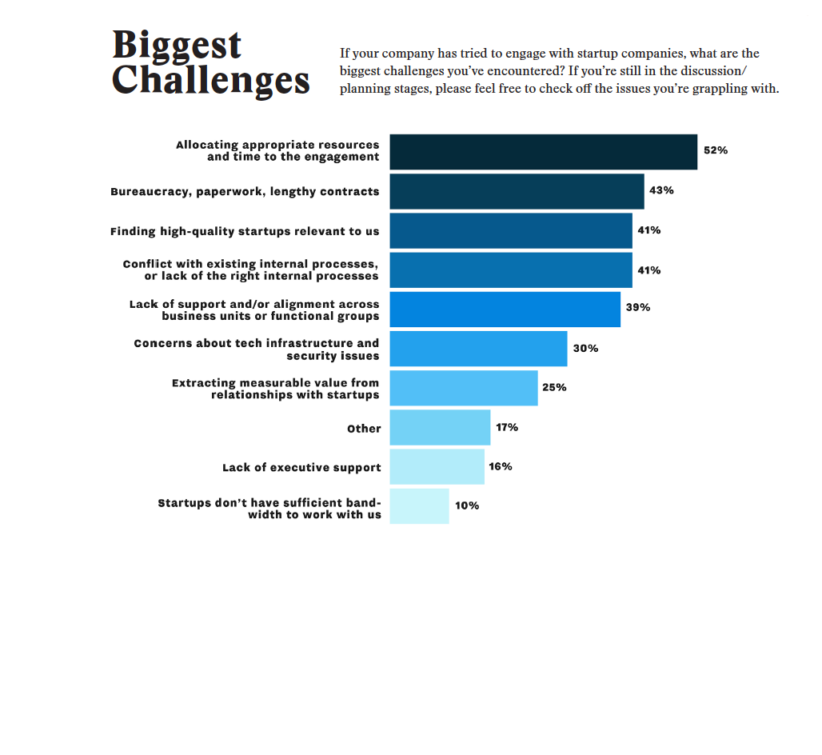

Slide 23
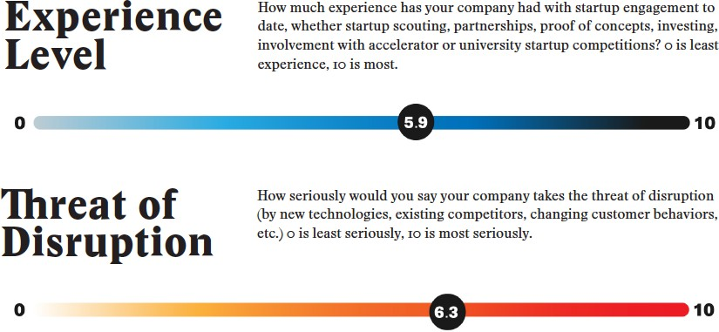
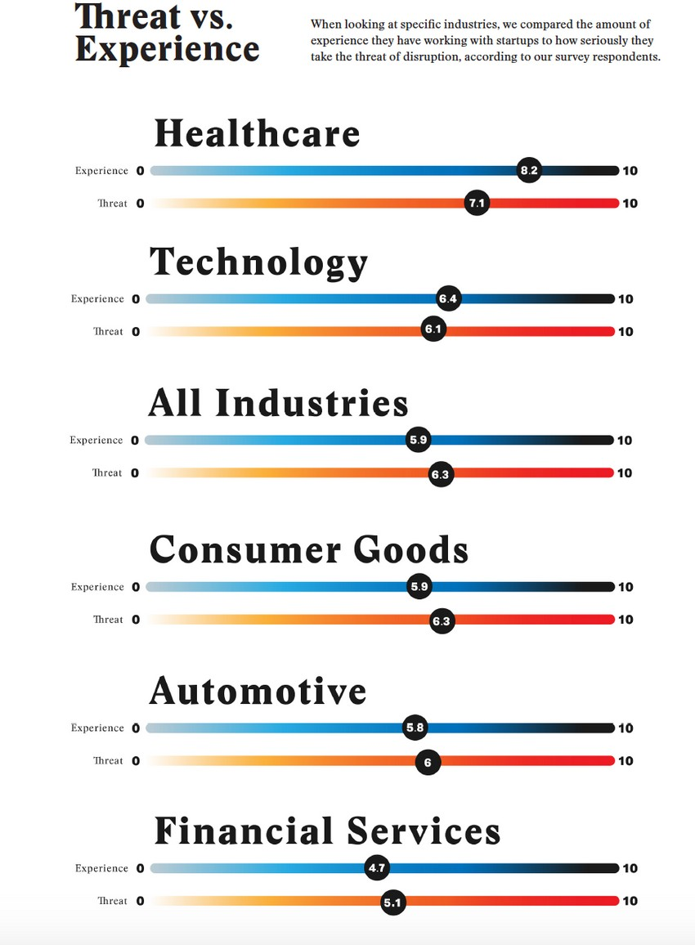

Slide 24
Benchmarking Innovation Impact 2020 Q3 2019 — Data from 215 respondents

Slide 25
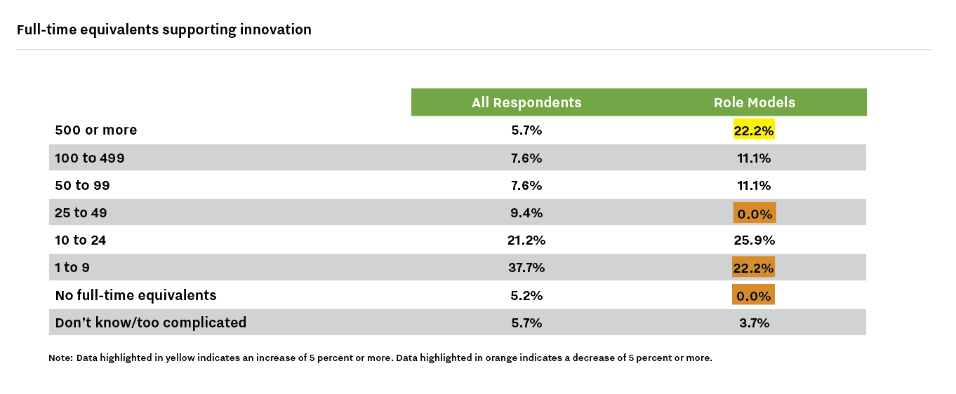

Slide 26
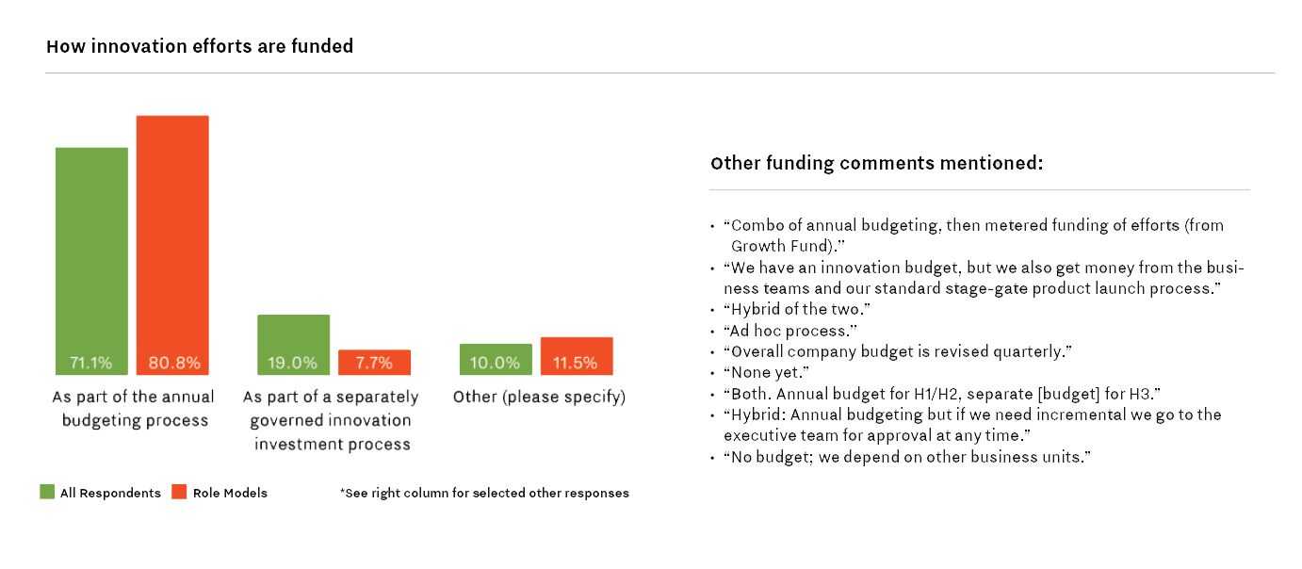

Slide 27
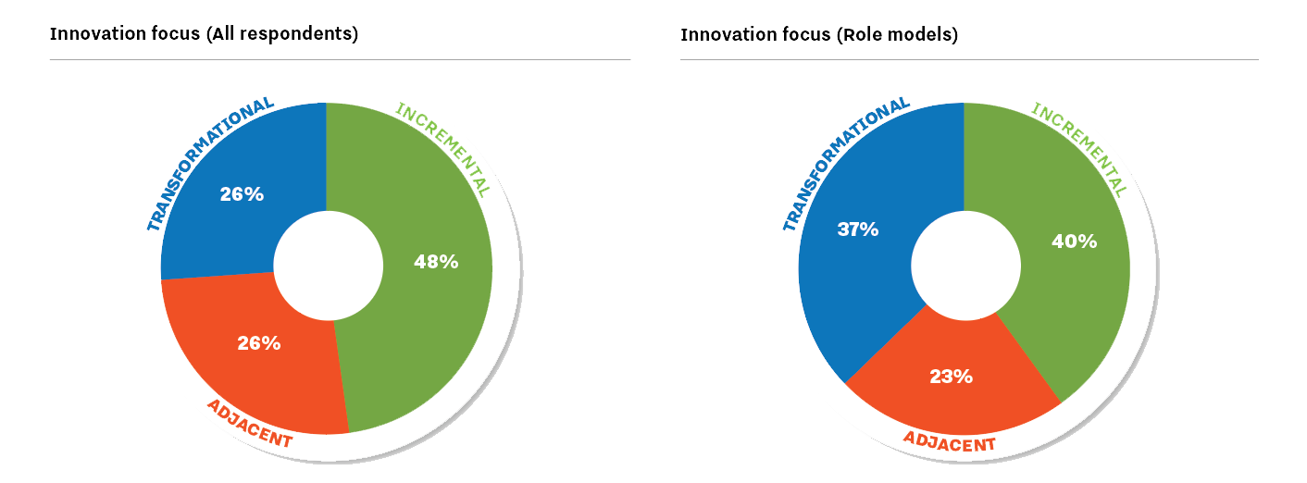

Slide 28
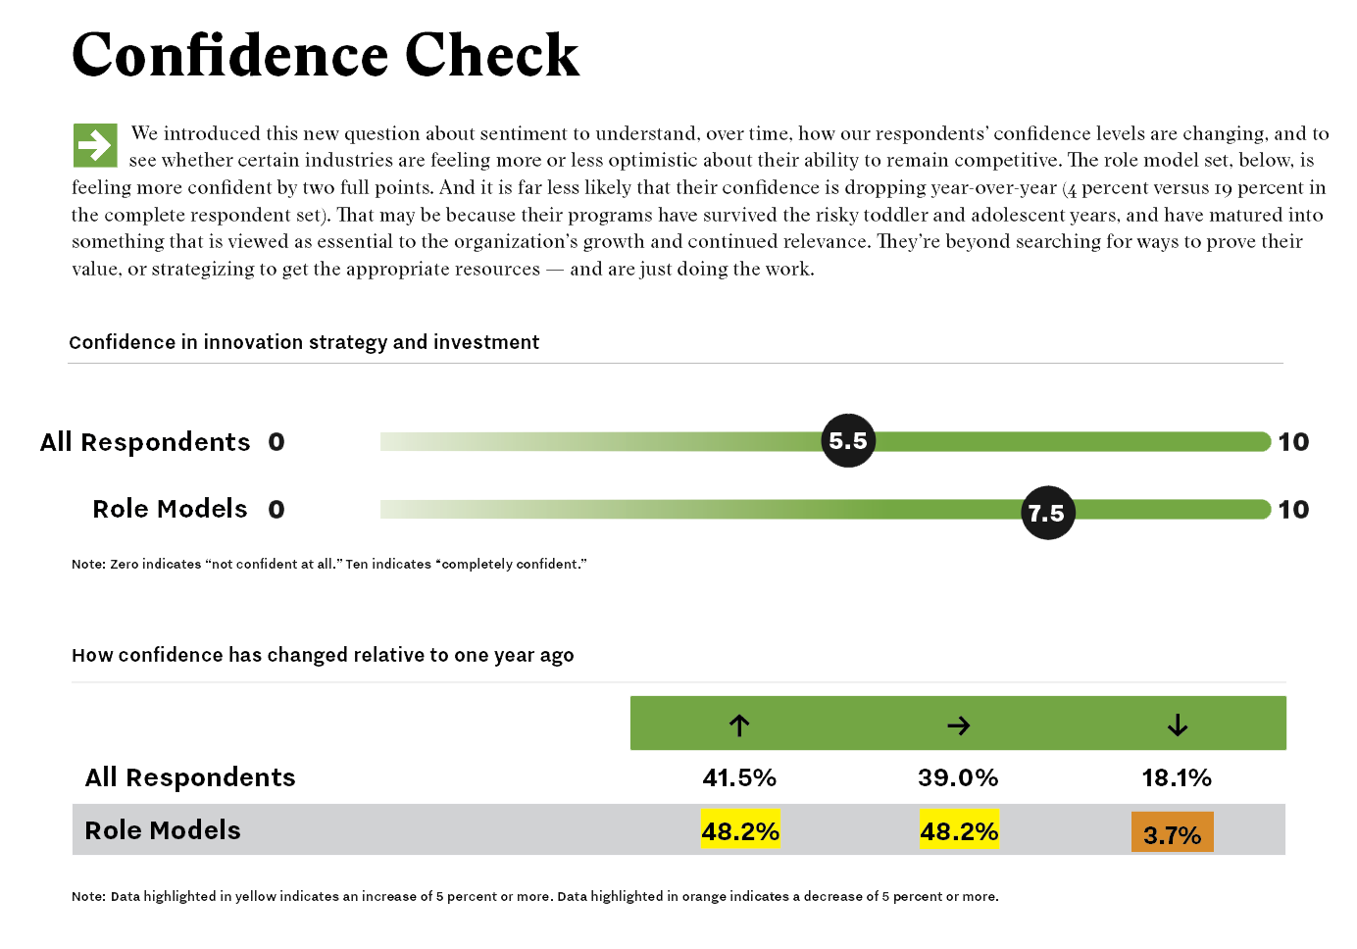

Slide 29
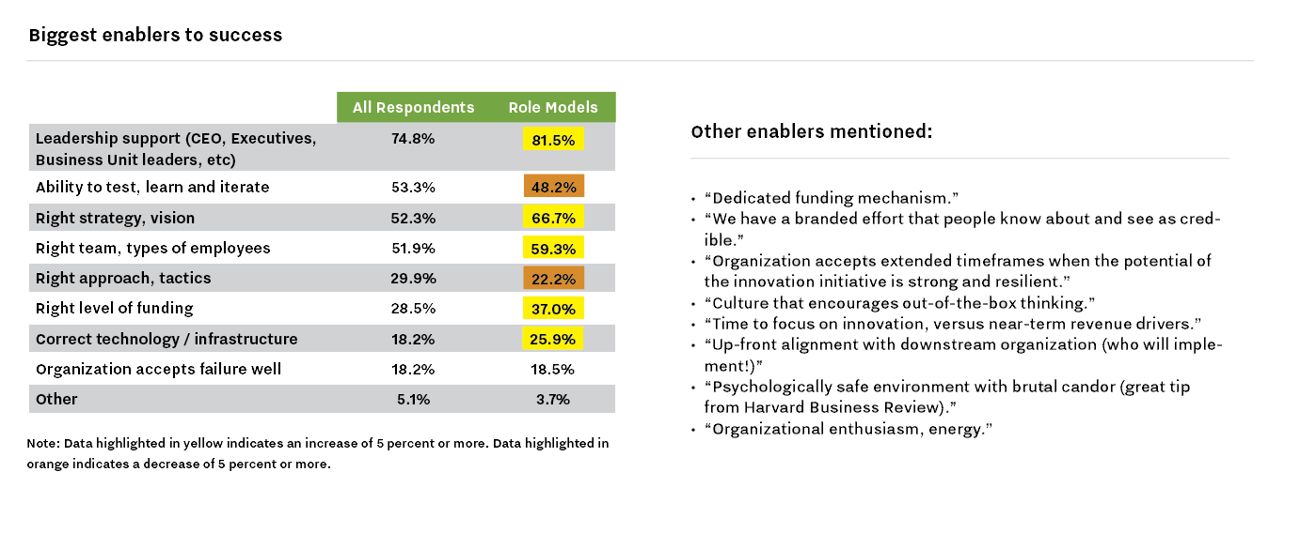

Slide 30
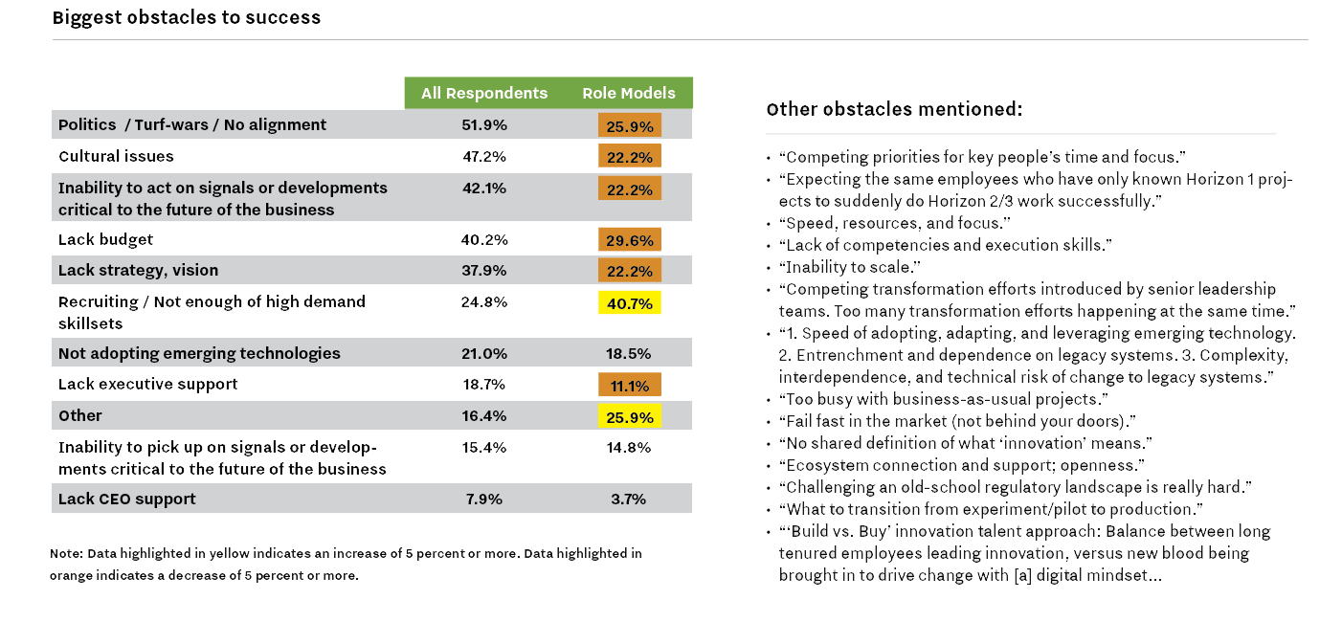

Slide 31
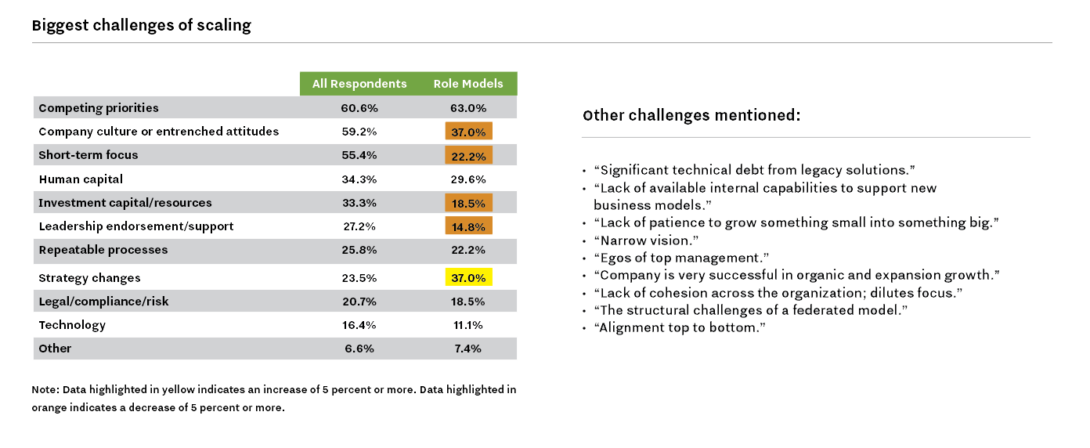

Slide 32
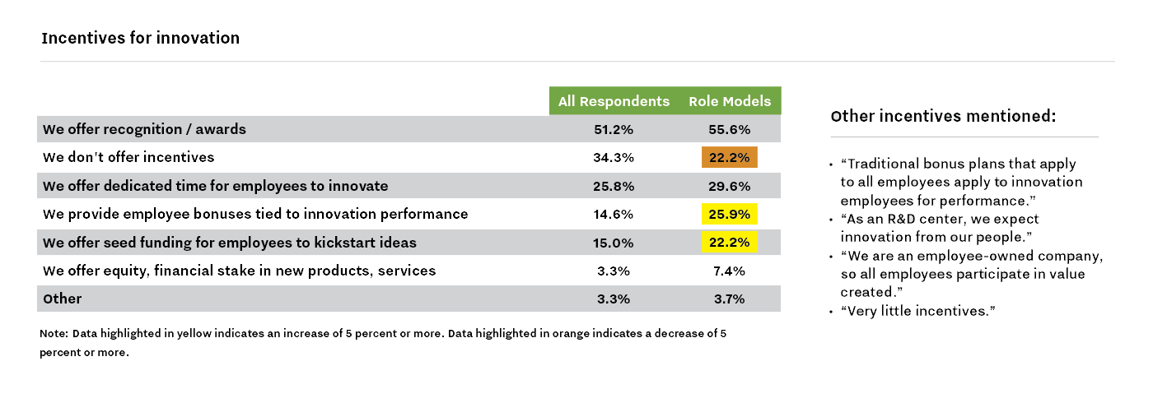

Slide 33
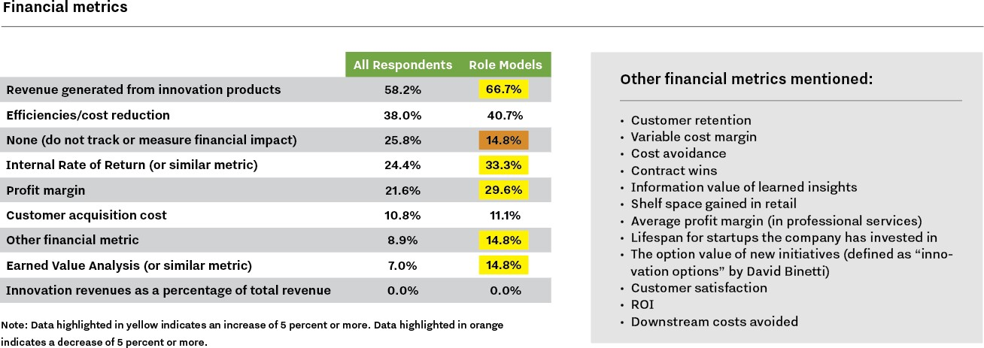

Slide 34
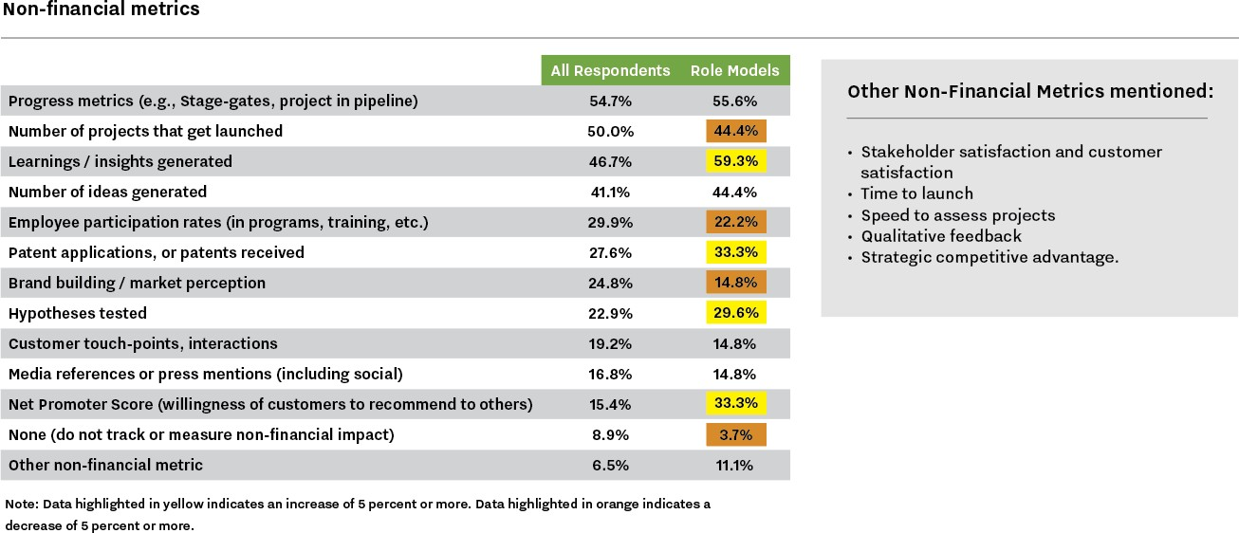

Slide 35
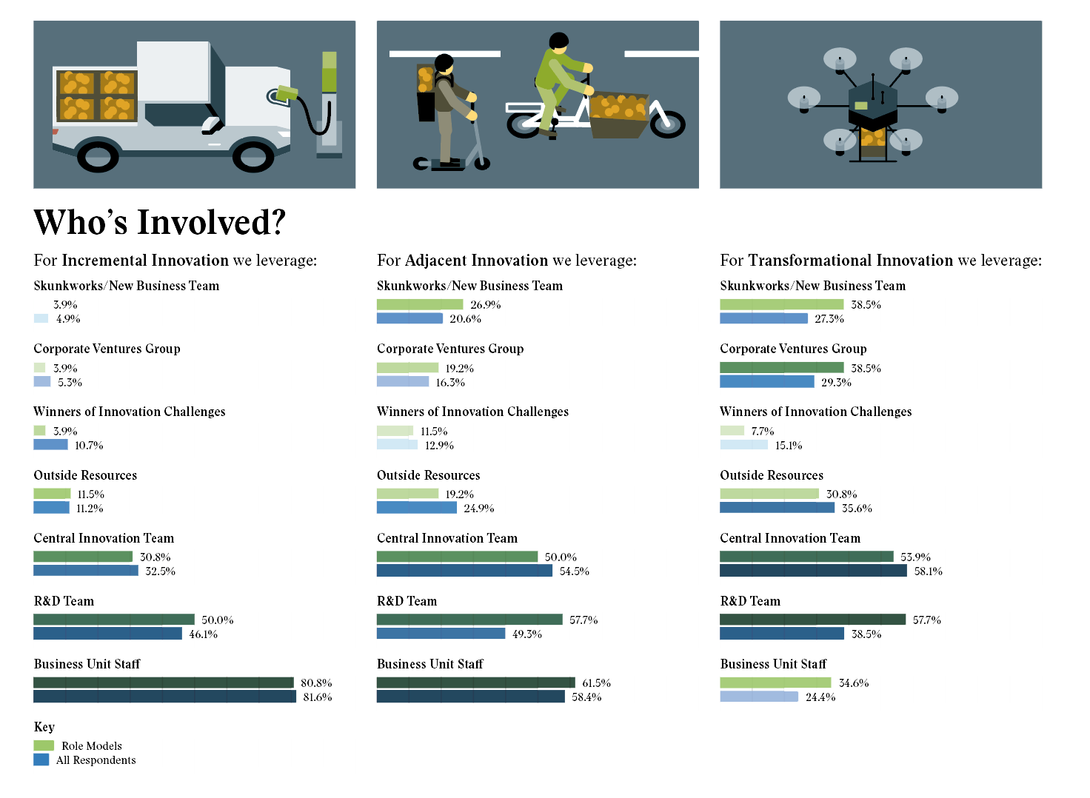

Slide 36
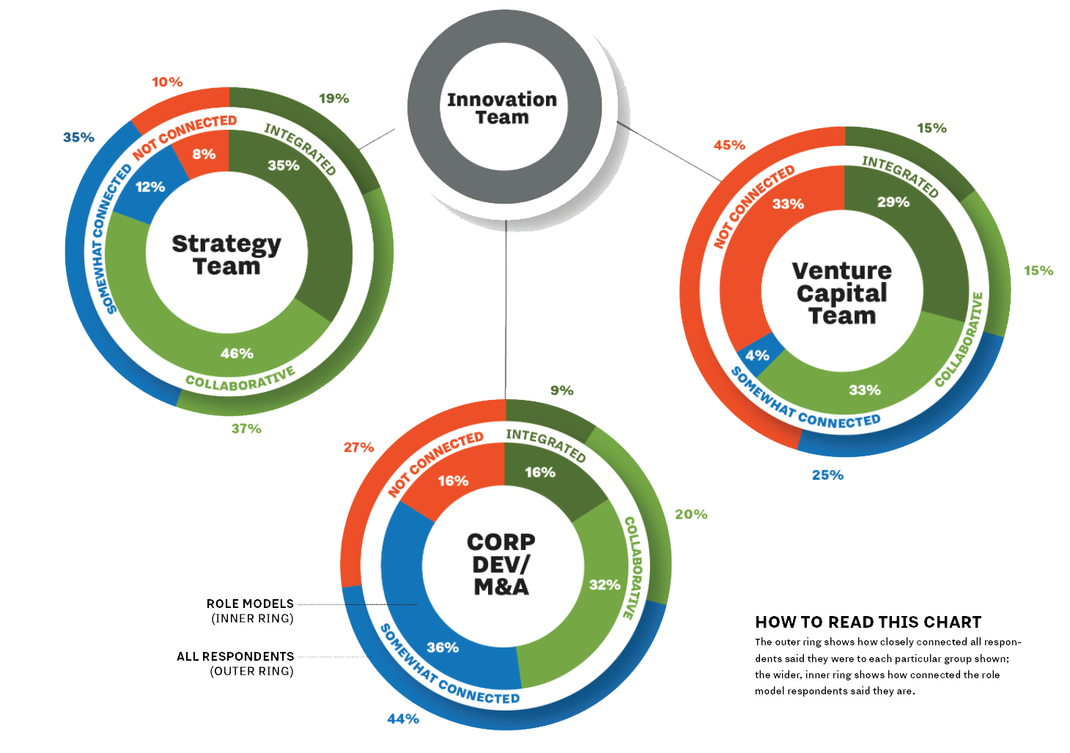
Connectivity to Other Groups

Slide 37
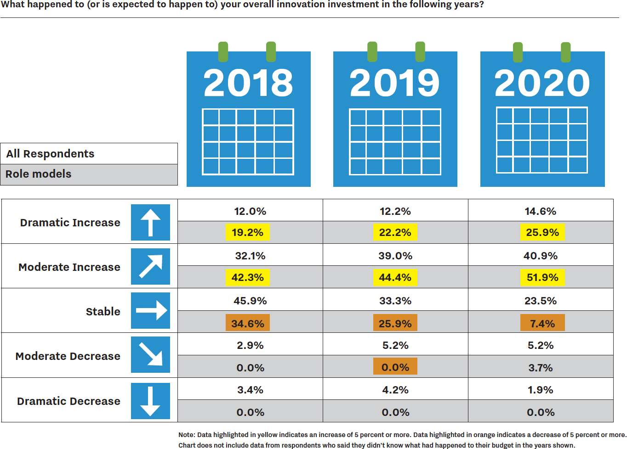

Slide 38
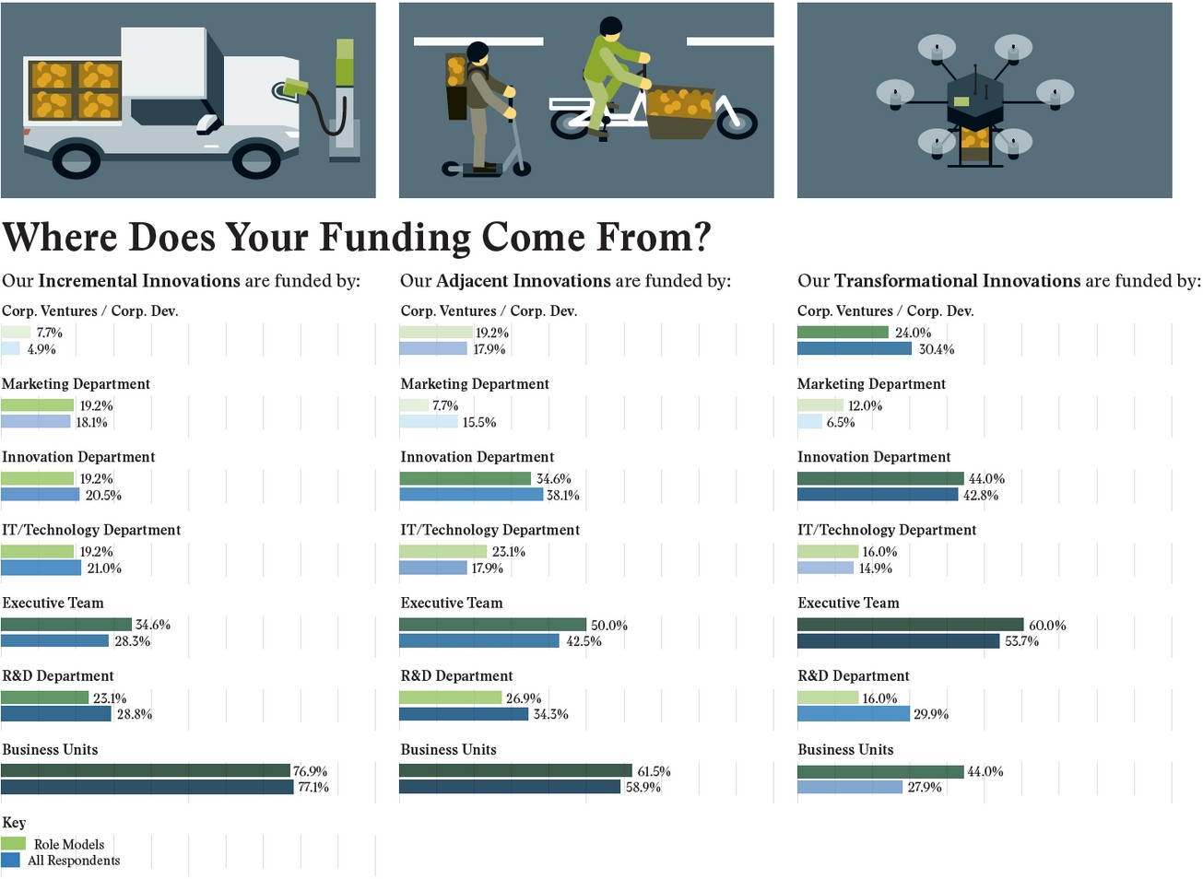

Slide 39
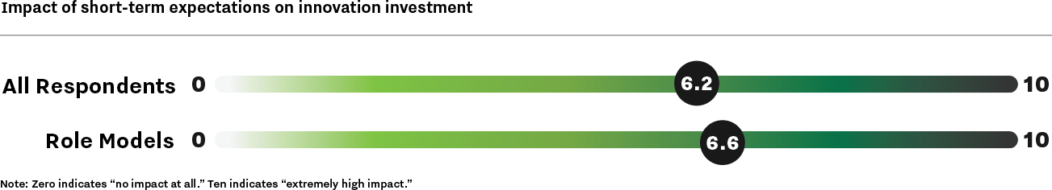

Slide 40

2019 Compensation Survey: How Innovation, R&D, & Strategy Executives Get Paid
Q4 2019 — Data from 175
respondents

Slide 41
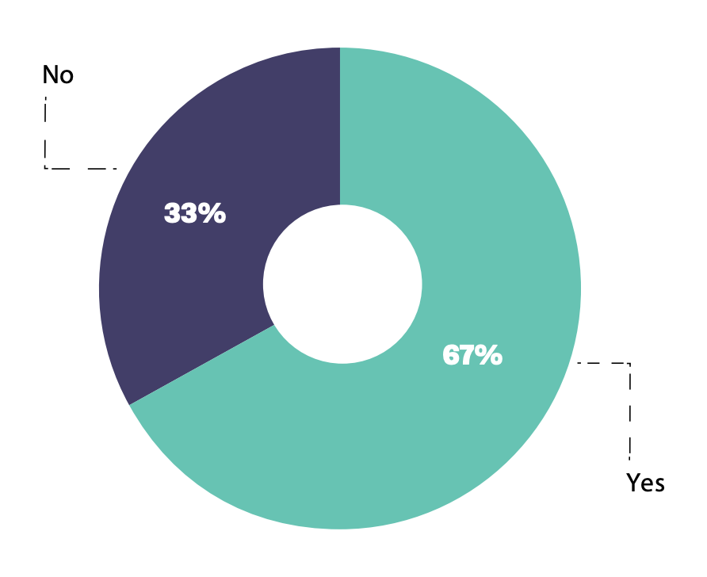
Is your compensation tied to performance?

Slide 42
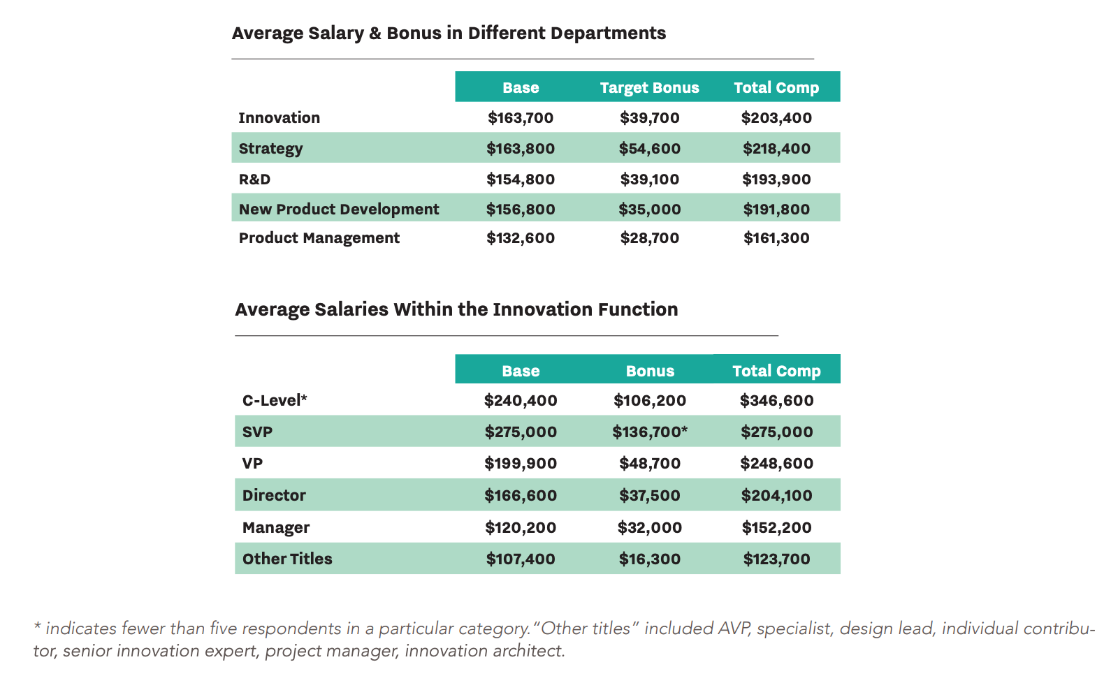

Slide 43
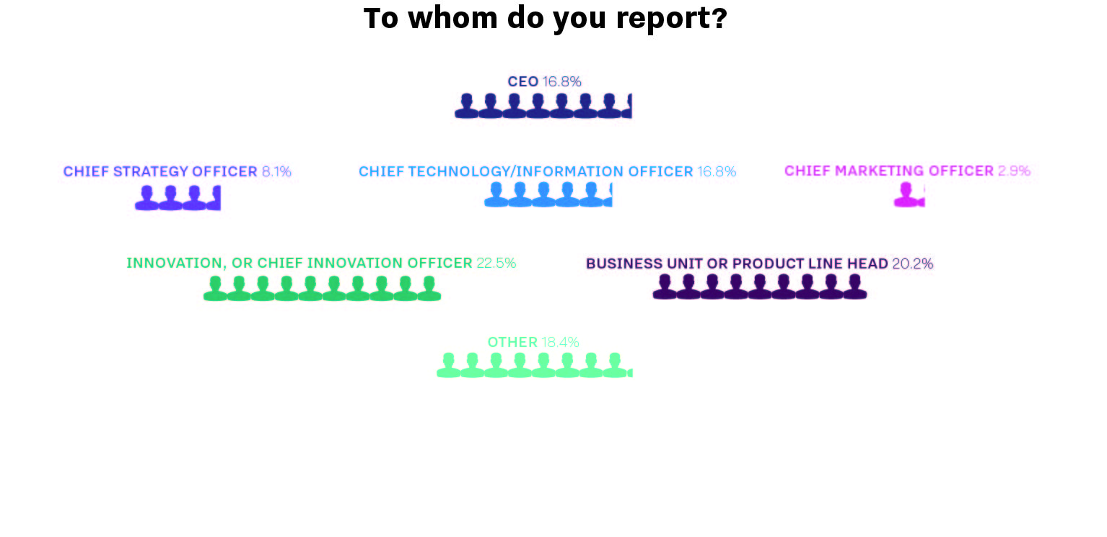

Slide 44

Quick Wins: Data and Case Studies on Delivering Results Fast
Q4 2019 — Data from 132 respondents

Slide 45


Slide 46


Slide 47
Using charts and graphs from this presentation
Feel free to use these charts and graphs internally in your own presentations, or in public presentations, with credit to Innovation Leader / innovationleader.com. We ask that you do not post this presentation on the web in its entirety, as it was created exclusively for Innovation Leader's members. This material is © 2020 Innovation Leader.
About us: Innovation Leader is an unbiased research and information provider that serves corporate innovation, R&D, and strategy executives in Global 1000 companies.

