Slide 1


Metrics Share March 27, 2020

Slide 2
How Do You Measure Innovation?
It depends……
How did you originally sell innovation to leadership?
What flavor(s) of innovation are you focused on?
How far along are you on your innovation journey?
Volume Metrics (#’s)
Value Metrics ($’s)
Ideas Generated
Initiatives Sponsored/Funded
Initiatives Developed/Piloted
Employees Trained/Engaged
Partnerships Established
Revenue from Innovations
ROI of Innovations
Efficiencies Gained
Speed to Market
Net Promoter Score

Slide 3
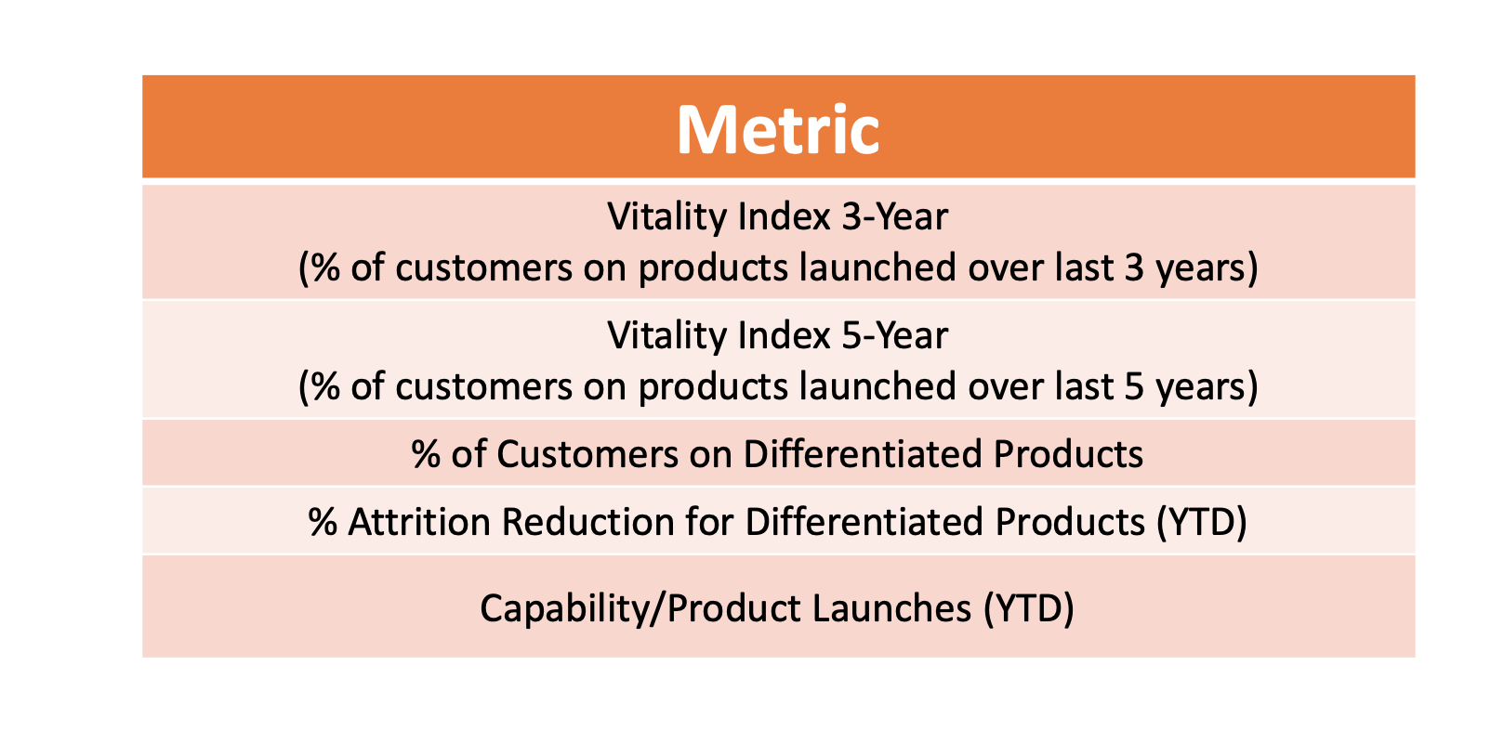
Primary Core Innovation Metrics

Slide 4
Corporate Innovation Program Metrics | ©2019 Shashi Jain | Infrastructure | People | Community
 | Starting | Emerging | Advanced | Measures
Process | Outlined process with executive buy-in and investment allocations | Recurring process and selected follow-on investments | Repeated success of ideas to companies and overall process iteration | Seniority level of support Yield from stage Regular modifications to program
People | Outline of program (time allocations, team formation…) | Steady flow of new applicants, clear skills development | Acceleration of participants in/out of the program, high degree of skills training, rapid alignment of cross-functional teams and resources | Overall applicants, moving to full time Skills training and mastery
Ideas | Central place for idea capture | Structured ideas coming from many areas of the company, evolved decision gates | Clear progression of ideas into formal “companies” with teams and success or joint projects with partners. | Volume, quality and yield of ideas % of ideas from different groups
Customer development | Can identify key customer segments, end users. Can build personas | Performs formal interviews with customers, users. Formal programs for engagement with top customers | Ongoing engagement in development and ideation process | Validation cycle time Engagement level of “customer council”
Product development | Outline of resources and approach for development | Rapidly forming teams, regular shipping of prototypes | Rapid prototyping for new ideas, methodical production shipping for mature ideas | Sprint success Achievement of goals
Decision Making | Clear ownership of decision and discussion of tradeoffs. | Defined process with buy-in from stakeholders; decision making is faster than “normal” | Culture of decision quality embedded; data-driven decisions made quickly. | Speed of decision making Quality- how often choose right course? Yield- does execution match effort
Community Engagement (to affect ideas) | Identified external resources | Selected engagement of external mentors or experts | Formal and programmatic inclusion of community with ideas and teams | Mentors/partners engaged Quality and frequency of engagement (survey)
Community Engagement (company engagement in local communities) | Identify local groups. | Sponsorship and cross-pollination of people. | Bi-directional engagement with key community groups to share ideas and best practices | # of events and level of engagement Cross-pollination of people
External marketing | Identify internal channels/build relationships Infrequent mentions | Internal and external comms alignment Regular mentions | Inbound PR interest Frequent high-value mentions | Mentions (internal and external) Mentions in high-value outlets

