Slide 1


> Innovation is a “drill.” What’s the ”hole”?
Notes:
Much as we “hire” drills to create holes and milkshakes to quench our thirst (and, at times, occupy unruly children in the back seats of our cars), companies “hire” innovation leaders and their teams to do particular jobs for the organization (such as “Generate $100M in new revenue in 5 years” or “Develop digital service-delivery capabilities”). Since innovation is a solution to a problem, careful problem definition is essential if innovation investments are to pay off. What is the job you have been hired to do?

Slide 2
> The importance of top-down alignment
Corporate Statements
Mission:
Why we exist
Vision:
What we aspire to be
Values:
What we believe in
Strategy:
Our game plan
Objective:
Our desired ends
Metrics:
How we will measure progress
Domain:
Where we will play
Advantage:
How we will play, win
Source: https://hbr.org/2008/04/can-you-say-what-your-strategy-is
Notes:
In their 2008 HBR article “Can You Say What Your Strategy Is?,” authors David Collis and Michael Rukstad share their research findings that most senior leaders cannot clearly and concisely summarize their company’s strategy. In essence, a company’s strategy is the solution (the “drill”) senior leaders craft and implement to deliver upon their company’s mission and vision (“holes” or Jobs-to-be-done) in accordance with its values. A clearly-defined strategy describes specific goals the company will achieve, and also key considerations like where the company will play; how it will win; and how it will track its progress toward achieving those goals. Given that innovation is a force that can help a company achieve its strategic goals, clarity here is crucial. Collis and Rukstad appropriately invoke the old adage, “If you don’t know where you are going, any road will take you there” when describing the organizational “rudderlessness” than can occur without such clarity.

Slide 3
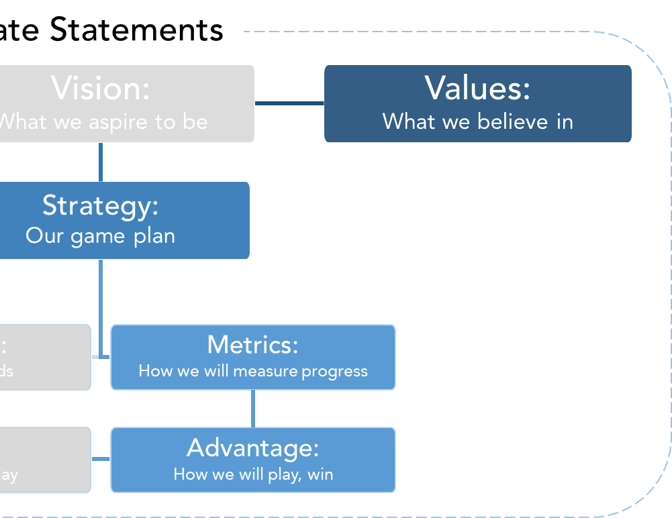
> The importance of organizing systematically
Internal Innovation Ecosystem
Strategy
Style
Structure
Shared Values
Skills
Systems
Staffing
Source: https://www.mckinsey.com/business-functions/strategy-and-corporate-finance/our-insights/enduring-ideas-the-7-s-framework
Notes:
The same adage applies to innovation. McKinsey’s 7S framework, at right, can be used to describe the elements of an innovation ecosystem, including the innovation strategy; structure of innovation capabilities; specific innovation systems used to do things like scout, partner and test & learn; the number of people and types of skill sets required; the optimal leadership style, and the shared values or culture that may help advance innovation most effectively.
Without clear strategic “destinations” (the diagram at left), any innovation “road” (diagram at right) could be the right one. Senior leaders should develop those 7S elements to optimally match what the corporate strategy requires from innovation.
When that link is strong, it becomes possible to continually assess whether the company is traveling down the right innovation road, and to select a new path if needed. When this link is weak – or non-existent – it is easy to invest a lot of people, time, and money into an innovation vehicle that goes nowhere.

