Slide 1
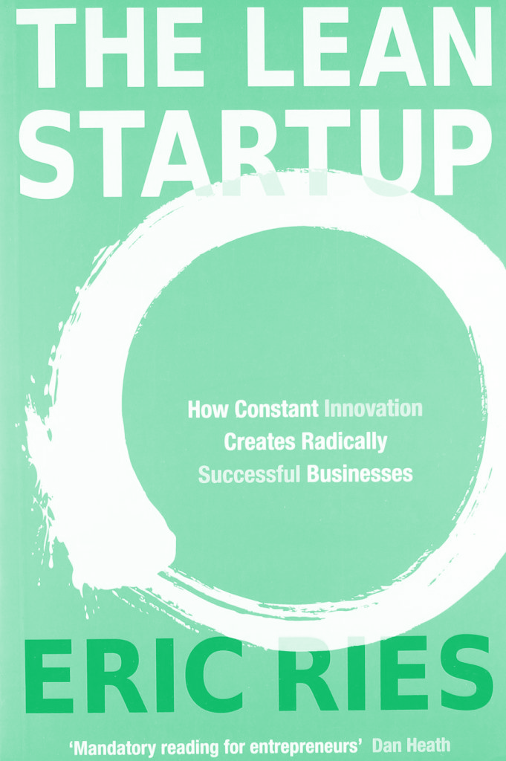
My take on the LEAN START-UP approach to innovation
Alexandru Darie / April 10th 2019

Slide 2

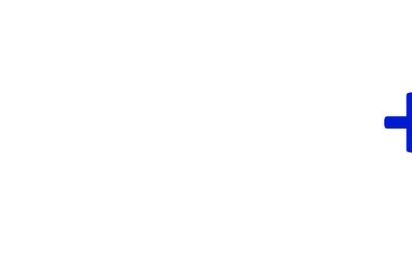
Inspired by the LEAN movement of Toyota Production and applied to the world of innovation
LEAN
START-UP
strive to avoid / reduce /eliminate waste by working in small batches,
when problems occurs, stop and analyze and
react proportional to impact of the issue
operate under extreme uncertainty
to create a sustainable business
through rapid iterations
and continuous user feedback
+
+

Slide 3
Have a VISION that motivates the team. Pivot when STRATEGY does not generate the growth you plan for.
COMMUNICATE
CHANGE
Y
WHAT
HOW
WHY
VISION
STEER
This is your or your company’s TRUE CORE, the reason why you wake-up every day. It almost NEVER changes
True North
Operating in in highly uncertain environments requires you to continuously evaluate your strategy. Have a clear set of PIVOT or PERSEVERE meetings set to discuss change
STRATEGY
Business Model, Product Roadmap, Partners and Competitors, Customers, Launch and Growth Plans
Changes every day based on customer feedback and the vision of the Product Manager
PRODUCT
Product Features, User Stories, Product Architectures

Slide 4
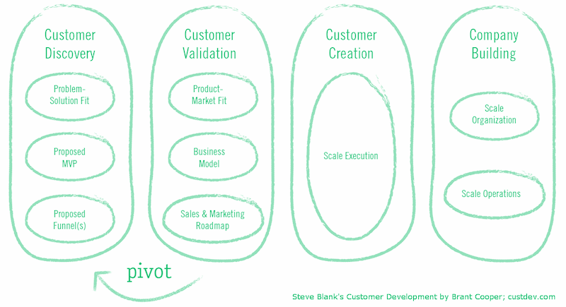
Customer Discovery Process

Slide 5
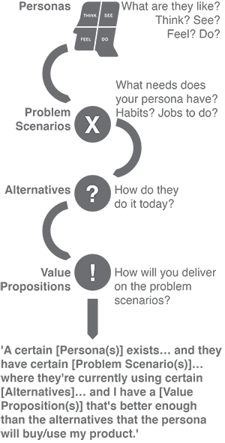
PERSON QUESTIONS Script
PROBLEM QUESTIONS Script
SOLUTION QUESTIONS Script
Who are they?
What is their role?
How do they interact with peers?
How do they find new products?
How much time do they spend on TaskX?
How is their budget handled?
What arethe top 3 challenges in relation to TaskX?
Why? Tell me more…
When was the last time you had [problem]?
How often did this happen to you?
How did you solve it? How long did it take?
What went well when solving it?
What was frustrating or time consuming?
How much did it cost you?
Did you tried something else? How did it go?
If you would describe the ideal solution, how would it look like?
Does this solution solve the problem you described?
Would you be willing to pay for this?
What is your biggest concern about the solution?
Would you be willing to sign up to be one of our early users?
Would you mind to participate in a follow-up interview?
What do they DO, SAY, FEEL, SEE, THINK?
End with and ASK and always FOLLOW-UP
Customer Discovery Interviews
Define right research channels in a 6-step exercise:
Make a list of behavior types and list how you can observe this.
Define at least three online and/or offline channels per behavior type.
Create a small experiment to test if you can see that behavior through that channel.
Assess if you have found enough evidence of (early adopter) behavior.
Approach more early adopters through successful channels and referrals.
Now go out of the building, and go on a date with your special one.
Every team member should do this exercise individually first and get together to discuss their findings and prioritize the results

Slide 6
USER RESEARCH METHODS Framework overview
QUALITATIVE
QUANTITATIVE
Usability testing
A/B Testing
User analytics
ATITUDINAL
BEHAVIOURAL
User interviews
Surveys

Slide 7
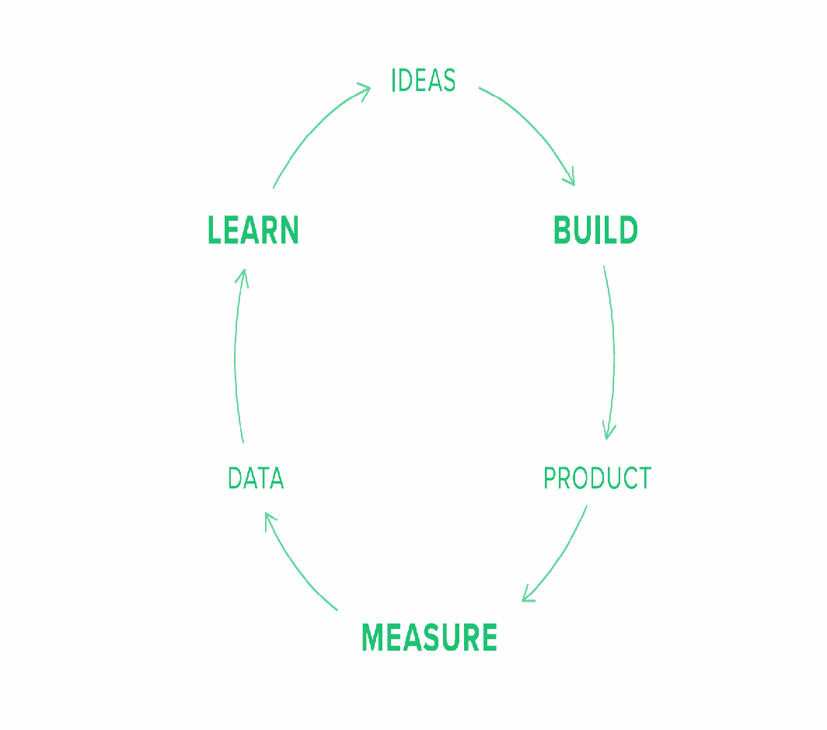
Achieve Product-Market-Fit and Accelerated Growth by ever faster BUILD-MEASURE-LEARN execution cycle
EXECUTION
PLANNING
Build-Measure-Learn cycle is the engine that powers the growth of the business. As the cycle repeats, it also shorten, accelerating with each iteration. There are 3 types of GROWTH ENGINES: Sticky, Viral, Paid
Collecting right data enables the INNOVATION ACCOUNTING that is key to steering the execution in order to avoid waste.
Every investment in execution has to be VALIDATED leading to what it is now called VALIDATED LEARNING
There are 3 main LEARNING MILESTONES:
1. Create the BASELINE
2. TUNE the engine
3. PIVOT or PERSEVERE
IDEAS
Planning cycle works in reverse from Execution one
It is the key to SUCCESS by enabling FAILURES. It advocates for up-front definition of the learning goals and then to validate those.
There are 2 types of HYPOTHESIS – one is addressing the expected GROWTH and other the supposed VALUE delivered to users
To be able to validate those hypothesis, right METRICS need to be define, avoiding so called vanity metrics.
Knowing what you need to measure, it is time to define what is the fastest and the cheapest way of engaging with the users and collect the necessary data to confirm or infirm your hypothesis. Those are your Minimum Viable Products or MVPs
EXECUTION
CYCLE
LEARN
PLANNING
CYCLE
BUILD
HYPOTHESIS
MVPs
DATA
PRODUCT
METRICS
MEASURE

Slide 8
GROWTH ENGINES Overview
MVPs Overview
STICKY Engine of Growth
VIDEO MVP
MECHANISM: Lock-in / Retention
FOCUS: Validating value hypothesis
KPIs: Customer Acquisition Rate & Customer Churn Rate
DELIGHTFUL
PRESENTATION of your product, even thought it does not exist, addressed to the users in order to collect feedback.
It can be executed as a landing page, video presentation, presentation slides, etc
USABLE
VIRAL Engine of Growth
CONCIERGE MVP
RELIABLE
MECHANISM: Spreads with use
FOCUS: Validating value hypothesis / Referral rate > 1
KPIs: Viral coefficient / Referral rate
Focus on a SINGLE or VERY FEW EARLY ADOPTERS and learn everything you can, adapt the solution to their needs.
Once done, slowly start adding more customers and automate the solution
FUNCTIONAL
MVP
PAID Engine of Growth
WIZARD-OF-OZ MPV
MECHANISM: Paid advertising
FOCUS: Validating growth hypothesis
KPIs: Customer Lifetime Value – Acquisition Cost > 0
Pretending you have developed an advanced automated solution, engage with the EARLY ADOPTERS and observe their behavior, learning all you can to improve the solution

Slide 9
MVP TESTS Overview
DESIGN ARTIFACTS Overview
QUALITATIVE
QUANTITATIVE
Marketing materials
Landing page
Explainer video
Ad campaign
Marketing A/B tests
Crowdfunding
Interactive Prototypes
PRODUCT TEST
MARKETING TEST
INTERACTIVITY
Clickable Wireframes
Clickable Mockups
Wireframes
Mockups
Interactive prototype
Wizard of Oz
Concierge
Live product
Fake door
Product analytics
Product A/B tests
Hand sketches
Static Wireframes
Static Mockups
FIDELITY

Slide 10
Product Market fit
Formulate and Validate the Hypothesis at each of the pyramid levels.
When trying to do root cause analyses make sure you go deep enough to prevent you only do cosmetic fixes
UX
FEATURE SET
VALUE PROPOSITION
SOLUTION SPACE
PRODUCT-MARKET FIT
PROBLEM SPACE
UNDERSERVED NEEDS
TARGET CUSTOMER

Slide 11
UX Design Hierarchy
Usable, delightful
VISUAL
INTERACTION
INFO ARCHITECTURE
CONCEPTUAL DESIGN
UX

Slide 12
PIVOT TYPES Overview
ZOOM IN
CUSTOMER NEED
CHANNEL
What previously was considered a single feature becomes the whole product.
Customer remains the same but the need we solve changes.
Changing the way the product is sold to users
ZOOM OUT
PLATFORM
VALUE CAPTURE
What was considered full product becomes just a single feature
Moving from Single Application to Platform or reverse
Change the way you capture value in your solution
e.g. Move from pay-by-user to paid-through-advertising
Move from single sided market to a multi-sides market
where one side subsidize the other
CUSTOMER SEGMENT
BUSINESS ARCHITECTURE
ENGINE OF GROWTH
Change the Customer Segment you focus on.
Watch out for changes in Go-To-Market Strategy, channel of execution, tools to support all the above
e.g. in extreme case moving from B2C to B2B
High margin & Low volume change to Low margin & High volume
Changing the way your solution will grow.
Flip between STICKY/VIRAL/PAID Engines
Watch for the meaningful KPI changes
e.g. From an add-on spreading virally to a stand-alone product people pay for

Slide 13
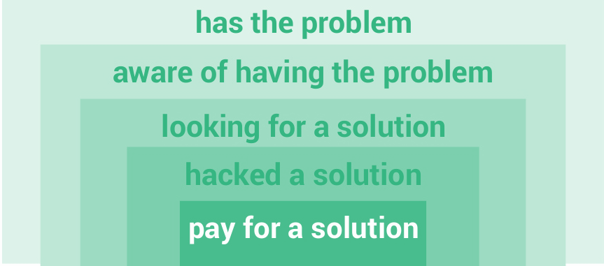
PROBLEM-SOLUTION FIT
SOLUTION-MARKET FIT
!
KEY HYPOTHESIS, METRICS, FAIL CONDITION
PROBLEMS / NEEDS
VALUE PROPOSITION & UNIQUE ADVANTAGE
?
BENEFITS & SUPERIORITY CLAIMS
CUSTOMER SEGMENTS
AND CHANNELS
Main insights / ideas
List of underserved needs or unsolved problems the customer is facing
High-Level Concept & Sustainable Advantage
Main assumptions, including indicators to be tracked and what is the failed condition
Main benefits customer has if his problem is solved. List the marketing claims you can make to show superior product
List of characteristic of targeted customer; Path to the customer and type(s) of interaction to be designed
Value Hypothesis
V1
V2
CURRENT ALTERNATIVE
!
TARGET CONCEPT & MVP
V3
GROWTH ENGINE
Early Adopters
List of existing solution
List of other alternative to solve the same problem, serve the same need
Explain the full concept and list the MVP to be used to drive customer development process and data gathering
Engine of growth type
List of characteristic of ideal first customer
Growth Hypothesis
G1
G2
COST STRUCTURE
G3
REVENUE STREAMS
Customer acquisition costs
Distribution costs
Hosting and Operation Costs
People, office, etc
Revenue models
Lifetime value
Revenue forecast
Gross Margin forecast
INNOVATION ACCOUNTING
CUSTOMER DEVELOPMENT
PRODUCT METRICS
PROJECT METRICS
MARKET METRICS

Slide 14
Problem space Customer Needs Prioritization
100
…
…
…
1
5
Focus
IMPORTANCE
…
…
2
6
3
…
…
7
4
…
….
8
0
DISATISFACTION
100
….
9

Slide 15
HYPOTHESIS PRIORITIZATION
Leap-of-Faith Assumptions Ranking Main Hypothesis Prioritization
V
D-VALUE
G
D- GROWTH
F
FEASIBLE
B
VIABLE
High
Making the assumptions explicit will enable you to define the metrics and the experiments required to reach the learning milestones:
Value Hypothesis: what value and how are you delivering it to target users
Growth Hypothesis: how and how fast will users adopt your solution
Mapped the most critical hypothesis in time and magnitude in order to define the priority. Define experiments / MVPs required to validate most critical hypothesis.
…
…
G1
V1
Focus
MAGNITUDE OF IMPACT
…
…
G2
V2
G3
…
…
V3
G4
…
….
V4
Low
Low
IMMINENCE OF IMPACT
High
….
V5

Slide 16
METRICS TYPES AARRR Framework Overview
METRIC THAT MATTER MOST Process overview
MARKETING
Define your key metrics
1. ACQUISITION
Prospects visit from various channels
Measure your baseline
Ideas selection
2. ACTIVATION
Prospects convert to customers
Evaluate ROI potential of each metric
Select MMM to improve
Ideas to improve
Design & Implement
PRODUCT
3. RETENTION
Customer remain active
4. REFERRAL
Customer refer prospects
Observe changes and Learn
5. REVENUE
Customer making your business money
GLOBAL LEVEL
METRIC LEVEL

Slide 17
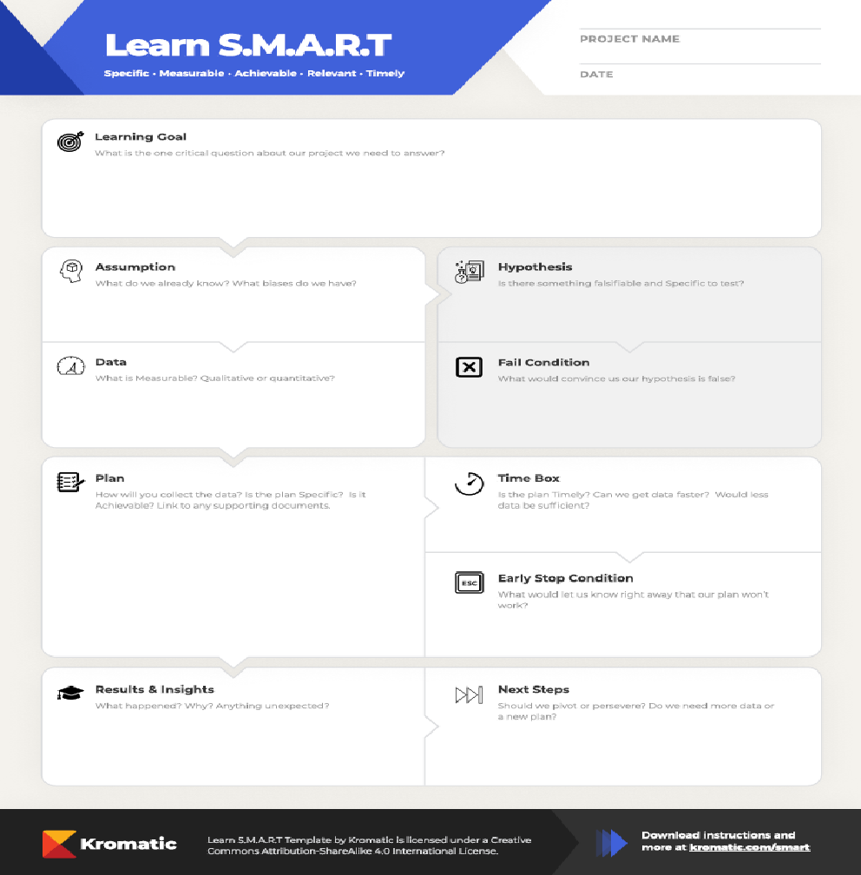
Interact Light play – Learning Goal to Hypothesis to Experiments Design
LEARNING GOAL
What is the one critical question about our project we need to answer
PLAN
TIME BOX
How will you collect the data? Is the plan Specific? Is it Achievable?
Is the plan Timely? Can we get data faster? Would less data be enough?
ASSUMPTION
HYPOTHESIS
What do we already know? What biases do we have?
Is there something FALSIFIABLE and SPECIFIC to test?
EARLY STOP CONDITION
What would let us know right away that our plan won’t work?
DATA
FAIL CONDITION
RESULT & INSIGHTS
NEXT STEPS
What is measurable? Qualitative or Quantitative?
What would convince us our hypothesis is false?
What happened? Why? Anything unexpected?
Should we pivot or persevere? Do we need more data or a new plan?

Slide 18
Business Forecast Main Hypothesis to Key Performance Indicators Forecast
HYPOTHESYS
KPIs
Target 3m
Target 6m
Target 12m
…
V1
…
…
…
V2
…
…
V1
…
V2
…
V3
…
G1
…
G2
…
G1
…
G2

Slide 19
Build-to-Learn MVPs Definition
MVP1
MVP2
MVP3
MVP4
…
…
…
…
…
V1
…
✔
✔
✔
✔
V2
…
V1
✔
✔
✔
…
V2
✔
…
V3
✔
✔
✔
✔
…
G1
✔
…
G2
✔
✔
…
G1
✔
✔
✔
…
G2
✔

Slide 20
Business Roadmaping Where to go next?
HORIZON III
HORIZON III
HORIZON III
V1
Radically New Markets
V2
V1
HORIZON II
HORIZON II
HORIZON III
G2
Adjacent Markets
G1
G2
HORIZON I
HORIZON II
HORIZON III
Existing Markets
Existing Offers
Adjacent Offers
Radically New Offers

Slide 21
Key Partners
Key Activities
Value Proposition
Customer Relationships
Customer Segments
…
…
…
…
…
…
…
…
Key Resources
…
Channels
…
…
…
…
…
…
…
Cost Structure
Revenue Streams
…
…
…
…

Slide 22
Business Models Exploration
1
...
2
...
3
...
4
...
5
...
6
…
ACTIVITIES
DECISSIONS
High
...
4
...
3
TRANSFER
INNOVATE
6
1
...
...
EXPECTED RETURN
increase expected profitability
DESIGN
2
...
...
IDEATE
5
KILL
Low
High
INNOVATION RISK
Low
TEST / VALIDATE
reduce risk / increase sustainability

Slide 23
Roadmap – Releases + Launches
DEV: $xxx
DEV: $xxx
VENTURE $$$
$xxx
$xxx
GOALS
MVP1 w/ AI Released
MVP1.1 w/ AI Updated
MVP2 w/ improved AI Released
# NPS Score increase
# NPS Score increase
# Sales increases
2020
NOW
Q1
Q2
Q3&4
BusDev / MarCom / Launch
...
...
...
VENTURE
...
User App / Feature Release
...
...
...
...
...
...
...
...
ISAAC
...
...
..
User Resh. / Design Resh. / UX / UI
...
...
DESIGN
ISAAC
...
...
...
AI Features
...
...
...
...
RESEARCH
ISAAC
...
...
AI Algorithms / Data Sources
...
...
...
....
...
...
...
...
RESEARCH

Slide 24
DASHBOARDS & QUERIES
(Democratized Data Access and Self-service tools)
PROMOTION CAMPAIGN
CUSTOMER SUPPORT
USER TRACKING
APPLICATION MONITORING
INFRA MONITORING
ECOMMERCE MONITORING
ENTERPRISE SYSTEMS
POWERED BY TOOLS AND TECHNOLOGY
DATA INGESTION
DATA LAKE
DATA WAREHOUSE

Slide 25
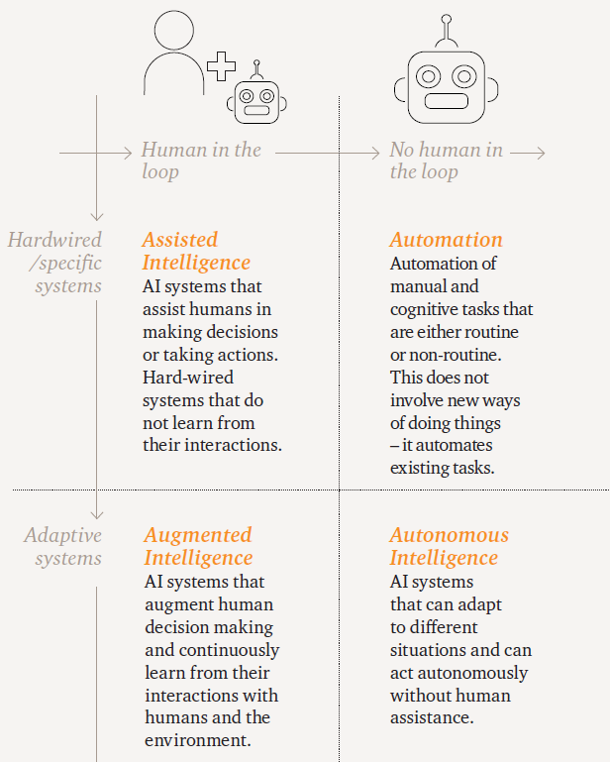
AI Organization - Idea2Impact process
IDEATION & GOALS
PRIORITIZATION
IMPLEMENTATION CHOICES
TRANSFORMATION
PERFORMANCE
CATCH THE NEXT WAVE
MAKE THE NUMBERS
USE-CASE GENERATION
RUTHLESS PRIORITIZATION
GENERATING
TECHNOLOGY -> BUSINESS APPLICATION
PROFITABLE GROWTH
Focused on scaling a particular disruptive opportunity identified in the incubation zone to a material revenue
Focused on maximizing the current primary revenue stream of the company
BUSINESS APPLICATION -> TECHNOLOGY
GOALS CLASSIFICATION
MARKET DIFFERENTIATION
MARKET OPPORTUNITY
UNIQUE ASSETS
INVESTMENT REQUIRED
EXTERNAL DISRUPTIONS
NETWORK EFFECT
COST
RETURN ON INVESTMENT
PAYBACK PERIOD
NONMATERIAL IMPACT
CHANCES OF SUCCESS
ORG. READINESS
MORE ENGAGEMENT
PRODUCTIVITY BOOST
DISRUPTIVE
PRIO CRITERIAS
SUSTAINING
RECOGNITION
RECOMMENDATION
PERSONALIZATION
AUGMENTED REALITY
KNOWLEDGE SYSTEM
OUTCOME PREDICTION
FORM AUTOMATION
CONVERSATIONAL UI
OMNI-BOOTS
INNOVATION
BREAKTHROUGH INNOVATION
SYSTEMS & PROGRAMS
VALUE ESTIMATION
Focused on evaluating multiple new opportunities enabled by new technology waves to identify future viable business options
Focused on delivering the programs and systems to support the performance zone
USE-CASE VALUE MODELING
USER NEEDS RESEARCH
CONSUMING
REVENUE
INCUBATION
PRODUCTIVITY
HOW TO ACHIEVE IT?
POSITION FOR THE NEXT WAVE
MAKE IT ALL WORK
MAKE
BUY

Slide 26
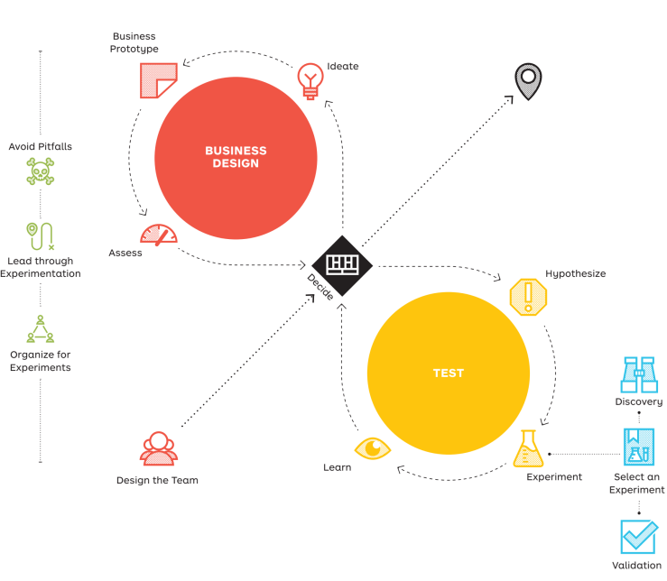
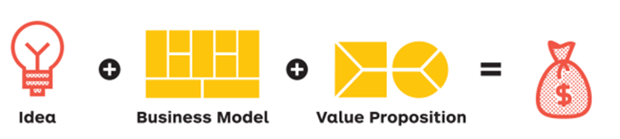
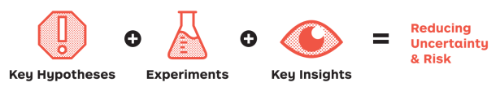

Slide 27
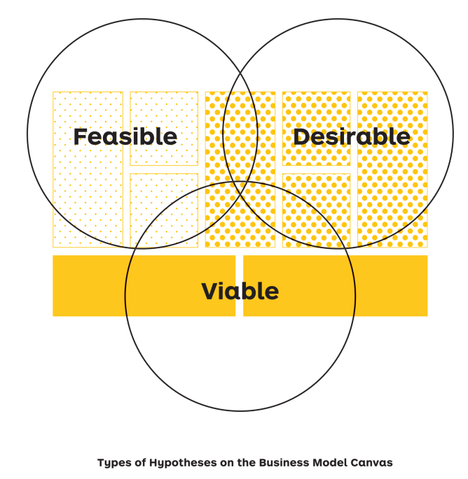
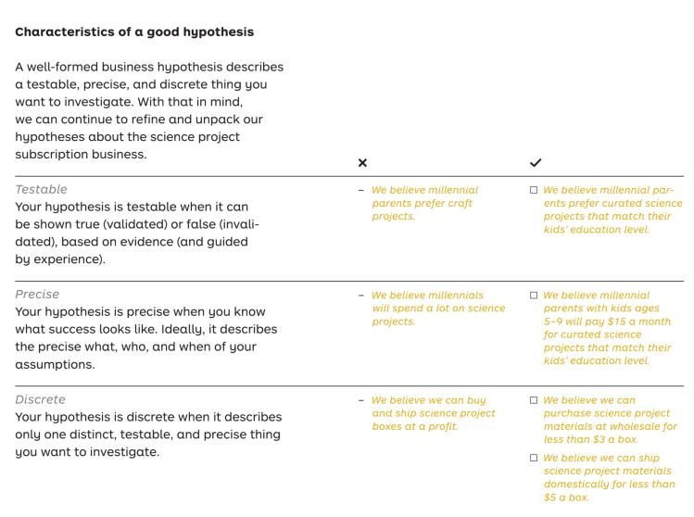
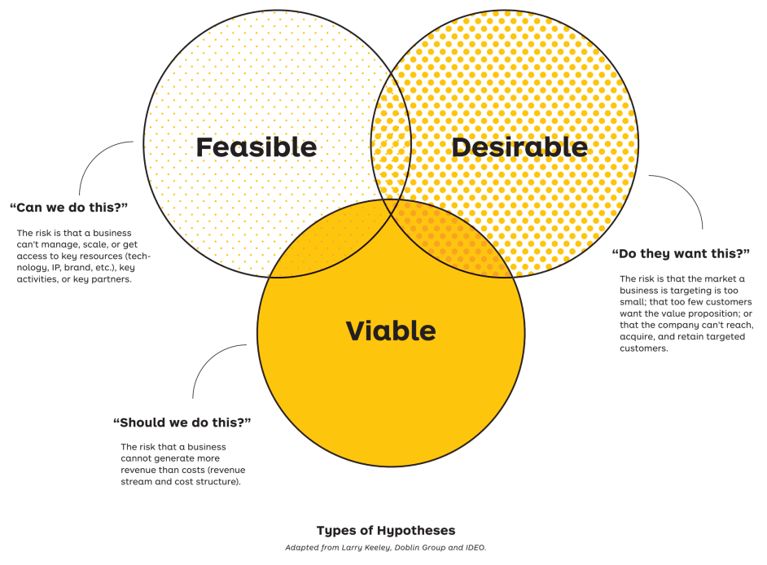

Slide 28
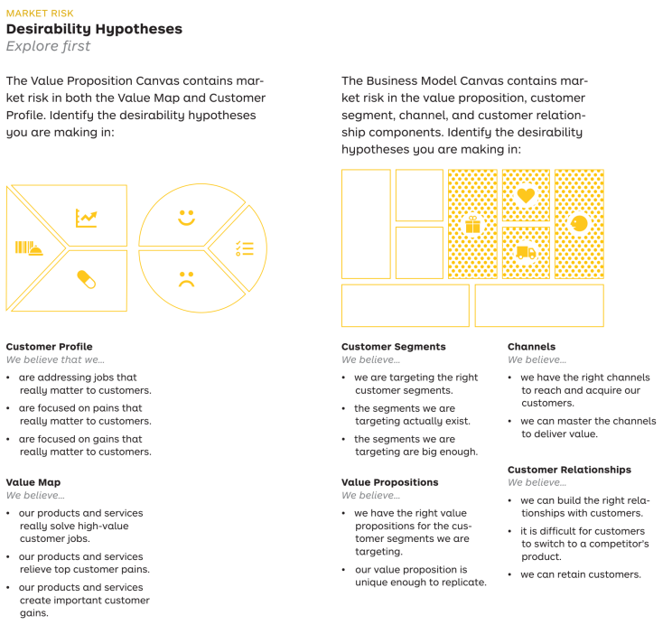
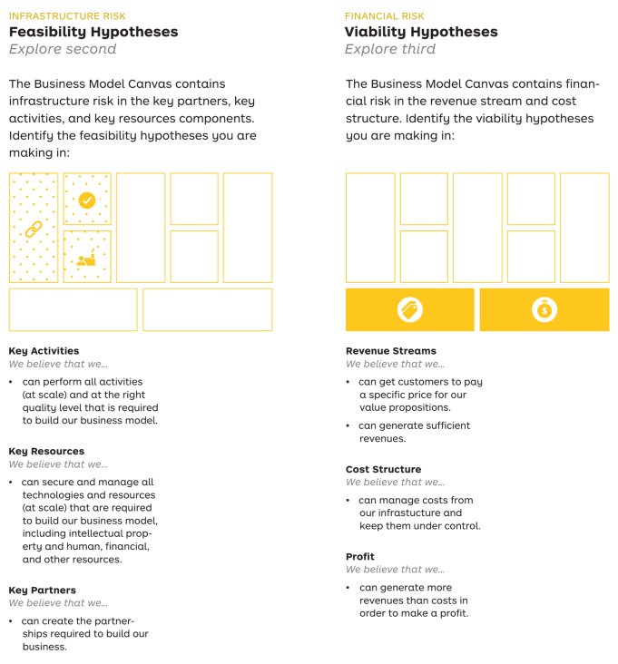
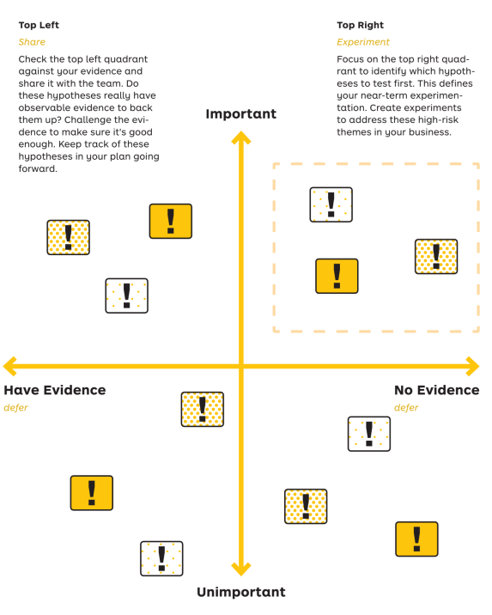

Slide 29
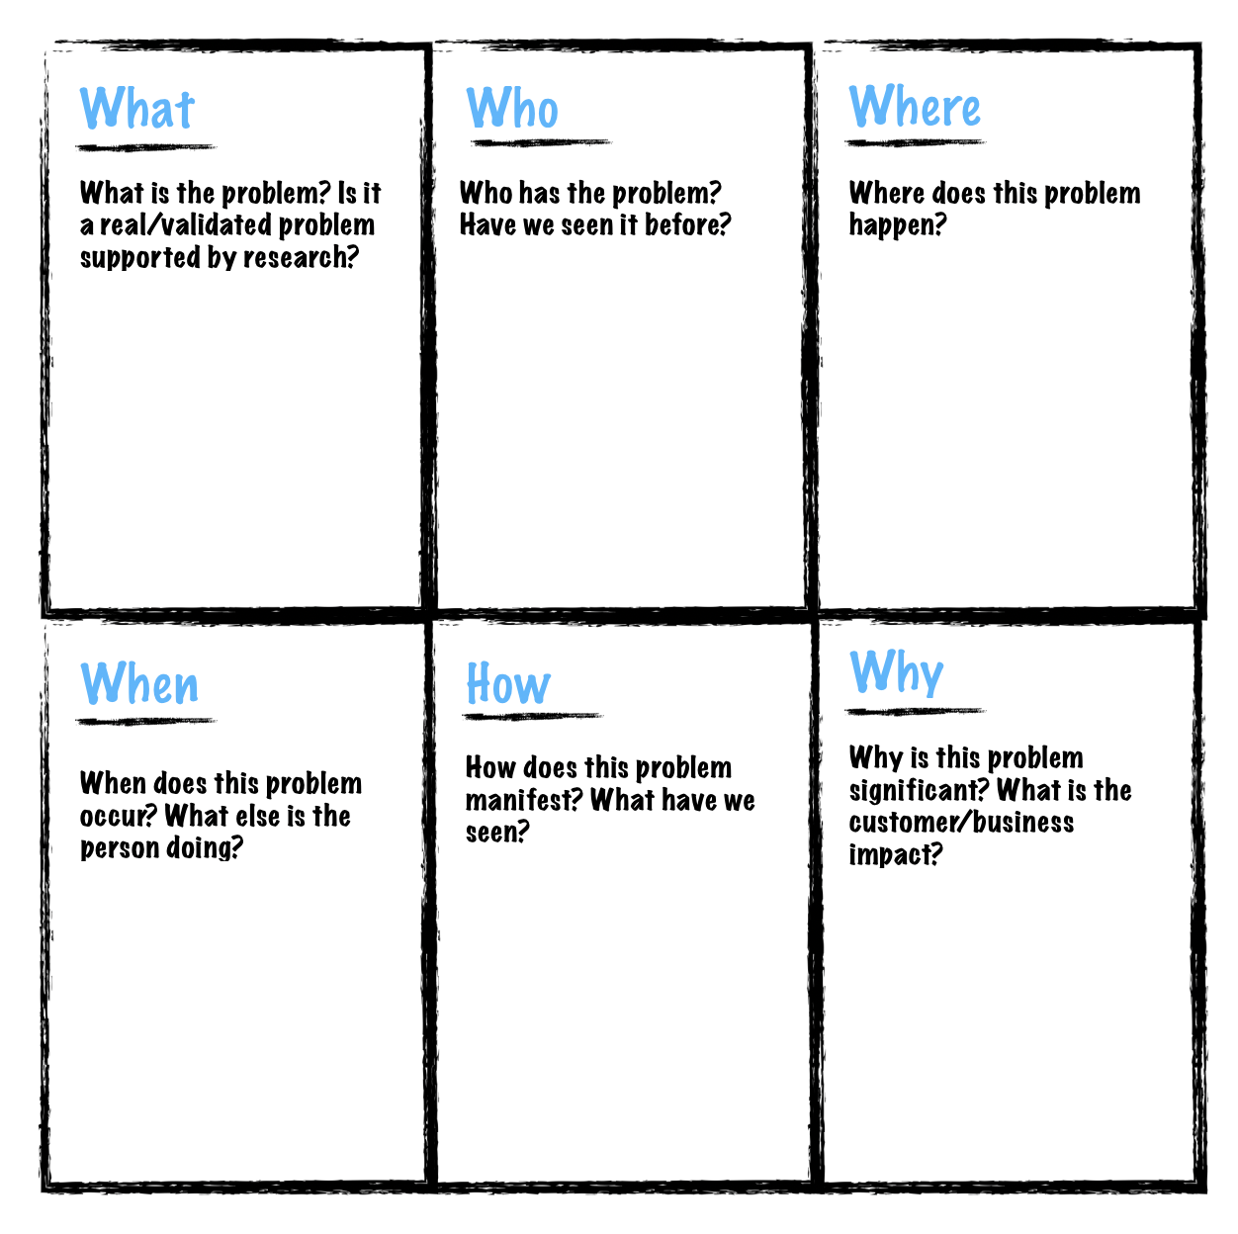
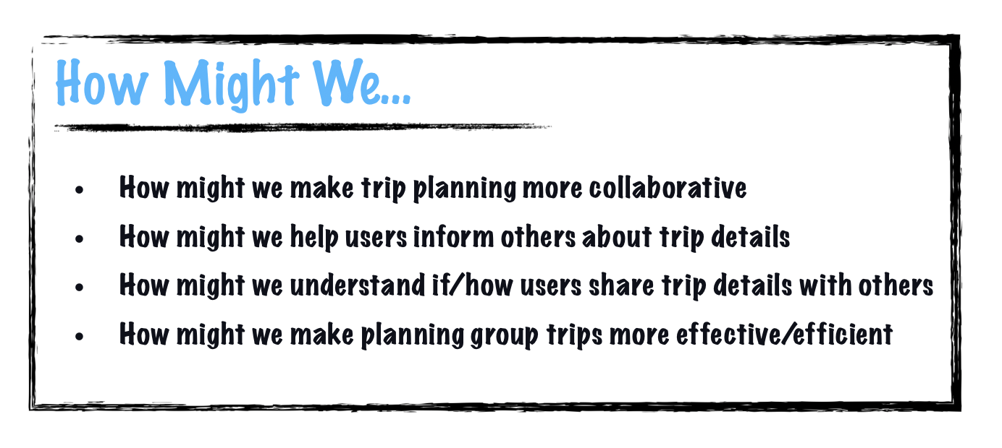
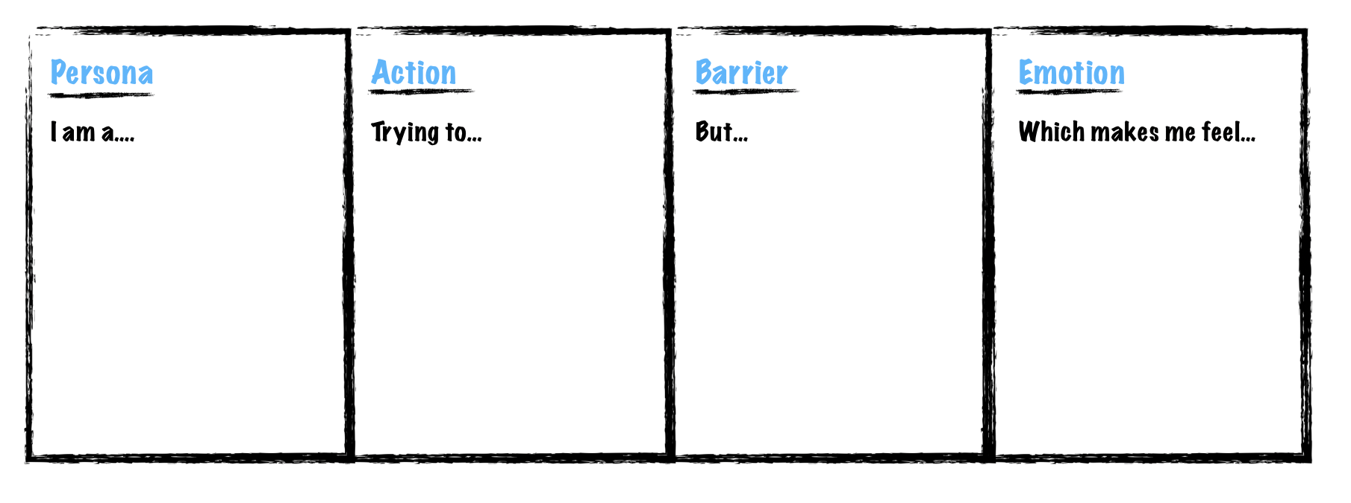
White hat: Facts - What information do we have? - What hasn’t worked in the past? - What information is missing that we need? - What are the weaknesses? Green hat: Creativity - What are the other angles we are missing? - What are the alternatives? - What are the next steps? Yellow hat: Benefits - What are all the benefits of the different options? - What solutions would work? - What is the best-case scenario (for users and the business)? Black hat: Risk - What are the different risks of each option? - What solutions would not work? - What is the worst-case scenario (for users and the business)? Red hat: Feelings - How do the options make you feel (from the user’s perspective)? - What do you like about the options? - What don’t you like about the options? Blue hat: Process - Where are we now? - What other work needs to be done? - What is the next step?

Slide 30
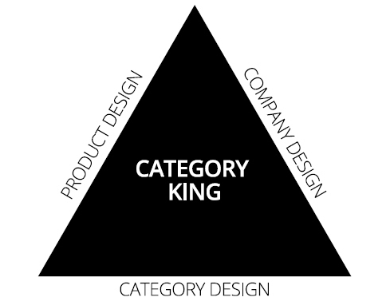
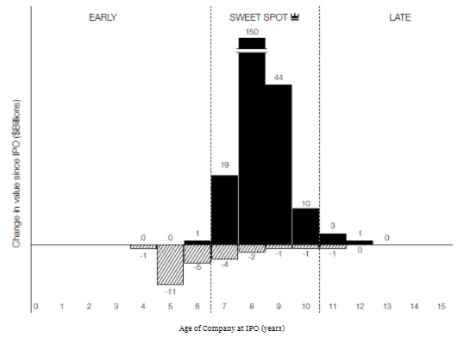
Category kings are taking 70..80% of the category value They design PRODUCT, COMPANY and CATEGORY at the same time. They sell DIFFERENT not just better

Slide 31
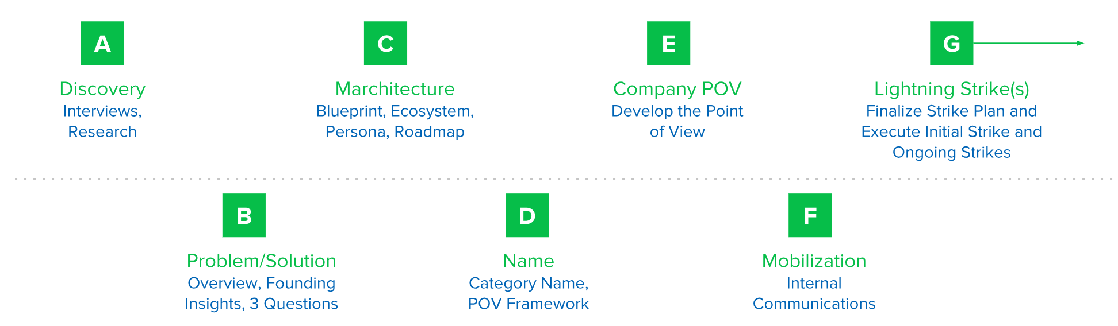
From Insight to Category to Point-of-View to Launch
Technology insight: …
Market insight: …

Slide 32
Finding the Category
What problem do you want to solve?
Is this a market insight (Uber) or technology insight (VM Ware), and why?
If you solve that problem, what is the category?
If you build the category, how big is it?
What could be the “emotional a-ha!” your customers will feel when they have a deep problem that needs solving?
Vision mission: What was the original market or technology insight that led you to create this company?
Customers: Who do you envision buying this product or service? Who will use it?
Problem statement: What’s the problem you think you can solve for your potential customers?
Use cases: What are the specific ways people will use this product or service to solve their problem?
Product/solution: Give a detailed explanation of the technology behind the solution—what does it do now, and what else is it capable of doing?
Ecosystem: In many cases there are other companies involved in solving the problem or adding additional value. These companies form an ecosystem around the problem and solution. What are all the companies and where in the ecosystem are the control points where one company has leverage?
Competition: Who else is trying to solve this problem—or, if no one else sees the problem yet, who might jump in to compete with you to solve the problem once you identify it?
Business model: How will your product or service change business for your customers? Will it increase their return on investment or reduce costs in a significant way? Or does it allow them to do something that couldn’t have been done with prior technology, creating huge value?
Sales and go-to-market: Enterprise companies should articulate how the product or solution will make its way to the market. Through a sales force? Through distribution partners? Both? For a consumer company, how will users find out about your solution? From app stores? Search? Viral adoption? Growth hacking techniques? Advertising? PR?
Organization: How is the company organized? Who are the major influencers on the company? How are decisions made? What kind of culture will work?
Funding strategy: What’s the next funding event? A private financing? An IPO? How much runway does the company have before it needs more money and what kind of funding is in place to execute against the category strategy?

Slide 33
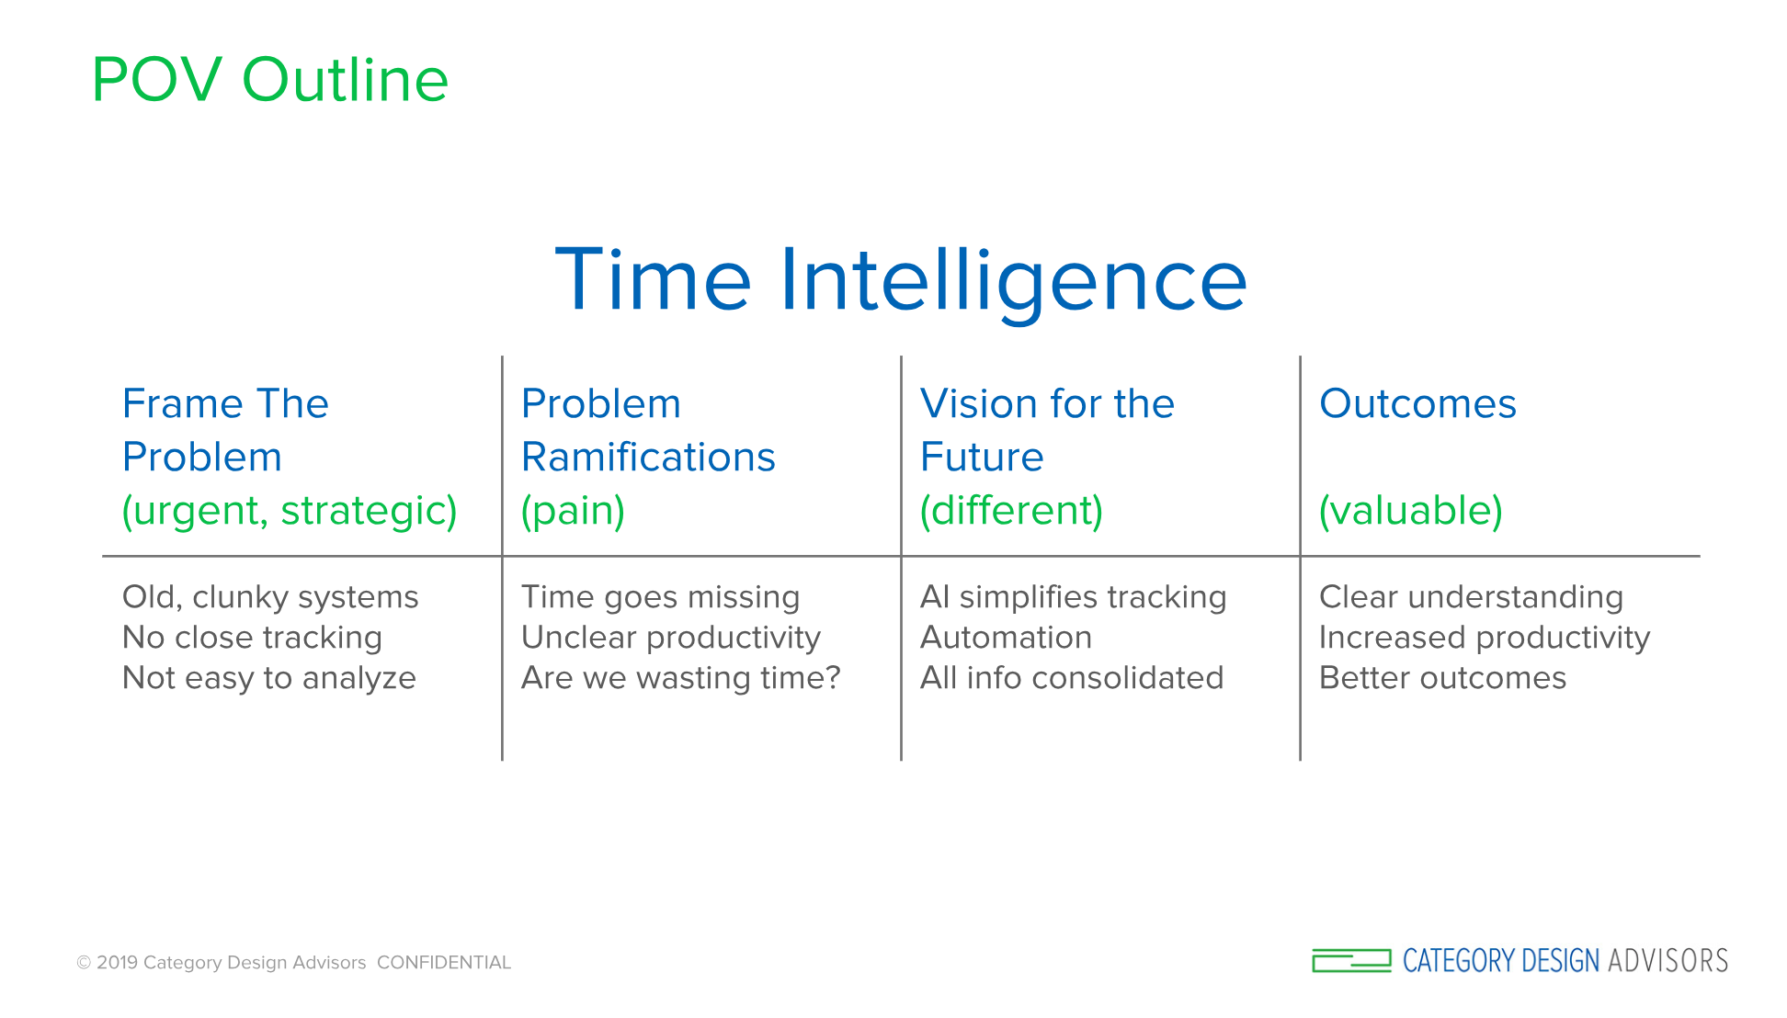
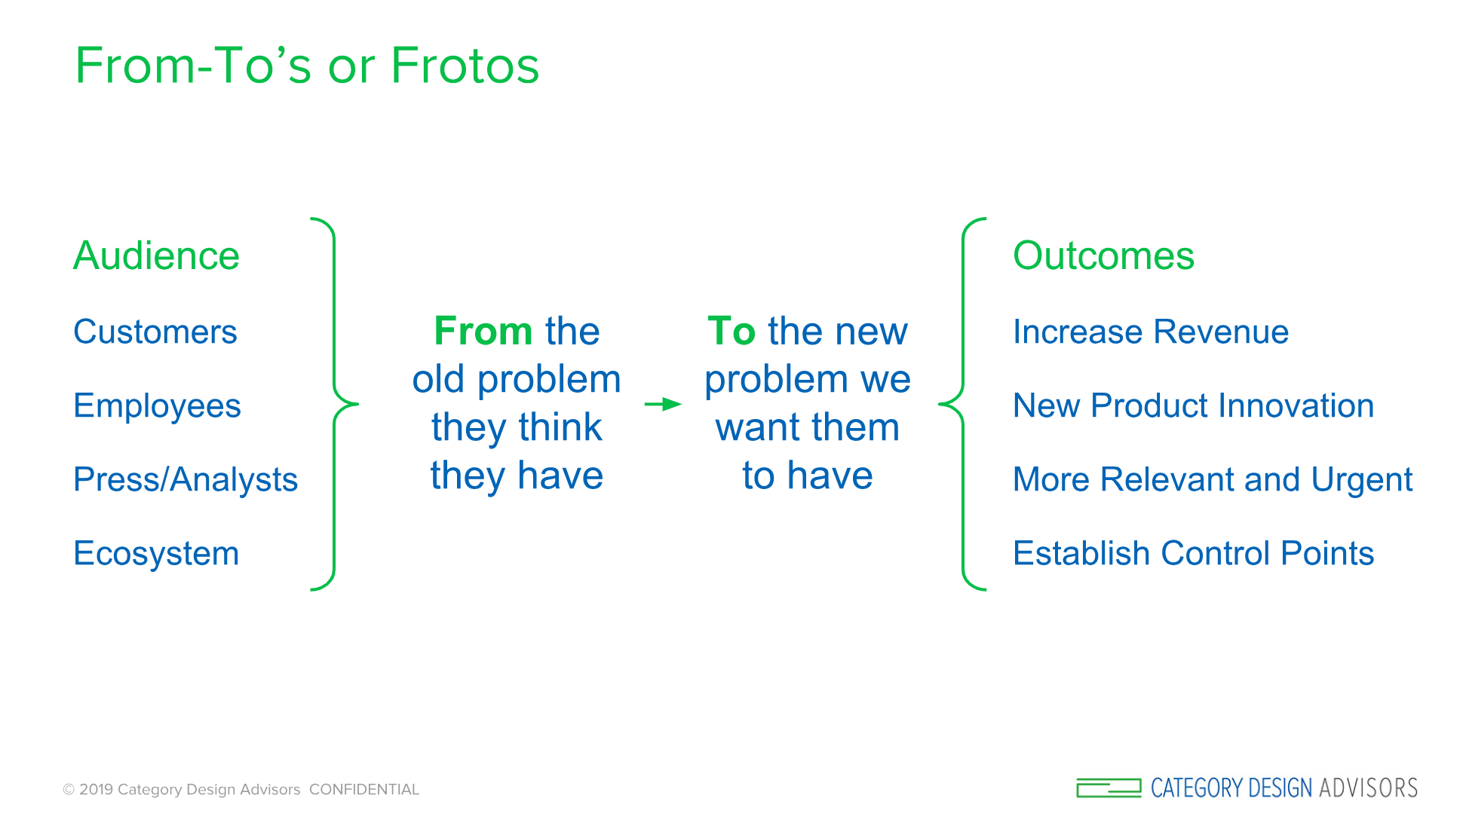
Finding the Point-of-View
HOW THE COMPANY AND PRODUCT ARE DIFFERENT:
The POV needs to express different , not better . So what is that difference? What are all the things that are different about this company and product? Which ones will strike a chord with which audiences? What is the different that could ultimately give the company its identity?
HOW THIS COMPANY WILL CREATE THE PRODUCT OR SERVICE THAT SOLVES THE CATEGORY’S PROBLEM:
Discuss not just what you’ll ultimately offer to customers, but how you can get there. What’s the road map for achieving the vision? For getting to different ?
THE ENVISIONED ULTIMATE OUTCOME:
If the company is successful, what will the world look like? How will it be changed? Will it mean, as Salesforce’s POV said, “the end of software”? Will it mean, as Sensity forecasted in its POV, the establishment of a new kind of Light Sensory Network? How is that ultimate vision different or the same compared to visions already circulating?
THE NATURE OF THE COMPANY:
Benioff set up Salesforce as a pirate competitor with a humanitarian heart. Southwest has a freewheeling, fun-loving image. Apple is on a mission to bring elegant and uncompromising design to technology. What is your company’s culture? What kinds of people lead it? What image does it want with the public and in the media?

Slide 34
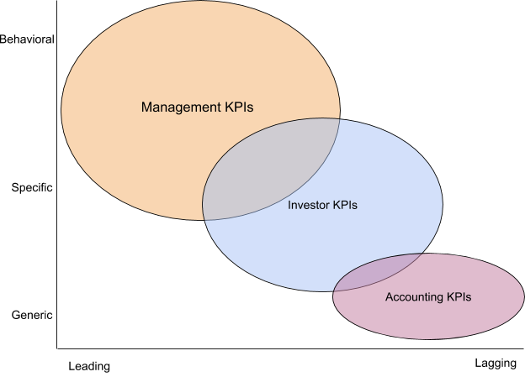
Metric Term | Definition | Example
Actionable | Measurements that indicate clear actions to be taken. | iOS crash reports per day
Vanity | Measurements for the sake of bragging. | Total iOS downloads
Flow | Measurements that change over time. | Daily active users
Stock | Cumulative metrics. | Total user signups
Qualitative | Stories. | NPS O Feedback
Quantitative | Numbers. | 30 Day NPS Score
Leading | Predictors of future performance. | Average weekly hours in manufacturing
Lagging | Indicators of past performance. | Labor cost per unit of output
Correlation | Those indicators that are common to most every company. | Cash balance
Specific | Indicators unique to businesses like yours | Daily active users
Behavioral | Operating based on the behavior of customers. | % of new users
Management KPIs | KPIs that drive the behavior of your company based on customer insights. | % new users posting 7th picture
Investor KPIs | More specific and leading metrics often inquired of by people knowledgeable of businesses like yours. | Monthly Recurring Revenue
Accounting KPIs | Common metrics shared by most companies. | Cash balance
Value KPIs | Indicates the value you’re creating for your customer and capturing in your business. | Lifetime Value
Growth KPIs | Measures your ability to scale the business. | Cost-to-acquire and lifetime value ratio

Slide 35
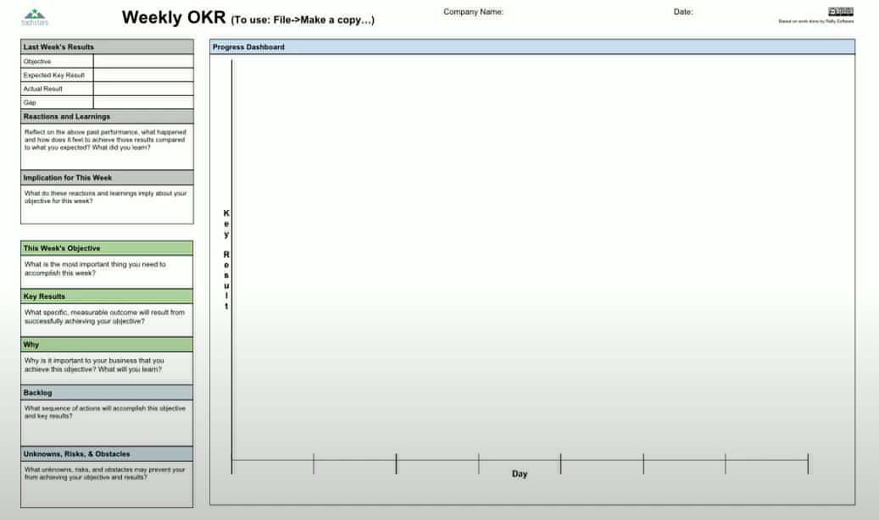
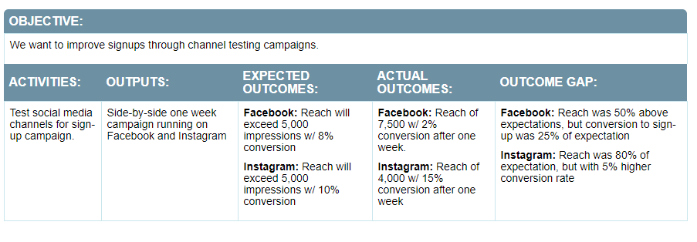

Slide 36
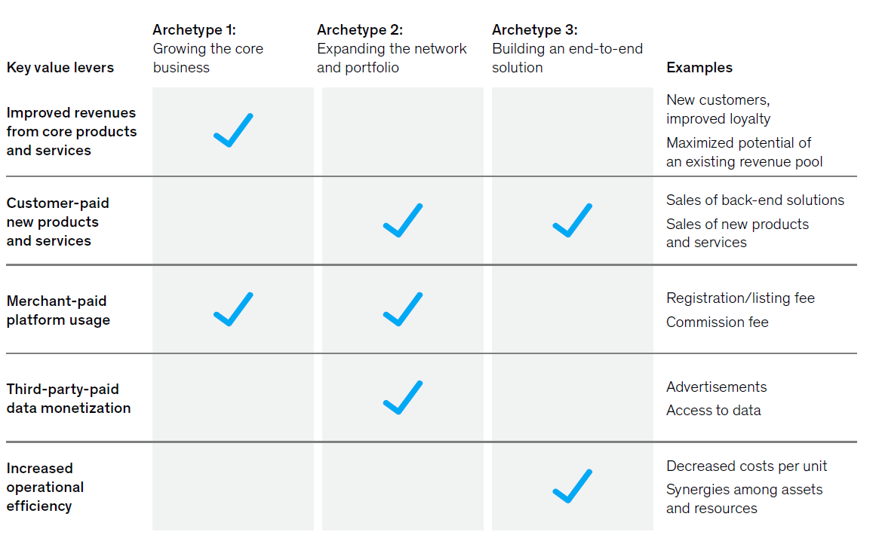
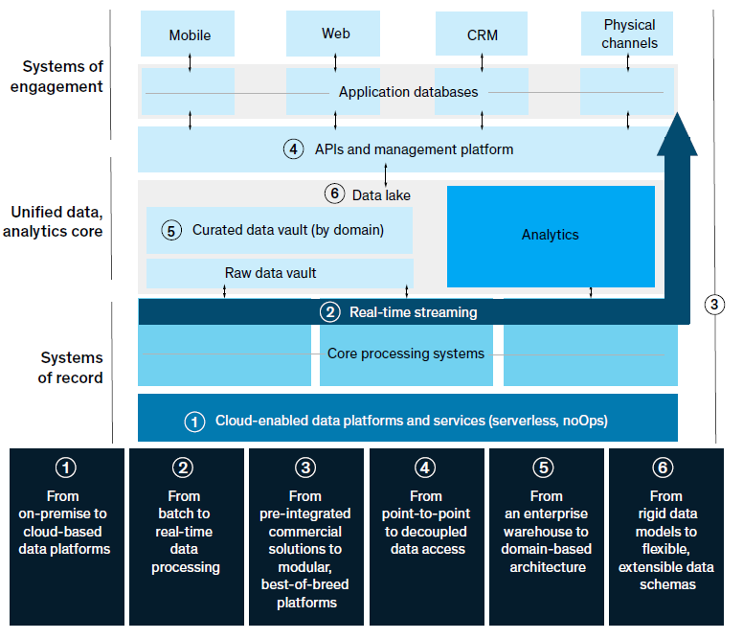
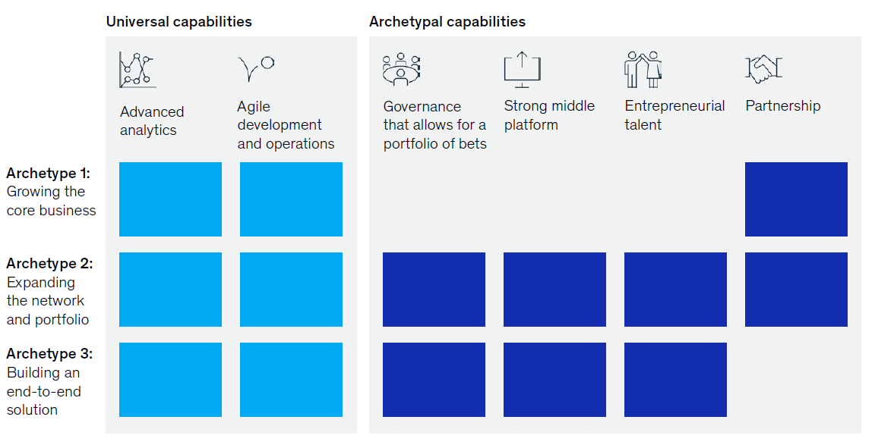

Slide 37
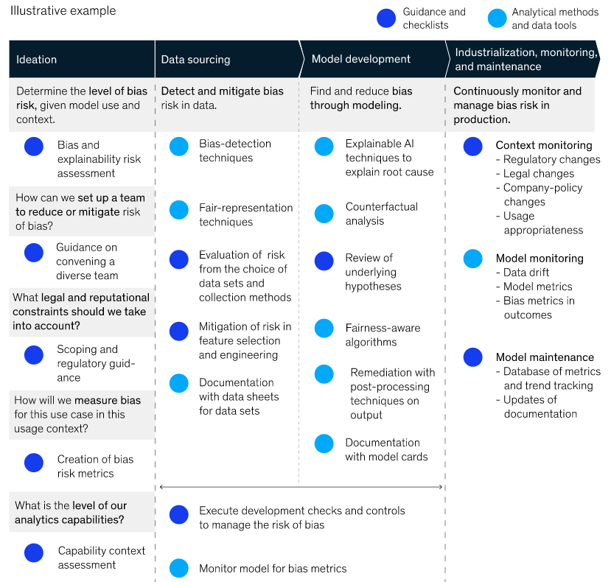
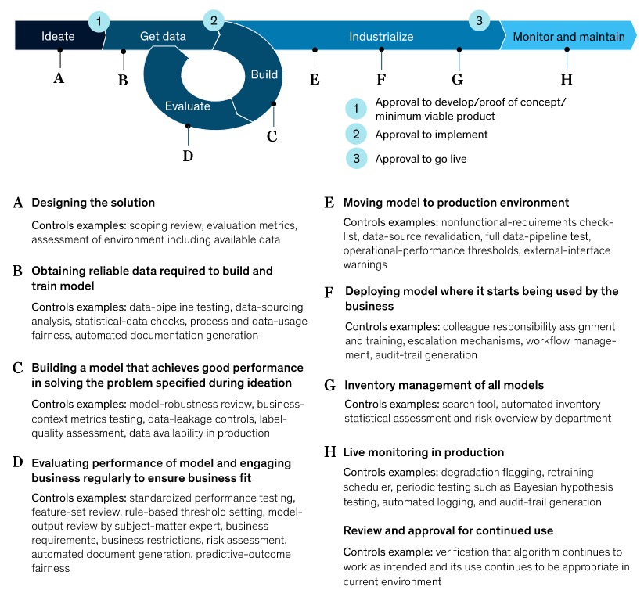
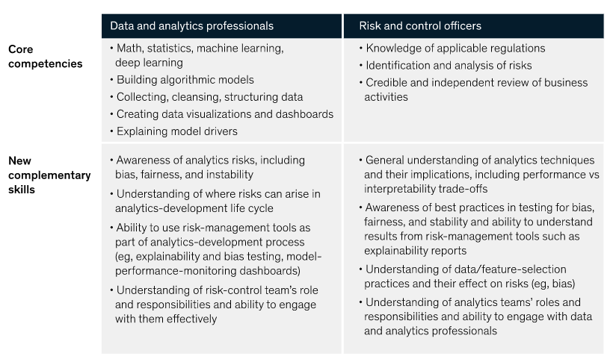

Slide 38
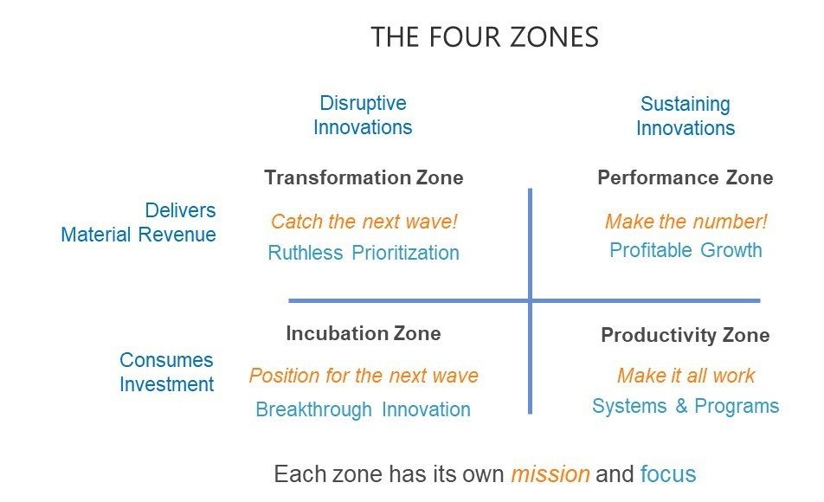
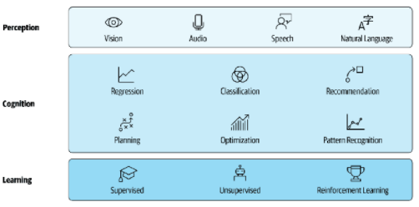

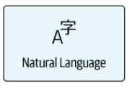
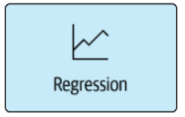
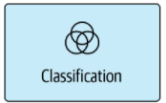
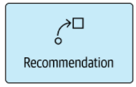

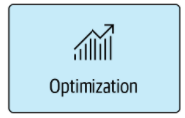
Metrics associated with the business impact
These are closely aligned to your selection criteria and they are different for projects in each of the four zones. Some examples of business impact metrics are adoption, revenue, cost savings, and productivity increase.
Quality metrics
You’ll want to measure the level of quality of the final product, as well as its evolution. Metrics in this group can include the accuracy of the system, user satisfaction, deployment ratios, and volume of support incidents.
Metrics related to the implementation
To improve future execution and readiness, you should also measure the implementation itself: for example, schedule performance, budget performance, employee satisfaction, and completeness of requirements.
Market differentiation
Will this use case create a strong, sustainable differentiation for the organization in the market?
Market opportunity
What total addressable market is associated with this use case?
Unique assets
What unique assets (data, processes, customer base, etc.) does the organization have to address this use case in a different way than its competitors?
Investment required
Can the organization sustain the long-term investment required to successfully develop the use case and move it to the transformation zone?
External disruptions
Is there an external disruption that the organization may miss out on if it doesn’t target this use case? What is the potential negative impact of that?
Network effect
Can this use case ignite a virtuous cycle with exponential growth?
Cost
What is the estimated cost of the implementation, including internal and external resources?
Return on investment
How profitable can we estimate the use case to be, in terms of incremental sales, reduced costs, productivity gains, or improved quality?
Payback period
What’s the estimated time it will take for the investment to pay for itself?
Nonmaterial impact
What other metrics might be affected by the use case (customer satisfaction, loyalty, brand perception, increased barriers for competitors, etc.)?
Risk
How likely is the implementation of the use case to be successful? What dependencies and uncertainties are involved?
Readiness
Is the organization in a good position to implement this use case? Does it have the necessary resources (data, infrastructure, human resources, organizational resources) for it?

Slide 39
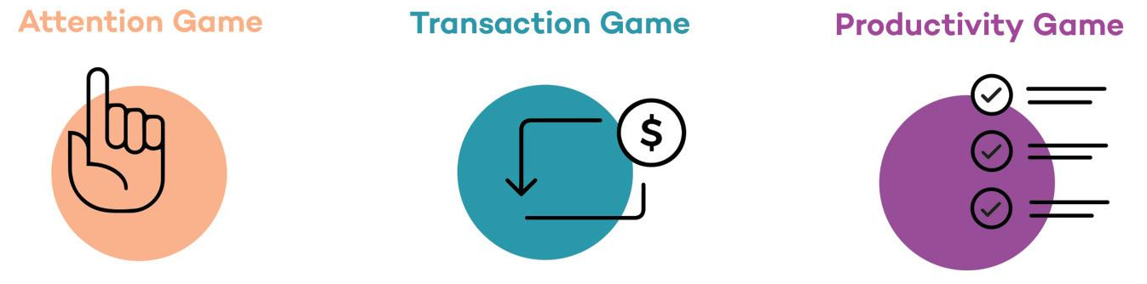
What game are you playing?
You are playing the Attention Game…
If you find yourself saying this:
Our business benefits directly if customers spend more time with our product.
We want customers’ mindshare.
Customers use our product to read, watch, listen, and play.
Or your product is similar to this: Facebook (social networking); Netflix (online video); Atlanta Journal Constitution (newspaper)
Example of an Attention oriented North Star Metric:
Company: Atlanta Journal-Constitution (newspaper)
North Star Metric: Regular readers
Definition: Number of subscribers consuming more than 7 articles per month
You are playing the Transaction Game…
If you find yourself saying this:
Our business benefits directly if customers participate in the economy using our product.
We want customers’ wallets.
Payments and commerce are important to us.
Customers use our product to purchase, order, measure, transact, and track.
Or your product is similar to this: Amazon (retail and logistics); Walmart (discount retail); Progressive Insurance (personal insurance)
Example of a Transaction oriented North Star Metric:
Company: Walmart (discount retailer)
North Star Metric: Full Carts
Definition: Number of monthly purchases that contain over a certain number of items.
You are playing the Productivity Game…
If you find yourself saying this:
Our business benefits directly if customers efficiently accomplish tasks using our product.
Efficiency and achievement are important to us.
Customers use our product to make, work, complete, configure, and build.
Or your product is similar to this: Salesforce (business & customer management software); Adobe (design and publishing software); LexisNexis (legal research)
Example of a Productivity oriented North Star Metric:
Company: LexisNexis (legal research)
North Star Metric: Actionable Searches
Definition: Percentage of searches that return results selected by users within first 5 results.

Slide 40
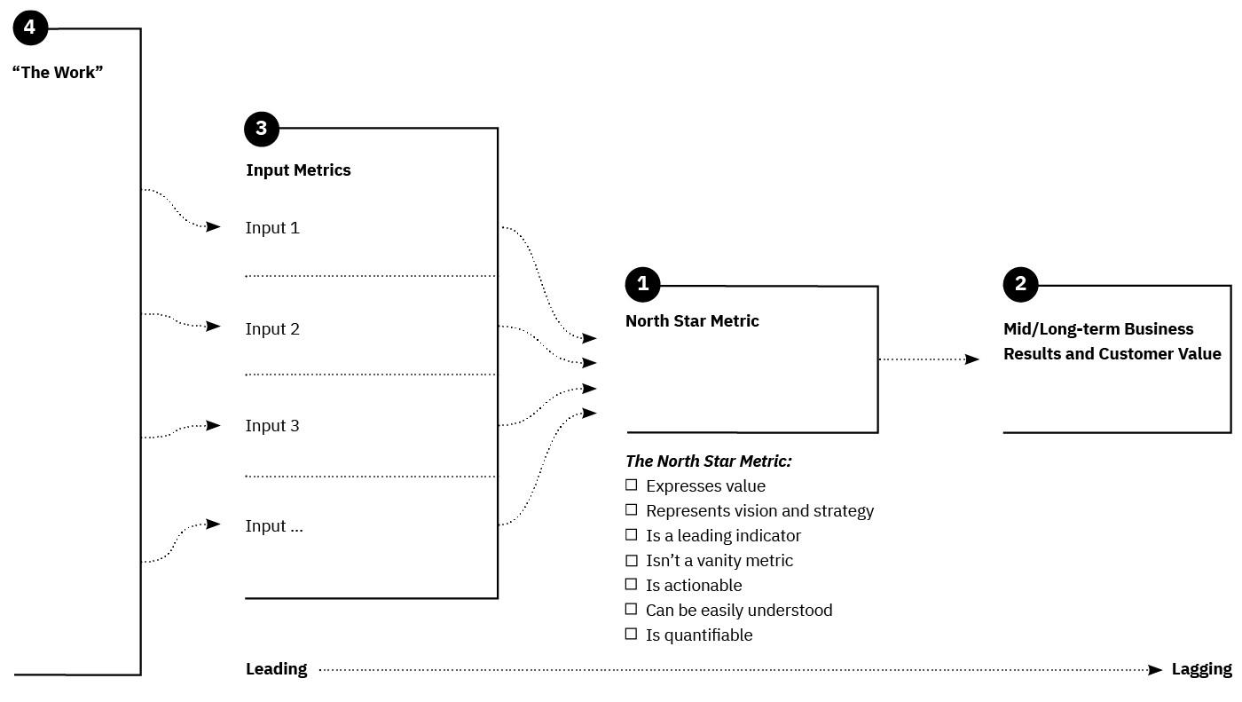
What is North Star Metric?

Slide 41
The definition of your metric should cover both your product’s current market, functionality, and performance and its potential future.
There will always be a healthy tension between what you are (the current state of your product) and what you want to be (some new reality you want to enable with your product). For a first pass, brainstorm the actual behaviors that might align with the concept behind your North Star Metric and inputs. For example, if your product is designed to encourage regular meditation, you might observe prolonged streaks of daily meditation sessions.
When converging on your North Star Metric and inputs, consider the following questions:
How will changes in this metric impact your decision-making? What decisions are you hoping to inform? If you have historical data, “try on” the various changes in the metric over the months or years.
What doesn’t this metric tell you? Are any of those questions or uncertainties more important to address?
Assume that all product development activities stopped. Would the metric increase? For how long? Why?
In his talk Performance… It’s for People!, Andy Davies argues that, “Your analytics are skewed. They’re biased towards visitors who’ll tolerate the experience you’re delivering,” How does your chosen metric account for this?
Will you eventually be able to generate this metric continuously or frequently with minimal effort?
How is the metric affected by seasonality, day-of-the-week, and day-of-the-month effects?
Is it possible (and helpful) to compare this metric across various account and user cohorts? Ideally, there is value in viewing it in isolation and across cohorts.
What will be your signal to revisit this metric? Assuming you revisit it periodically, what tests will you run to determine that it is still useful?

Slide 42
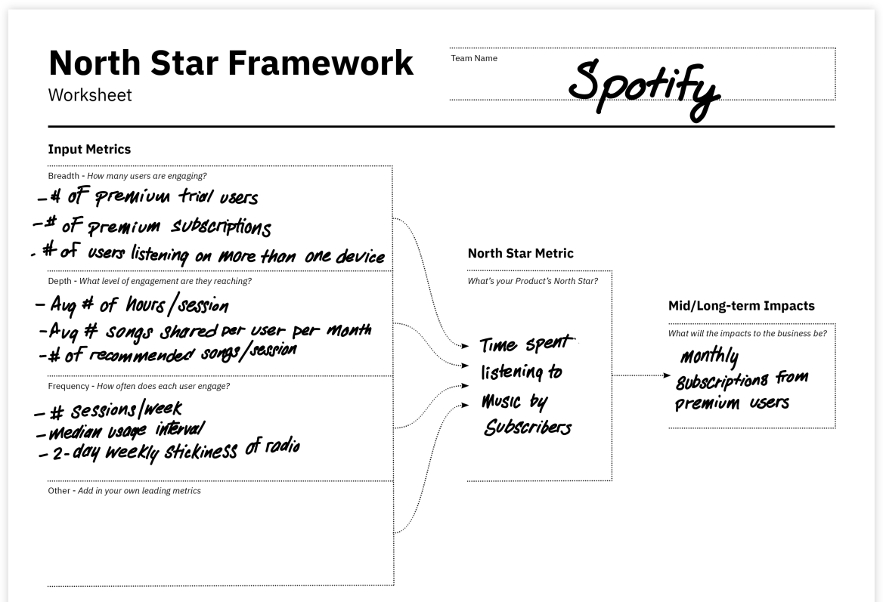
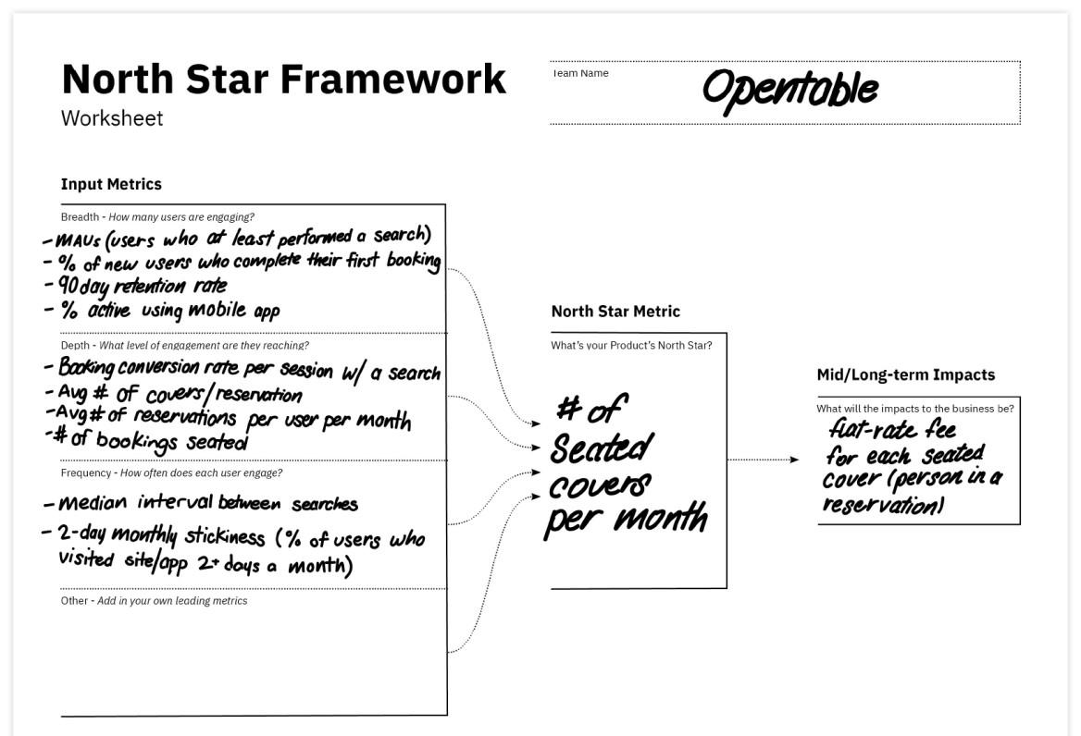
North Star checklist
It expresses value. We can see why it matters to customers.
It represents vision and strategy. Our company’s product and business strategy are reflected in it.
It’s a leading indicator of success. It predicts future results, rather than reflecting past results.
It’s actionable. We can take action to influence it.
It’s understandable. It’s framed in plain language that non-technical partners can understand.
It’s measurable. We can instrument our products to track it.
It’s not a vanity metric. When it changes, we can be confident that the change is meaningful and valuable, rather than being something that doesn’t actually predict long-term success—even if it makes the team feel good about itself.

Slide 43
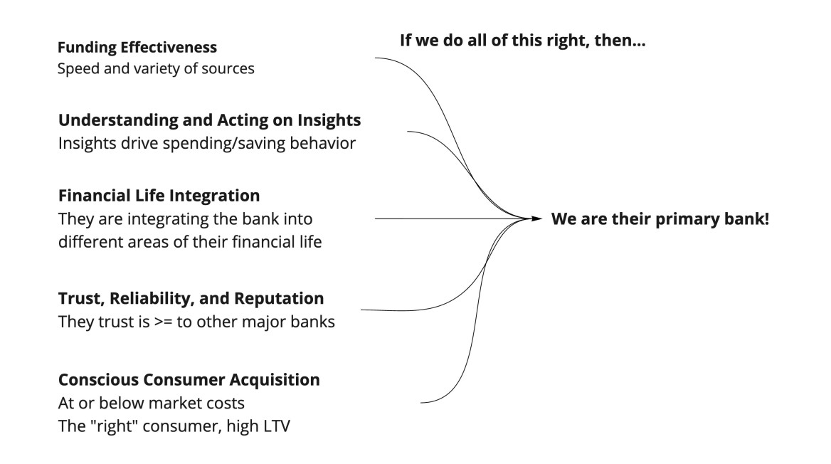
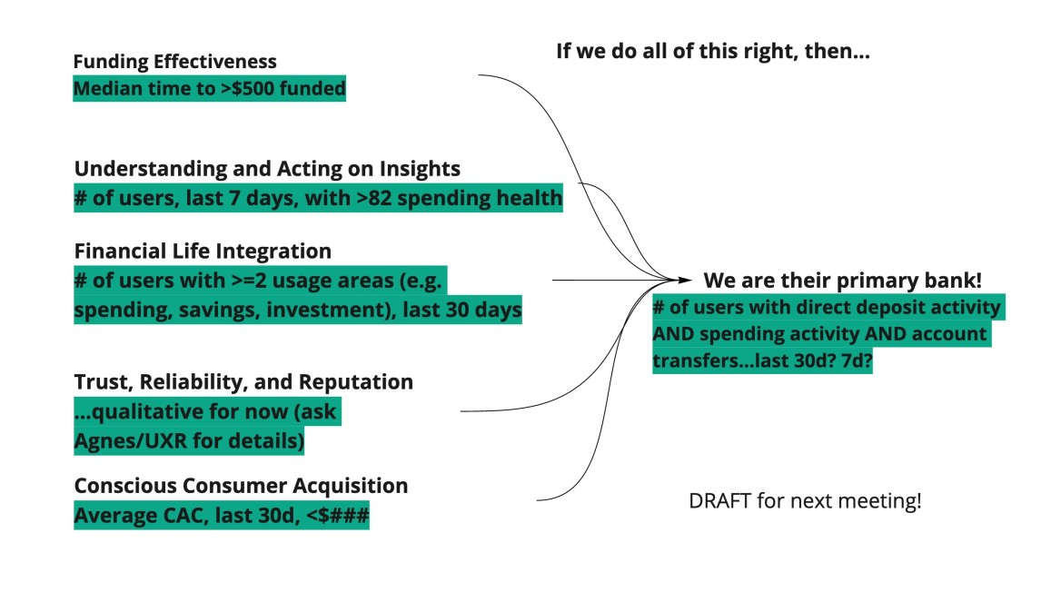
North Star - examples

Slide 44
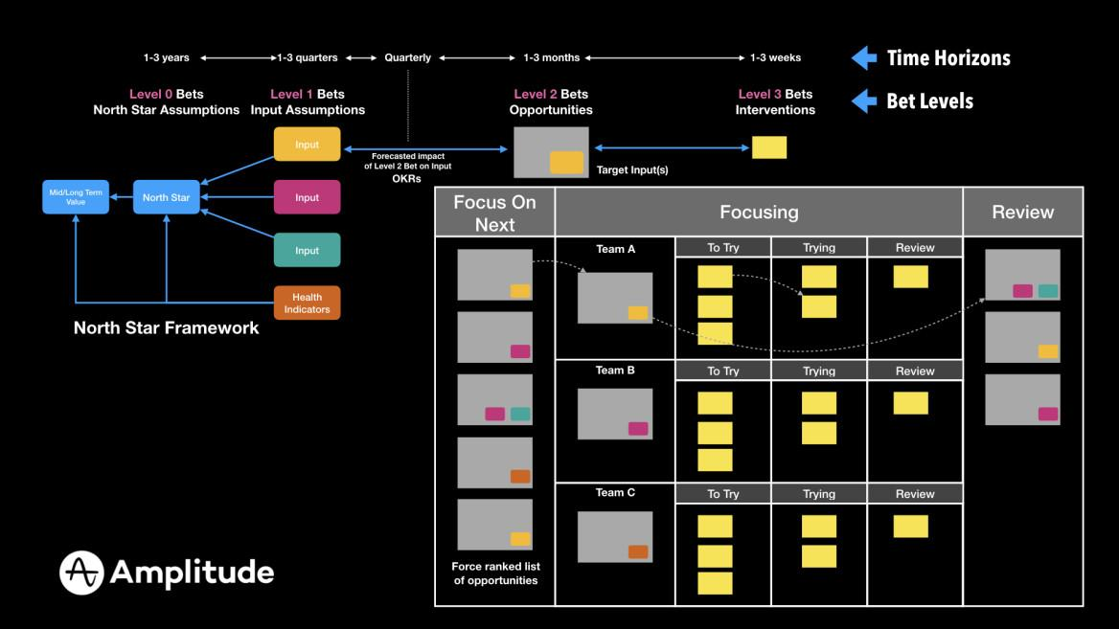

Slide 45
Creating shared understanding by writing down the believes, the vision and values to the customer
Our direct competition is [……………]. We are disrupting legacy options like [……………]. In turn, [……………] may disrupt us.
One technology change that will affect us is [……………]. This change will impact us because [……………]. As a response, we will [……………].
I think the real reason we win new customers is because [……………].
I believe [some behavior in our market] is due to [reason].
If we focus on meeting [a specific customer need], and do that extremely well, we will have some leeway when it comes to [less important challenges]
Believes
Vision Statement
Value Exchanges
Hypothetical Vision: “For the film aficionado, our documentary streaming service is the world’s most authoritative source of expertly-curated short films, expert commentary, and informed community.”
What we learn from this statement:
The product isn’t for everyone; it’s for aficionados.
The product doesn’t endeavor to be comprehensive. A relatively small selection of films is a feature, not a bug.
The films in the service’s library are short.
“Authoritative” is a key characteristic of the service.
The service is differentiated from competitors through quality of curation, commentary, and a community of like-minded people.
Questions this statement raises:
Does the company differentiate through deep technical expertise in video streaming?
Communities are hard. How will the company build a community?
The delivery arrives intact outside your apartment in under 30 minutes
Monthly account reconciliation was successful
A collaborator makes their first comment on your design
Wow. This music recommendation is actually pretty decent.
Based on the logging, it looks like the SDK is working
Your significant other says “Yes!”
Your medication arrives before you need to call for a refill
Your student was pre-registered for the next courses in their degree plan at days and times that fit their preferences.

Slide 46
Elevator Pitch
For MAIN TARGET CUSTOMER SEGMENT, who has IMPORTANT UNDERSERVED NEED, POPULATION is a HIGH GROWTH MARKET CATEGORY CREATE / JOIN that MAIN KEY BENEFIT.
Unlike COMPETITION SET, the product HARD TO COPY POINT OF DIFFERENTIATION.

