Slide 1
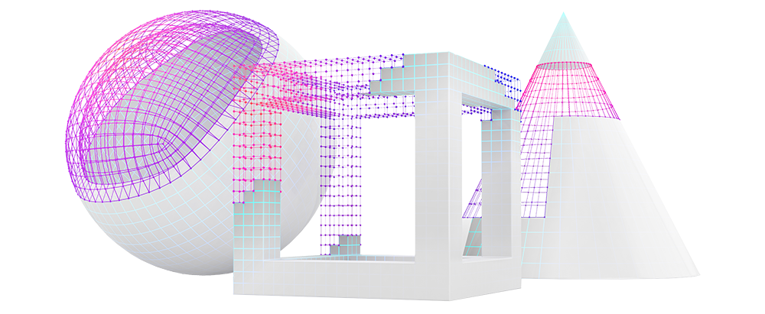

  Design as a Competitive Advantage
  2021 Survey Results

Slide 2
  Overview
In a business landscape where design-led companies like Tesla, Airbnb, Nike, and Target can produce buzz, healthy profit margins, and intense customer devotion, why do so many companies still view design as a discrete department that plays a limited role — one that often isn’t very high on the C-suite’s priority list?
We’ve been exploring that question — as well as the broader role that design can play in influencing overall corporate culture and process — as part of our 2021 research initiative, “Design as a Competitive Advantage.” In July 2021, we conducted a short survey to gather data from corporate innovation, new product, strategy, and R&D leaders. Our sponsor, PA Consulting, provided input into the survey.
We received 107 qualified responses; the top six industries represented were:
Consumer goods and products
Financial services
Healthcare
Medical devices
Higher education and technology (a tie)

Slide 3
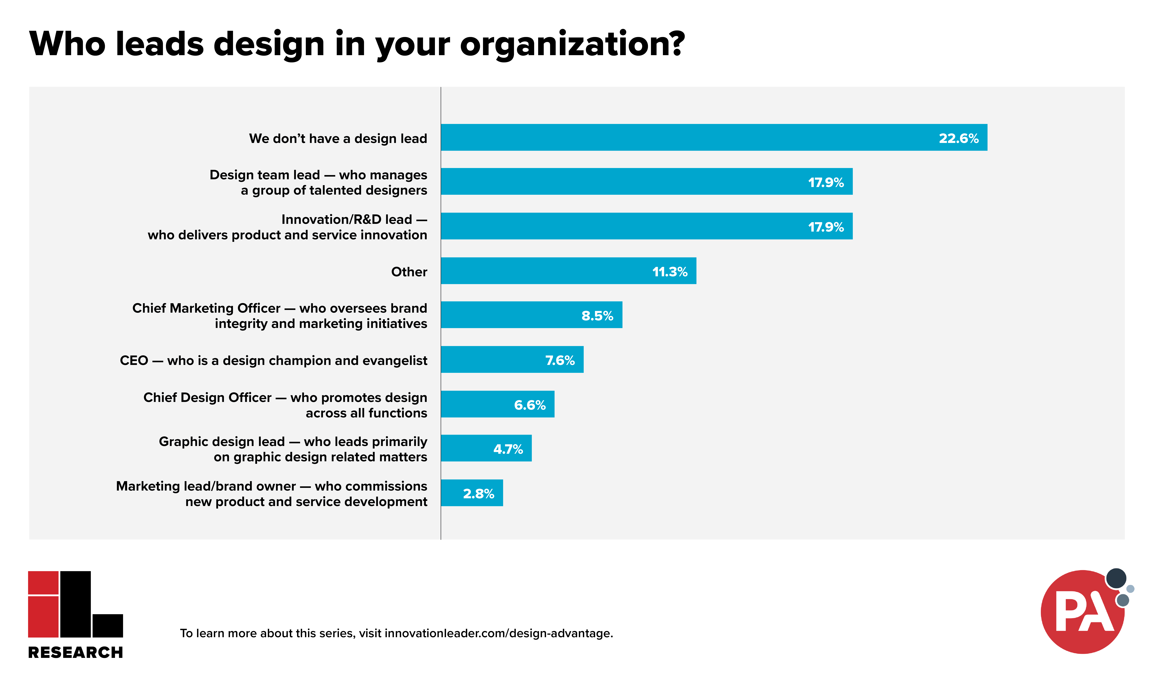

Slide 4
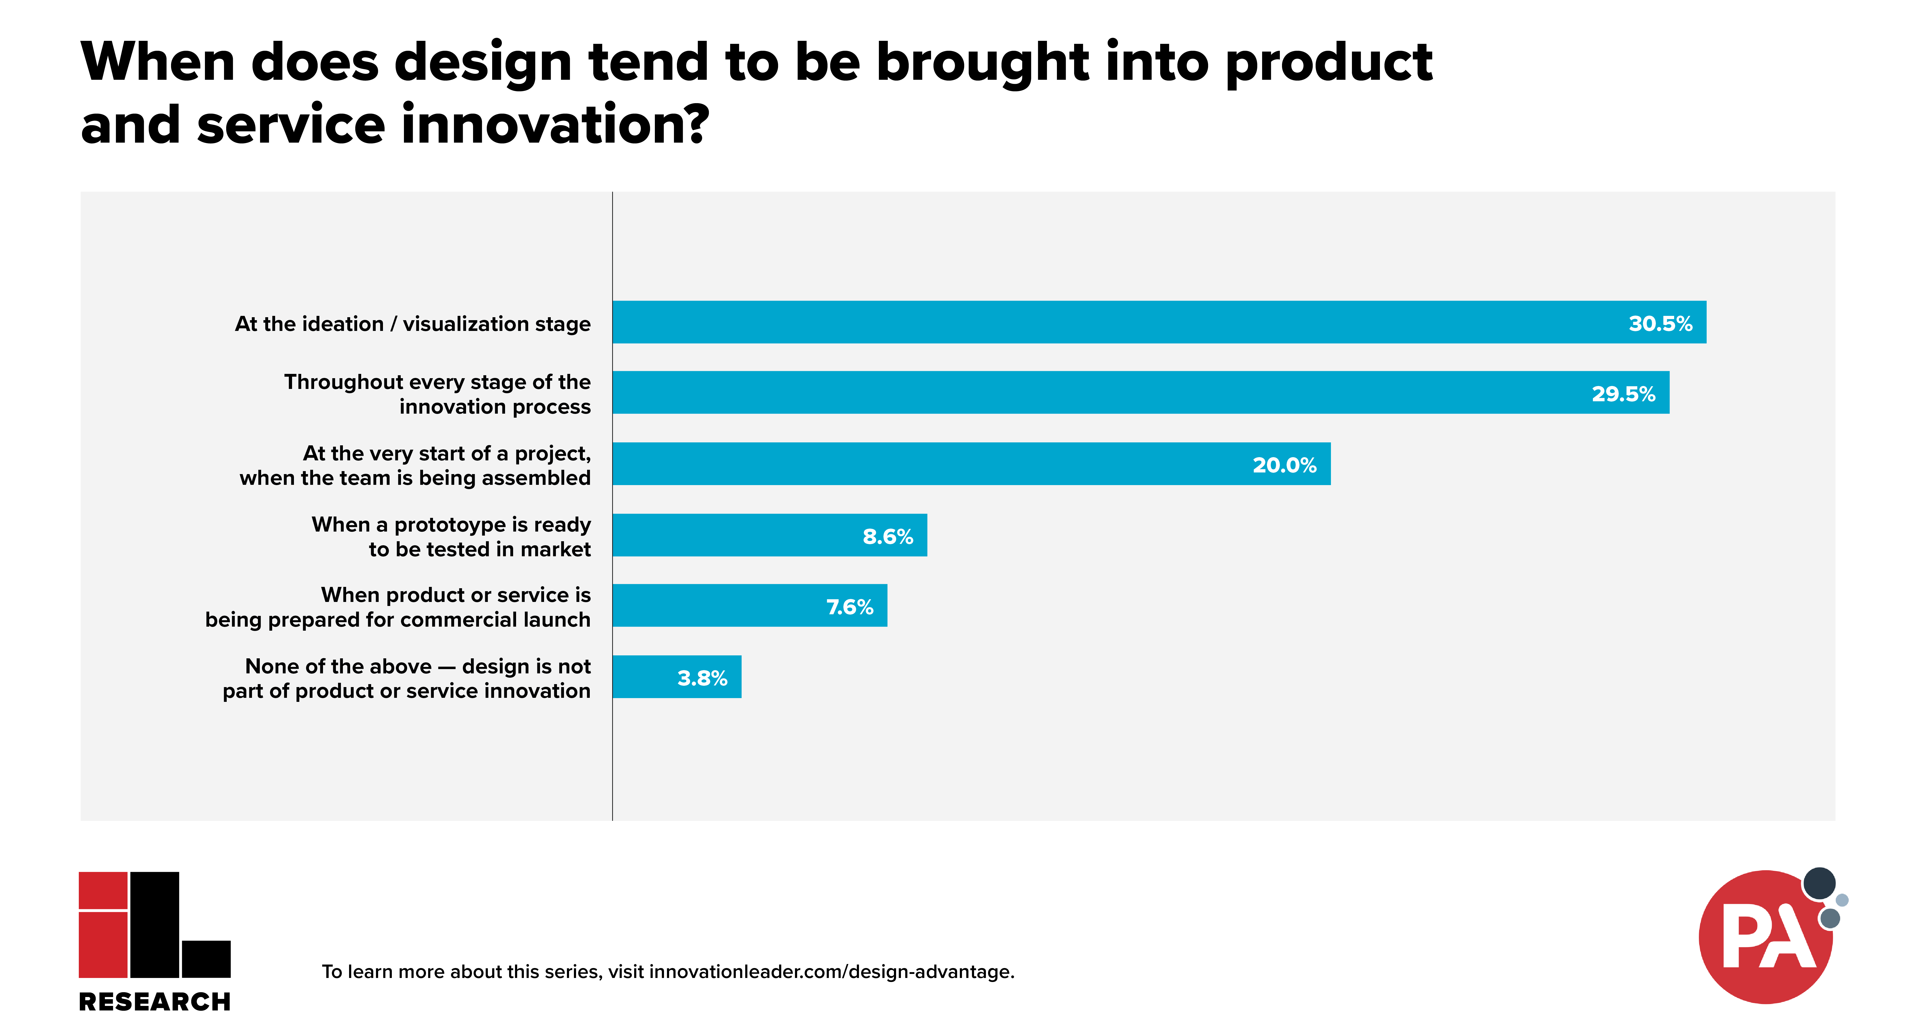

Slide 5
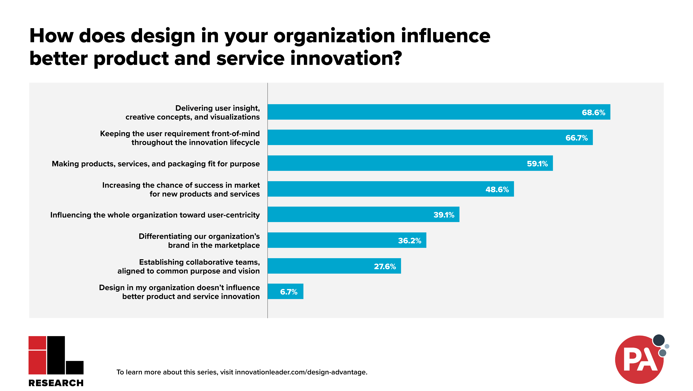

Slide 6
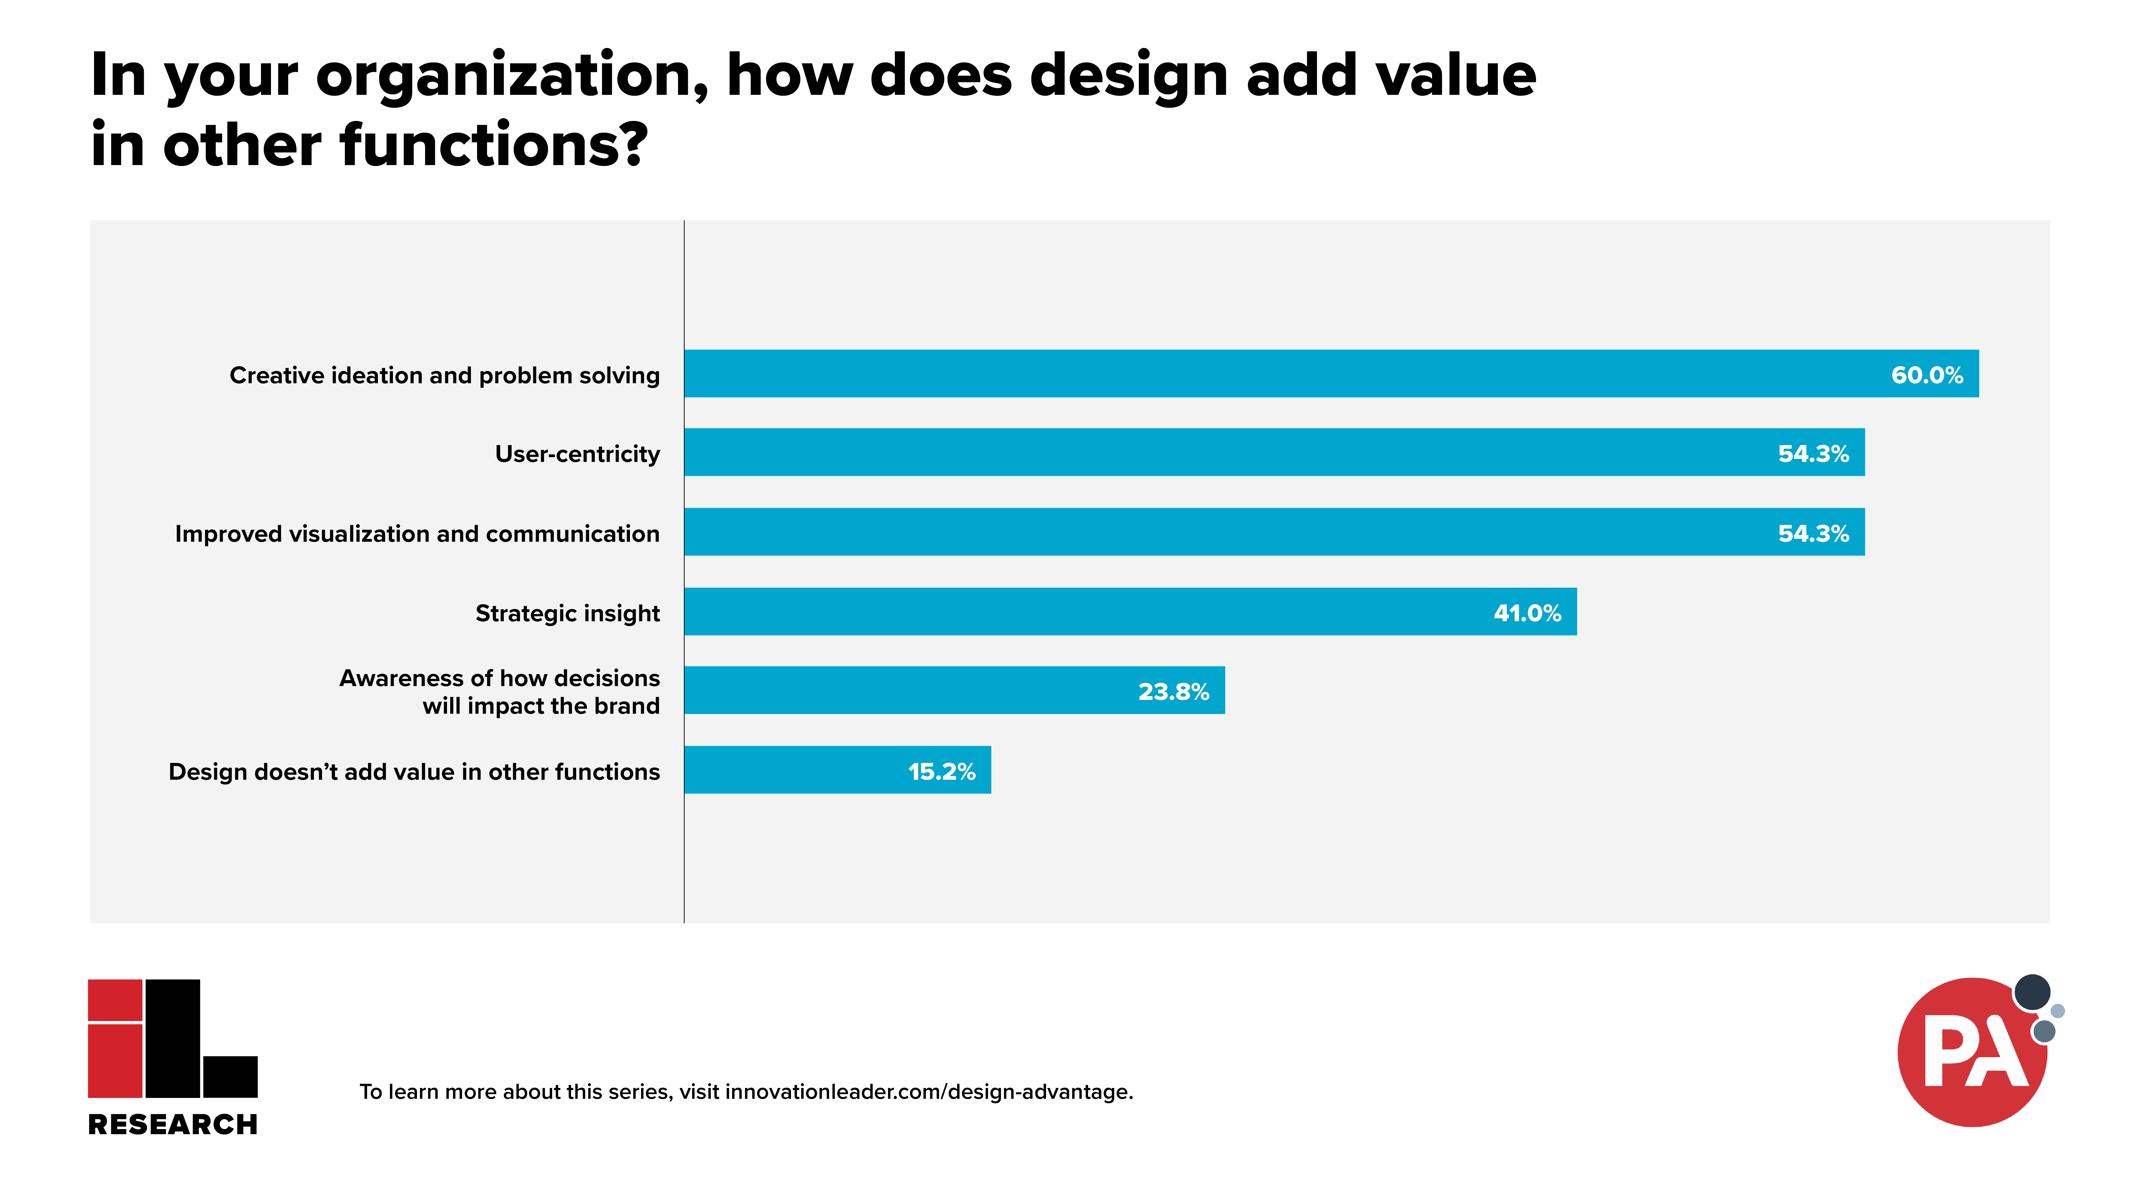

Slide 7
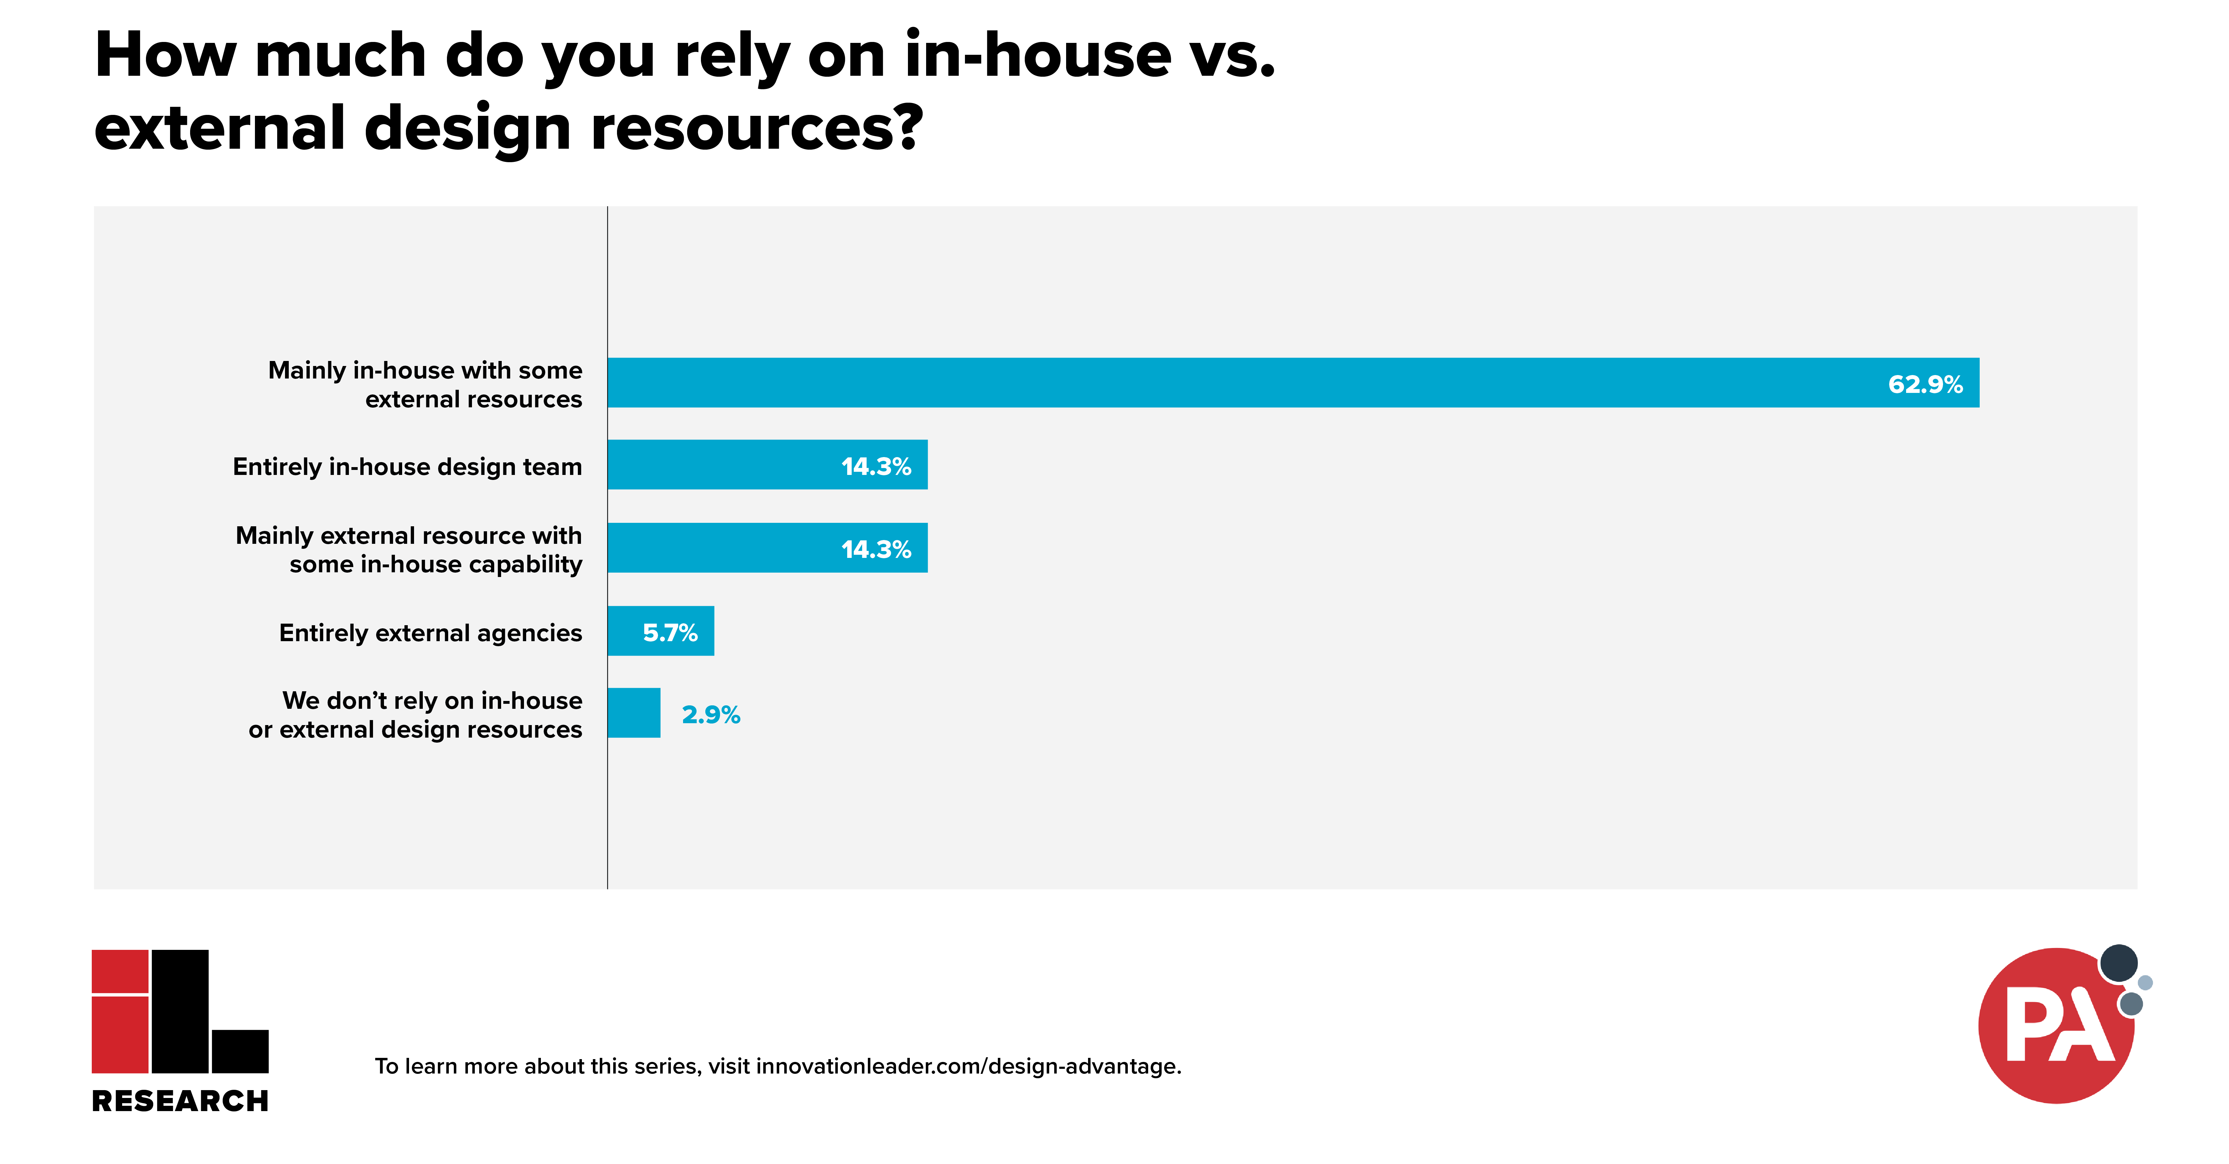

Slide 8
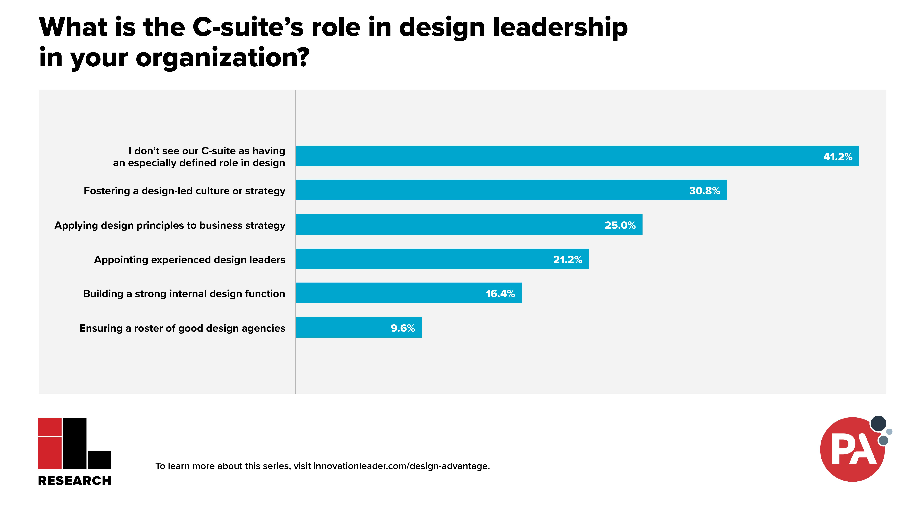

Slide 9
  Qualitative Comments: Role of Design
What role do you see design playing in the strategy and culture of the most successful organizations (not including your own)?
“Top organizations are design-led… or at least have a executive-level design leader who can ensure there are design/customer-centric goals, metrics and initiatives included in the overall organization’s strategy and mission.” — Consumer Goods & Products
“Design keeps the project focused on the customer and business opportunity; without design, I’ve seen teams get very distracted by ‘shiny pennies’ and every possible solution available, resulting in diluted products/processes/solutions.” — Healthcare
“Many people act in a very tactical manner, just executing tasks. Design can unlock deeper meaning and opportunities.” — Aerospace & Defense
“It’s not just the cherry on the cake; it is the cake.” — Healthcare

Slide 10
  Qualitative Comments: Making It Central
In your organization, are there changes made recently, or that you would like to see made, to make design more central to your strategy, culture, and approach?
“We are reorganizing to have design be a key driver/leader of innovation and growth.” — Consumer Goods & Products
“We focus on continuous learning and staying curious.” — Engineering & Construction
“Creating roles in our organization dedicated to design is a major first step. Also, consistent messaging from the C-suite as to the necessity of a design strategy.” — Professional Services
“I believe using the vocabulary of customer centricity and human centered design allows non-design affiliated stakeholders to develop an appreciation of design’s value once they observe and take part in the development process. They see that it’s continuous, not one and done.” — Financial Services

Slide 11
  If you use this data in other places…
Please credit Innovation Leader (www.innovationleader.com) & PA Consulting (www.paconsulting.com).
Thank you!

