Slide 1
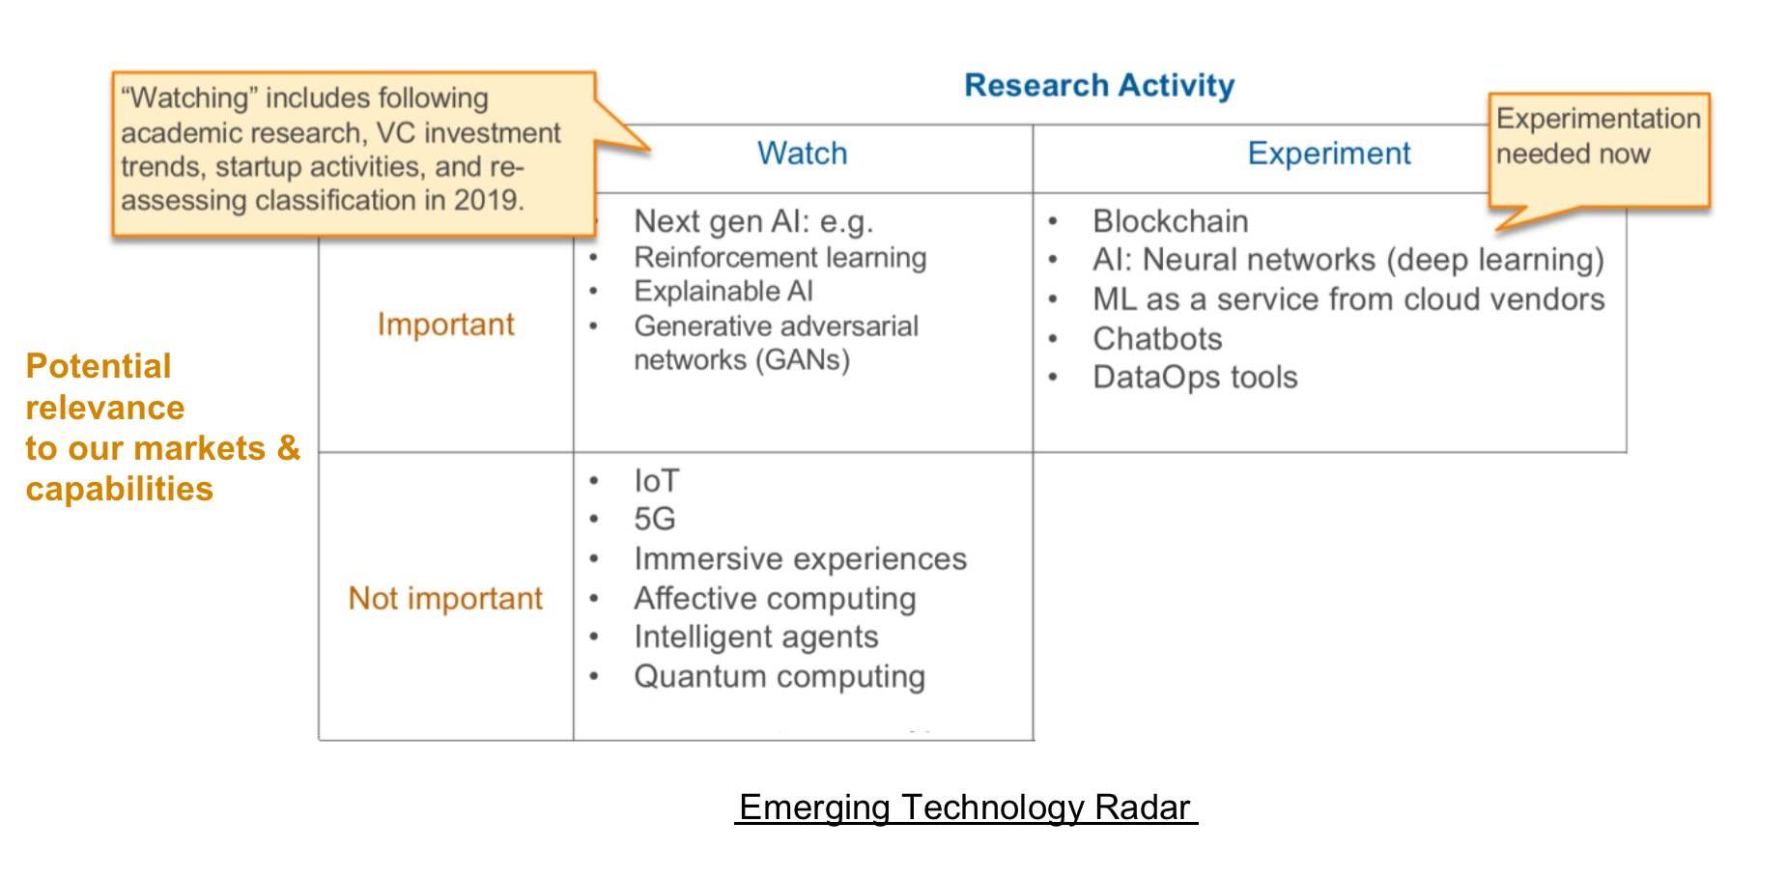
Top categories: Just watch the technology, or experiment/pilot test with it?
Categories at left: Is it important or not important at the moment, in terms of its relevance to the company’s markets and capabilities? If not important, can be left to vendors/startups to develop, and potentially eventually move into experimentation mode as it matures.

