Slide 1

  Best Practice Tools and Templates
  Defining Your Innovation Strategy, Vision & Mission
  Developed inside a publicly-held manufacturing company

Slide 2
Aligning on definitions and strategy is crucial
Context
An organization will struggle to innovate effectively if a person says “innovation” in a room of 10 people and those 10 people think 10 different things
Innovation can mean many different things and without alignment on basic definitions and concepts, innovation teams and their stakeholders cannot communicate, much less collaborate
It is therefore essential to make sure that everyone is on the same page with the “What, Where, When, Why, How” of innovation
The following slides describe and share two templates successfully used by an innovation leader in a large US manufacturing organization to put such a foundation in place

Slide 3
Template Described
Defining the terms
Descriptive title. We use XYZ Corp. as our generic company name in this deck.
Clear, concise prioritization criteria
(“Should we pursue it?”)
A XYZ Corp. definition of innovation can help us sort through the portfolio and identify measures of success
Reinvent XYZ’s industry by delivering…
Innovations must meet the following criteria:
Creates new sources of revenue and/or,
Incorporates new business models and/or,
Gives us access to new markets and/or,
Is a significant source of retention or acquisition and/or,
Yields significant operational savings
Clear, concise
core definition
XYZ Corp.
Innovation Definition
New products or services that leverage our capabilities and that address the needs of our target consumer segments in unique, differentiated and sustainable ways
Clear, concise evaluatative criteria
(“Should we continue to pursue it?
Measured by:
Differentiation: Our idea is radically different from what exists in the market
Magnitude: Addresses a big, sizeable problem
ROI: Must significantly improve acquisition or retention, or be a new source of revenue
Strength of the portfolio: Expansion of protection and creation of prevention portfolio of products and services

Slide 4
A XYZ Corp. definition of innovation can help us sort through the portfolio and identify measures of success
Template
Innovations must meet the following criteria:
Creates new sources of revenue and/or,
Incorporates new business models and/or,
Gives us access to new markets and/or,
Is a significant source of retention or acquisition and/or,
Yields significant operational savings
Reinvent XYZ’s industry by delivering…
XYZ Corp.
Innovation Definition
New products or services that leverage our capabilities and that address the needs of our target consumer segments in unique, differentiated and sustainable ways
Measured by:
Differentiation: Our idea is radically different from what exists in the market
Magnitude: Addresses a big, sizeable problem
ROI: Must significantly improve acquisition or retention, or be a new source of revenue
Strength of the portfolio: Expansion of protection and creation of prevention portfolio of products and services

Slide 5
Template Described
Defining the objectives
Clear, quantitative performance metrics
(Vitality Index is the % of your revenue generated by new products)
Clear, concise definition of the innovation imperative
Why we are here and what we’re going to do
Vision Statement
Transform XYZ into one of the most innovative companies in the world, enabling unprecedented growth and consumer loyalty for our brands.
Mission
  Fuel the organization with new and unique consumer solutions so XYZ can deliver its growth objectives across existing and future product and/or service categories on a sustainable basis
Business Impact
For the 2022-2024 period, the Innovation goal is to deliver 30 % in Vitality Index and 20% of innovation revenue
Over the 3-5 year horizon, the team will materialize the winning path to transform from a (product company) to a (solutions company)
Collaboration is crucial to success; sends important message
Clear, concise definition of innovation values
We collaborate with key functions in the organization to deliver new and winning products and go-to-market strategies that drive growth and brand differentiation.
We make XYZ more innovative by…
INSPIRING the organization to be think innovatively and to lead in the industry
EMBEDDING innovation as a sustainable and inescapable process and capability at XYZ
EMPATHIZING with consumers, identifying insights that drive sustainable advantage
CREATING ideas in collaboration with teams and to turn them into new and feasible business opportunities

Slide 6
Template
The future of innovation at XYZ
Vision Statement
Transform XYZ into one of the most innovative companies in the world, enabling unprecedented growth and consumer loyalty for our brands.
Mission
  Fuel the organization with new and unique consumer solutions so
  XYZ can deliver its growth objectives across existing and future product and/or service categories on a sustainable basis
Business Impact
For the 2022-2024 period, the Innovation goal is to deliver 30 % in Vitality Index and 20% of innovation revenue
Over the 3-5 year horizon, the team will materialize the winning path to transform from a (product company) to a (solutions company)
We collaborate with key functions in the organization to deliver new and winning products and go-to-market strategies that drive growth and brand differentiation.
We make XYZ more innovative by…
INSPIRING the organization to be think innovatively and to lead in the industry
EMBEDDING innovation as a sustainable and inescapable process and capability at XYZ
EMPATHIZING with consumers, identifying insights that drive sustainable advantage
CREATING ideas in collaboration with teams and to turn them into new and feasible business opportunities

Slide 7
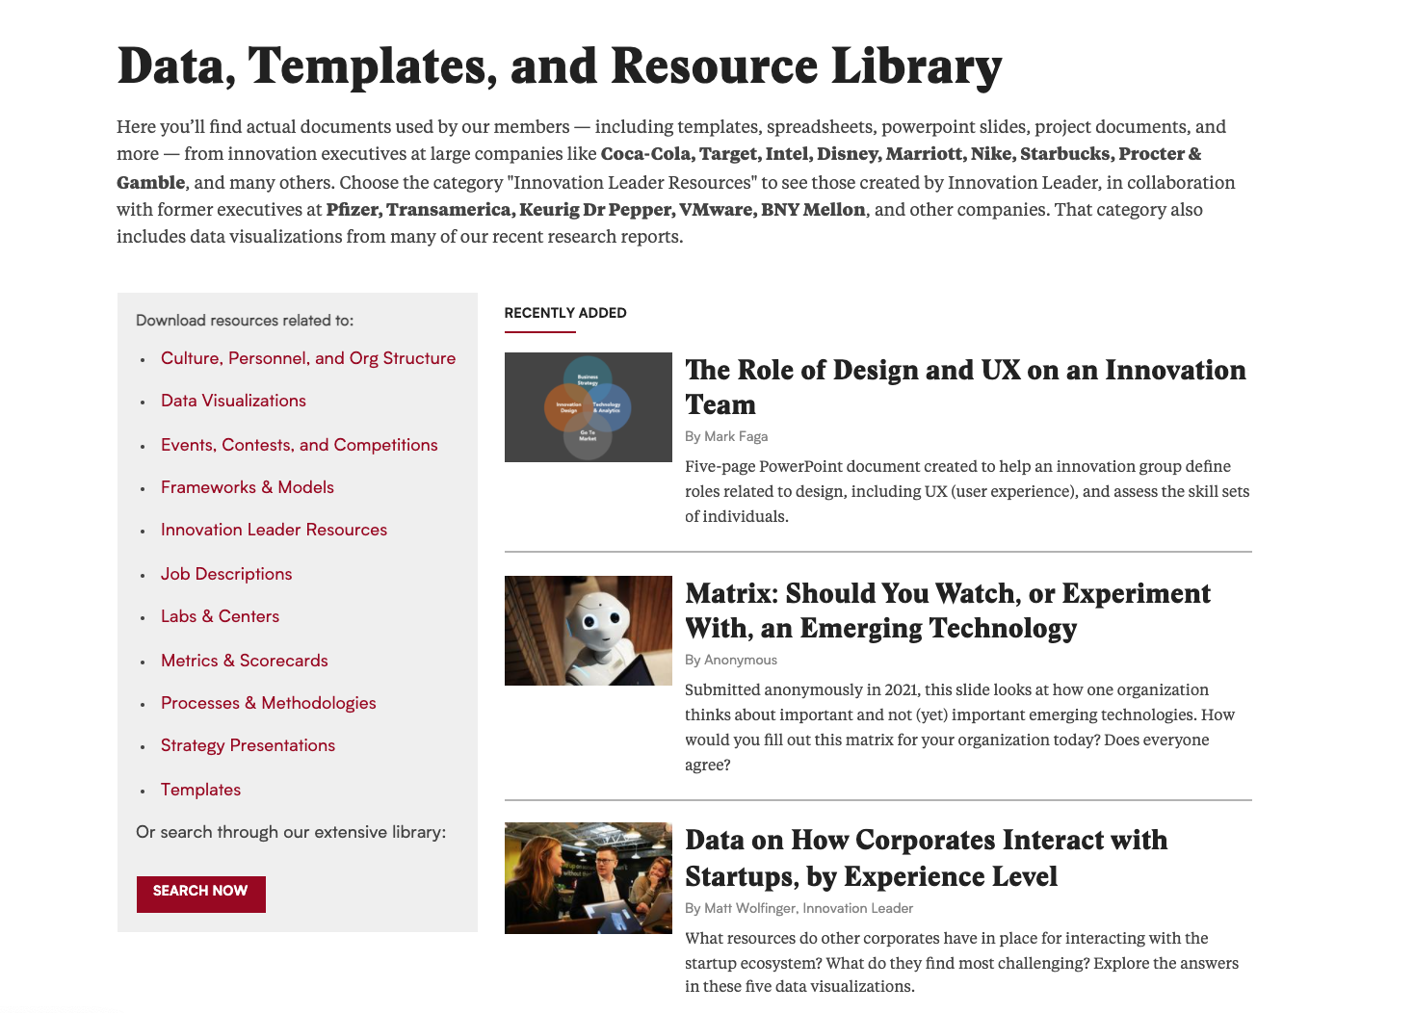
For more…
Context
InnoLead has created and collected more than 250 templates like this one.
Visit https://www.innovationleader.com/data-and-templates to browse and search.

