Slide 1
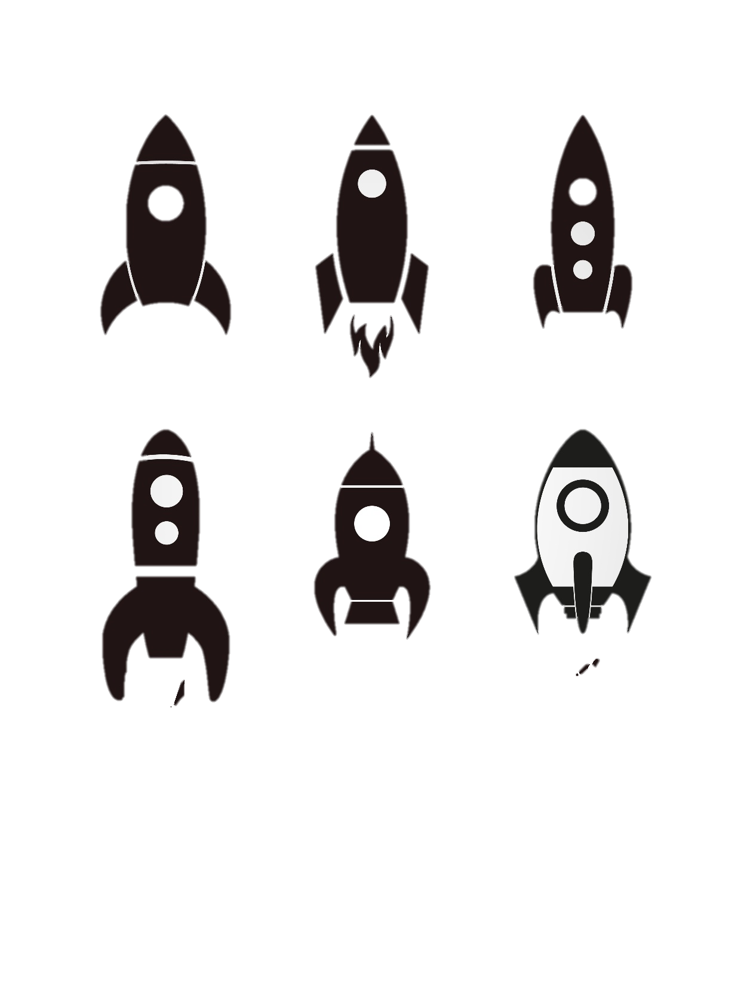
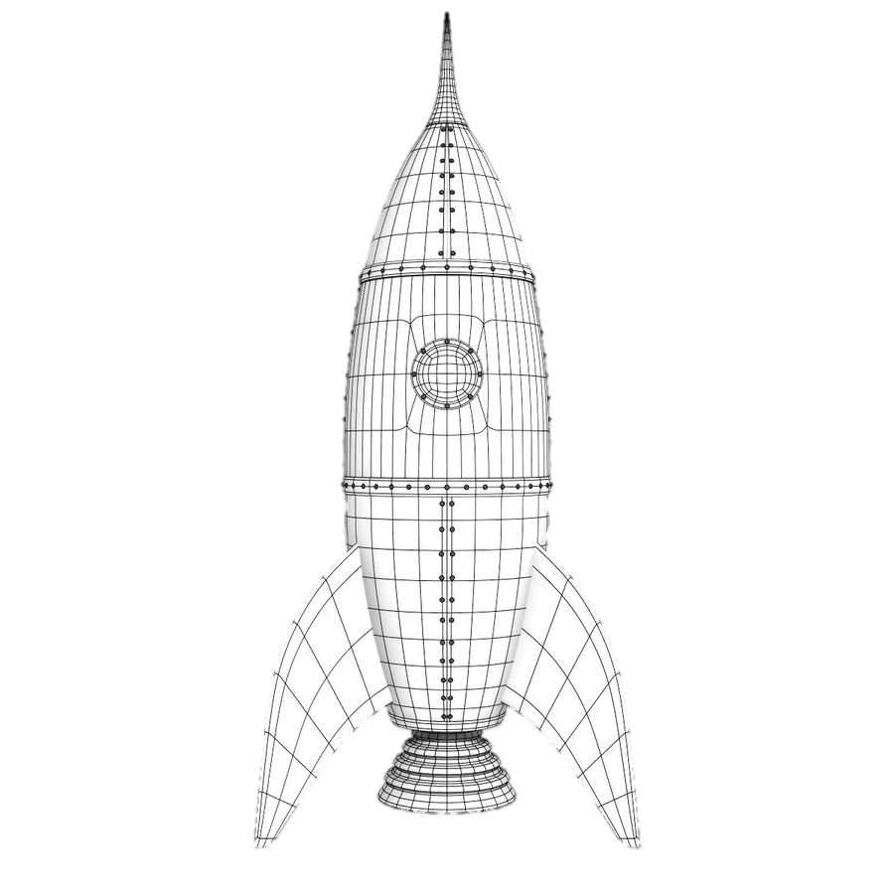

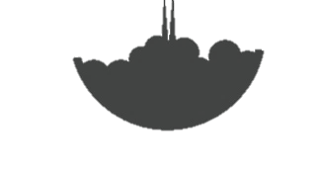
Maturity Model: Accelerating ROI by De-Risking Investments
Maturity
Business Lifecycle
Decline
Growth
Launch
- Cash flow +
Time
Maturity Model
Is it useful?
Is it usable?
Is it used?
Is it scalable?
Is it exitable?
Investment Levels
Useful
Small initial IR&D investment
Usable
~10-fold increase in initial IR&D investment
Used
~100-fold increase in initial IR&D investment
Scalable
~1,000-fold increase in initial IR&D investment
Exitable
Timeframes
Days
Weeks
Years
Years to Decades
Months
Operations, Maintenance & Monetization
Pilot and Initial Sales
Deliverables
Business Case
Prototype
Market Share
Notes:
The USE framework is a customer/market-centric framework for determining whether to continue funding an incubated new venture. In this framework, a new venture progresses through the following stages:
Useful – Does the venture solve a meaningful problem for a viable addressable market?
Usable – Once you test an MVP with problem owners, is its value clear and intuitive to the user?
Used – Is there demand from the people or companies you test it with to become a beta-client? Is the solution stable and valuable in beta?
Scalable – Can we expand beyond our first mover customers and build out a robust sales pipeline?
Exitable – When the venture achieves a scale that starts to affect corporate earnings where should it live? As an autonomous business unit, a spin off, or serve as the engine of transformation across other businesses?

