Slide 1

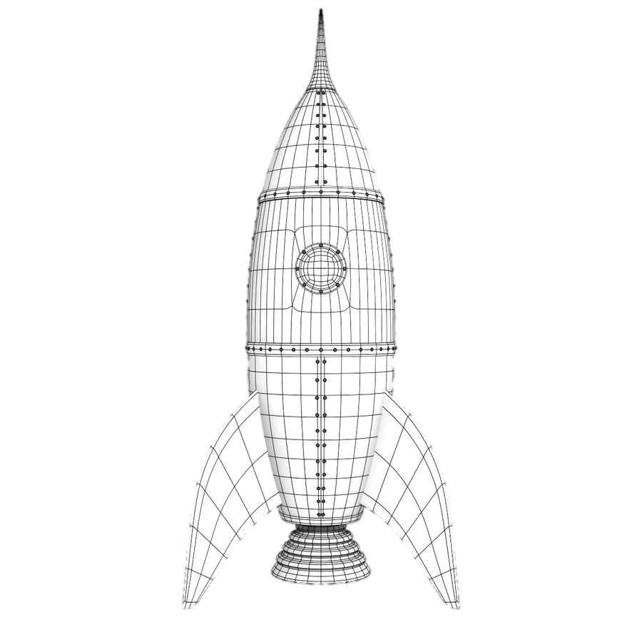


Maturity Model: Accelerating ROI by De-Risking Investments
Maturity
Business Lifecycle
Decline
Growth
Launch
- Cash flow +
Time
Maturity Model
Is it useful?
Is it usable?
Is it used?
Is it scalable?
Is it exitable?
Investment Levels
Useful
Small initial IR&D investment
Usable
~10-fold increase in initial IR&D investment
Used
~100-fold increase in initial IR&D investment
Scalable
~1,000-fold increase in initial IR&D investment
Exitable
Timeframes
Days
Weeks
Years
Years to Decades
Months
Operations, Maintenance & Monetization
Pilot and Initial Sales
Deliverables
Business Case
Prototype
Market Share

