Slide 1



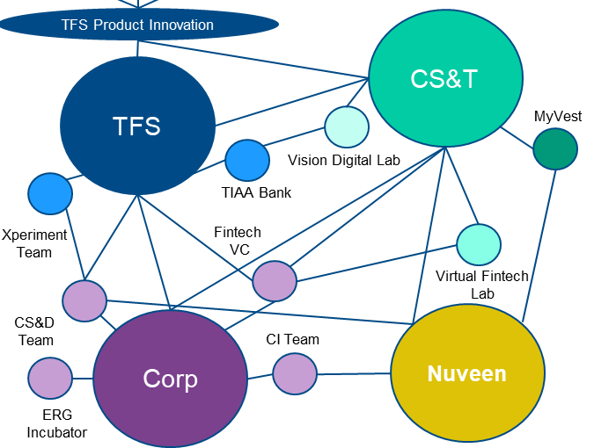












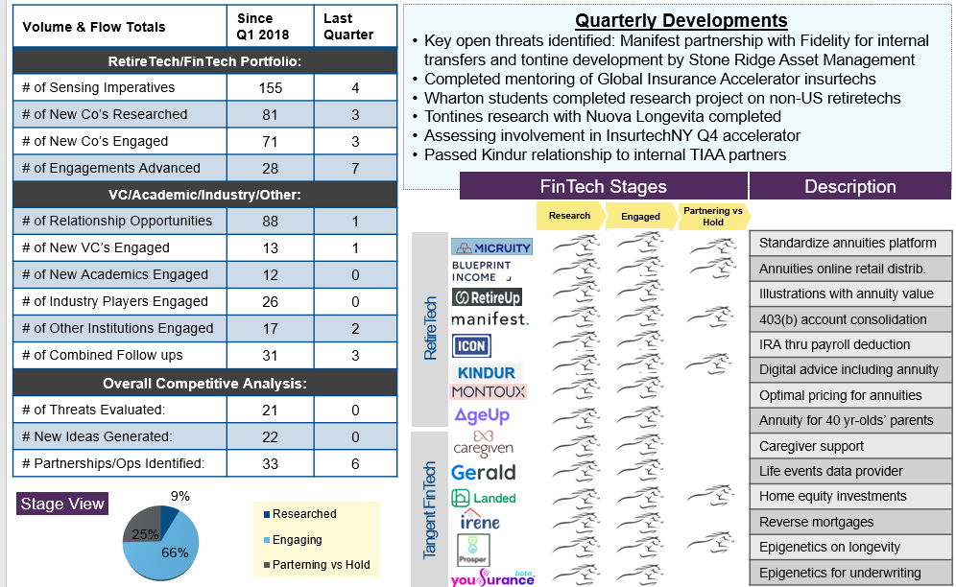






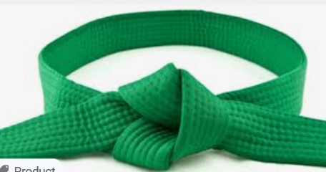


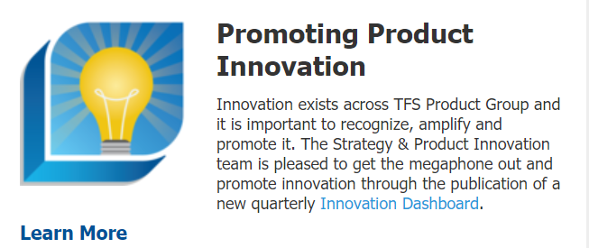
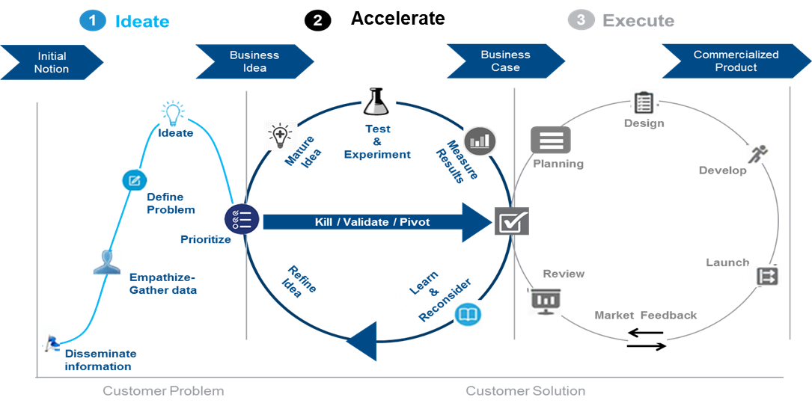

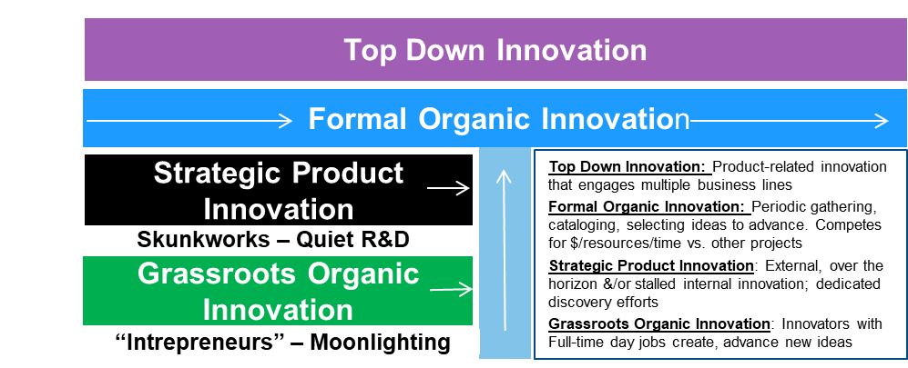
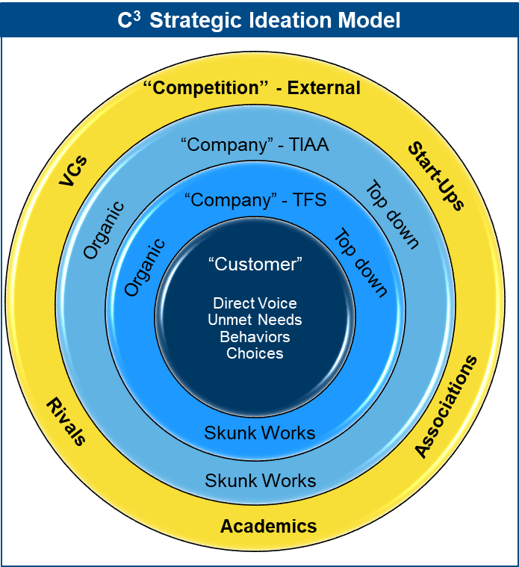


Key Elements of Innovation Capabilities
Q3
YEAR 1
YEAR 2
YEAR 3
Internal Organization
Product Innovation Formalized
Added Sr. Internal Advisory
Group
Innovation Across
15-Person
Team
Seed Funding for R&D and Amplifying
$$
Increased Engaging Around the Company
Formal Partnerships within the Company
Internal Project Incubator
External Sensing
Global Research
Academic
Accelerators
External Engagements
Student engagement Product Challenges
R&D
Sponsors
Mentors
Advisors
VC Committee & PAC
(Capitol Hill)
RR Donnelly
Consulting Industry
Academic Training
Connectivity, Amplification and Internal Recognitions for Innovation
Internal Culture
Newsletters
Internal Events
Innovation Leadership
Training
Outcome-Driven Innovation
Design Thinking, Lean Startup
Sponsor Industry
Certifications
Industry Training
Customer Focus
Jobs To Be Done
Demand studies (voice of customer)
Unmet Customer Needs
Ethnographic behavioral research
Capabilities Development
Innovation Needs
Innovation Framework
Idea Collection & Monitoring
Launched
Innovation
Dashboard
Global Sensing Dashboard
Competitor Watchtower
Conference Presentation
Ideation Processes
C3 Idea Sourcing System
Dept. Idea Collection
Process
Launched Idea Repository
Division-wide Ideation Processes
.)
Idea Coaching System
Advance Grass Roots ideas
Needs-driven packaged solutions workshop – surfaced 12 ideas
Acceleration / Experiments
Acceleration Process
Test/Learn to kill, validate, or pivot
Crowdsourced Idea Prioritization
Sponsored evaluations
Research, experiments
Stood up Corporate Lab (Strategic experiments)

