Slide 1

  Slides on
  Scoping Opportunities, Fleshing Out Concepts, and Doing Customer Research
  July 2022
Notes:
Notes: The slides in this short deck, all originally created inside publicly-traded US companies, discuss scoping out opportunities and projects, and lay out customer research methods.
For more resources like this, see innovationleader.com/resources.

Slide 2
Elaborating on an Opportunity
IDEA IN BRIEF
INSIGHTS BACKING THE IDEA
Explain idea in brief
Why would this help our company differentiate its offering?
Why does our company have a high chance of success at this? What are our competencies enabling this?
What are the insights that this idea originated from?
HOW DOES IT MAKE MONEY?
FINANCIAL OPPORTUNITY
What are the money-making levers in this idea?
  Cost Reductions?
  Alternate Revenue Streams?
  Margin Improvements?
  Others?
Brief financial estimates
Include big margin drivers and estimates
Include timeframe estimates: When revenue can start flowing?
RISKS & MITIGATION
RECOMMENDED NEXT STEPS
What are the key risks in terms of
  Our assumptions
  Known unknowns
How will we mitigate these risks? (Experiments/actions to close knowledge gap)
What are the next steps:
  Full Implementation?
  Experimentation to clarify unknowns?
  Consumer / Trade Partner Research?
  Others?

Slide 3
Fleshing Out Concepts (Worksheet)
TITLE:
CORE CONCEPT IDEA:
What is the main idea or theme of the concept?
CONSUMER:
Who are the target consumers for this concept? What is the consumer value proposition (why would they be interested?)
PRODUCT FEATURES AND FUNCTIONS:
What features & functions must the concept must have? What additional features and functions are preferable, but not essential?
KEY DESIGN ELEMENTS:
What are the important elements relating to design (shape, look, materials, finish, etc.)?
COMMERCIAL ENABLERS:
What other business model elements (channels, distribution, promotion, services, etc.) are necessary to enable the concept to succeed?
SUPPORTING IDEA FRAGMENTS:

Slide 4
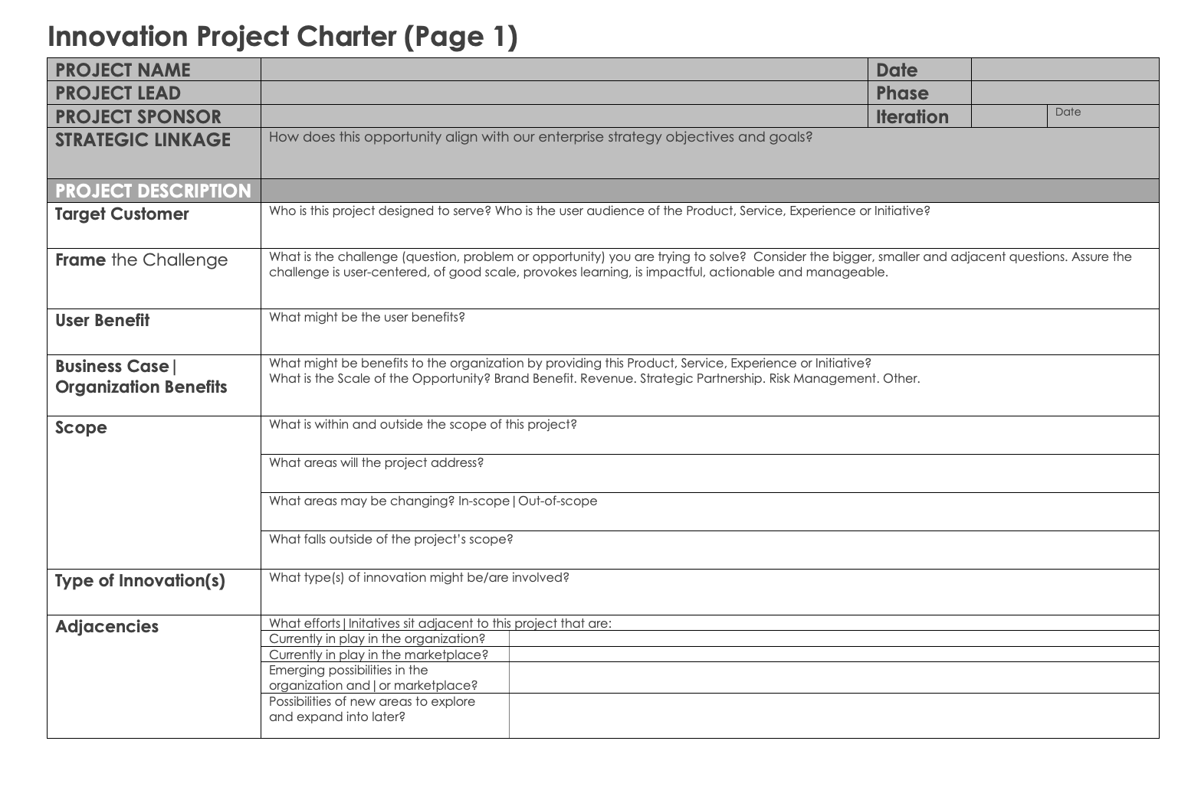
Typical Project Charter Elements for Scoping (p.1)
* Developed by Notre Dame’s Innovation Academy

Slide 5
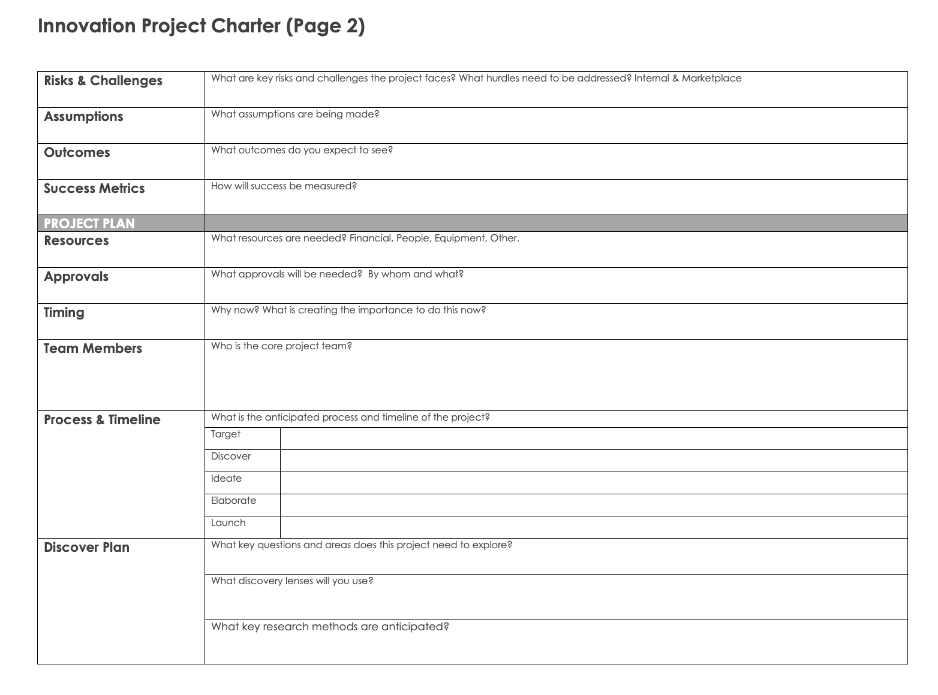
Typical Project Charter Elements for Scoping (p.2)
* Developed by Notre Dame’s Innovation Academy

Slide 6
Research Methods Cheat Sheet (p. 1)
Type of Research
Objective
Research Responsibility
Quantitative Idea Screener
Early quantitative assessment of which ideas have the greatest potential based on benchmarks
Consumer Insights
Qualitative Consumer Lab
To provide consumer-driven insights that improve the relevance of concept to the target
Consumer Insights
BASES Snapshot
Quantitatively confirm viability of several concepts and prioritize the concepts that have the greatest consumer interest. Six Factors for Success.
Consumer Insights
BASES Concept In-Home Use-Test (IHUT)
Concept and product tool to qualify initiative for launch with basic diagnostics of drivers and limiters of appeal. Eight Factors for Success, Yr 1 Volume
Consumer Insights
BASES II
Most robust BASES tool. Concept and product based forecast, in-depth diagnostics, and optimization opportunities. Twelve Factors For Success, Yr 1&2 Volume
Consumer Insights
6

Slide 7
Research Methods Cheat Sheet (p. 2)
Type of Research
Objective
Research Responsibility
Concept Product Development (CPD)
Qualitative guidance on product development with a focus on fit with initial concepts
Sensory
Research Guidance Test (RGT)
Quantitative Guidance on product development to narrow down prototypes prior to final validation
Sensory
Central Location Test (CLT)
Quantitative test at multiple facilities to determine consumer acceptance compared to category norm or benchmark for final validation or for BASES II
Consumer Insights or Sensory
In-Home Use Test (IHUT)
Consumers use the product in home to determine acceptance compared to category norm or benchmark for final validation or for BASES II
Consumer Insights or Sensory

