Slide 1
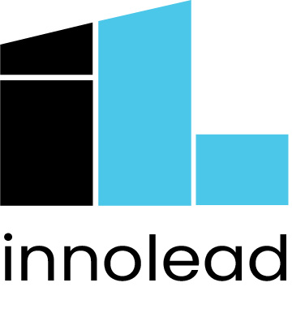
Pitch Deck for a Corporate Venturing/Startup Engagement Strategy July 2022
Notes:
Notes: This slide deck was put together inside a US-based, publicly-traded insurance firm as part of making the case for a more concerted corporate venturing and startup/university engagement strategy. We’ve removed or altered certain key identifying details.
For more resources like this, see innovationleader.com/resources.

Slide 2
Defining Corporate Venturing
Corporate Venturing is the organization model, structure and approach for cultivating and engaging the startup ecosystem, with three goals:
Access external thinking, ideas, products/services and adjacent business models
Translate them to growth options for the firm; and
Convert options into new businesses opportunities.

Slide 3
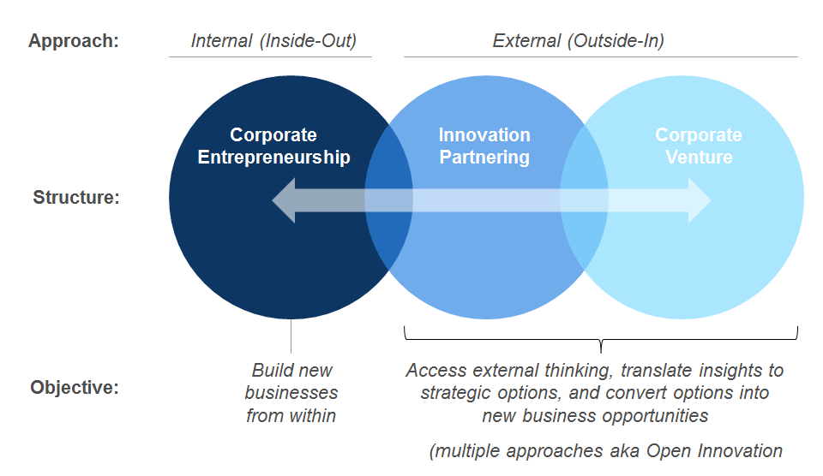
Corporate Venturing is a Kind of Open Innovation

Slide 4
Our Model is Designed to Build the Future by…
Finding technologies, services or business models that can disrupt our industry
Establishing external connections that enable us to create the future
Partnering or investing in companies that enable our transformation mission
Creating a positive return by investing through a venture capital model.

Slide 5
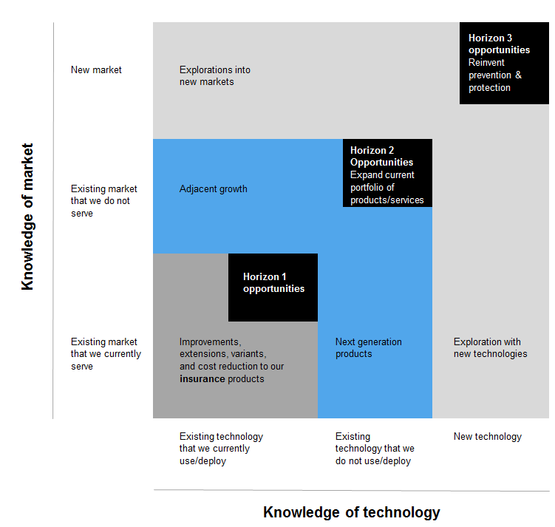
Our Primary Focus in Corporate Venturing
our primary focus

Slide 6
Our Objectives
Create a clear view of profound changes in our industry, discover the unknowns by seeking where nobody else is looking.
Identify the emerging companies technologies and markets that have potential of disrupting our current business model.
Partner with, back, or build companies that support our transformation vision.
By creating a window to the world, we will connect with companies that can help us accelerate our innovation efforts within our business units.

Slide 7



Accomplishing our Objectives Requires Three Types of Engagement
Universities
Accelerators/Incubators
Venture Capital
These three type of partners are interested engaging with our company because we know our industry and we have a large customer base. We can advise and provide access to customers to accelerate growth.

Slide 8



University Engagements are a Window to the Future
Description
University engagement is valuable for exploring spaces where [our company] is uncertain where disruptions may emerge from. Through a few strategic partnerships, we can leverage resources across schools and research centers in key universities.
Potential Relationships
Partnership with GA Tech to develop prototypes in collaboration with students over the course of a semester.
Contact: XXXXXX
Type | Description | Characteristics
Lab membership | Get access to a lab’s research. Includes a set amount of interactions. | Way to foster a relationship in the spirit of open innovation. Discover potential new directions. Other companies are part of the membership.
Class sponsorship | Single or multiple semester to research, design and build. | Can be used to discover new talent, technology, opportunities.
Applied research Sponsored project or problem | 2 to 3 year research on a topic of interest | Can direct an ambitious study in an area of interest for [our company.]
Partnership with MIT Computer Science and Artificial Intelligence Lab to explore AI and ML applications.
Contact: XXXXXXX
Partnership with Stanford entrepreneurship program to identify and develop new technologies and Silicon Valley relationships
Contact: XXXXXXX
Existing Relationships (partial list)
Imperial College London
Columbia University
CalTech
University of Texas/Austin

Slide 9


Accelerators/Incubators Allow Us to Connect and Engage with Early-Stage Companies
Description
Identify, partner and invest with companies between the Seed and Series A funding rounds. Participate in an existing accelerator with non-competing companies. [Our company] collaborates on the direction and investments and participates in the startup culture of the accelerator or incubator.
Potential Partnerships
Contact: XXXXX
Format Accelerate partnership formation by identifying potential start-up partners that are strategically aligned with the business objectives
Investment thesis
High-growth. Invest in a high variety of companies in early stages.
Participate in the local startup environment and global opportunities.
1871 is at the center of the local Chicago start-up community. The opportunity is to work 1871 to identify relevant startups and to be part of the entrepreneurial environment.
Contact: XXXXX
Zero equity accelerator program active in Massachusetts, Texas, Israel, Mexico, and other geographies. They have industry-specific accelerator programs, including one focused on HealthTech/digital health.

Slide 10



VC, Private Equity Firms, Angel Groups Expand Our Reach into Early-Stage Companies and Build a Portfolio
Description
Participate in industry disruptions by engaging and investing in emerging technologies and business models by investing in companies that adhere to our investment thesis and that support our transformation vision.
Potential Partners
New York based VC firm with global focus on technology
Contact: XXXXX
Format
A strategic partnership with a VC/private equity firm to manage deals and the portfolio
Utilize a partner for strategic relationship on the advisory board
Access the portfolio of other equity firms in relevant sectors
Invest in companies that adhere to our investment thesis and that support our transformation vision.
DC-based VC firm with focuses on technology and healthcare
Contact: XXXXX
Georgia-based VC firm investing in pre-seed, seed, and Series A rounds of startups led by women of color.
Contact: XXXXX

Slide 11
Operating Model for Our Corporate Venturing Unit
Strategic Intent
Function-agnostic, serving the transformation mission of [our company]
Three macro areas of focus: Personalization, Connected Health/Home Monitoring, and the Metaverse
Seeking opportunities across the insurance and healthcare ecosystem
Team with representation from key innovation stakeholders [at our company]
Led by a principal reporting into corporate strategy & [our company’s existing investments arm]
With meaningful external representation/advisors
Highly visible to early stage community: start-ups, incubators, venture groups, universities
Management Structure
Speed – Develop intelligence in strategic areas making to expedite due diligence
Pricing – Low threshold
Friendly to the start-up and investment community
Internal – Solid team, direct line to businesses,
External – Easy to deal with, moves quick, supports needs of early stage companies
With a long-term commitment
Strategic Advantage

