Slide 1

  Options to Consider for
  Org Structure, Innovation Process, and Measurement
  July 2022
Notes:
Notes: The slides in this collection, all originally created inside publicly-traded US companies, lay out various options for setting up innovation organizations; defining roles; creating processes and pipelines for moving projects forward; and measuring outcomes.
For more resources like this, see innovationleader.com/resources.

Slide 2
Innovation Process Flow Chart
Approval to start Discovery & obtain funding
Discovery Stage Gate Exit & obtain funding
Innovative Concept
Request for Seed Money
Yes
Yes
Perform Pre-Discovery work
Yes
Perform Discovery work
Perform Early Design work
No
No
No
Early Design Stage Gate Exit
End
End
End
No
Yes
Determine Owning Department
Dept Funds
Funding levels:
The Innovation Funding process has three levels:
1) < $50K will be approved by the Innovation Governance Team
2) < $0.5M will be approved by the Innovation Council
3) > $0.5M will be approved by the Innovation Board
Project Expectations:
Projects funded by the Innovation Bucket will:
1) Provide project transparency (i.e. project status, issues, risks)
2) Follow established Strategic Operations process (i.e. Peer Reviews, Project Management practices)
Innovation Council/Governance Team Expectations:
Innovation will:
1) Make decisions with the XXX portfolio in mind.
2) Make timely decisions
3) Knock down barriers
4) Assist the project through the process.

Slide 3
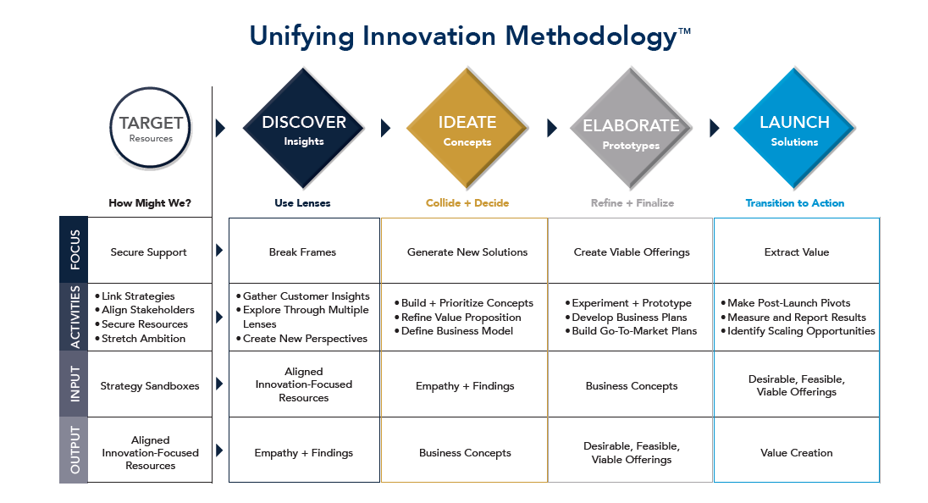
Innovation Process
* Developed at Notre Dame University. More info.

Slide 4
Develop, Hold, Kill Model
On Deck
Exploration
Project Scoping
Development Process
Start of stage Gate
Hold
Deprioritized in favor of other projects
Discovery
Exploration in progress
Early concept testing
“Back of envelope” math done
Prelim effort vs. impact
Strategically aligned
Work not yet activated
Project prioritized
Prep for Discovery
Stage Gate process
Kill / Shelve
Not strategically aligned
Low appeal
Not technically feasible

Slide 5
Innovation Council Goals
What defines success from the perspective of our Innovation Council?
20 Ideas into discovery that meet our Innovation Definition
Appropriately spend the $10M on innovation projects
Create a culture of steady idea generation
60 percent of project “stops” should happen during discovery.
Innovation Process deployed and communicated
Innovation Definition:
Unique and compelling consumer solution (differentiates our company)
Create sustainable competitive advantage
Create superior shareholder value (high margin, scalable opportunities)

Slide 6
Innovation Org Design
Objective: Fuel the company with new and unique consumer solutions on a sustainable basis, so we can meet our growth objectives across existing and future product and/or service categories.
Innovation Strategy & Process
Innovation Product Management
Design Thinking
Open Innovation
Innovation
Project Management
Advanced Development
Create innovation strategy to deliver growth goals
Design and implement process and structure to execute innovation strategies
Develop innovation as a sustainable competitive advantage
Facilitate alignment across BUs
Design and manage market research to create empathy, build insights and to refine and validate concepts
Design and conduct workshops to generate ideas
Facilitate idea screening and prioritization
Turn ideas into compelling product concepts in collaboration with industrial design, R&D and BUs
Manage build-measure-learn loops with consumer insights, industrial design, and engineering
Introduce best practices in UX for Internet of Things products
Plan, manage and close innovation projects
Facilitate commitment and productivity, remove obstacles and ensure project success
Manage project expectations by ensuring project plan is aligned to business goals and ensuring milestones and are achieved
Shared ownerships of innovation initiatives until fully transferred to business units
Shared definition of strategy, business goals and facilitate process across functions to go from Framing to User Requirements
Ensure uniqueness, feasibility and viability of ideas
Create necessary business plans, business models and financial scenarios for sizing projects
Serve as the interface with BUs on all projects
In collaboration with R&D, coordinate identification and activation outside sources of ideas that can accelerate execution of strategy
Establish processes to do this in a sustainable basis and in alignment with strategy
Identify and manage external partnerships
Voice-of-customer ideation and idea screening for tech feasibility
Frankenstein prototyping
Completive technical assessment
Support tech scouting
Support internal ideation

Slide 7
Assessing Current Capabilities & Capacity
Innovation Strategy & Process
Innovation Product Management
Design Thinking
Open Innovation
Innovation
Project Management
Advanced Development
Current Skill/Experience in team
Current Capacity
Current Need
Gaps/Notes
Good skillset, not enough capacity to conduct project portfolio in depth and with speed
Good skill in the team, we need capacity to do a lot of tactical work pre, during and post idea labs
Need capacity to accelerate market research and test and learn
Space deficient for tasks
Central point of coordination
Need to improve their marketing of open innovation challenges when live to attract more submissions
Team could use support to free up time for greater depth of design thinking
Broader engineering expertise could be leveraged
Tighter coordination with engineering organization for added capacity
Need prototyping space
Need to more quickly test new products in the electric vehicle ecosystem
Need more involvement from senior members in team
Notes:
This slide can be used to evaluate the current state of skills on each team; how much capacity they have for additional work; the need or demand for them; and any gaps.

Slide 8
Recommended Structure and Roles
Key Roles & Responsibilities
VP Innovation
Sr. Project Mgr
Innovation
Innovation Analytics Manager
Design Thinking Mgr
Product Mgr Innovation
Sr. Product Mgr Innovation
Sr. Director Innovation
R&D Innovation
VP Innovation
Ensure delivery of innovation program organization-wide
Lead all aspects of innovation strategy and execution
Liaison to Executive Team and VPs in BUs
Sr. Director
Innovation
Ensure robustness of the front-end idea funnel and quality of idea handoff
Oversight of innovation pipeline: advance, hold, kill
Lead / support elements of open innovation strategy/execution
Support innovation strategy development; lead execution of certain elements
Liaison to Product Directors in BUs
Sr. Product Manager, Innovation
Product marketing lead on strategic innovation projects
Ensure success of core innovation projects on 3 year product plan
Frame and align core and strategic innovation projects
Team lead for implementation of innovation branding
Liaison to Product Mangers in BUs
Product Manager
Innovation
Open
Product marketing lead on core innovation projects
Supports Sr. Product Manager in execution of strategic innovation projects
Work with product managers to identify opportunities to close business gaps in product plans
Sr. Project Manager
Innovation
Ensure project plans are aligned to business goals
Plan, manage & close innovation projects; remove obstacles & ensure success
Facilitate creation, documentation and transfer of successful projects to execution teams
Manage expense planning for innovation projects
Support elements of design-thinking process and building innovation culture
Design Thinking Manager
Open
Apply the best design-thinking methodologies and tools available
Lead activities to synthesize data into insights / themes for ideation activities
Design and facilitate Idea labs; prioritize ideas and write product concepts
Introduce best practices in UX for Internet-connected products
New roles
Existing roles
Resources residing in Global organization
Innovation Analytics Manager
Open
Analyze, monitor and report key innovation metrics
Partner with product managers and customer insights to assess and understand markets and turn data into solid business insights teams can use for framing and refining innovation projects
Work with product managers to assess and size ideas and business concepts
Design and prepare financial modeling and initial business case development

Slide 9
Choosing Focus & Assessing Portfolio
DISCOVER
Set the strategy and vision
DEVELOP/PROTOTYPE
Stretch the ideas and support their development
EXECUTE
Provide resources and break barriers to accelerate
1
2
3
Proposed process:
Annually
Set an executive annual deep dive on a mega trend (proposed Q2: drone and robotic delivery)
Quarterly
Review status on overall portfolio and reprioritize as needed (set agenda for upcoming meetings)
Assess how much progress we are making against overall goals
On-going meetings
Deep dives and key decisions (see below) on prioritized projects
Key actions and decisions:
1
Select strategic areas of focus
2
Go/NoGo - Resource specific concepts for development
3
Go/NoGo - Resource pilots and prototypes
Thoroughly polish all innovation work and push the thinking ahead
4

Slide 10
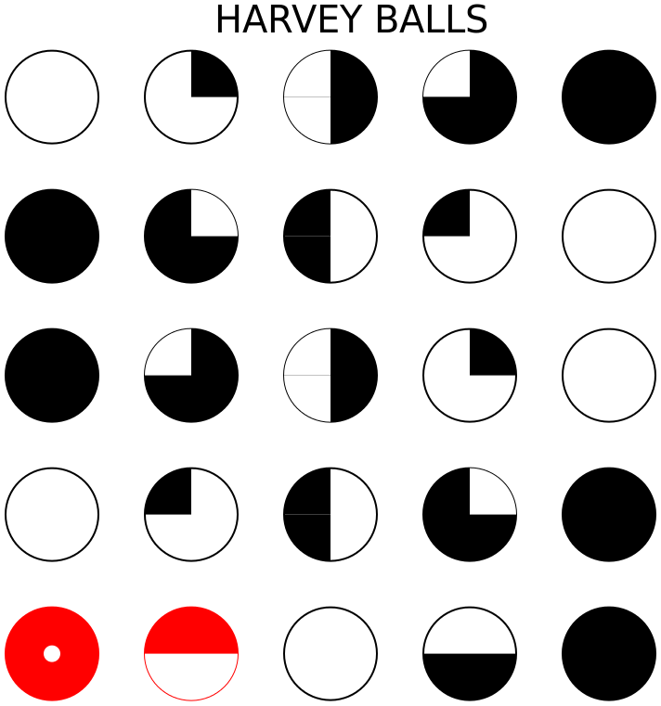
Evaluating Individual Projects
Level of Magnitude >$500m
Consumer
Compellingness
Market
Differentiation
Capability Fit
Readiness
Biometric ID
Warehouse robotics
Custom quoting
Cybersecurity
New subscription
service offering
Virtual advisors/chatbots

Slide 11
Mapping Out the Innovation Portfolio (Project Mix)
2. EXPAND BEYOND THE CORE
3. NEW TO THE WORLD
EXPAND BEYOND THE CORE
Project name
Project name
Growth Pillar
1. EXISTING BUSINESS
4. NEW BUSINESS MODEL
Project name
Project name
CORE
Asia
NA
EXISTING
Business Model
NEW
LA
EU
Global
Geography
= Non-product project
= Products

Slide 12
Mapping Out the Innovation Portfolio (Project Status)
Expand
Beyond
the
Core
TRENDY
Project name
Extend the Core
Project name
Core
CONSERVATIVE
Project name
Asia
NA
Discover
Develop
Opportunities
Experiment &
Validate
Deliver &
Grow
LA
EU
Global
Geography
= Non-product project
= Products

Slide 13
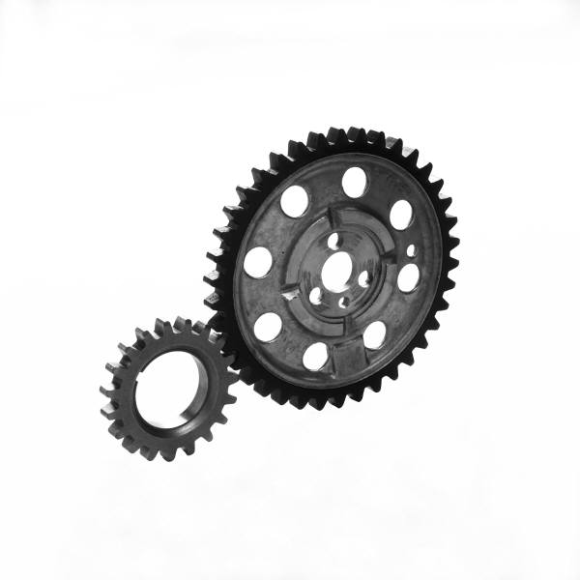

Measuring Performance (Proposed Framework)
Innovation to Cash (ITC)
(all the efforts required to take an idea and turn it into cash)
Inputs
Processes
Outputs
Human & Capital Resources
Activities that transform inputs into outputs
Commercialized innovation and, ultimately, cash
“You can’t manage, what you can’t measure”
Measures should be established to answer the following critical questions related to the Innovation-to-Cash process:
What human and financial resources are dedicated to innovation activities?
How specifically are these resources being deployed?
  Core v. non-core innovations?
  Incremental v. disruptive?
  Category/region?
How much time does it take to complete the process?
How much time is spent in “decision time” v. “execution time”?
Is the process functioning as intended?
How healthy is the pipeline?
What is revenue growth attributed to innovation?
What is the margin uplift?
How are new innovations performing in the market, as compared to commitments made during the development and testing process?

Slide 14
Measuring Performance (Another Framework)
Innovation Revenue (internal & external sources)
Total balance of sales from Innovation
External operating profit and direct contribution margin
uplift from Innovation
Output
Measures
Innovation lifecycle (measures period of time product meets innovation criteria in the market)
Commitment Delivery Index (measures actual in-market performance against tollgate commitments)
Quality scores
Process Measures
Decision cycle time
Execution cycle time
Innovation pipeline health
% of Pipeline from external sources
Input Measures
% of Pipeline assessed as disruptive
Attrition rate (% of all projects stopped prior to commercialization)
% of Engineering resources ($ & headcount) dedicated to innovation
% of Engineering resources ($ & headcount) dedicated to non-core innovations
% of Engineering resources ($ & headcount) dedicated to disruptive innovations
Total # of projects entering first stagegate

