Slide 1


2022 Data on Sustainability in Large Organizations

Slide 2
About our Respondents
The data in these slides comes from an InnoLead survey fielded from May to July 2022, which received 46 qualified responses from a range of industries.
Two-thirds of the respondents work for an organization with 1,000 or more employees.
Fifty-four percent of our respondent companies are headquartered in North America, with 30 percent based in Europe, and the remaining 16 percent based elsewhere.

Slide 3
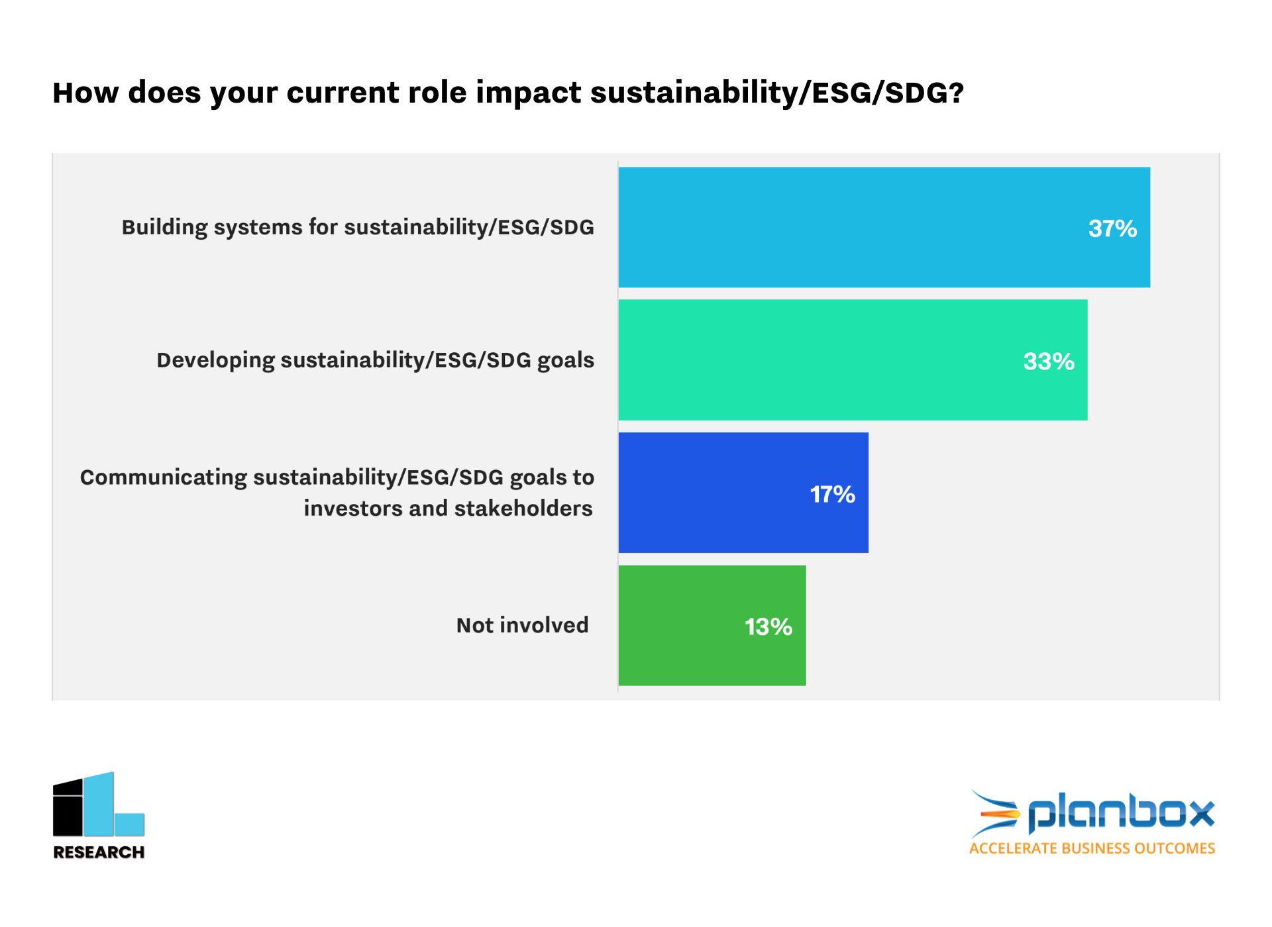

Slide 4
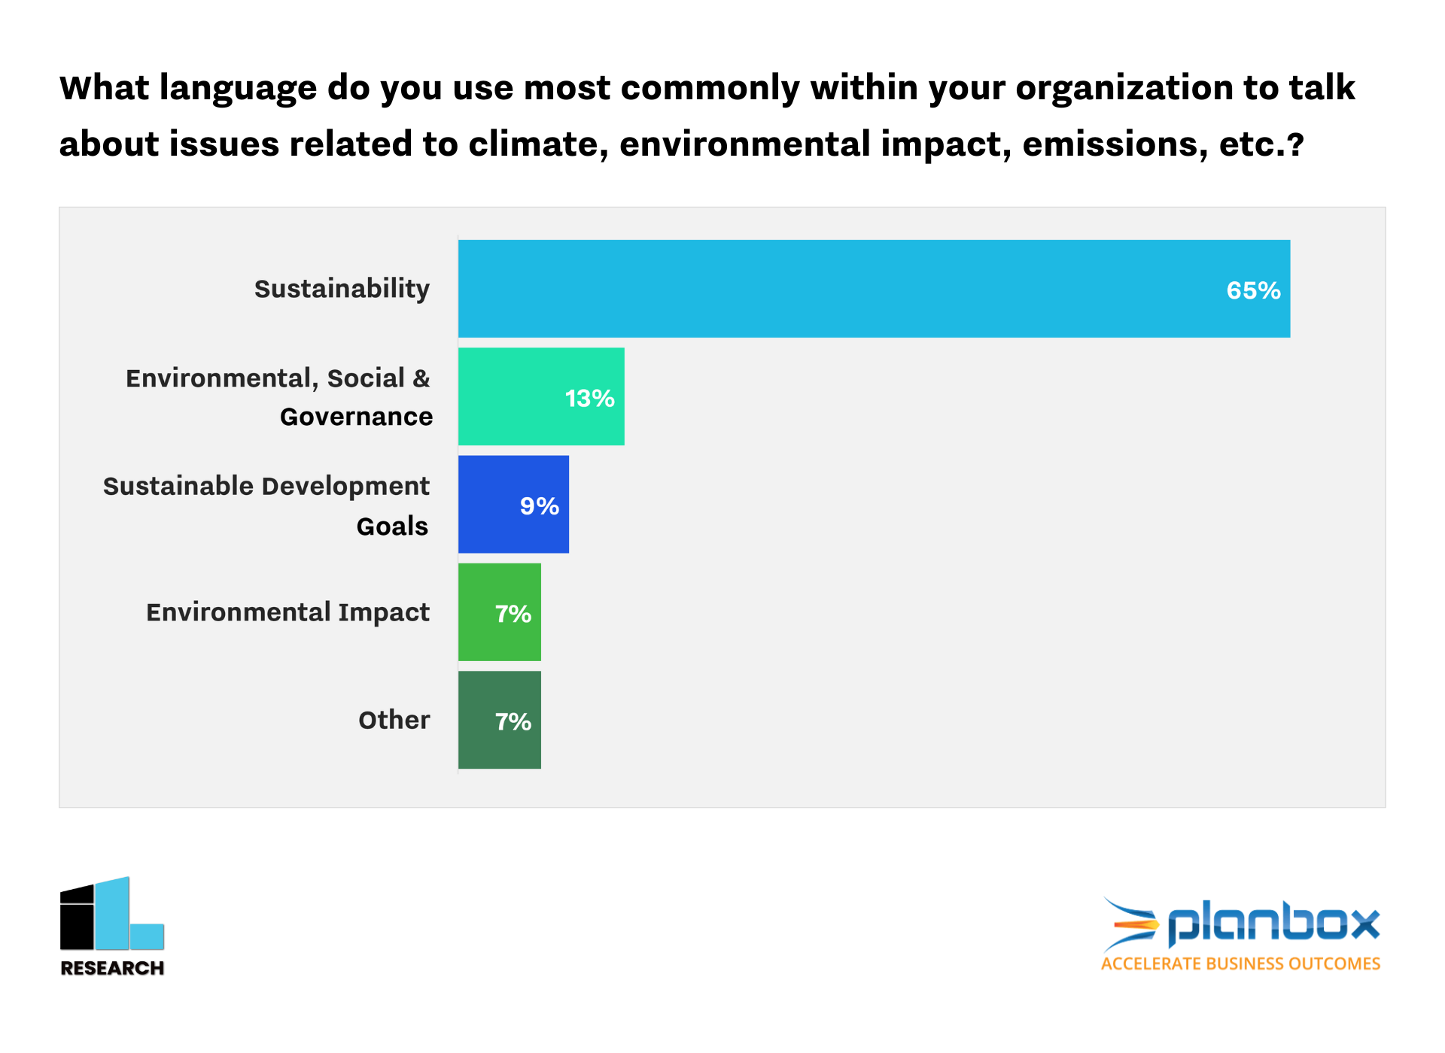

Slide 5
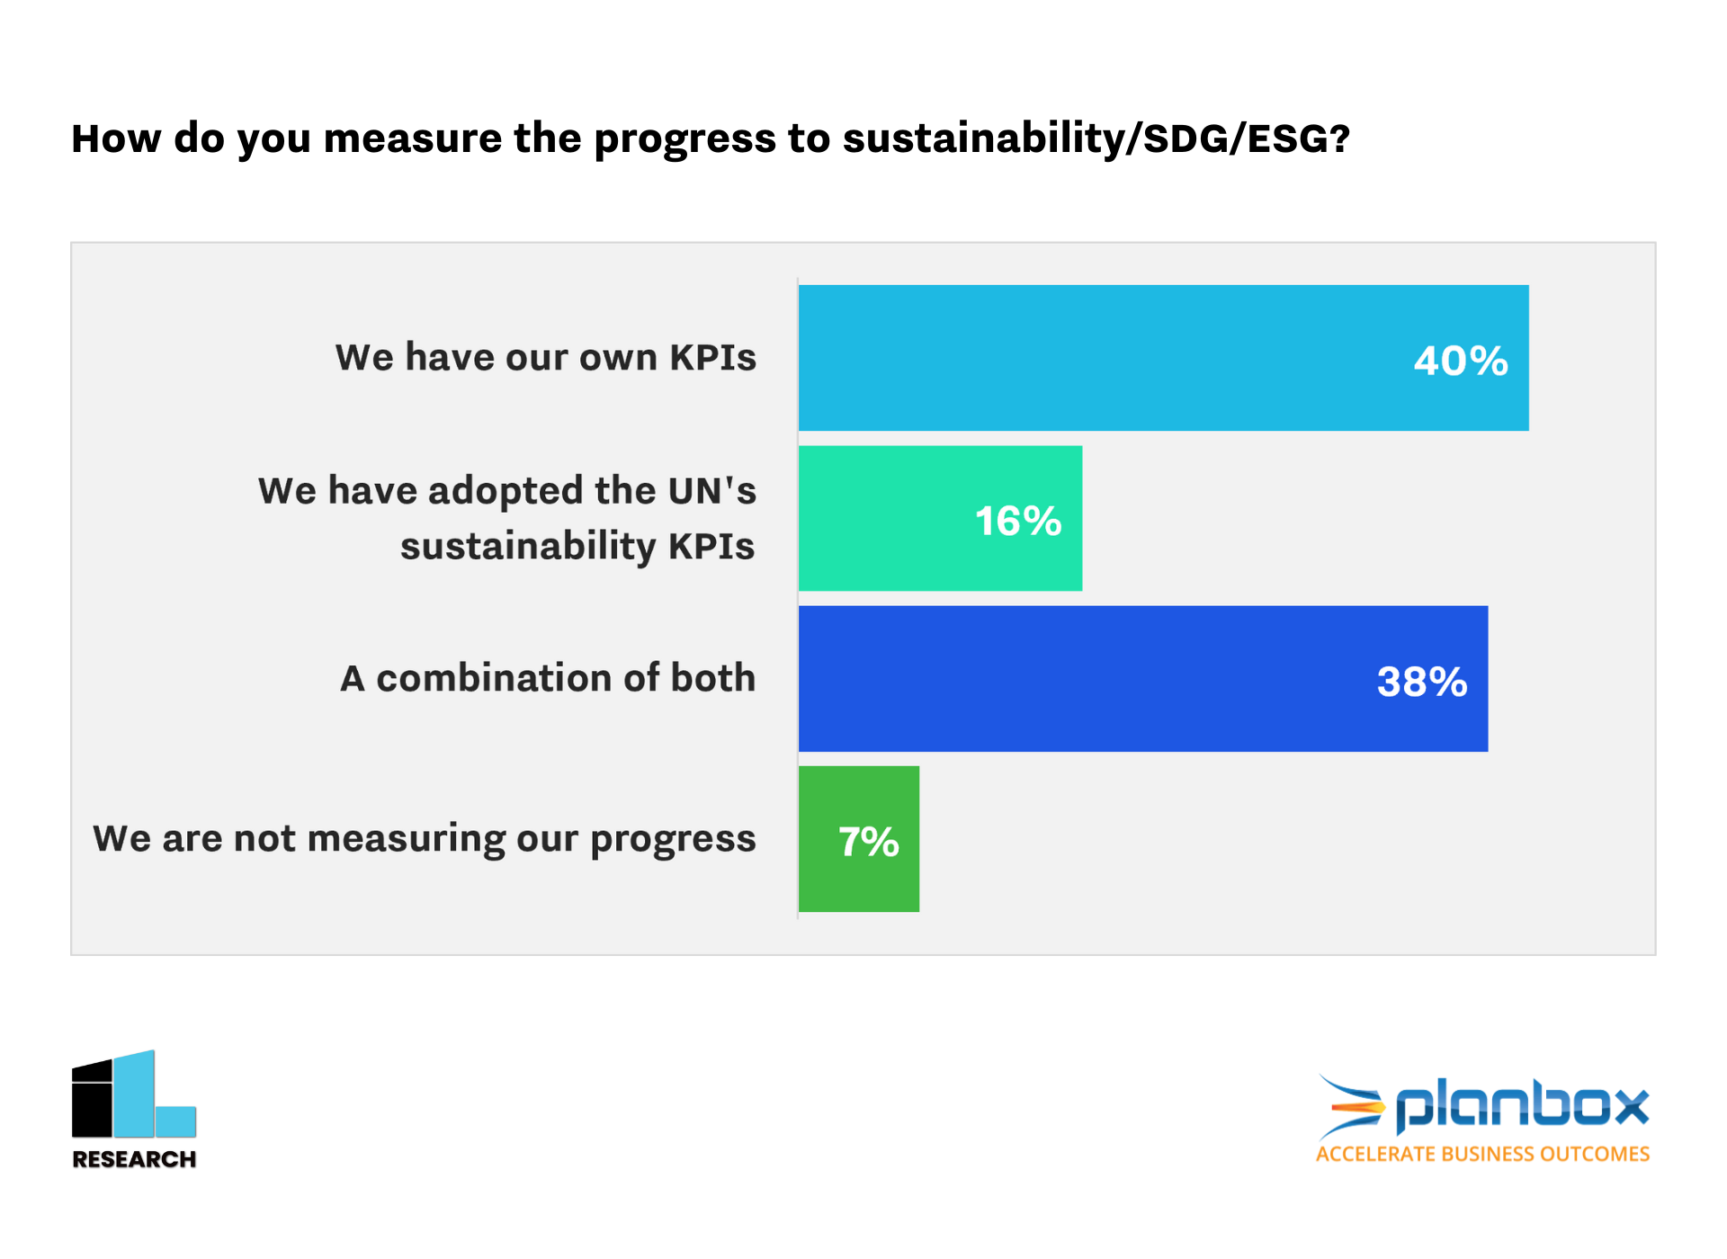

Slide 6
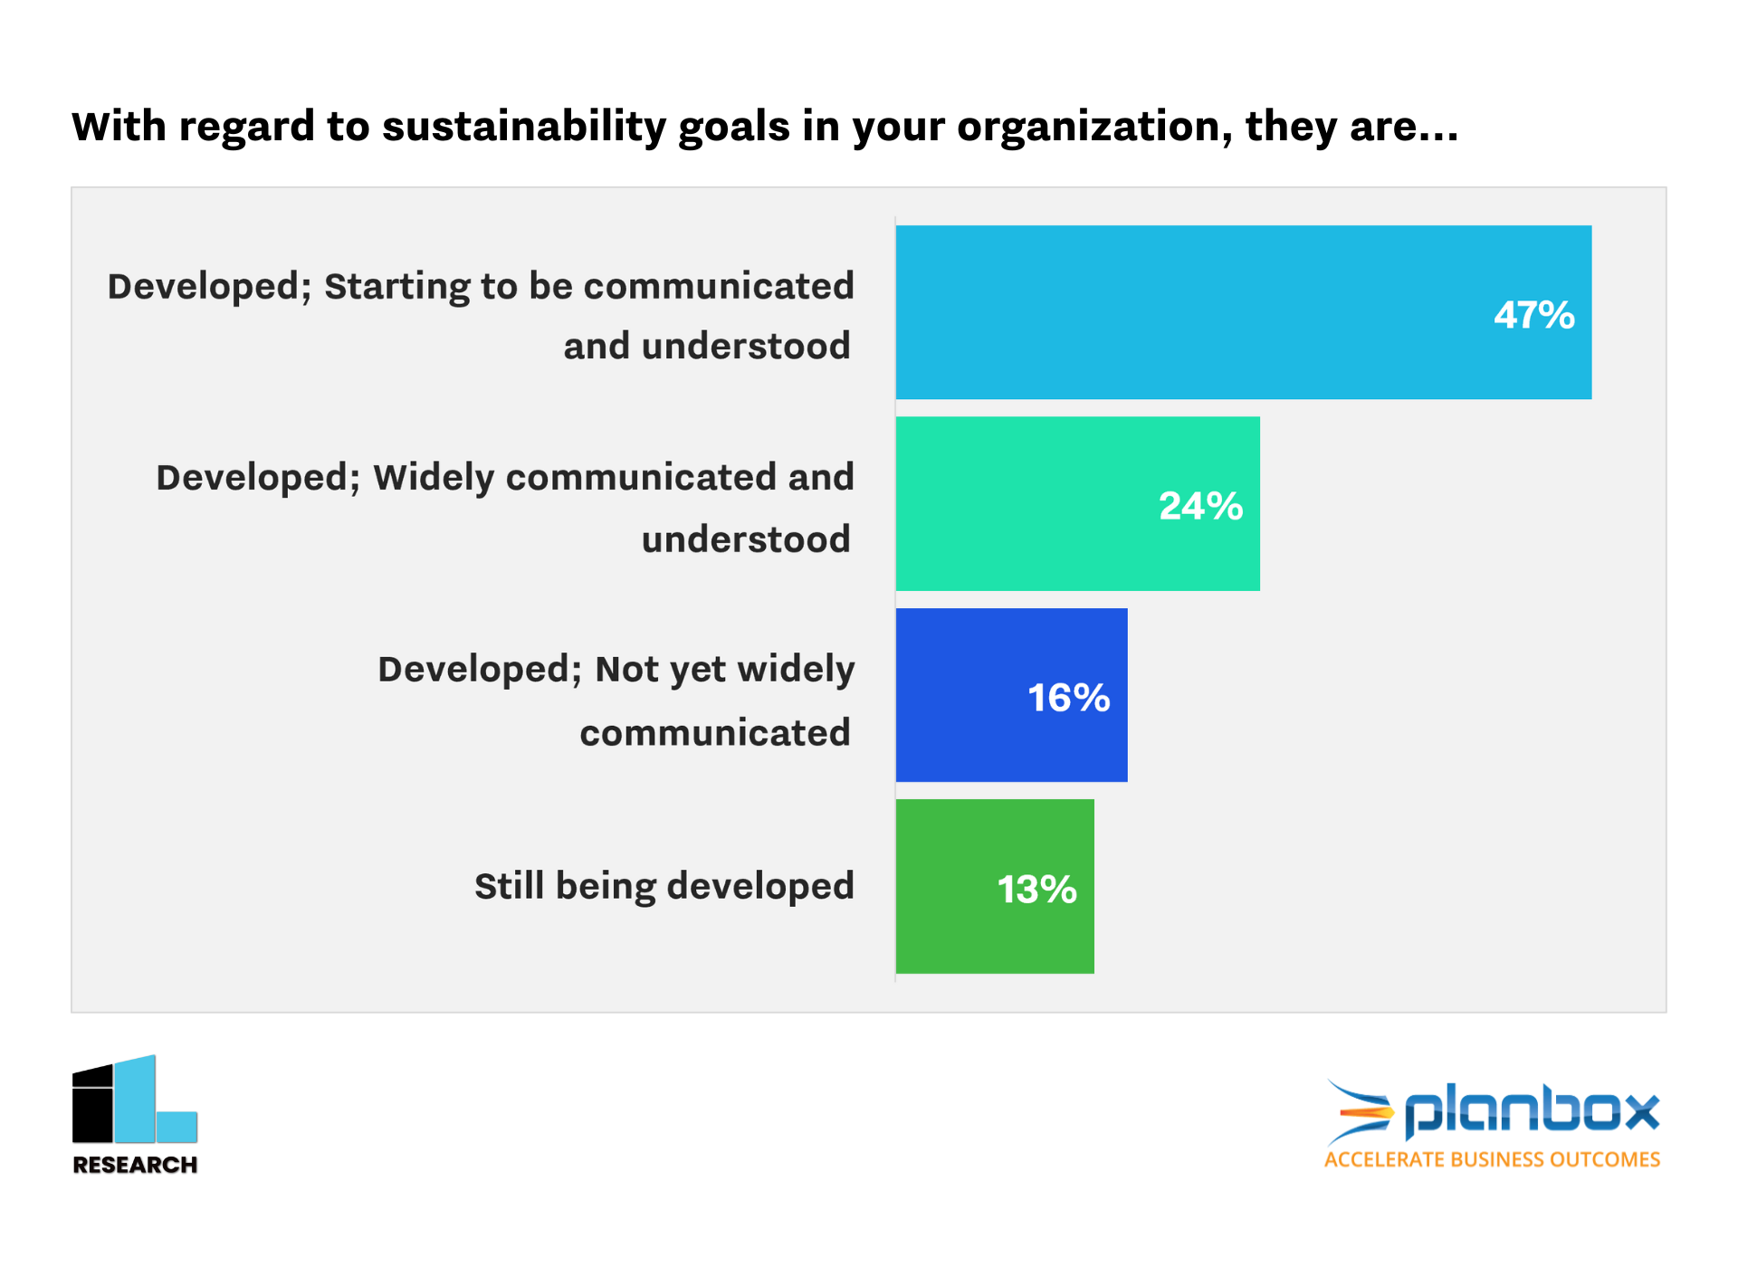

Slide 7
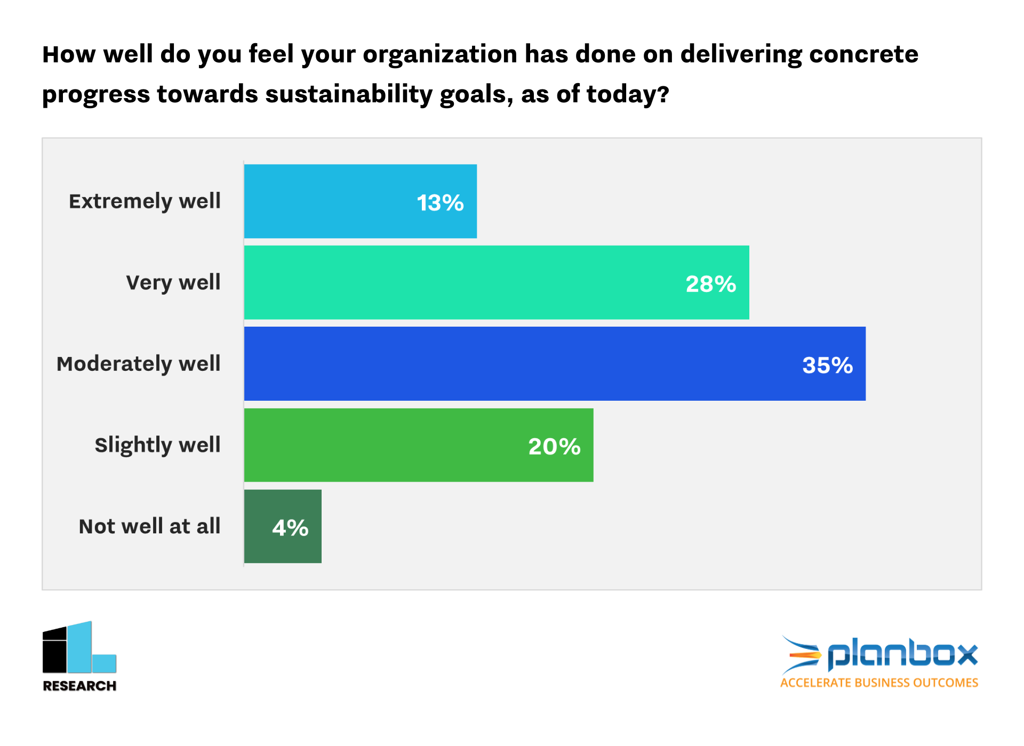

Slide 8
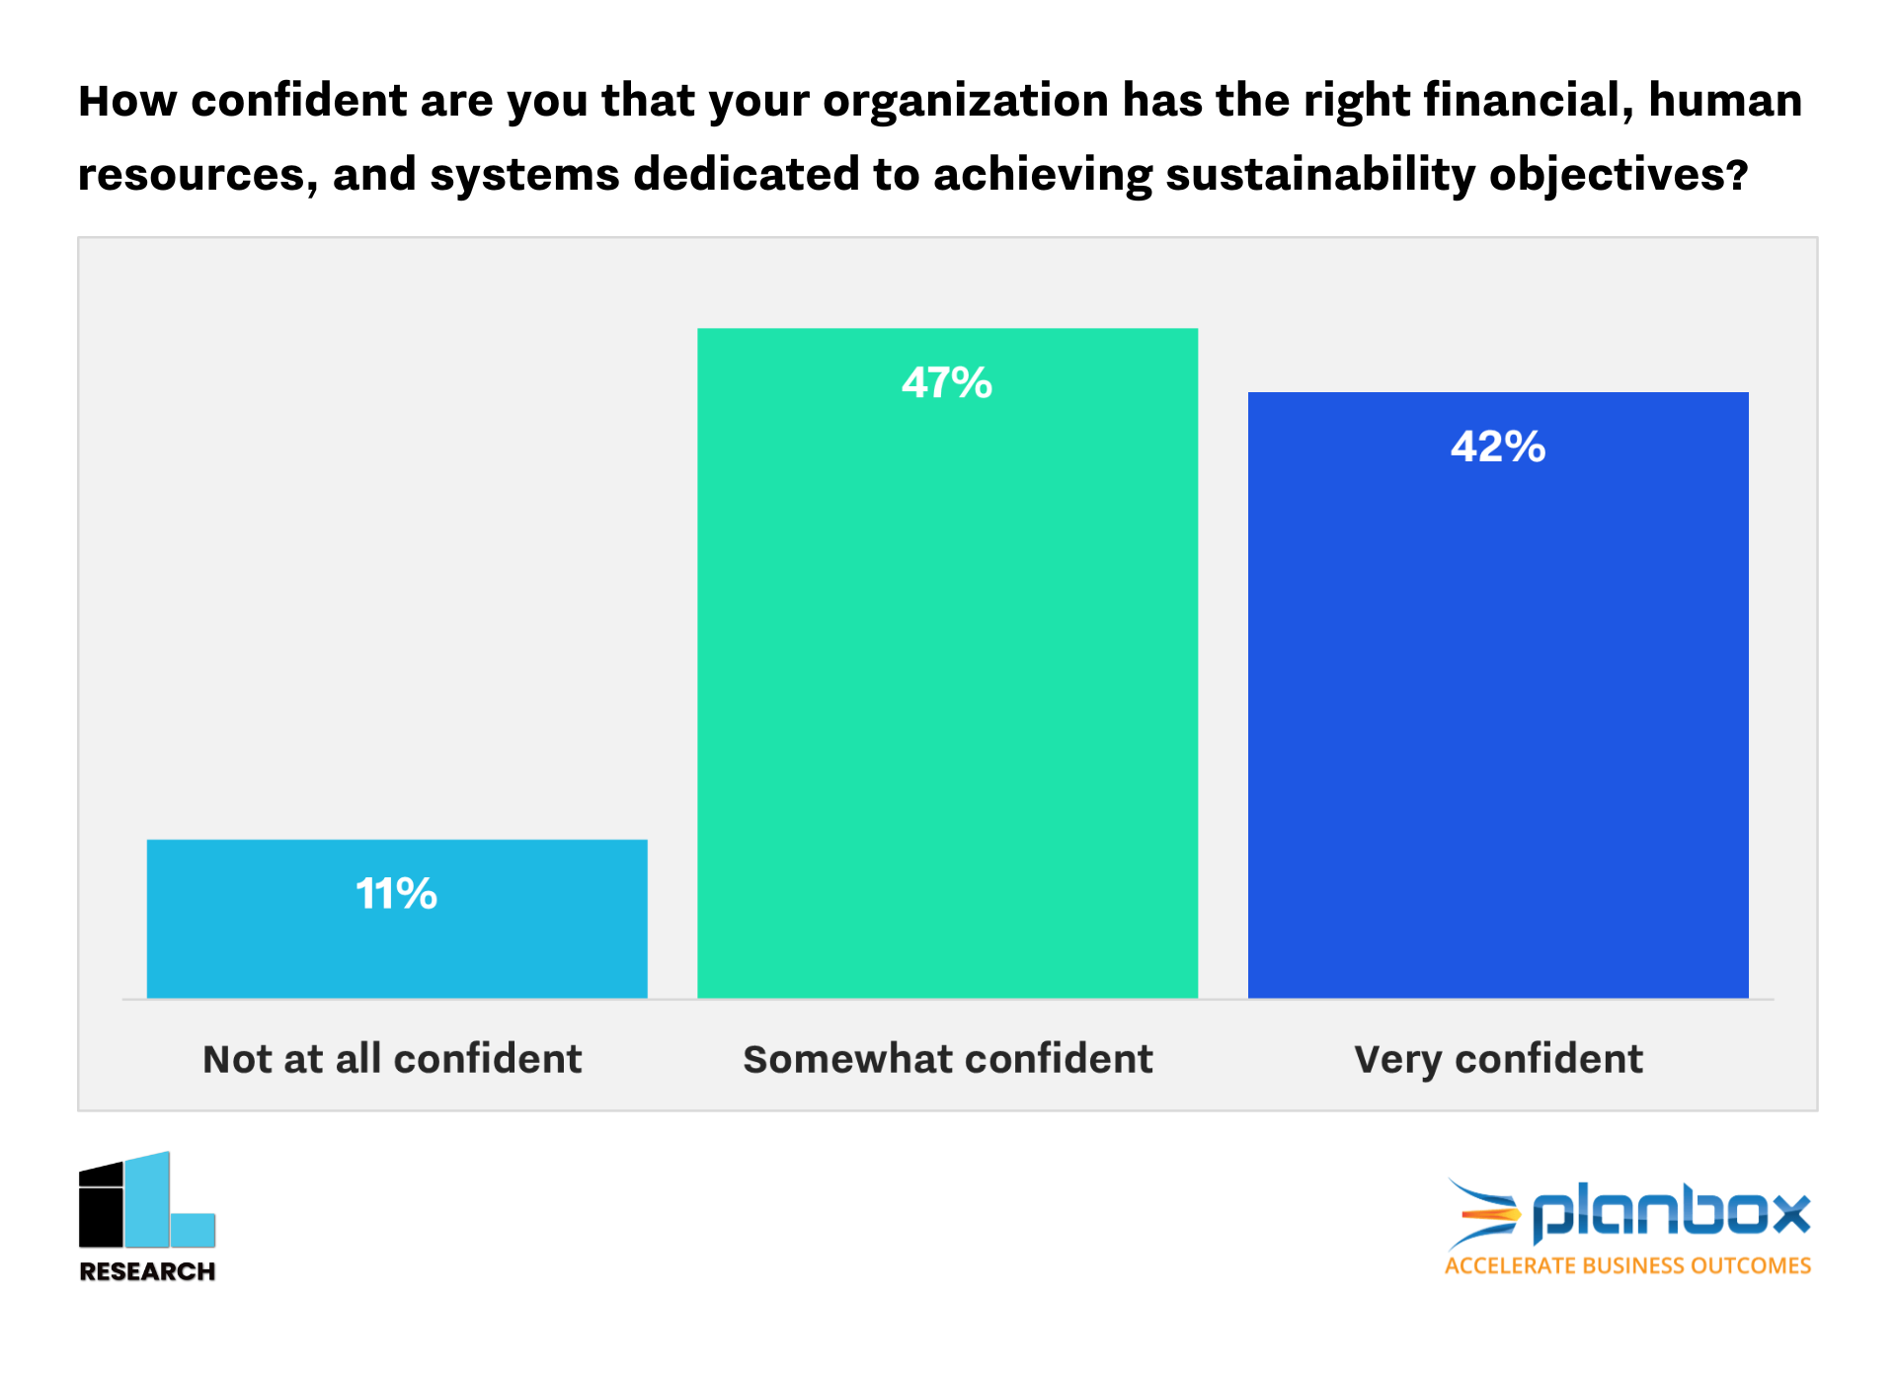

Slide 9
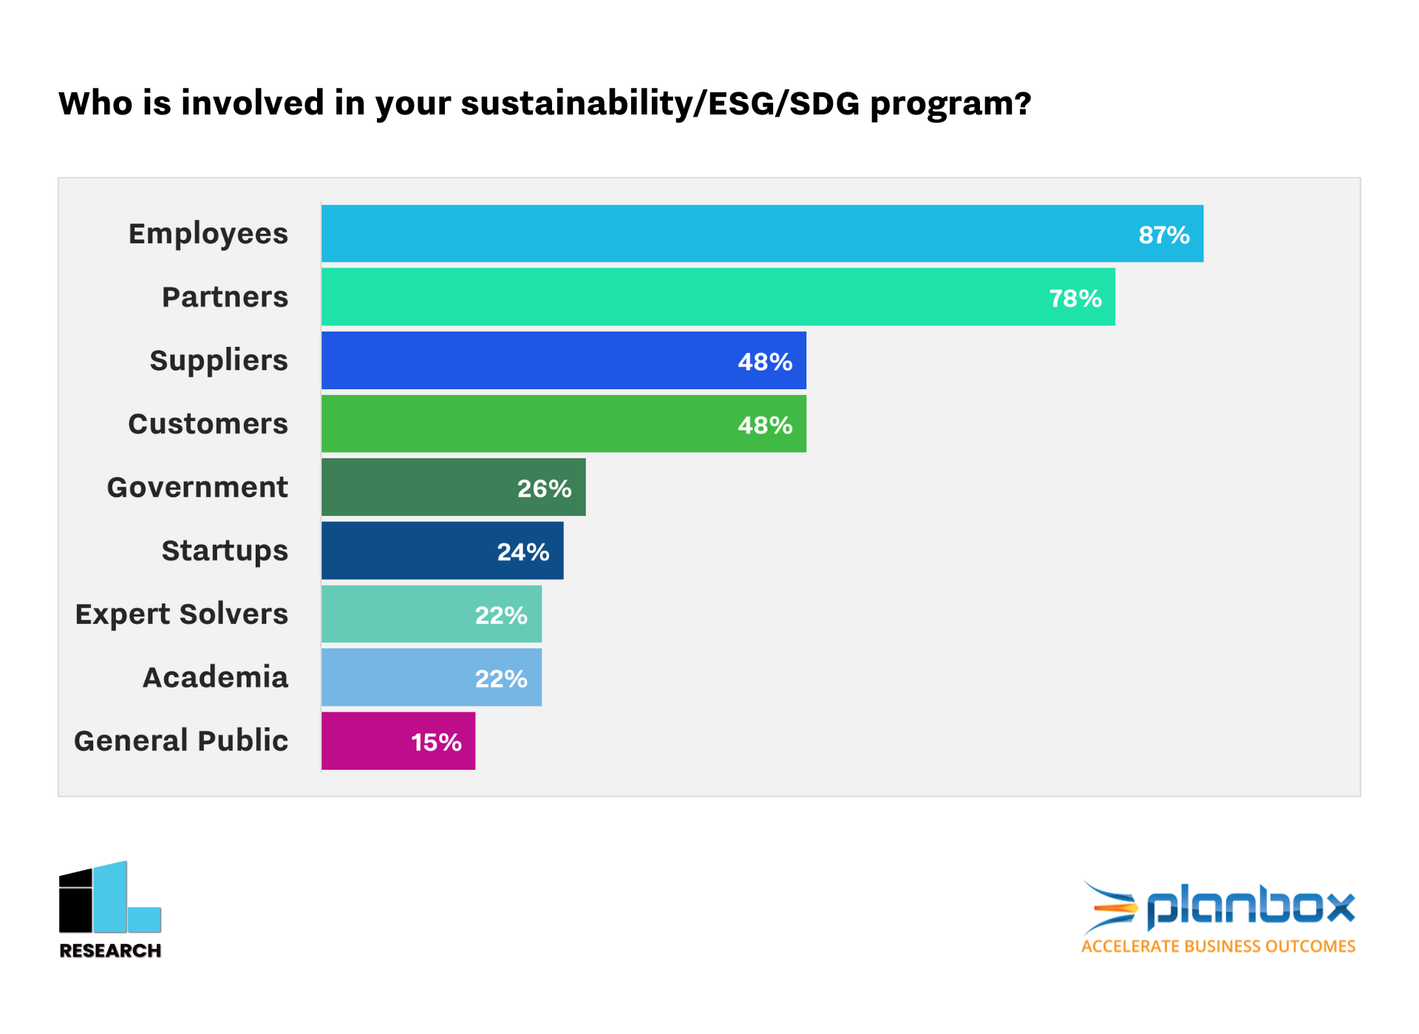

Slide 10
