Slide 1


Venture Studio Initiative Kickoff 7.28.22 Alex Slawsby Chief Growth Officer

Slide 2
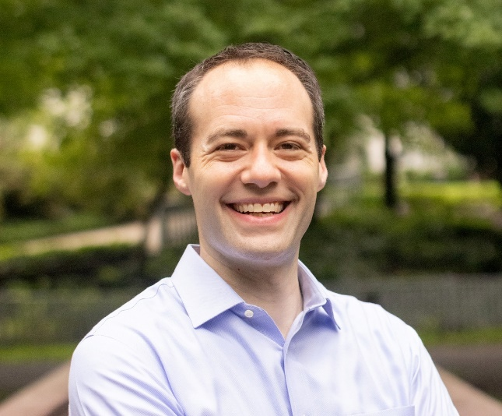
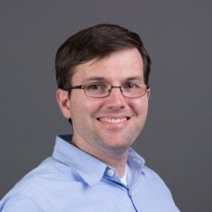
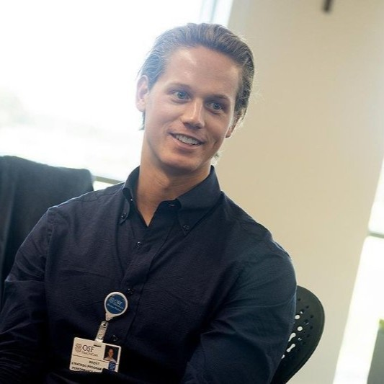



Introductions
Alex Slawsby
Chief Growth Officer
Bryan Smith
Director of Product,
Mobility Solutions
Brent Cross
Director of Transformational Innovation & Commercialization
7.28.22 Venture Studio Initiative Kickoff

Slide 3
Objectives
Introduce the Initiative’s “Why, How, What”
Learn from Bryan and Brent
Share what’s next
Make sure you’re involved throughout!
7.28.22 Venture Studio Initiative Kickoff

Slide 4

The imperative…
7.28.22 Venture Studio Initiative Kickoff

Slide 5
The requirement…
Core
Existing Customers + Existing Offerings
Adjacent
New Customers or New Offerings
Transformational
New Customers and
New Offerings
C
A
T
C
C
C
C
A
A
A
A
T
T
T
T
7.28.22 Venture Studio Initiative Kickoff

Slide 6
Poll
“Our innovation portfolio investments are balanced optimally across core, adjacent and transformational opportunities.”
7.28.22 Venture Studio Initiative Kickoff

Slide 7
The problem…
Adjacent
New Customers or New Offerings
Transformational
New Customers and
New Offerings
A
T
Capability Model
and/or
Business Model
Antibodies
7.28.22 Venture Studio Initiative Kickoff

Slide 8
The paths…
Build, Buy and/or Partner
7.28.22 Venture Studio Initiative Kickoff

Slide 9
Poll
“Large organizations can successfully incubate new businesses that break their existing capability and/or business models.”
7.28.22 Venture Studio Initiative Kickoff

Slide 10
A potential solution…
Venture Studios
Organizations that exist to build startups by bringing together some combination of strategic and operational support
7.28.22 Venture Studio Initiative Kickoff

Slide 11
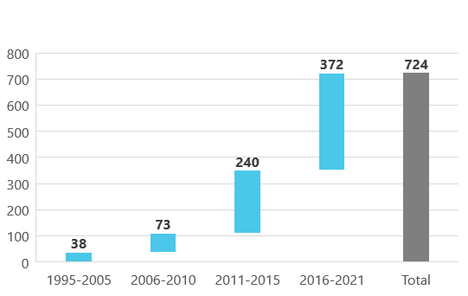
A potential solution…
Venture Studios
Count by Launch Year
<- Total active venture studios (as of January)
Source: Enhance Ventures
7.28.22 Venture Studio Initiative Kickoff

Slide 12
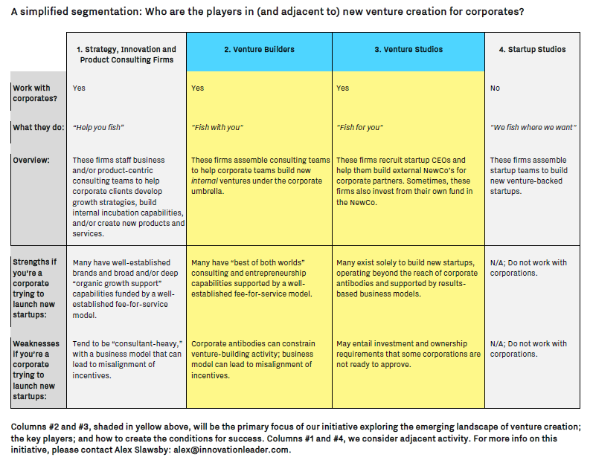
But…
Venture Studio vs. Startup Studio vs. Venture Builder?
Corporates vs. Corporates
Internal Team vs. Internal Team
Own fund vs. Own fund
Co-invest vs. Co-invest
Equity vs. Equity
7.28.22 Venture Studio Initiative Kickoff

Slide 13
Let’s learn…
Bryan Smith
Director of Product,
Mobility Solutions
Brent Cross
Director of Transformational Innovation & Commercialization
7.28.22 Venture Studio Initiative Kickoff

Slide 14
What’s next…
Profiles of Enhance Ventures, Highline Beta, Pioneer Square Labs, Rainmaking and U+ with others to come
Case studies and thought leadership
Panels of Venture Builder and Venture Studio leaders (September+)
Deep-dive webcasts with individual Venture Builders and Venture Studios (October+)
Sessions at Impact Silicon Valley (November 2 – 3)
7.28.22 Venture Studio Initiative Kickoff

Slide 15
Thanks!
Contact us…
alex@innovationleader.com
bryansmith@bfusa.com
brent.s.cross@osfhealthcare.org
Check out the content at…
innovationleader.com/venturestudios
7.28.22 Venture Studio Initiative Kickoff

